Slide 1
MESA Exam 6
Operations
Overview

Slide 2
Outline
Design
Timeline
Components

Slide 3
Exam 6
No longer: MESA Classic Exam (ancillaries)
Now: MESA Exam 6 = Core + Ancillaries
(particularly for ancillaries at all sites)

Slide 4
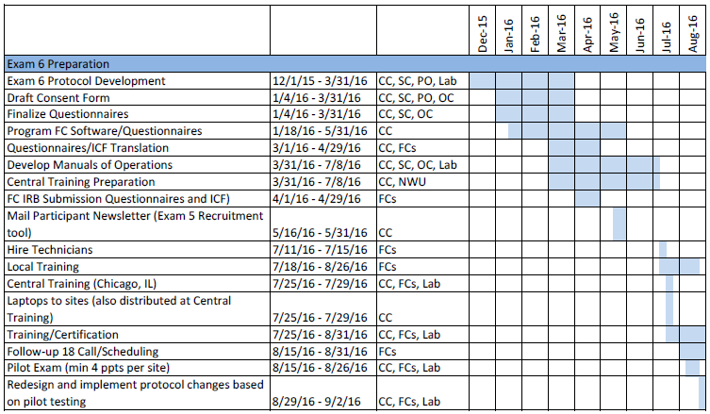
Exam 6 Preparation Timeline

Slide 5
Exam 6 Preparation Timeline

Slide 6
Exam 6 Timeline (Sept 2016-May 2018)

Slide 7
Exam 6 Core
#Participants | ~ 4000 ppts
Time Burden | Average duration: 90 minutes
Exam components | Consent (Core + Ancillary Components) Check-in Seated blood pressure, pulse oximetry Anthropometry Phlebotomy Medical history (SF-12) PROMIS Physical Function Personal history/demographics Medication Inventory

Slide 8
Exam 6 Ancillary Studies (All Sites)
PI | N | Title | Name | Tests
Bertoni/Shah | All | Transition from risk factors to early heart failure (HF) | MESA HF | ECHO, 6MWT (CPET)
Kramer | All | The Urinary KNOWledge Study | UKNOW | QQF
Barr | 2000 | Pulmonary microvascular perfusion in MESA | MESA Lung | Spiro, CT
Smith | 650 | COPD in non-smokers | MESA Lung Nonsmokers | Spiro, CT
Heckbert | 1500 | Atrial fibrillation (AF) & vascular disease of brain | MESA AF | Patch monitor

Slide 9
Exam 6 Ancillary Studies (Select Sites)
PI | N | Title | Name | Test
Liu, Ding | All at Wake, CU, Minn | Obesity-related epigenetic changes and type-2 diabetes | MESA Epi-genetics | Blood draw
Liu, Ding | 1000 at JHU, Wake | Epigenetics of cognitive function | Epi-genetics Cog Fxn | Blood draw, Cog Fxn
Wang, Gupta | All at NWU | Tissue Sodium, Inflammation, and Blood Pressure | MESA Tissue Sodium | MRI Leg
Hughes, Craft | 550 at Wake | Cardiometabolic risk for Alzheimer's | MESA Memory | MRI Brain
Shea | 350 at CU | HDL and carotid FDG PET | MESA PET | PET, MRI Carotid

Slide 10
Exam 6 Components
 | Time | Sample | Main or Ancillary
Reception/Consent | 15 | All | Main
Change Clothes | 5 | All | Main
Blood Pressure | 15 | All | Main
Pulse Oximetry | 0 | All | Main
Anthropometry | 10 | All | Main
Phlebotomy | 15 | All | Main
Urine Collection | 5 | All | MESA HF
Snack | 5 | All | Main
Echocardiography | 25 | All | MESA HF
Arterial Stiffness | 5 | All | MESA HF
Spirometry | 20 | 2650 | MESA Lung/NonSmk
Lung CT | 30 | 2650 (1000 w/ contrast) | MESA Lung/ NonSmk
6 Minute Walk Test | 15 | All | MESA HF
Patch Application | 15 | 1500 | MESA AF
Total time | 3:00

Slide 11
Exam 6 Questionnaires
 | Time | Sample | Main or Ancillary
Medications | 10 | All | Main
Medical History | 10 | All | Main
Personal History | 5 | All | Main
Physical Activity | 15 | All | Main
Urinary Incontinence | 15 | All | UKNOW
Lung Questionnaire | 10 | 2650 | MESA Lung/NonSmk
COPD Scores | 20 | 2650 | MESA Lung/NonSmk
HF Symptoms/Risk | 25 | All | MESA HF
Physical Function | 15 | All | MESA HF
Cognitive Function | 35 | 1500 | MESA AF
Additional Cognitive Function | 95 | 1040 | MESA Memory/Cog Fxn
Total (main) | 2:05
Total (all) | 4:15

Slide 12
Exam 6 – Other Visits
 | Time | Sample | Main or Ancillary
Brain MRI | 35 | 1500 | MESA AF/Memory
Carotid PET MRI | 95 | 540 | MESA PET
Lower Extremity MRI | 45 | 753 | Tissue Sodium
CPET | 2 hrs | 300 | MESA HF
Brain PET/CSF | 3-4 hrs | 540 | MESA Memory

Slide 13
Repeat Measures from Earlier Exams
 | Main or Ancillary | Previous Exams
Blood Pressure | Main | 1, 2, 3, 4, 5
Pulse Oximetry | Main | 5
Anthropometry | Main | 1, 2, 3, 4, 5
Phlebotomy/Urine | Main | 1, 2, 3, 4, 5
Medications | Main | 1, 2, 3, 4, 5
Medical History | Main | 1, 2, 3, 4, 5
Personal History | Main | 1, 2, 3, 4, 5
Physical Activity | Main | 1, 2, 3, 5
Lung Questionnaire | MESA Lung/NonSmk | 3, 4, 5
Spirometry | MESA Lung/NonSmk | 3, 4, 5
Lung CT | MESA Lung/NonSmk | 5
Cognitive Function | MESA AF/Memory/Epi CogFunc | 5

Slide 14
New Measures for Exam 6
 | Main or Ancillary
Heart Failure Risks | MESA HF
6 Minute Walk Test | MESA HF
Echocardiography | MESA HF
Arterial Stiffness | MESA HF
CPET | MESA HF
Urinary Incontinence | UKNOW
Lung CT w/ Contrast | MESA Lung
Physical Function | MESA AF
Patch Application | MESA AF
Brain MRI | MESA AF/Memory
Lower Extremity MRI | Tissue Sodium
Brain PET/CSF | MESA Memory
Addnl CogFunc | Memory/Epi CogFunc
Carotid PET MRI | MESA PET

Slide 15
Thank You!!!

