Slide 1

Rediscovering Pulmonary Emphysema, and Implications for Cardiac Function
The MESA Lung Study
R Graham Barr, MD DrPH
Departments of Medicine and Epidemiology
Columbia University Medical Center
Funding: NHLBI R01s HL077612, HL075476, HL093081
RC1 HL100543

Slide 2
Chronic Obstructive Pulmonary Disease Mortality Rates, 1960s, 1980s, 2000s
Thun, NEJM, 2013

Slide 3
Outline
  Definitions
  Prevalence and Clinical Significance
  Endothelial Hypothesis of Emphysema
  Cardiovascular Consequences

Slide 4
Brief History of Emphysema
"emphysema” ἐμφυσᾶν emphysan meaning "inflate"
Ruysh (1721) – enlarged airspaces
Baillie (1789) – tissue distruction
Lanneac (1839) – “Emphysema”
Gough (1952) – Emphysema subtypes

Slide 5
Definition of Emphysema
Emphysema = destruction of gas exchanging surfaces of the lung (alveoli)
Vestbo, GOLD Statement, 2013

Slide 6
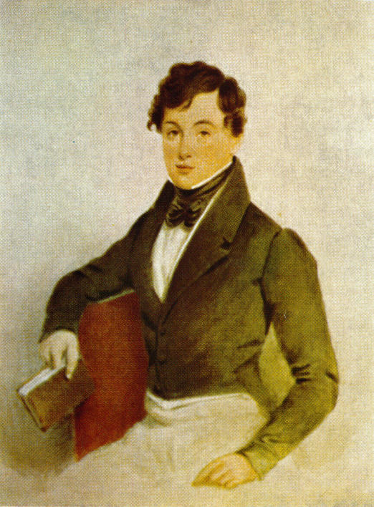
Chronic Obstructive Pulmonary Disease
  Airflow limitation that is not fully reversible
  COPD =
  Post-bronchodilator
  FEV₁/FVC ratio < 0.70
            John Hutchinson, c. 1840
Vestbo, Am J Crit Car Med, 2013
Notes:
UPDATE AND CHECK REFERENCE

Slide 7
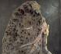
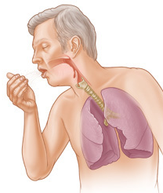
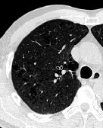
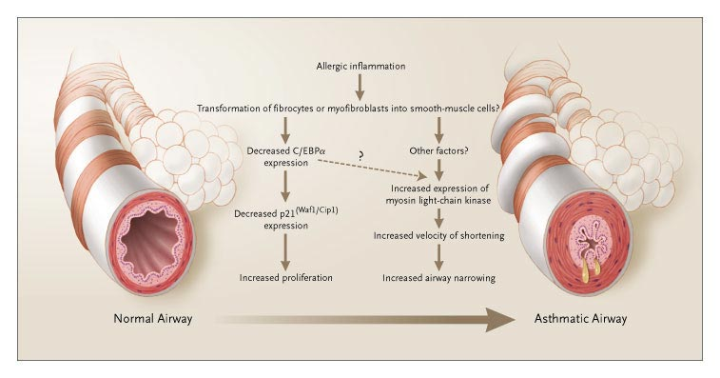
Chronic Lower Respiratory Diseases
CHRONIC BRONCHITIS
EMPHYSEMA
COPD
CHRONIC AIRFLOW OBSTRUCTION
ASTHMA

Slide 8
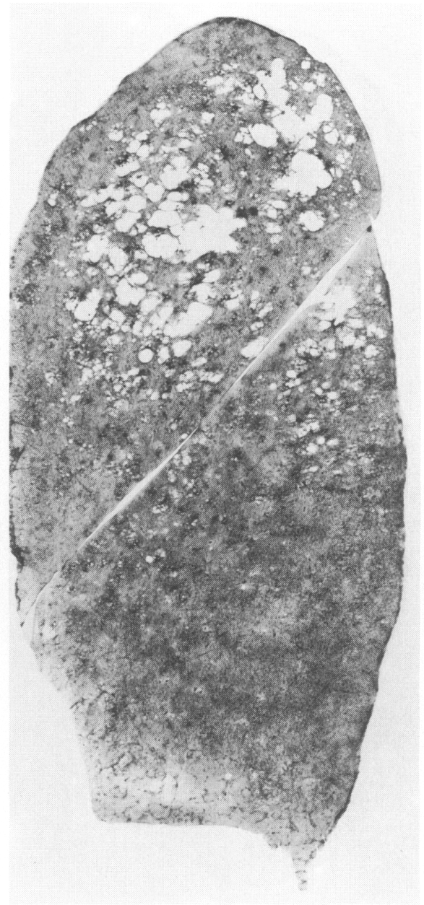
Emphysema: Prevalence at Autopsy
1,831 autopsies from NYS:
Mild emphysema
  10% of never smokers
  54% of pipe/cigar smokers
  87-99% of cigarette smokers
Moderate/severe emphysema
  3% of never smokers
  8% of pipe/cigar smokers
  37-52% of cigarette smokers
Auerbach, NEJM, 1972

Slide 9
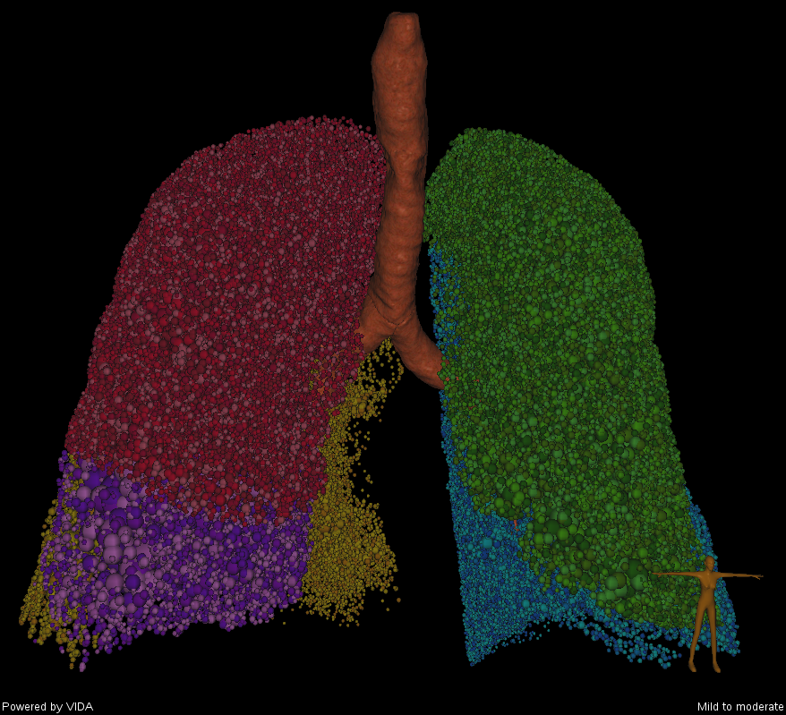
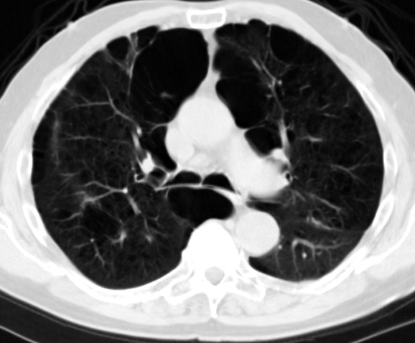
Lung Imaging with CT

Slide 10
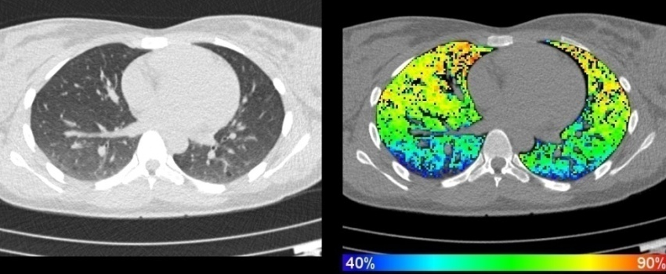
Emphysema on CT – Quantitative
  Percent emphysema
  =
  number voxels < -950 HU
  total voxels
Reproducible
  Inter-rater ICC=0.99; inter-scan ICC=0.94

Slide 11
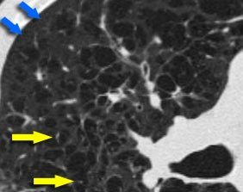
Emphysema on CT – Qualitative
Looks like gold standard
Moderate reproducibility
  κ=0.66 for mild emphysema
  κ=0.93 for moderate-severe emphysema
http://www.radiologyassistant.nl/en/42d94cd0c326b

Slide 12
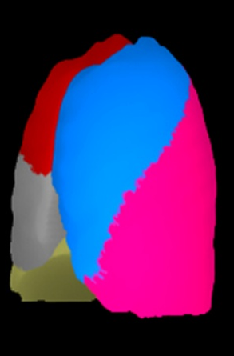

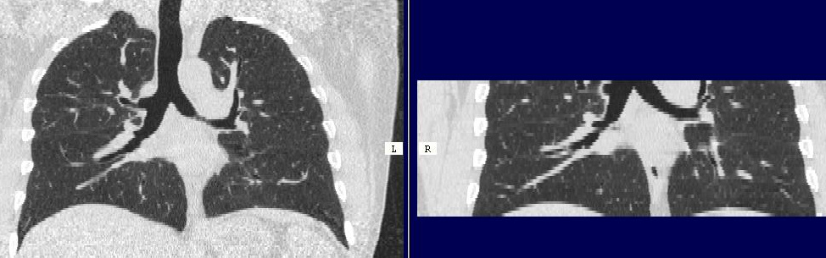
Validation of Partial-Lung Measures
r=0.99
r=0.92-0.95
% Emphysema – Partial-lung
% Emphysema – Full-lung CT
% Emphysema – Full-lung
500 current and former smokers (NLST)
% Emphysema – Cardiac MD-CT
24 MESA participants
Reddy, ATS, 2005
Hoffman, Acad Radiol, 2009

Slide 13
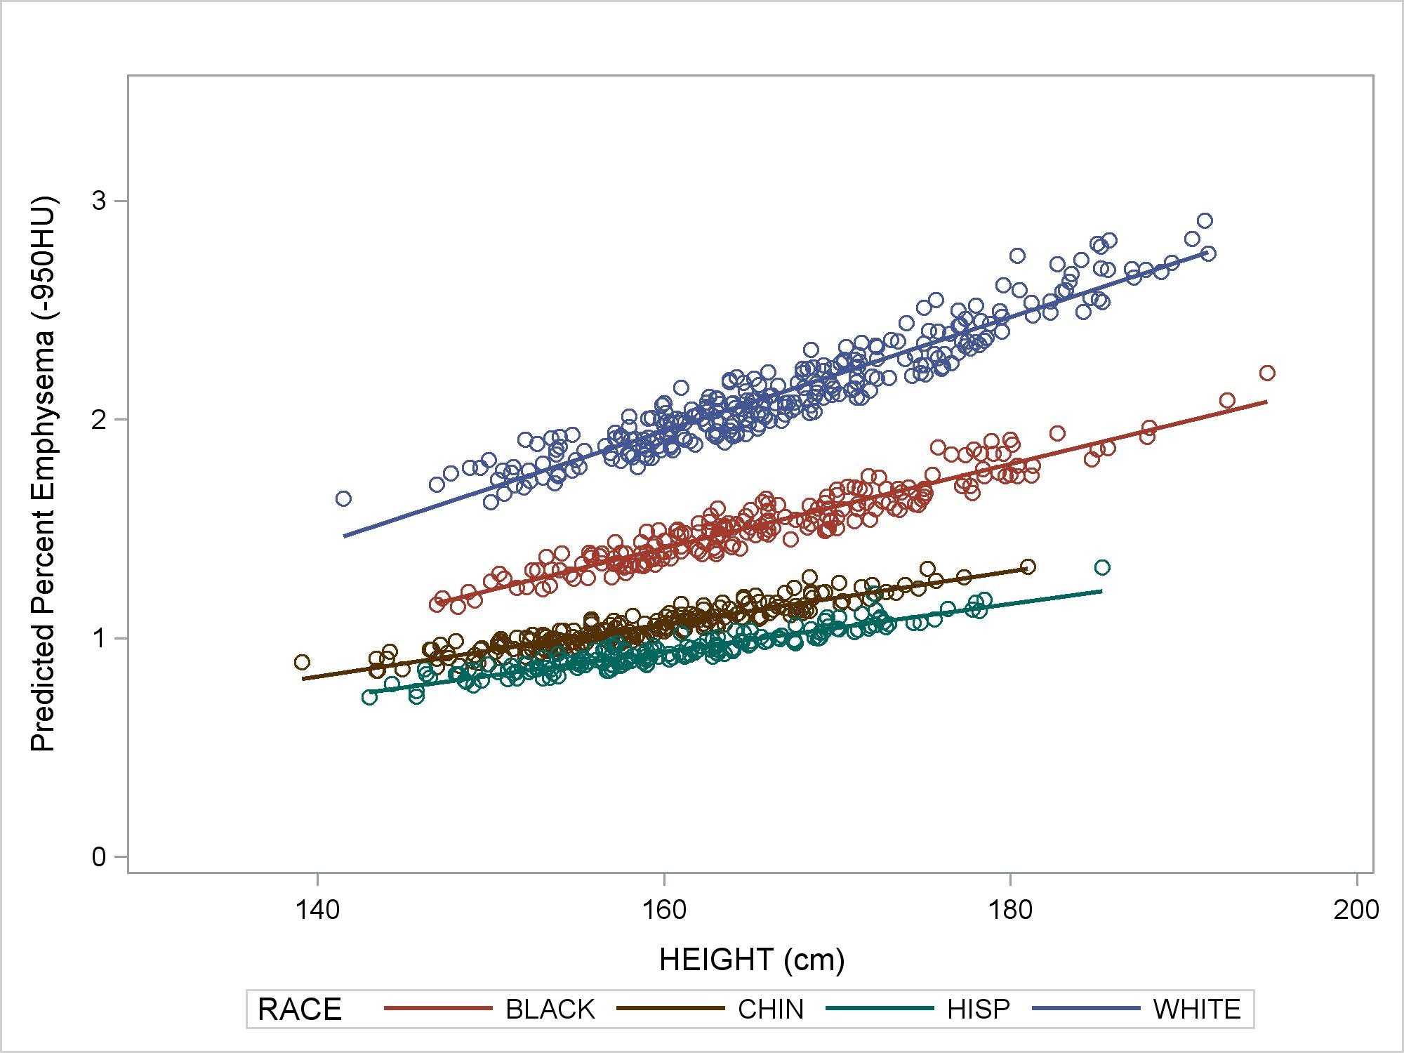
Percent Emphysema in “Normals”
N=854
(Exam 5)
Hoffman, revise/resubmit, Annals ATS, 2014
Notes:
Compare with autopsy studies:
Leopold/Gough (1957) 65 panacinar vs 75 panlobular+panacinar
Thurlbeck (1963, Boston): centrilobular emphysema in 22% of 138 unselected autopsies and panlobular in 14%
Heard/Izukawa (1964, London):

Slide 16
Emphysema in the General Population
Emphysema is common in older adults
Occurs mostly in patients with normal lung function
Greater percent emphysema on CT in MESA is associated with dyspnea, reduced exercise tolerance, and increased all cause mortality

Slide 17
Endothelial Hypothesis of Emphysema
Smoking
Endothelial apoptosis and dysfunction
Microvascular damage
Systemic circulation
Alveolar destruction
(%emphysema)
Pulmonary circulation
↓ Pulmonary blood flow
↓LV-EDV
↓SV

Slide 18

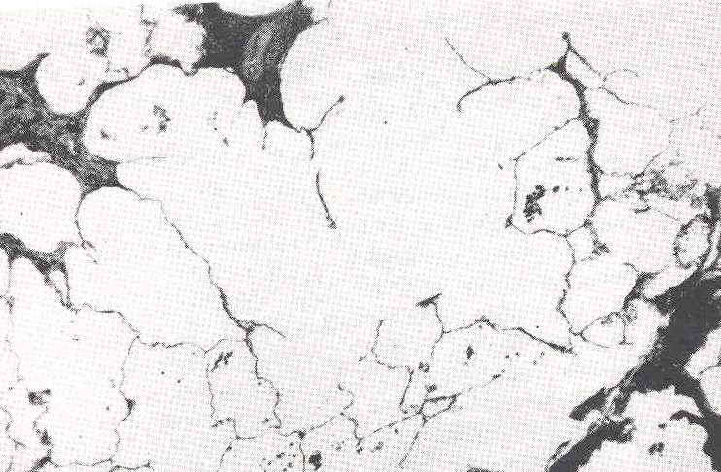
Background
- COPD
Traditional view of pulmonary capillary damage
  Secondary to very severe COPD and emphysema
  Right ventricular failure and impaired left heart filling (cor pulmonale)
Revisionist view
  “Thinning and lacunar change in alveoli with compression and loss of capillaries.… It is problematic whether capillary obliteration or the alveolar change comes first. The former appears more probable.”
Liebow, Am Rev Respir Dis, 1959

Slide 19
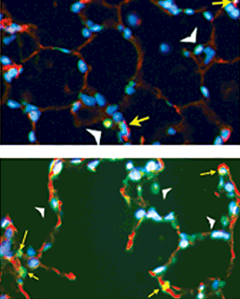
Background
- COPD
Experiments in animal models:
  Endothelial apoptosis causes
  “emphysema”
  VEGF-dependent, ceramide- mediated
Petrache, Nature Med, 2005

Slide 20
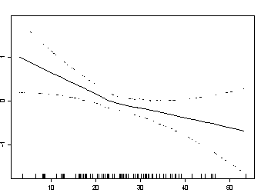
Systemic Endothelial Dysfunction
Flow-mediated Dilation
P=0.005
(linear)
N=107
CT Percent Emphysema (%)
Barr, AJRCCM, 2007

Slide 21
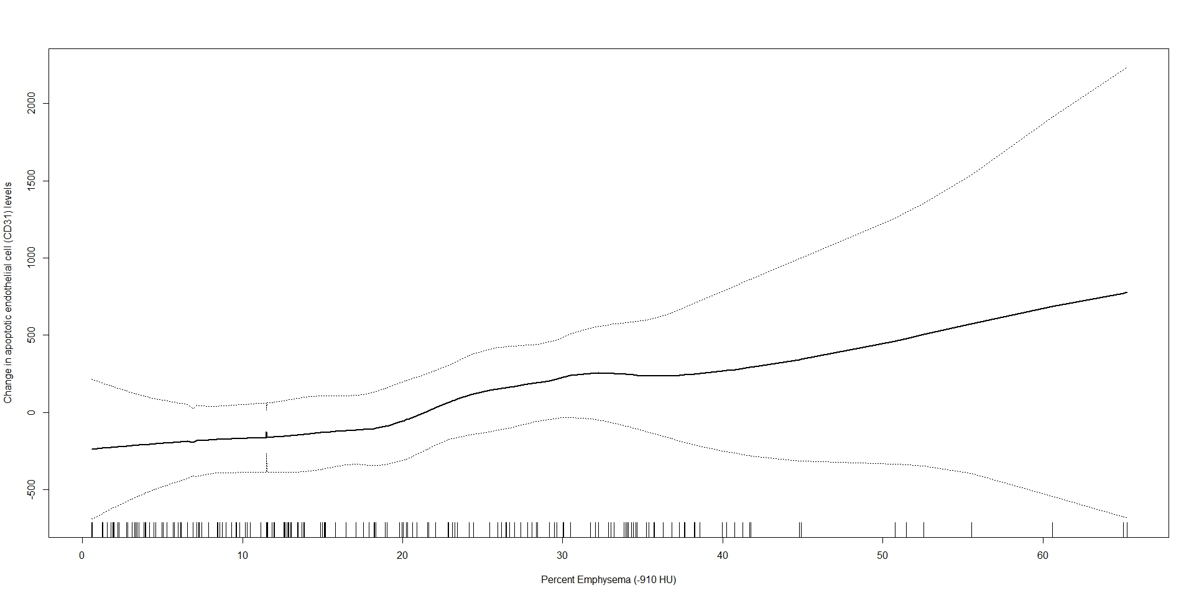
Endothelial Microparticles, Emphysema
P = 0.03
CD31+ EMP levels
Percent Emphysema
Thomashow, AJRCCM, 2013
Notes:
Positive but weaker and non-significant relationships were observed for CD51⁺ EMPs and CD62E⁺ EMPs.

Slide 22
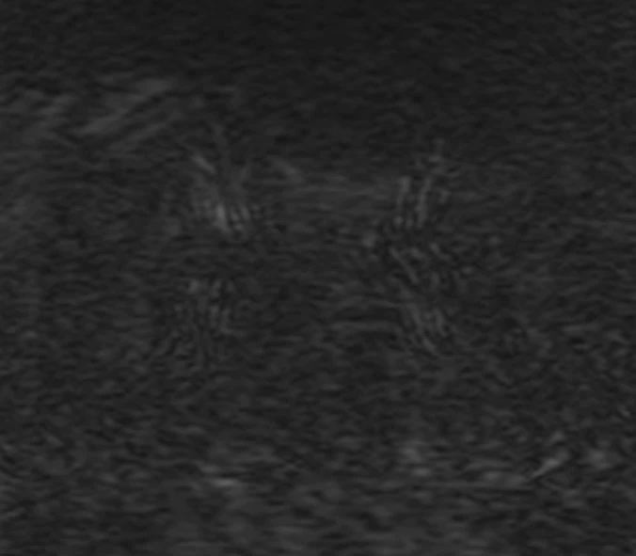
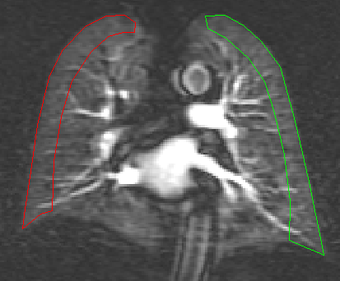
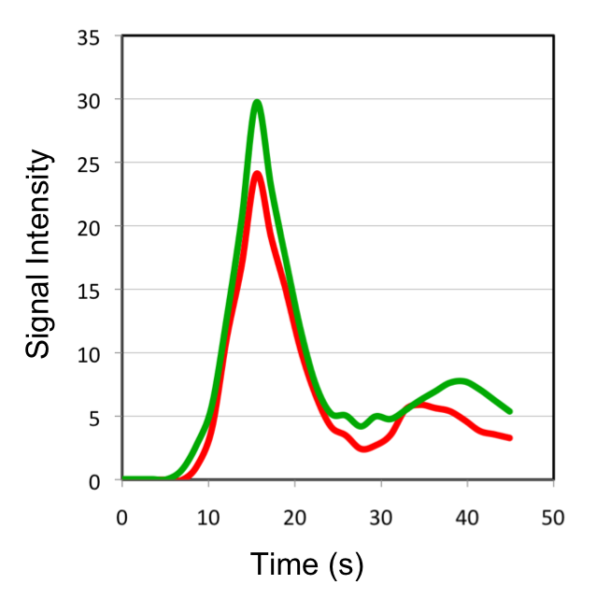
Quantitative Perfusion Parameters
Signal intensity-time curves in the peripheral lung parenchyma and the right ventricle (AIF)
Hueper, Invest Radiol, 2013

Slide 23
Endothelial Hypothesis of Emphysema
Flow-mediated dilation is associated with reduced, ?progression of percent emphysema
Related adhesion molecules (ICAM-1) and endothelial microparticles are associated with progression
Pulmonary microvascular blood flow is markedly reduced “early”

Slide 24
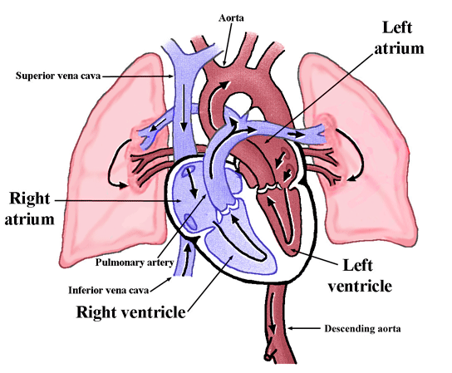
The Cardiopulmonary Unit

Slide 25
% Emphysema and Stroke Volume
- Lung
Current Smokers Former Smokers Never Smokers
P<0.001
(linear)
P<0.001
(linear)
P<0.001
(linear)
Stroke Volume (ml)
CT percent emphysema
Solid dots = Stroke volume; thin lines = 95% CI
    Adjusted for age, sex, race/ethnicity, education, smoking status, packyears, cigars, BSA, height, diabetes, fasting plasma glucose, hypertension, systolic and diastolic blood pressure, CRP, scanner type and mAs.
P-interaction with smoking status <0.001
Barr, NEJM, 2010

Slide 26
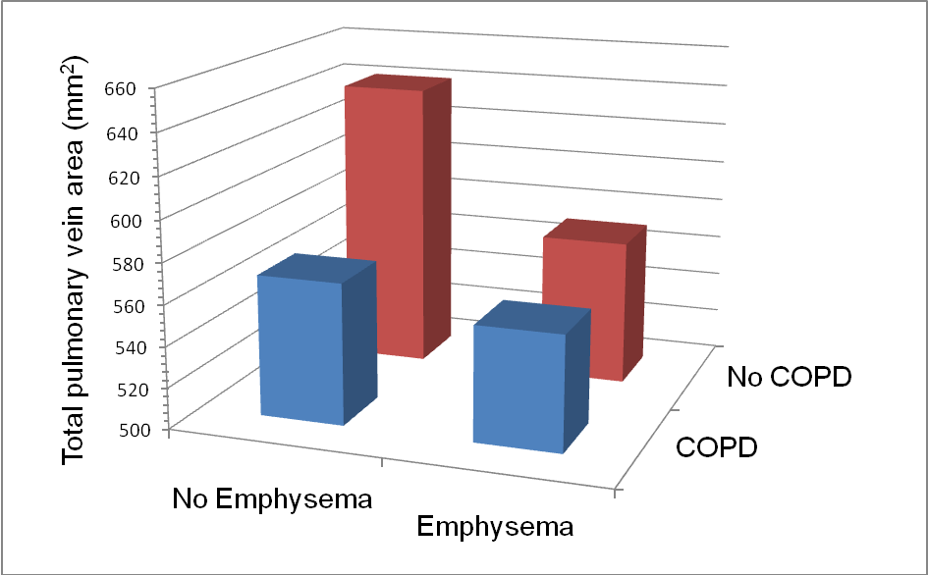
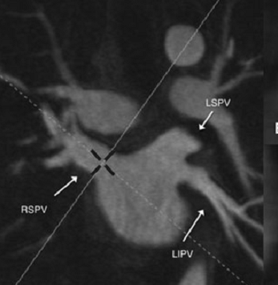
Pulmonary Vein Size in Emphysema
Smith, Chest, 2013

Slide 27
Emphysema and Cardiac Function
Emphysema is associated with impaired LV filling
Pulmonary vein and left atrial size are reduced, suggesting a low LV end-diastolic pressure and ‘upstream’ resistance in COPD

Slide 28
Hypothesis
  The total pulmonary vascular volume (TPVV) is reduced in emphysema
  Reduced TPVV is associated with reduced LV filling

Slide 29
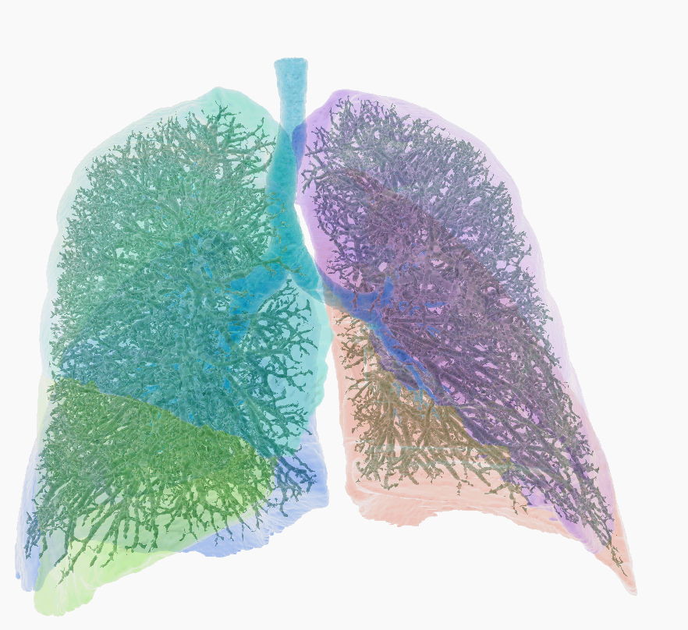
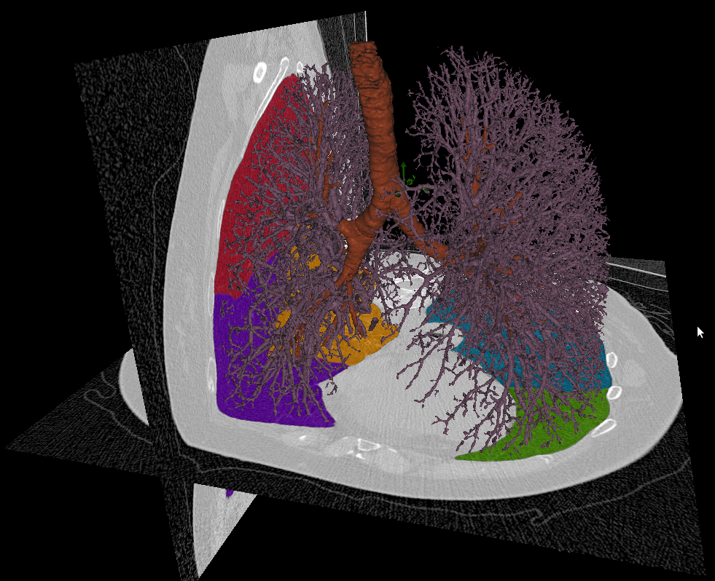
Total Pulmonary Vascular Volume

Slide 31
Conclusions
  Pulmonary emphysema is common among smokers and never smokers
  Associated with dyspnea, impaired LV filling, and mortality
  Support for the endothelial hypothesis of emphysema
  Subclinical impairment in LV filling appears due to an upstream cause in MESA, possibly related to subclinical emphysema

Slide 32
Acknowledgements
- Lung
MESA Lung Study Investigators MESA COPD Investigators
Columbia Firas Ahmed, MD MPH John Austin, MD
Ben Smith, MD MS Charles Powell, MD
Katie Donohue, MD MPH Martin Prince, MD PhD
Dan Rabinowitz, PhD David Bluemke, MD PhD
Steven Shea, MD MS Daichi Shimbo, MD
Johns Hopkins Wendy Post, MD Joao Lima, MD
Northwestern Kiang Liu, PhD Steven Kawut, MD MPH
Lewis Smith, MD Megha Parikh, MS
Wake Forest Jeff Carr, MD MS Katja Hueper, PhD
Univ Arizona Paul Enright, MD Jens Vogel-Claussen, MD PhD
Univ Iowa Eric Hoffman, PhD Andrew Laine, PhD
Univ Vermont Russell Tracy, PhD Elizabeth Oelsner, MD
Univ Washington Richard Kronmal, PhD Carrie Aaron, MD
Karen Hinckley, MS Tess Pottinger, MS
UCLA Robert Detrano, MD PhD Emlyn Hughes, PhD
Karol Watson, MD PhD
Other John Hankinson, PhD

