Slide 1
MESA Lung/MESA COPD Report
R Graham Barr, MD DrPH
Departments of Medicine and Epidemiology
Columbia University Medical Center
Funding: NHLBI R01s HL077612, HL075476, HL093081
RC1 HL100543

Slide 2
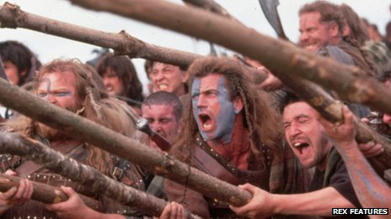
Remember Sept 18th, 1314

Slide 3
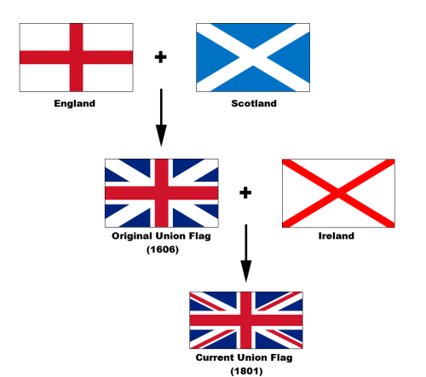
Remember 1603

Slide 4
Outline
Design
Publications
Emphysema ≠ COPD
The shrinking heart and lungs
Data availability
MESA Lung III / MESA Lung non-smokers
MESA COPD II

Slide 5
MESA Lung vs. MESA COPD
MESA Lung
3,965 ppts w/ spirometry, Exam 3-4, 5
3,205 ppts w/ full lung CT in Exam 5
%emphysema on all Exam 1, Family, Air cardiac CTs
10 yr f/u of %emphysema in 3205 ppts
MESA COPD
Case control study of 325 ppts, Exam 5

Slide 6
Emphysema ≠ COPD

Slide 7
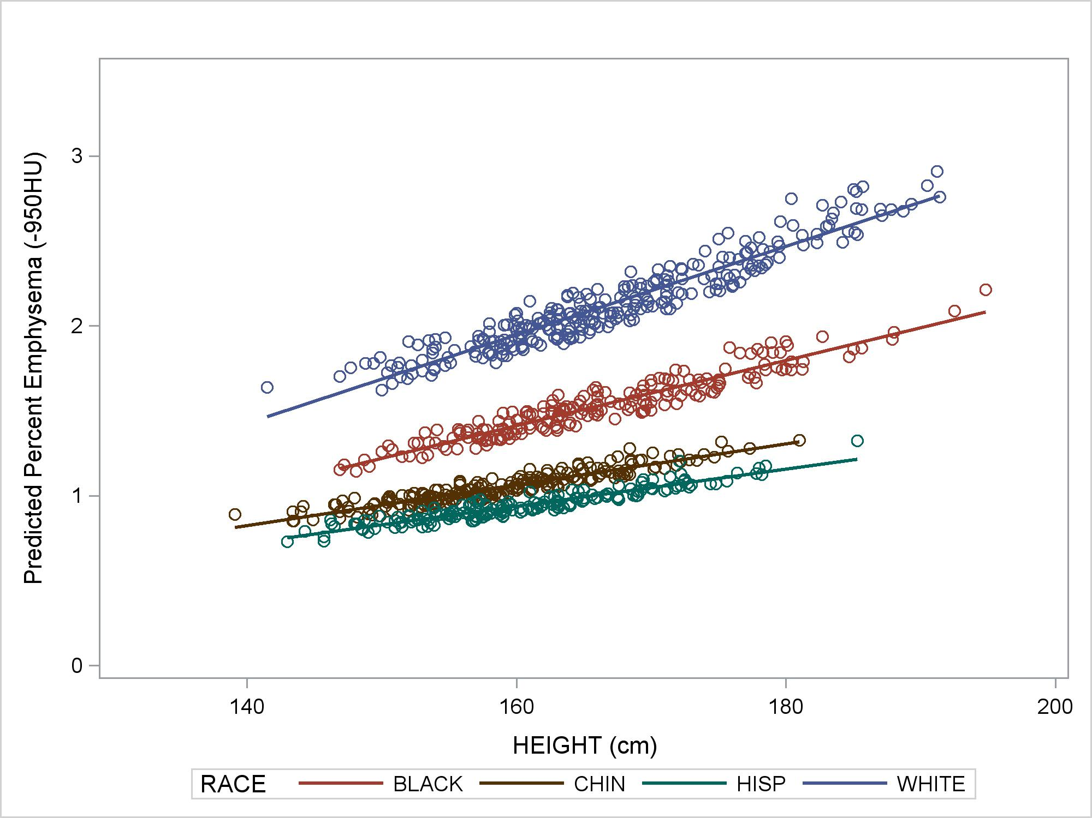
Percent Emphysema in “Normals”
N=854
(Exam 5)
Hoffman, Annals ATS, 2014
Notes:
Compare with autopsy studies:
Leopold/Gough (1957) 65 panacinar vs 75 panlobular+panacinar
Thurlbeck (1963, Boston): centrilobular emphysema in 22% of 138 unselected autopsies and panlobular in 14%
Heard/Izukawa (1964, London):

Slide 8
GWAS for Percent Emphysema
- Lung
Manichaikul, AJRCCM, 2014

Slide 9
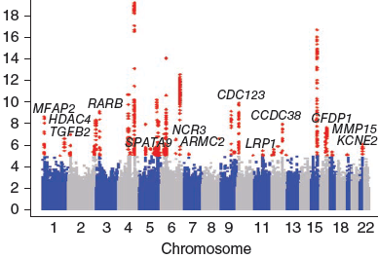
GWAS for Lung Function (FEV₁/FVC)
HHIP
Emphysema genes
THSD4
AGER/PPT
n=94,612
1 m SNPs
Soler Artigas, Nat Gen 2010
Cheng, AJRCCM, 2013
Manichaikul, AJRCCM, 2014

Slide 10
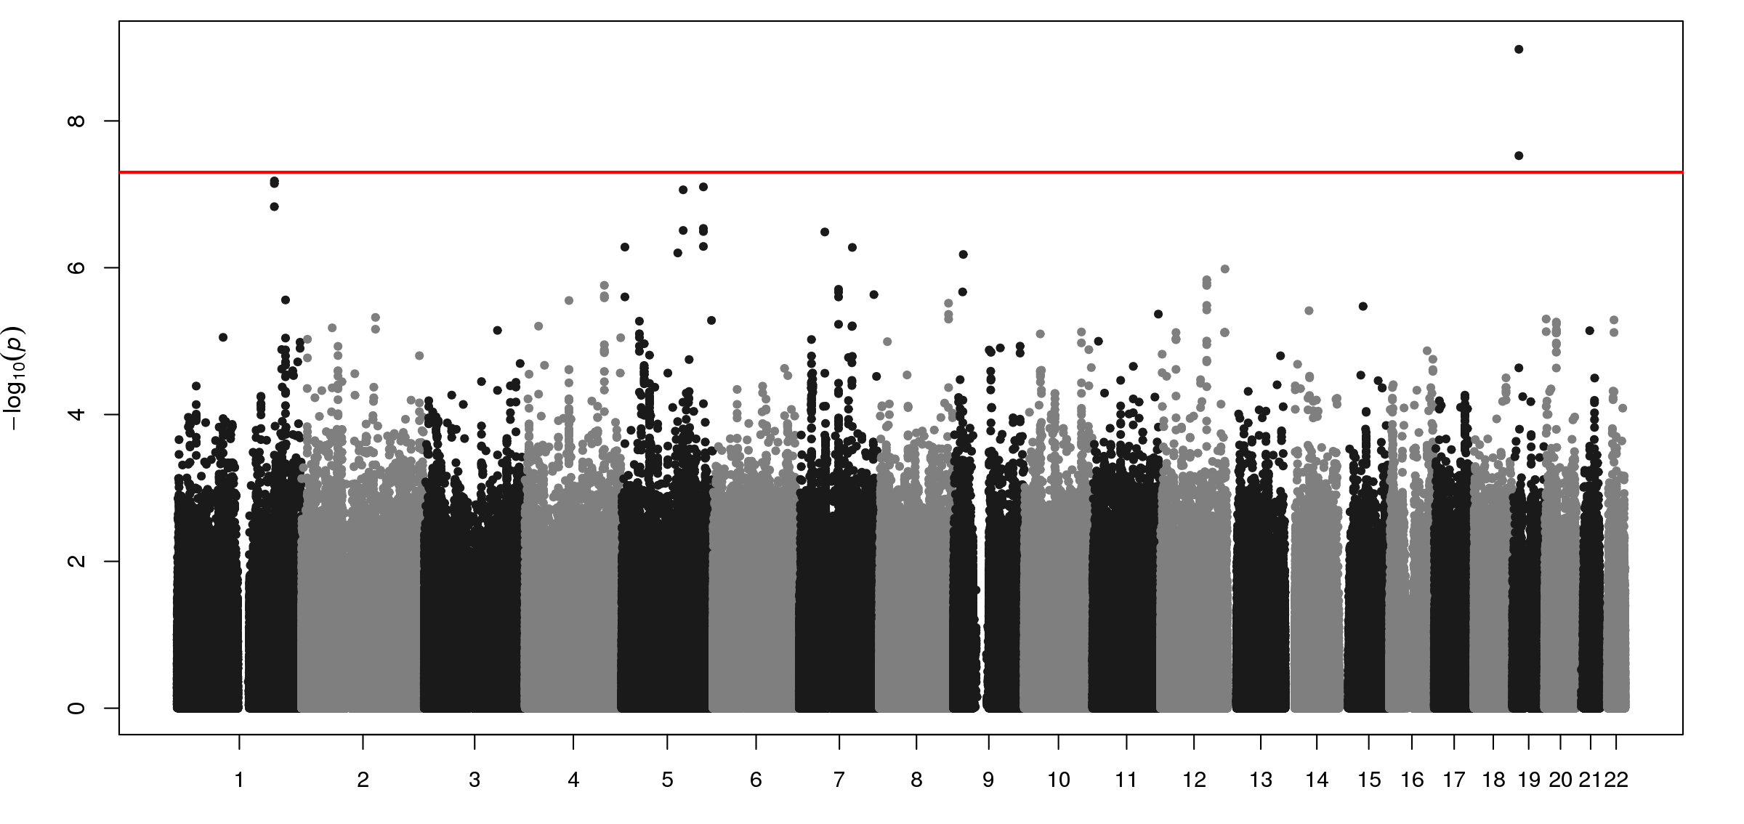
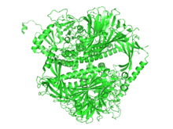
GWAS for Percent Emphysema
- Lung
2113 Hispanics
rs10411619
Plasma α₁ Antitrypsin level
MAN2B1
P=0.01
subforms of alpha-mannosidase
Manichaikul, AJRCCM, 2014

Slide 11
Emphysema in the General Population
Emphysema is common in older adults
Occurs mostly in patients with normal lung function
Distinct genetic basis
Greater percent emphysema on CT in MESA is associated with dyspnea, reduced exercise tolerance, and increased all cause mortality

Slide 12
Smaller Heart and Lungs

Slide 13
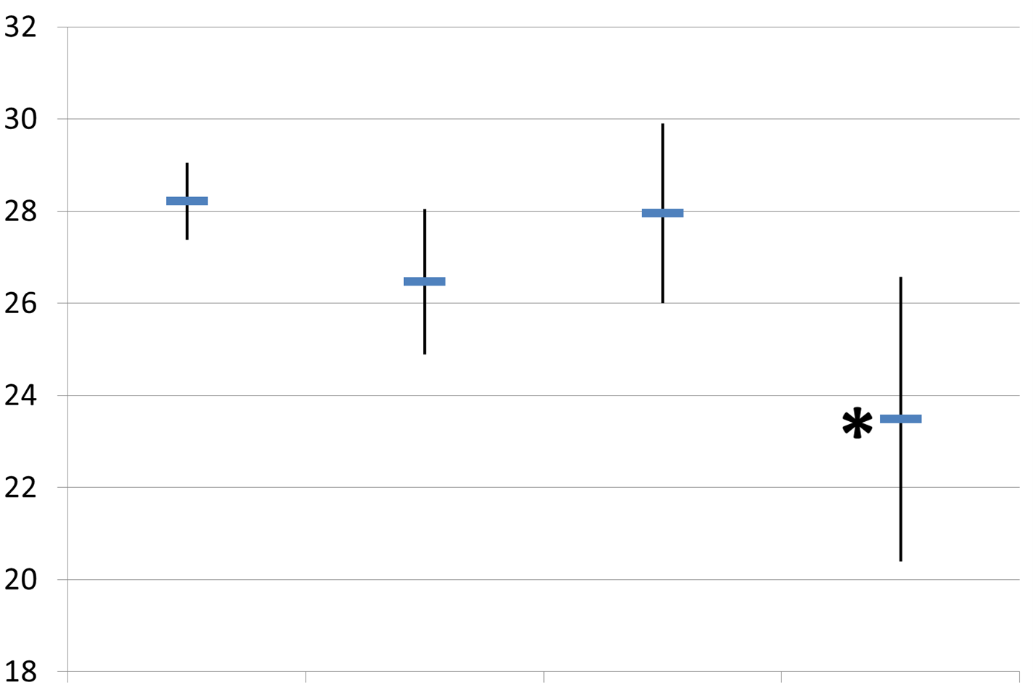
Classic Emphysema Subtypes on CT
- Lung
* P<0.05
Body Mass Index (kg/m²)
None Centrilobular Paraseptal Panlobular
n=205 n=65 n=33 n=15
Smith, Am J Med, 2014

Slide 14
%Emphysema and LV Measures
- Lung
 | Change in cardiac measure per 0.10 increase in percent emphysema (95% CI) | P-value
LV End Diastolic Volume (ml) | -4.1 (-4.9, -3.3) | 10⁻¹⁶
LV End Systolic Volume (ml) | -1.4 (-1.9, -0.9) | 10⁻⁸
LV Stroke Volume (ml) | -2.7 (-3.3, -2.2) | 10⁻¹⁶
LV Ejection Fraction (%) | 0.0 (-0.2, 0.3) | 0.89
Cardiac Output (L/min) | -0.19 (-0.23, -0.14) | 10⁻¹⁴
LV Mass (g) | -2.5 (-3.4, -1.6) | 10⁻⁸
Adjusted for age, sex, race, education, packyears, cotinine, BSA, height, DM, FPG, HTN, SBP, DBP, CRP, fibrinogen
Barr, NEJM, 2010

Slide 15
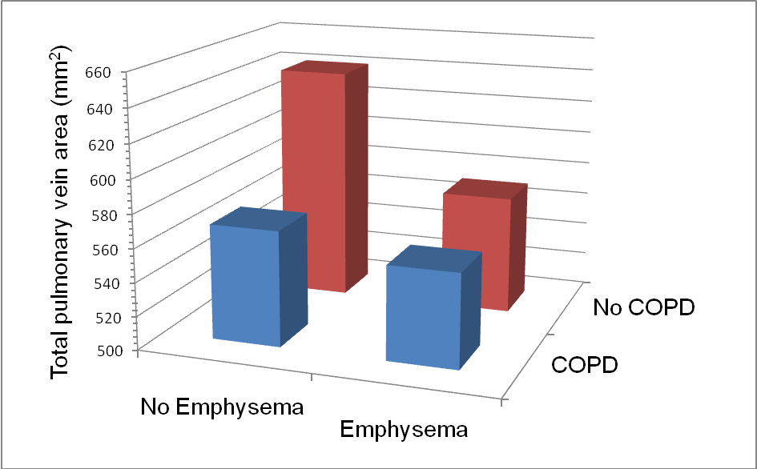
Pulmonary Vein Size in Emphysema
Smith, Chest, 2013

Slide 16
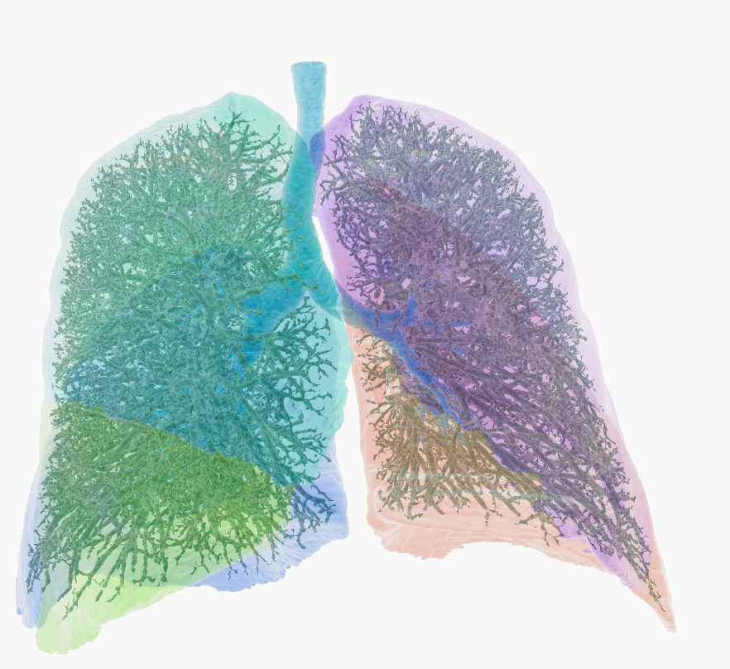
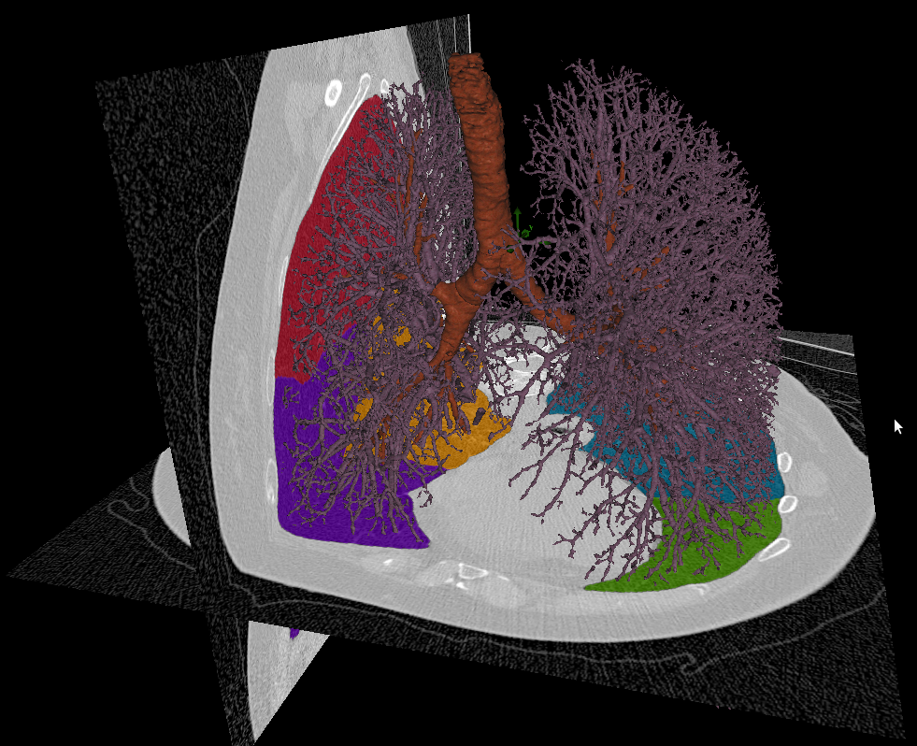
Total Pulmonary Vascular Volume

Slide 17
Right Ventricular Changes in COPD
Adjusted for age, gender, race/ethnicity, cohort, height, weight, smoking status, pack-years, hypertension, sleep apnea and mAs
Kawut, JACC, in press

Slide 18
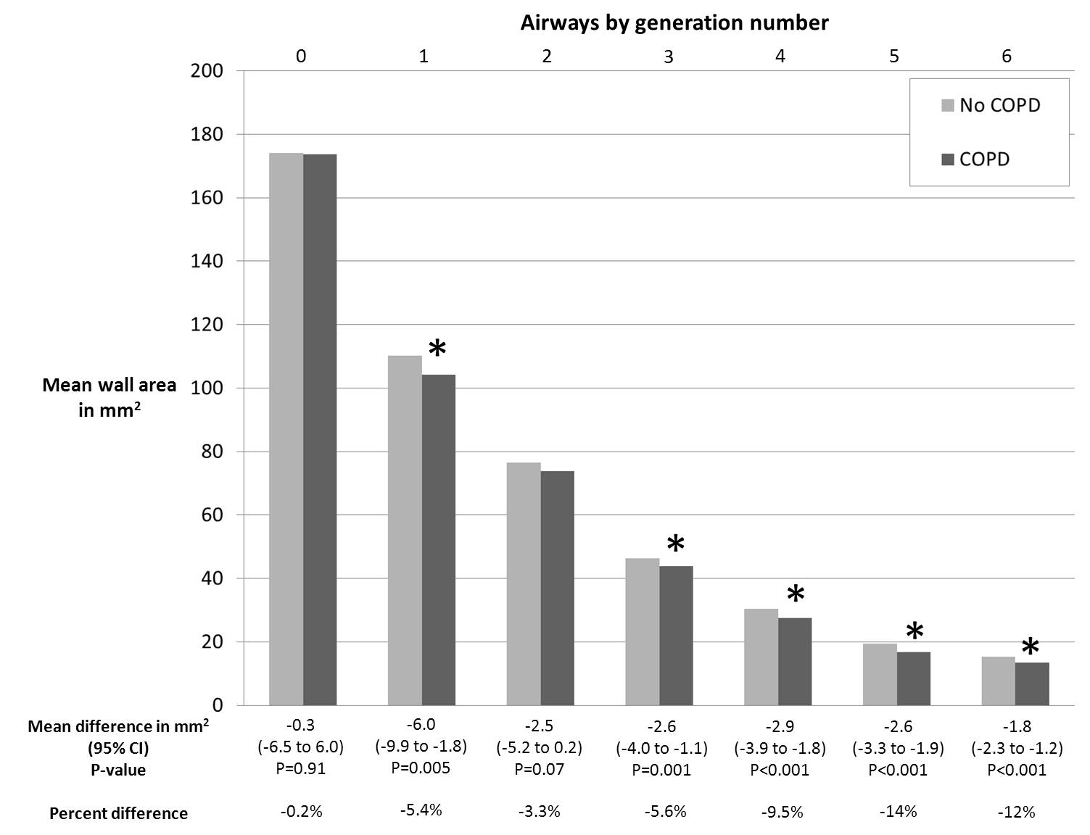
Smaller Airway Walls in COPD
Smith, Thorax, 2014

Slide 19
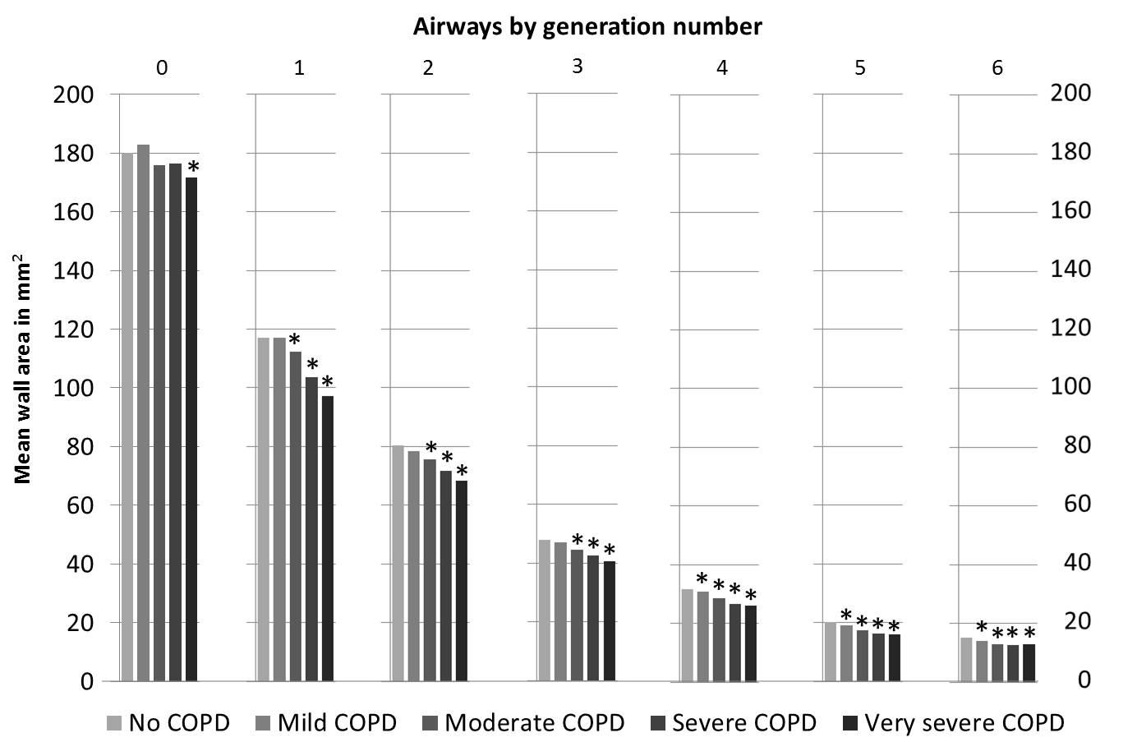
Smaller Airway Walls in COPD
Smith, Thorax, 2014

Slide 20
Small Heart and Lungs in COPD
COPD and particularly emphysema
Smaller LV, LA, pulmonary veins, TPVV, and right ventricle
Smaller airways in COPD
Failure of cardiopulmonary function

Slide 21
Data Availability – MESA Lung
Exam 5 (n~3,205)
Spirometry (+ post-bronchodilator if airflow limitation)
Percent emphysema and “emphysema” > ULN; HAA
Qualitative reads of emphysema subtype, interstitial lung abnormalities
Airways
Total Pulmonary Vascular Volume
Urinary cotinine
Exam 1-4 (~all)
Percent emphysema and high attenuation areas

Slide 22
MESA Lung III
Pulmonary microvascular blood volume is reduced and total pulmonary artery volume (TPAV) is increased in panlobular emphysema
Summited 5/14

Slide 23
MESA Lung “Nonsmokers”
Examination of panlobular emphysema in the general population
Possible submission 2/14

Slide 24
MESA COPD II
5:00 Introductions
5:10-5:25 Pulmonary Vasculature on CT and MRI and Systemic Blood Pressure
5:25-5:35 Scientific Output of MESA COPD
5:35-5:45 Aims of MESA COPD II
5:45-6:00 Protocol and Logistics
6:00-6:20 MRI +/- Echocardiography
6:20-6:35 Pulmonary Vascular Volume on CT and Left Ventricular Filling
6:35 Close

Slide 25
Acknowledgements
- Lung
MESA Lung Study Investigators MESA COPD Investigators
Columbia Firas Ahmed, MD MPH John Austin, MD
Ben Smith, MD MS Charles Powell, MD
Katie Donohue, MD MPH Martin Prince, MD PhD
Dan Rabinowitz, PhD David Bluemke, MD PhD
Steven Shea, MD MS Daichi Shimbo, MD
Johns Hopkins Wendy Post, MD Joao Lima, MD
Northwestern Kiang Liu, PhD Steven Kawut, MD MPH
Lewis Smith, MD Megha Parikh, MS
Wake Forest Jeff Carr, MD MS Katja Hueper, PhD
Univ Arizona Paul Enright, MD Jens Vogel-Claussen, MD PhD
Univ Iowa Eric Hoffman, PhD Andrew Laine, PhD
Univ Vermont Russell Tracy, PhD Elizabeth Oelsner, MD
Univ Washington Richard Kronmal, PhD Carrie Aaron, MD
Karen Hinckley, MS Tess Pottinger, MS
UCLA Robert Detrano, MD PhD Emlyn Hughes, PhD
Karol Watson, MD PhD Christian Lo Cascio, MD
Other John Hankinson, PhD

