Slide 1
Pulmonary Perfusion in MESA The MESA Lung Study III
R Graham Barr, MD DrPH
Eric Hoffman, Matt Budoff, Greg Burke, Aaron Folsom, John Hankinson, David Jacobs, Richard Kronmal, Kiang Liu, Wendy Post, Dan Rabinowitz, Russ Tracy, Karol Watson
NIH/NHLBI/DLD R01-HL077612-9

Slide 2
PROGRESS REPORT – MESA Lung I/II
Major hypotheses confirmed
>100 papers published
NEJM, Ann Intern Med (2), AJRCCM (7), Circ (3), Nat Gen
Major papers on:
Heart-lung interactions (>125 citations)
Significance of emphysema in the absence of COPD
Genetic basis for emphysema
4 R01’s, RC1, 2 R21’s, K23, Alpha1/COPD Foundation

Slide 3
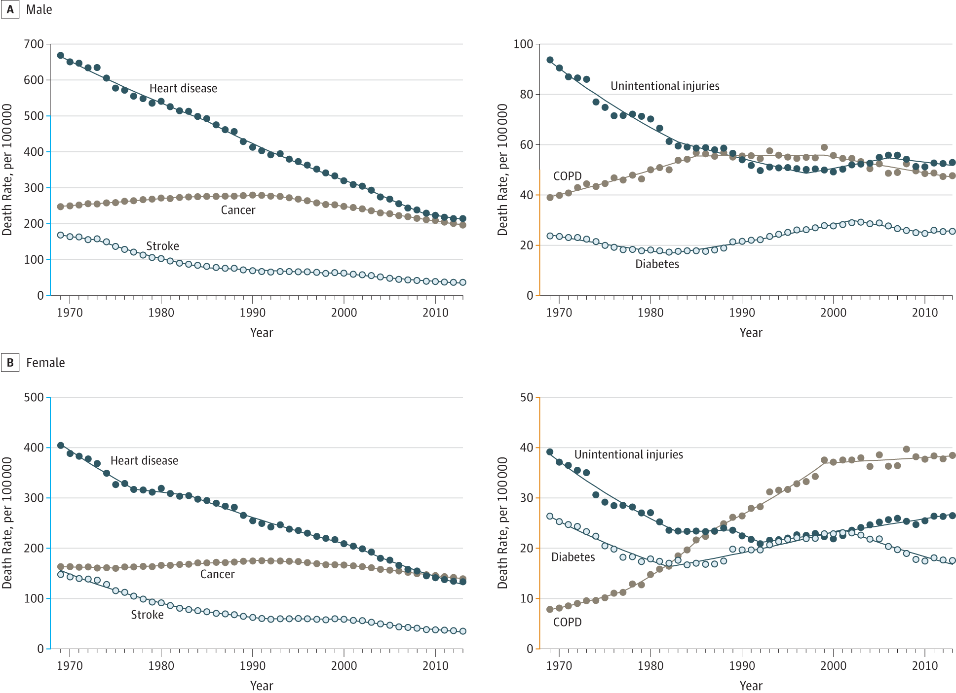
Mortality Rates, US, 1969-2013
Men
COPD
Women
JAMA, 2015

Slide 4
COPD-Related Conditions
Chronic Bronchitis
Emphysema
COPD
CHRONIC AIRFLOW OBSTRUCTION
Asthma

Slide 5
Emphysema without COPD is Common in the General Population
MRC Chronic Bronchitis (8%)
Emphysema on CT
(8%)
COPD
(10%)
Asthma onset < Age 45 (7%)
MESA Lung II
55-94 years; 45% never smokers
n=2,426
Notes:
Compare with autopsy studies:
Leopold/Gough (1957) 65 panacinar vs 75 panlobular+panacinar
Thurlbeck (1963, Boston): centrilobular emphysema in 22% of 138 unselected autopsies and panlobular in 14%
Heard/Izukawa (1964, London):

Slide 6
Emphysema on CT has a Poor Prognosis Independent of COPD
Emphysema associated with dyspnea and reduced exercise tolerance in MESA ppts without COPD
Predicts respiratory exacerbations and hospitalizations independent of lung function
Major correlate of impaired left ventricular filling
Predicts all-cause mortality in MESA pts without COPD
Among current, former and never smokers
Smith, Am J Med, 2014
McAllister, PloS ONE, 2014
Barr, NEJM, 2010
Oelsner, Ann Intern Med, 2014

Slide 7
Change in Percent Emphysema over 10 years
 | N | Effect Estimate | 95% CI | P-value
Active smoking | 4472 | 0.98 | 0.66, 1.31 | <0.001
Pack-years (per 10) |  | 0.05 | 0.00, 0.11 | 0.05
Body mass index |  | -0.05 | -0.07, -0.02 | 0.001
Retinal venule size | 4121 | 0.13 | 0.02, 0.24 | 0.02
eGFR (per SD) |  | 0.11 | 0.00, 0.22 | 0.05
ACE/ARB use |  | -0.77 | -1.33, -0.21 | 0.007
Aspirin use |  | -0.33 | -0.57, -0.08 | 0.009
sICAM-1 (per SD) | 1860 | 0.23 | 0.06, 0.39 | 0.008
vWF (per SD) | 841 | 0.07 | 0.00, 0.14 | 0.05
Th1 cells (per SD) | 813 | 0.18 | -0.03, 0.39 | 0.09
CMV Ab positivity | 843 | 0.20 | 0.05, 0.36 | 0.01
CRP (per SD) | 4441 | 0.13 | 0.03, 0.23 | 0.01
Mixed effects model with random intercept and slope adjusting for variables in box plus demographics, scanner, time*sex, time*race, and time*pack-years

Slide 8
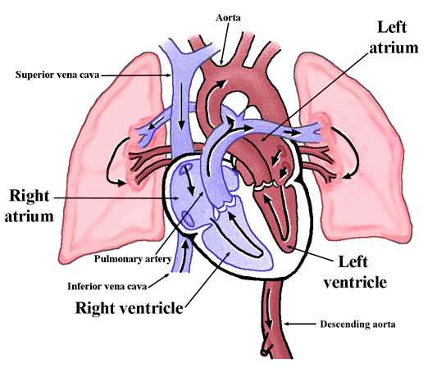
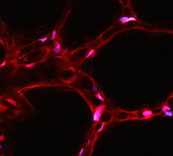
Importance of the Pulmonary Vasculature
Physiology
Biology
Courtesy: J Bhattacharya

Slide 9
Cigarette Smoking
Air Pollution
Occupational Exposures
ADORA2A
PX2R7
AGER
Innate Immunity
Adaptive Immunity
Endothelial Apoptosis/Microvasculature Loss
Neutrophil Attachment
NKT cells
Potential ConfoundersP/E
Fibrosis/IPF
PAH
Medications
Pulmonary Microvascular Compromise
Microaggregation/
in-situ thrombosis
Hyperviscosity
Pulmonary Vasoconstriction
Hypoxia
Impaired LV filling
Reduced Cardiac Output
“HF preserved EF”
Emphysema Progression

Slide 10
Pulmonary Vascular Volume on CT is associated with Impaired LV Filling
MESA Lung II n=2259 | Difference per SD unit of PVV (95% CI) | P-value
LV end-diastolic volume, mL | 3.0 (1.9, 4.0) | <0.0001
LV stroke volume, mL | 2.0 (1.3, 2.6) | <0.0001
LV mass, g | 0.7 (-0.2, 1.6) | 0.12
LV mass/end-diastolic volume | -0.02 (-0.03, -0.01) | <0.0001
Adjusted for age, gender, race, ht, wt, scanner, mAs, smoking status, pk-yrs, education, HTN, SBP, cholesterol, HDL, diabetes and diuretic use

Slide 11
AIMS
Pulmonary perfusion is lower and pulmonary arterial volume is greater in emphysema/panlobular emphysema
Immune activation is associated with emphysema progression and NKT-cell number and activation state are increased in emphysema and in participants with reduced pulmonary perfusion
Lobar reductions in the pulmonary vascular volume are associated with progression of emphysema over 6 years

Slide 12
Approach
Target 2000 ppts, 6 sites
Inclusion: 3204 MESA participants with full-lung CT in 2010-12
Exclusions:
CT: >20 mSv from MESA scanning or MESA COPD II CT
Contrast: Iodine allergy; eGFR<=60
Albuterol: arrhythmia, unstable angina/recent MI
Questionnaire
Spirometry (+ post-bronchodilator if airflow obstruction)
Lung CT: 1000 with contrast; 1000 without contrast lung CT
Creatinine (1000), FPG, CBC/diff; blood for iNKT cells (192); cotinine

Slide 13
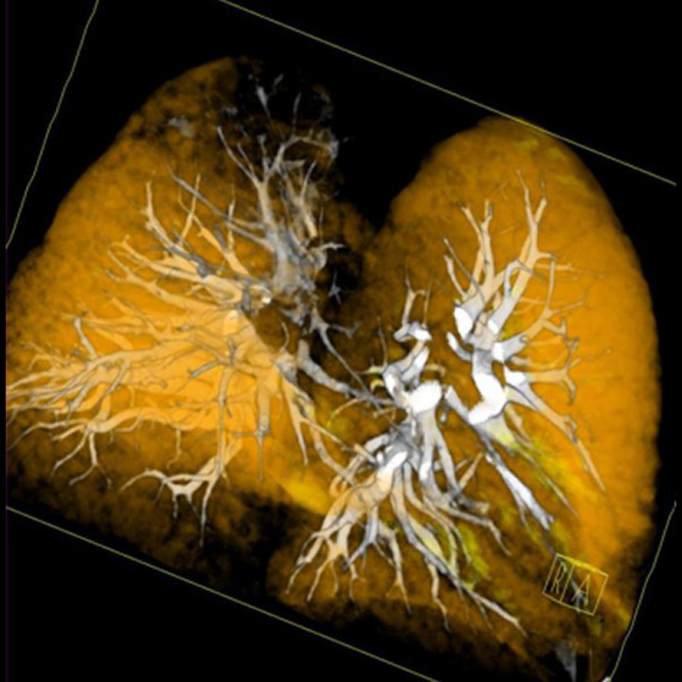
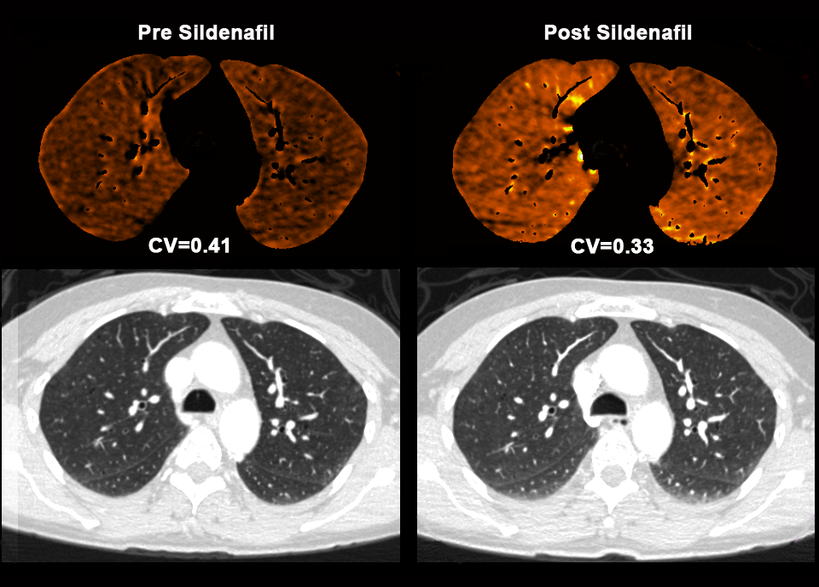
Dual-Source, Contrast-enhanced CT for Pulmonary Perfusion
Fuld, Radiology, 2013
Siemens, 2013
Hoffman, unpublished

Slide 14
Thanks !!!

