Slide 1
Atrial Fibrillation Study
Clinic Procedures for Patch Application

Slide 2
Two New Forms!!!
MRI Exclusion Form
Unique questions for Atrial Fibrillation Subjects only
Atrial Fibrillation Study Completion Form
Purpose is for tracking various study components

Slide 3
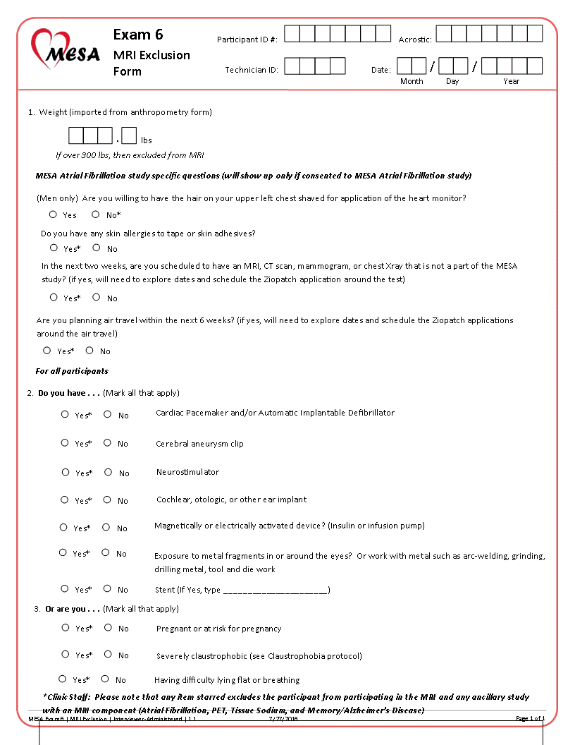

Slide 4
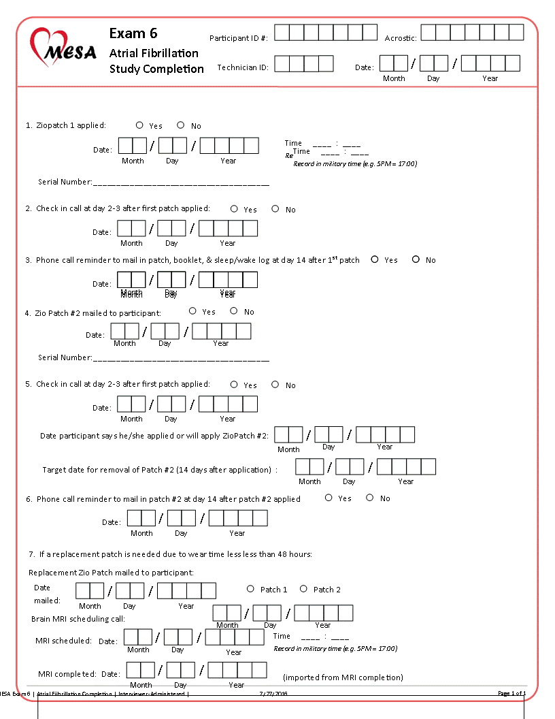

Slide 5
Register the participant/patch online at www.zioreports.com

Slide 6
Record Zio Patch #1 application information on Study Completion Form

Slide 7
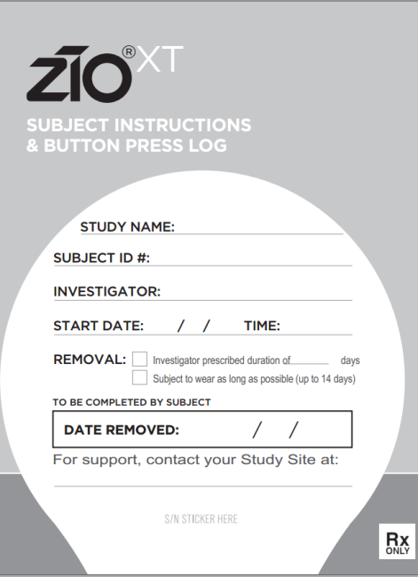
Fill in the front page of the booklet
MESA
MESA ID #
Site PI
MMDDYY
HH:MM
CROSS OUT!
ENTER 14 DAYS FROM ABOVE DATE
Site Phone

Slide 8
Apply and Introduce the Zio Patch
(Sample text in MOP)
Describe Patch
Show them kit, and instruct to ignore or cross out the sections with their name and online registration
Remind Ppt to return the pouch
Emphasize saving the box
Tell them to watch, so they will be able to do it themselves
Describe the wear time—14 days, but tell them if it comes off early we still want the patch back
Tell them of wear restrictions and expectations
They can always call with questions!

Slide 9
Turn the device on
Show the participant how to press the button if they have symptoms, and the location in the booklet to write down the symptoms for each button push
Show them the sleep wake log
Show them how to return the patch and booklet
Tell them about Patch #2 and timing
Show them the clinic phone number and point out the TSA statement on page 8

Slide 10
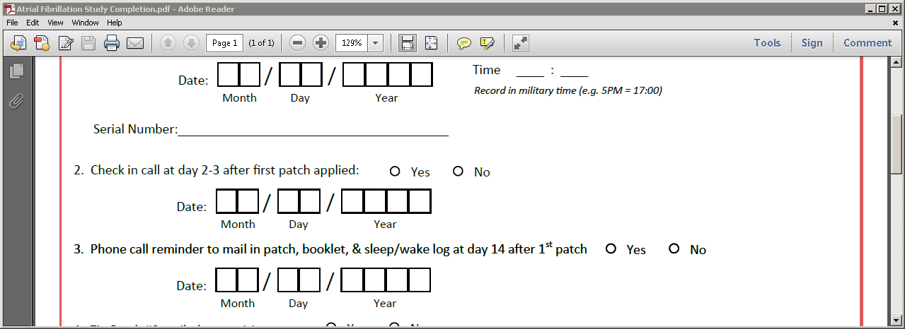
Reminder and check in calls
Zio Patch was piloted! We know that participants are compliant, and how to make the process as smooth as possible.
Check in call 2-3 days after the first application
Check in call 14 days after first application as reminder about mailing

Slide 11
Mailing of 2nd Zio Patch
CC will notify FC on twice weekly basis of participants needing 2nd patch
Register the participant and patch online
Open the box. DO NOT OPEN THE POUCH!
Take a booklet sticker, and record MESA ID and FC phone.
Apply serial # to booklet sticker
Stick corner of sticker onto the pouch and put both into the gray mailing box.
Mail via USPS

Slide 12
Check in and reminder calls for Patch #2
Same as Patch #1, but the first call will record either the date already applied, or the date planned to apply.

Slide 13
MISC and Q&A
We have Spanish and Chinese translations of the booklets
Will just need to substitute for English already provided. For second Zio Patch, will just add second translated booklet
Replacement Zio Patches
We will replace Zio Patches if something happens in the first 24-48 hours…BUT….they aren’t cheap!
Record on Study Completion Form
Questions or concerns….PLEASE CALL OR EMAIL!

