Slide 1
Aspirin Use and Longitudinal Progression of Percent Emphysema: The MESA Lung Study
Carrie P. Aaron, MD
Columbia University
- Lung

Slide 2
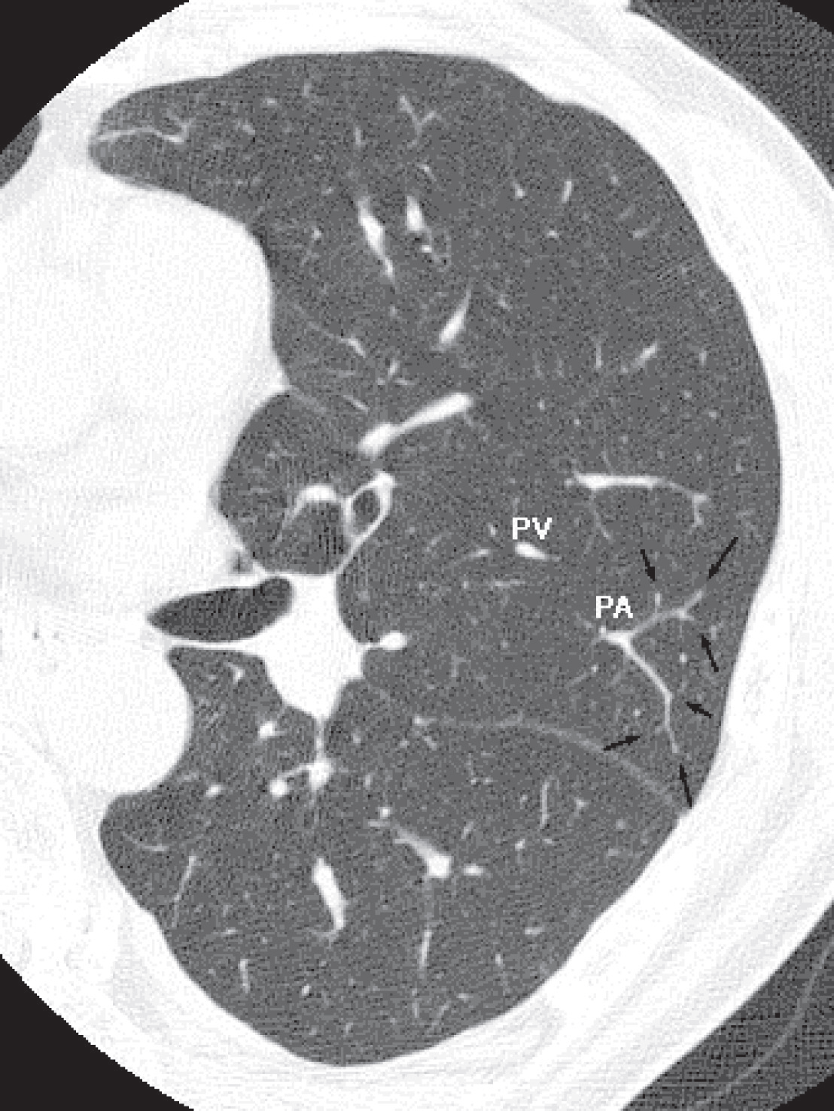
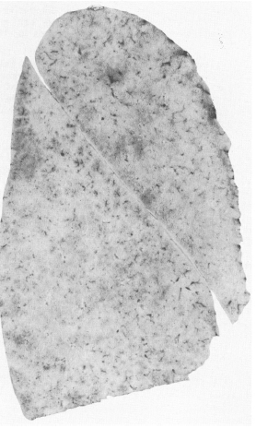
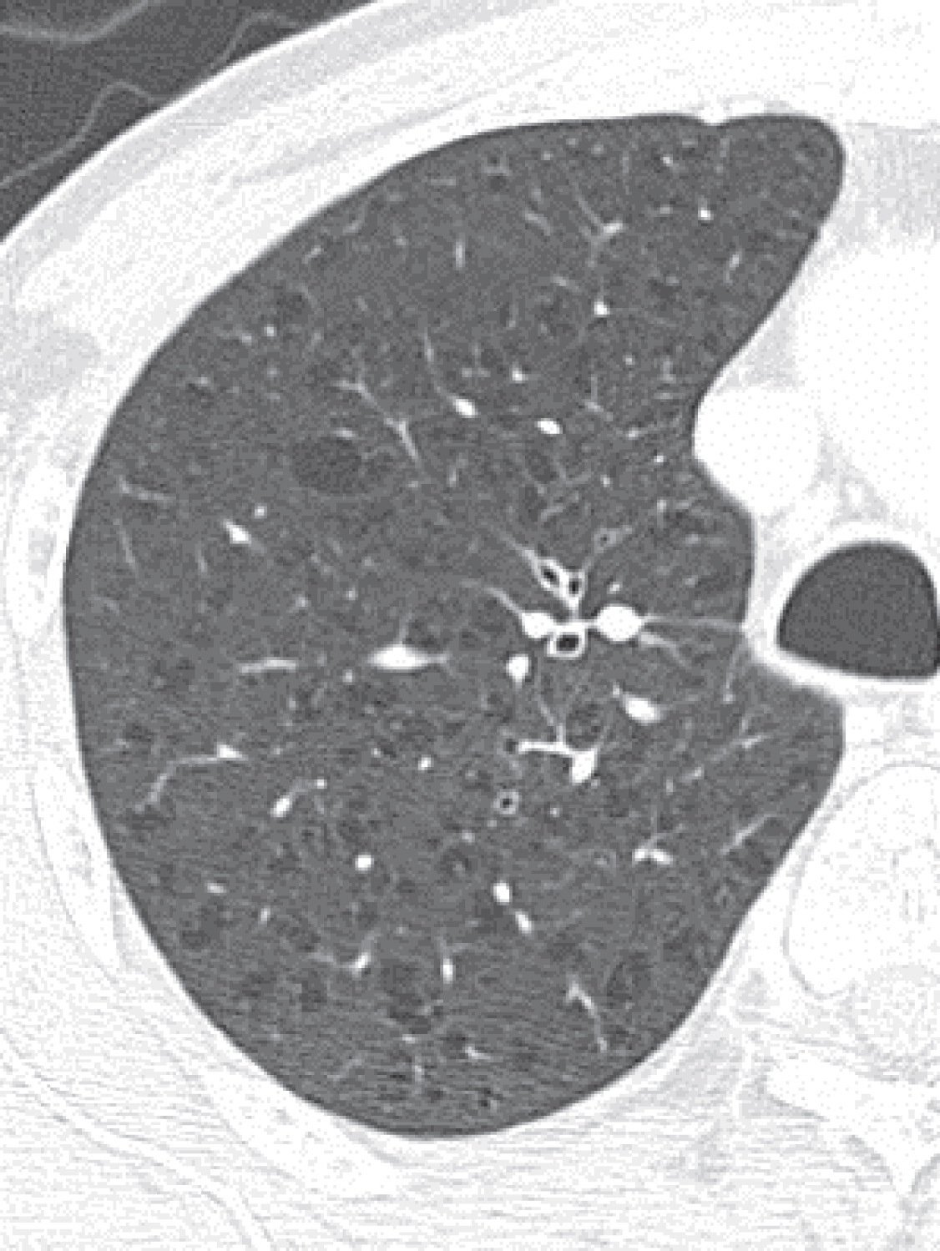
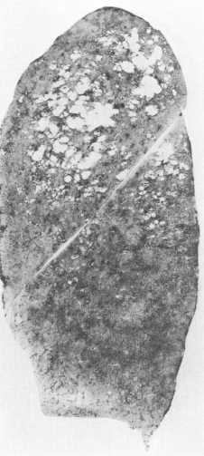
COPD and Emphysema
Chronic lower respiratory disease is the 3rd leading cause of death in the U.S.
Chronic obstructive pulmonary disease (COPD) is defined by airflow obstruction that is not fully reversible
NORMAL EMPHYSEMA
Emphysema is defined pathologically by the destruction of alveolar walls
– and can be identified on CT scan
Heron M, NVSR/CDC 2015. Pauwels, AJRCCM 2001.
Auerbach, NEJM 1972. Takahashi, Int J COPD 2008.

Slide 3
Importance of CT Emphysema
Percent of emphysema-like lung on CT (“percent emphysema”) has been associated with
increased dyspnea and hospitalizations
reduced cardiac function and physical activity
increased mortality in those with COPD, and in the general population without COPD
Oelsner, Am J Med, 2014. McAllister, PloS One 2014. Barr, NEJM, 2010. Lo Cascio, submitted. Johannessen, AJRCCM, 2013. Oelsner, Ann Int Med, 2014.

Slide 4
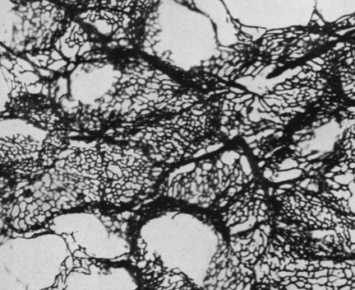
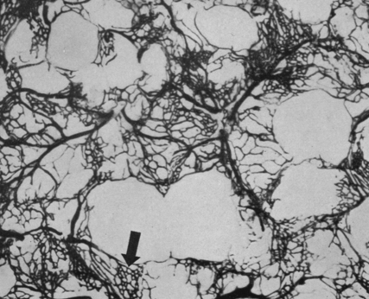
Pulmonary Microvascular Damage Occurs in Emphysema
Pulmonary capillaries are integral to the alveolar wall
and damaged in emphysema
NORMAL
EMPHYSEMA
Reid JA, Thorax, 1963

Slide 5
Emphysema and Platelet Activation
Vascular diseases often involve platelet activation, which may also be important in the development of emphysema
Aspirin reduces platelet activation via COX-1 dependent thromboxane A₂ (TXA₂)
TXA₂ causes vasoconstriction and inflammatory cell recruitment
Improve blood flow in pulmonary capillaries
Slow
progression of emphysema
Aspirin use

Slide 6
Hypothesis
Regular aspirin use is associated with a slower longitudinal progression of percent emphysema, measured on CT, over 10 years

Slide 7
Multi-Ethnic Study of Atherosclerosis
MESA enrolled 6,814 participants ages 45-84 in 2000-02
White, black, Hispanic and Chinese-American
Free of clinical cardiovascular disease
MESA Lung longitudinal cohort
4,472 participants
Median follow-up of 9.2 years, and 3 CT scans
Spirometry completed in a subset at 5 years

Slide 8
Aspirin Use
Medication bottles were brought to each visit and information was recorded at each visit
Regular aspirin use (3+ days per week) was self-reported at each visit

Slide 9
Percent Emphysema
- Lung
Percent Emphysema on CT
= voxels ≤ -950 HU / total lung voxels
(corrected for outside air attenuation)
Cardiac CT scans performed at baseline and up to 2 times in follow-up
Full lung CT scans at 10 year follow-up
Cardiac CT scan
For comparison the lower 2/3 of the full lung scans were used
Hoffman, Acad Rad, 2009.

Slide 10
Statistical Analysis
- Lung
Mixed effect models with a random intercept and slope to account for intersubject variability
Main exposure: interaction between time and regular aspirin use
Covariates:
baseline age, sex, race/ethnicity, education, pack-years, hypertension, ACEi/ARB use, C-reactive protein and sphingomyelin
time-variant scanner terms, height, weight and cigarettes/day
Sensitivity analyses by propensity score

Slide 11
Results – Aspirin Use
Of 4,472 participants
1140 (25.5%) were taking aspirin
926 (20.7%) reported taking aspirin 3 times a week or more
50% 81mg, 43% 300-325mg
82% report over the counter use, 17% prescribed by a physician

Slide 12
Results – Demographics
 | Regular aspirin use at baseline (N=926) | No regular aspirin use at baseline (N=3545)
Age (yrs), mean ± SD | 65.3 ± 8.9 | 60.3 ± 9.8
Male, % | 57.4 | 46.5
White (Non-Hispanic), % Black (Non-Hispanic), % Hispanic, % Chinese-American, % | 54 24 12 10 | 33 28 23 16
Never smokers, % Former smokers, % Current smokers, % | 40 48 12 | 48 37 15
Hypertension, % | 55 | 39
ACE-inhibitor or ARB use, % Statin use, % NSAID use, % | 18 27 12 | 11 12 17
FEV₁/FVC ratio, mean ± SD | 0.74 ± 0.09 | 0.75 ± 0.08
% Emphysema_{-950,} median (IQR) | 3.48 (1.57, 7.12) | 2.86 (1.18, 5.62)

Slide 13
Association of Aspirin Use with Change in Percent Emphysema
Mean progression: 0.64 percent emphysema over 10 years (95% CI 0.35, 0.94), P-value<0.001
No. participants = 4472 No. observations = 12040 | Change in % Emphysema per 10 years | 95% C.I. | P-value
Model 1 (scanner terms, age, sex, race/ethnicity, height, weight, education) | -0.37 | (-0.64, -0.10) | 0.006
Model 2 (Model 1 + pack-years and cigarettes per day) | -0.37 | (-0.63, -0.11) | 0.006
Model 3 (Model 2 + hypertension, ACE-ARB use, CRP, and sphingomyelin) | -0.34 | (-0.61, -0.08) | 0.01
Scanner terms adjust for model type, mAs adjustment terms, and voxel size

Slide 14
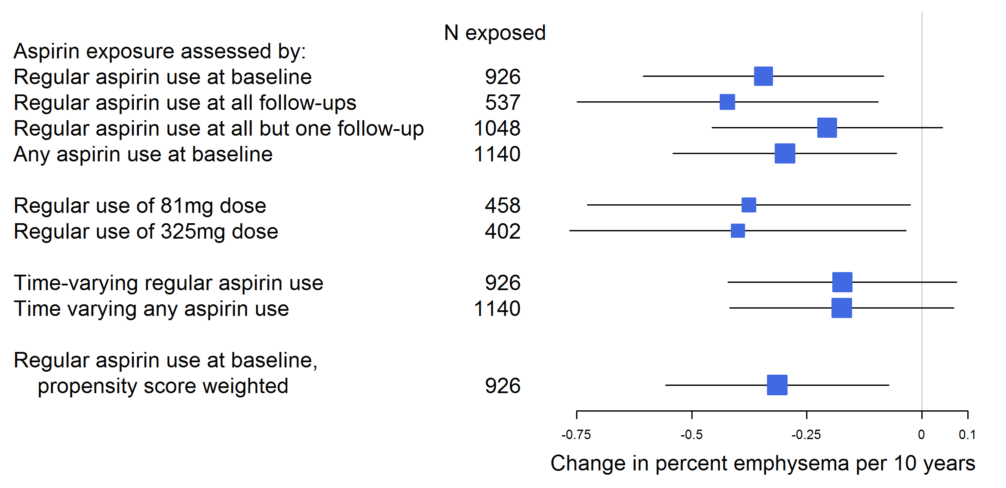
Association of Different Aspirin Exposures with Change in % Emphysema
Analyses adjust for baseline age, sex, race/ethnicity, education, pack-years, hypertension, ACE-inhibitor or ARB use, C-reactive protein, sphingomyelin and time-varying height, weight, cigarettes per day, scanner model, mAs and voxel size

Slide 15
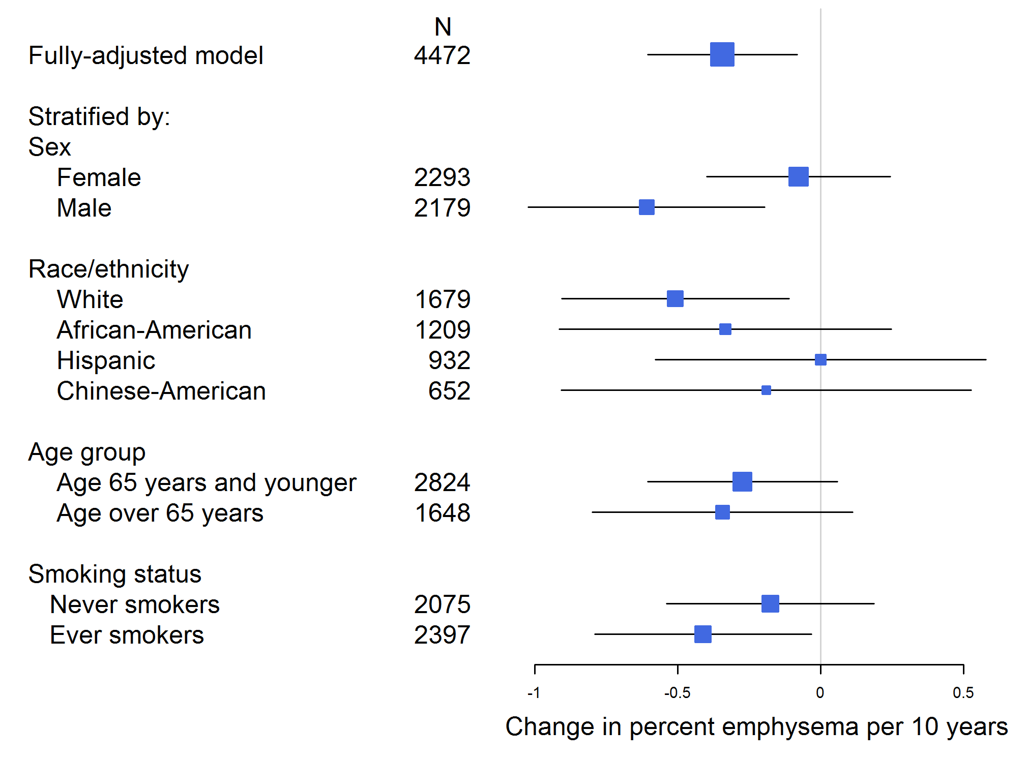
Association of Aspirin Use with Change in % Emphysema in Subgroups

Slide 16
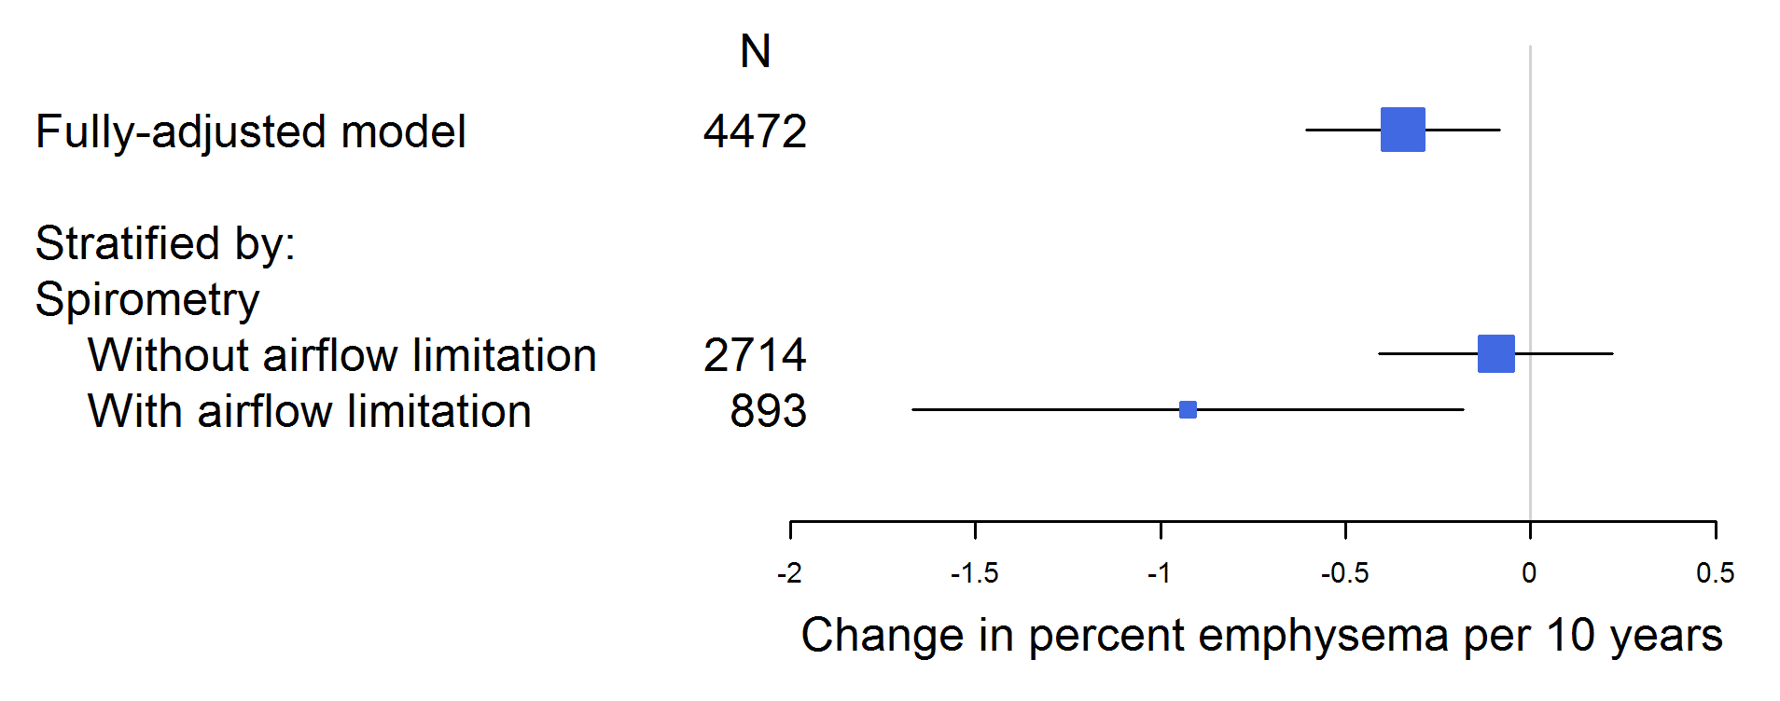
Association of Aspirin Use with Change in % Emphysema by Airflow Limitation
Results were stronger in those with airflow limitation
No change after further adjustment for use of other NSAIDs, COX-2 inhibitors, ADP-inhibitors, statins or diuretics

Slide 17
Limitations
Regular aspirin use was self-reported
Percent emphysema was assessed in partial lung scans in 2000-07
Differences in scanner models and protocols across 10 years of follow-up

Slide 18
Conclusions
Regular aspirin use at baseline was associated with a slower progression of percent emphysema over 10 years
Greater magnitude results seen in those with airflow limitation
Further studies of aspirin as a preventative or therapeutic strategy in emphysema may be warranted

Slide 19
Acknowledgements
R. Graham Barr, MD, DrPH
Joseph Schwartz, PhD
Eric Hoffman, PhD
John Austin, MD
David R. Jacobs, Jr, PhD
Joel D. Kaufman, MD
Lewis J. Smith, MD
Karol E. Watson, MD, PhD
Russell P. Tracy, PhD
- Lung
Funding: NIH R01 HL77612, RC1 HL100543, R01 HL75476, R01-HL093081, N01-HC-95159 through N01-HC-95169, UL1-TR000040; EPA R830543, R831697

