Slide 1

MESA Early Heart Failure Study 2020 Update
Sanjiv Shah / Alain Bertoni
Northwestern/ Wake Forest

Slide 2
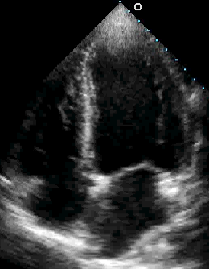
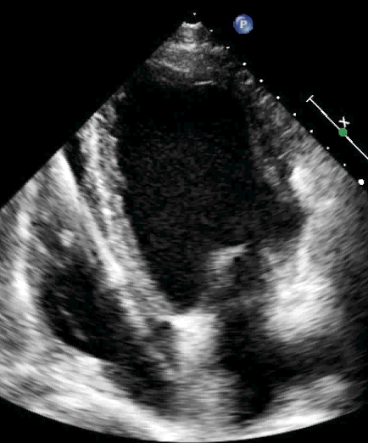
HFpEF vs. HFrEF
HFpEF
Heart failure with preserved ejection fraction
“Diastolic HF”
HFrEF
Heart failure with reduced ejection fraction
“Systolic HF”
Left
ventricle
Left
ventricle
Poorly understood
Increasing in prevalence
No definitive treatments
High morbidity/mortality
Well studied
Decreasing in prevalence
Many proven treatments
Decreasing morbidity
Decreasing mortality

Slide 3
What is early heart failure?
CLINICAL, SYMPTOMATIC HEART FAILURE IS A SPECTRUM
Depends on: (1) type of clinical presentation; (2) MD threshold to hospitalize the patient vs. outpatient treatment
OUTPATIENT
Dyspnea on exertion due to myocardial problem with evidence of ⬇cardiac output and/or
⬆LV filling pressures at rest or with exertion
INPATIENT
CHF hospitalization due to overt volume overload and/or low output state
CLINICAL SPECTRUM
Traditional HF endpoint in epidemiology studies
Potentially underdiagnosed
“early heart failure”

Slide 4
What is early heart failure?
Definition of early HF:
  No prior HF hospitalization and
  Presence of HF symptoms or functional limitation suggestive of HF and
  NTproBNP or echo evidence of elevated LV filling pressure (at rest or with passive leg raise – preload increase maneuver)
  We anticipate that most cases of early HF in MESA are early HFpEF
Notes:
Definition of early HF: We will define early HF based on the combination of: (1) symptoms and signs of HF and (2) objective abnormalities of cardiac structure and/or function on echocardiography. We utilized the Kansas City Cardiomyopathy Survey to identify symptoms of HF in study participants. Signs of HF will include 6MWT distance significantly below age- and gender-specific norms; elevated NT-proBNP; and echocardiographic signs of HF, including elevated left atrial pressure (E/e’ ratio) or right atrial pressure (size and collapsibility of the inferior vena cava); increased pulmonary artery systolic pressure; and/or reduced cardiac output (estimated using the LV outflow tract velocity-time integral). Abnormalities in cardiac structure and function on echocardiography will include cardiac chamber dilation, LV or RV systolic dysfunction, LV hypertrophy, LV diastolic dysfunction, and/or overt LV systolic dysfunction (i.e,. reduced LVEF).

Slide 5
MESA Heart Failure Study (Shah/Bertoni PIs)
Specific Aims:
Aim 1 (Prevalence): Determine the prevalence of early HF
Aim 2 (Pathogenesis): Examine associations between risk factors, biomarkers, and changes in risk factors with early HF and its pathophysiologic markers:
  Cardiac mechanics
  Ventricular-arterial coupling
  Myocardial pressure-stress relationships
Aim 3 (Phenomics): Perform machine learning analyses of previously ascertained MESA quantitative data and relate risk factor phenotypic signatures to pathophysiologic markers and HF subtypes
All participants, all 6 sites:
Questionnaires:
  KCCQ
6MWT
Laboratory: NTproBNP, Olink CVD3 proteomics
Echocardiography
  GE Vivid T8 2D, Doppler, speckle-tracking
    Resting echo
    Passive leg raise maneuver
Arterial tonometry
  Fukuda VaSera
    Pulse-wave velocity
    Augmentation index
    Arterial waveform
Substudy:
Cardiopulmonary exercise test

Slide 6
MESA Exam 6: Final
Heart Failure Study Components
Site | Selected | Echo | Arterial Stiffness | Physical Activity | KCCQ-12 | 6MWT
3: Wake Forest | 414 | 307 | 309 | 361 | 361 | 300
4: Columbia | 631 | 551 | 549 | 557 | 557 | 458
5: Johns Hopkins | 450 | 419 | 418 | 423 | 423 | 349
6: Minnesota | 568 | 547 | 525 | 555 | 555 | 447
7: Northwestern | 658 | 649 | 634 | 647 | 653 | 509
8: UCLA | 573 | 548 | 534 | 554 | 553 | 495
Total | 3294 100% | 3021 92% | 2969 90% | 3097 94% | 3102 94% | 2558 78%
CPET (Wake Forest only): n=135

Slide 7
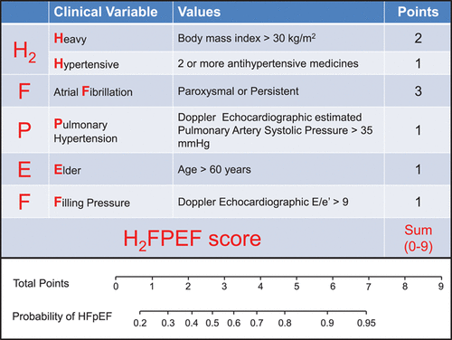
Diagnosis of HFpEF
H2FPEF SCORE
We defined AF based on ECG on echo or absence of A waves on mitral inflow (need to update to include all AF)
Reddy Y, et al. Circulation 2018

Slide 8
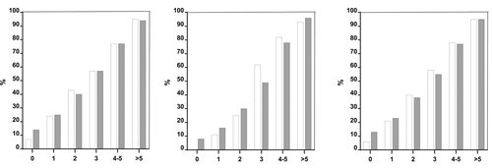
Diagnosis of HFpEF
H2FPEF SCORE
DERIVATION
VALIDATION
COMBINED
H2FPEF SCORE
H2FPEF SCORE
H2FPEF SCORE
Observed HFpEF prevalence
Model-predicted HFpEF probability
Reddy Y, et al. Circulation 2018

Slide 9
Distribution of H2FPEF score in MESA
H2FPEF Score | N | Percent | Cum.
0 | 6 | 0.19 | 0.19
1 | 426 | 13.24 | 13.4
2 | 765 | 23.77 | 37.2
3 | 813 | 25.26 | 62.5
4 | 584 | 18.15 | 80.6
5 | 407 | 12.65 | 93.3
6 | 187 | 5.81 | 99.1
7 | 12 | 0.37 | 99.4
8 | 7 | 0.22 | 99.7
9 | 11 | 0.34 | 100
Total | 3218
Score Groups | Freq. | Percent | Cum.
0-4 | 2,594 | 80.6 | 80.6
5 (prob 80%) | 407 | 12.7 | 93.3
6-9 (prob 90%+) | 217 | 6.7 | 100
Total | 3,218 | 100

Slide 10
MESA Early Heart Failure Algorithm

Slide 11
Kansas City Cardiomyopathy Questionnaire Short Version (KCCQ-12)
KCCQ: 23-item questionnaire designed to capture HF symptoms and QOL limitations
Short version (KCCQ-12; Spertus & Jones 2015) has good psychometric properties
  Score ranges from 0-100 (0=worst, 100=best)
Minimal clinically important difference: 5 points
 | Stable HF |  | Clinic Visit HF
NYHA Class | N | Mean (SD) | N | Mean (SD)
I | 310 | 86 (15) | 29 | 80 (15)
II | 267 | 73 (19) | 115 | 69 (20)
III | 80 | 50 (21) | 115 | 51(22)
IV | 7 | 29 (29) | 14 | 28(25)

Slide 12
KCCQ-12 summary score results
Age Categories | Mean KCCQ-12 score
 | Female | Male
55-64 | 92.1 | 93.6
65-74 | 90.7 | 94.3
75-84 | 87.0 | 90.7
>=85 | 82.4 | 87.2
MESA Exam 6 KCCQ-12 summary score: mean 90.4, SD 13.8
KCCQ-12 summary score <80: 15% prevalence
KCCQ-12 summary score <85: 20% prevalence

Slide 13
6MWT distance distribution
N=2531
Mean age 74 years, 53% female, 40% White, 13% Chinese, 25% Black, 22% Hispanic
            Mean distance: 410 meters (SD 96)
            25th percentile: 348 meters
            Median: 410 meters
            75th percentile 476 meters

Slide 14
CHS formula for 6MWD
Reference equation for 6MWD from healthy subset of CHS [Enright et al, Chest 2003]
For the total distance walked in meters:
  Women: 493 + (2.2 × height [cm]) − (0.93 × weight [kg]) − (5.3 × age)
  Men: same formula except add 17 meters to the calculated value
  Subtract 100 meters from the calculated value for the lower limit of the normal range

Slide 15
NTproBNP
In MESA Exam 6 participants, NTproBNP was assayed using standard ELISA assay (n=1000) and Olink CVD3 proteomic panel (proximity extension assay) (n=3300) and expressed in log₂ Normalized Protein eXpression (NPX) units
Regression between the two used to estimate NTproBNP level for the entire sample in standard units (pg/ml)

Slide 16
NTproBNP
Regression equation:
Estimated NTproBNP = e^{((0.82*Olink NTproBNP) – 0.68)}

Slide 17
MESA Early Heart Failure Algorithm
START
N=3022
NO early
HF
Prior history of HF hospitalization
YES
Overt HF
N=69
NO
N=602 with either KCCQ-12 < 80 or 6MWD < CHS lower limit
KCCQ12<80: n=442 (15%)
Abnormal 6MWD: n=225 (9%)
Symptoms of HF/dyspnea on KCCQ or PROMIS-Dyspnea or 6MWT below age-/gender-cut-offs (limited by dyspnea or fatigue)
NO
YES
History of chronic lung disease or prior abnormal PFTs
19.5%
of entire sample
NTproBNP > 250 pg/ml
YES
NO
E/e’ > 15 (septal) or
E/e’ > 10 (lateral) or
LA vol. index > 28 ml/m² or
LVEF < 40%
YES
NO
59%
of entire sample
YES
Possible early HF
Early HF
NO
During leg-raise:
E/e’ > 15 (septal) or
E/e’ > 10 (lateral) or
LA peak positive strain
< 10% increase compared to resting values
EF < 50%
EF > 50%
50%
of entire sample
YES
Early HFrEF
Early HFpEF
NO

Slide 18
Results
From N=3303, excluded:
  N=69 with previously adjudicated HF
  N=256 without echocardiogram
  N=7 without both KCCQ-12 and 6MWT
  Final sample: N=2956
Algorithm resulted in 602 potential early HF based on KCCQ12 and 6MWD:
  N=115 did not meet NTproBNP/echo criterion
  N=489 met criterion for HF
Final: N=472 (16%) HFpEF, N=15 (0.5%) HFrEF, N=2469 (83%) no early HF

Slide 19
Results in context
Current estimate of HF prevalence in US:
  N=6.5 million, of which ~50% have HFpEF
  HFpEF prevalence N=3.25 million
    1% of the overall US population
    4.7% of US population age > 60 years (68.7M in 2016)
H2FPEF score 5 or higher: 12.7% in MESA
  Est. US prevalence of early HFpEF: n=8.72 million
MESA Early HF algorithm: 16% in MESA
  Est. US prevalence of early HFpEF: 10.9 million
There may be up to ~10 million undiagnosed HFpEF patients in the US

Slide 20
Characteristics by HF status
Characteristic | No HF | HFrEF | HFpEF | P-value
 | N=2,469 | N=15 | N=472
Age | 73.1 | 83.5 | 75.7 | *
Female | 51% | 33% | 64% | *
White | 41% | 33% | 33% | *
Chinese | 14% | 0% | 13%
Black | 24% | 27% | 29%
Hispanic | 21% | 40% | 25%
HTN | 63% | 87% | 80% | *
Diabetes | 22% | 40% | 33% | *
Obese (BMI>30) | 32% | 40% | 42% | *
Mod+Vig PA MET-min | 5488 | 2273 | 3089 | *
Ejection Fraction | 62% | 41% | 63%
Mean Olink BNP | 4.48 | 7.25 | 5.19 | *
KCCQ12 | 94.8 | 62.9 | 70.5 | *
6MWD, N | 2137 | 5 | 298
6MWD, Meters | 426 | 292 | 303 | *
* p-value<0.01

Slide 21
Early HF and general health
GENERAL | No HF | HFrEF | HFpEF
HEALTH
EXCELLENT | 331 | 0 | 17
% | 13.4 | 0 | 3.6
VERY GOOD | 967 | 1 | 72
% | 39.2 | 6.7 | 15.3
GOOD | 858 | 7 | 204
% | 34.8 | 46.7 | 43.2
FAIR | 295 | 6 | 156
% | 12.0 | 40.0 | 33.1
POOR | 17 | 1 | 23
% | 0.7 | 6.7 | 4.9
Total | 2,468 | 15 | 472
Participants classified as early HF less likely to
report Excellent or Very Good health

Slide 22
Early HF and lung disease
Spirometry | Not HF | HFrEF | HFpEF | Total
normal | 1,273 | 4 | 186 | 1,463 (60%)
% | 62.0 | 40.0 | 49.2
obstructive | 551 | 5 | 127 | 683 (30%)
% | 26.8 | 50.0 | 33.6
restrictive | 231 | 1 | 65 | 297 (10%)
% | 11.2 | 10.0 | 17.2
Total | 2,055 | 10 | 378 | 2,443
Lung disease based on Exam 6 spirometry
used FEV1 and FVC to categorize
Lung disease and HF overlap is substantial

Slide 23
H2FPEF vs. MESA Early HF algorithm
H2FPEF score | Early HF
 | None | HFrEF | HFpEF
0-4 | 2064 | 9 | 333
 | 83.6% | 60.0% | 70.6%
5 | 283 | 2 | 82
 | 11.5% | 13.3% | 17.4%
6-9 | 122 | 4 | 57
 | 4.9% | 26.7% | 12.1%
Approximately 2/3rds of sample is low risk/not early HF
but otherwise there was not close overlap of 2 schemes

Slide 24
Next steps
Examine different cut points for 6MWD and KCCQ12
Add AF information (refine H2FPEF score)
Apply the European Society of Cardiology HFA-PEFF diagnostic algorithm (published in 2019)
  Relies exclusively on echo parameters and NTproBNP levels (with different cut-points for sinus rhythm vs. AF)
Once “final” definition of early HF, utilize CPET data to validate various definitions
Investigate association of “the usual suspects” - race/ethnicity, SES, health habits, obesity, HTN, diabetes, with early HF
Examine proteomic differences between no early HF vs. early HFpEF

