Slide 1
Defining “Normal,”
Scientific Racism,
and Lung Function
R Graham Barr, MD DrPH
Pallavi Balte, MD PhD
Elizabeth Oelsner, MD MPH
Ben Smith MD, MS
Departments of Medicine and Epidemiology
Columbia University Medical Center
Funding: NHLBI R01-HL077612, R01-HL130506
Lung

Slide 2
Outline
Brief history of spirometry and reference equations
Moving beyond race-based reference equations

Slide 3
Approaches to Define “Normal”
Equations derived in “healthy” group
Risk-based
  Inflection point in risk
  Model-based risk estimate
Treatment-based

Slide 4
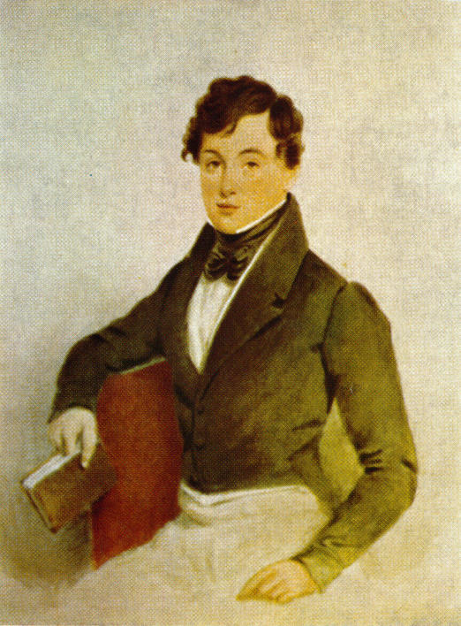
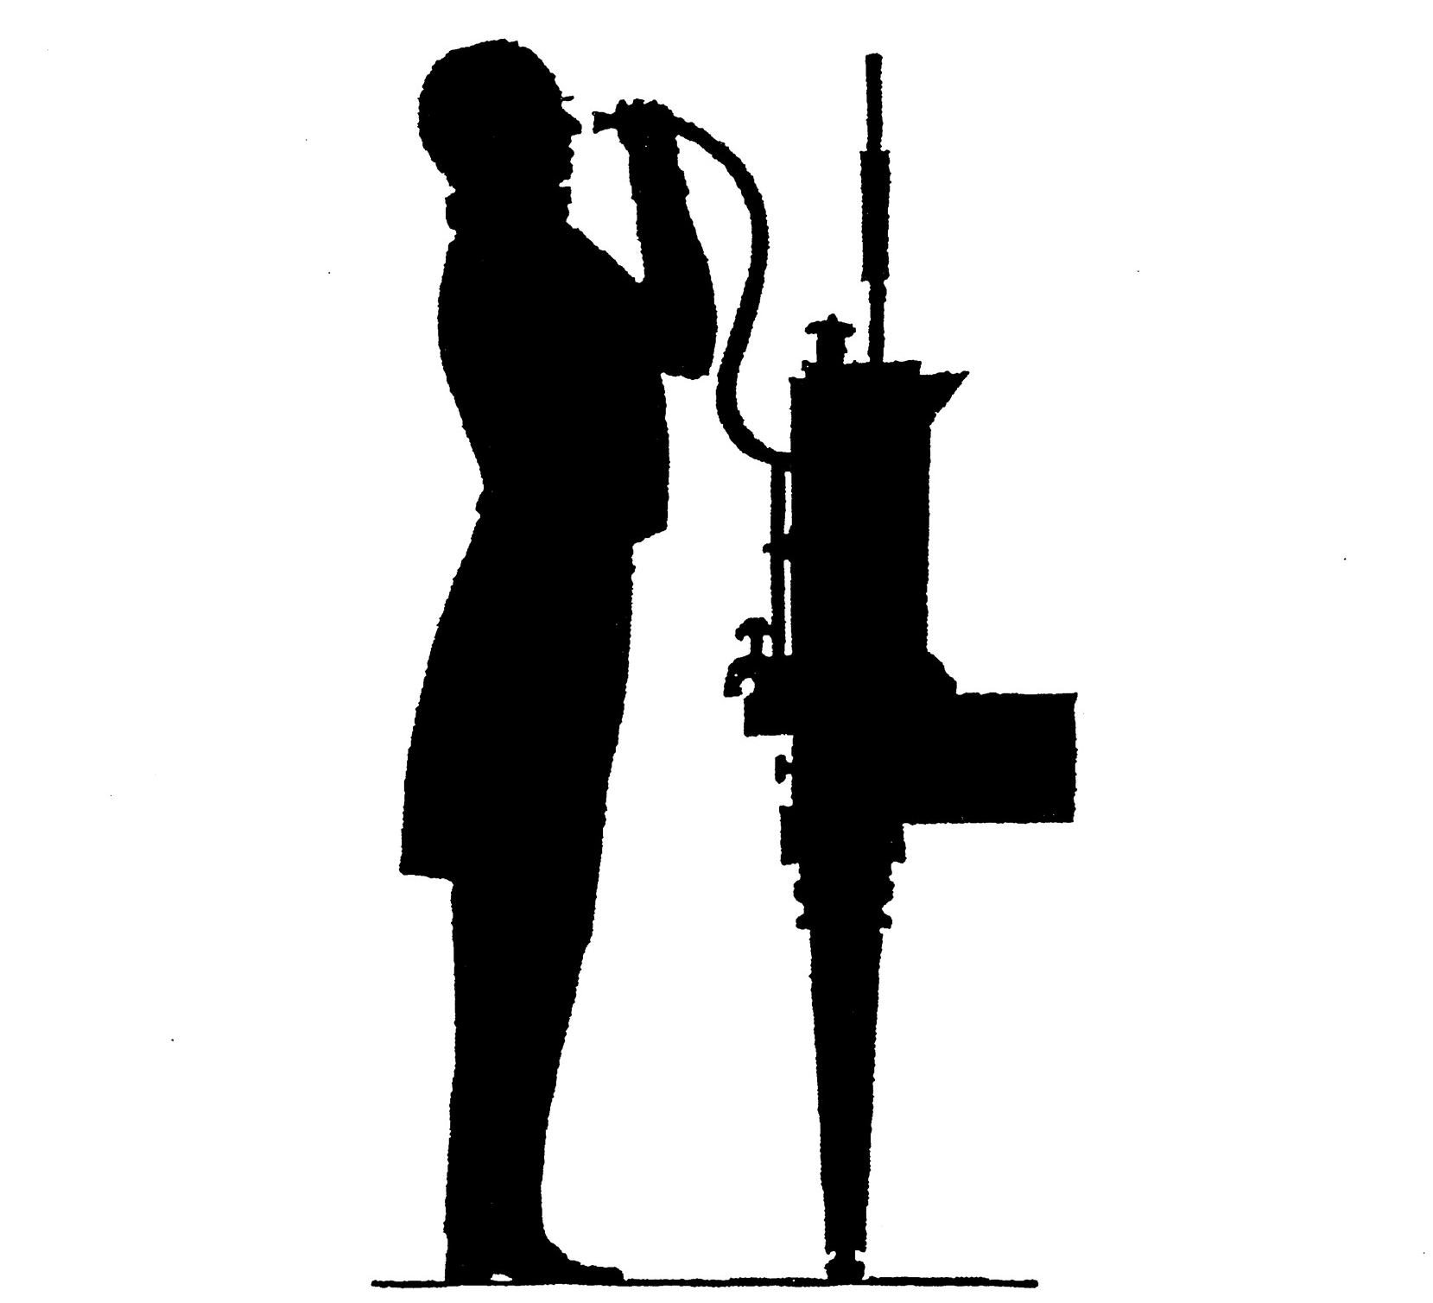
Invention of the Spirometer
  Vital Capacity (VC)
    Linear relation to age, height
    No relation to weight, chest circumference
    Lower disease, in paupers… ?due to “poor-house diet”
Hutchinson, Stats Soc, 1844
Notes:
NOT MENTIONED BY OSLER

Slide 5
Early Medicalized Racism
Thomas Jefferson and Samuel Cartwright MD wrote of a “difference in the pulmonary apparatus” to justify slavery
Vital capacity in US military, 1869
Jefferson, Notes on the State of Virginia, 1787
Cartwright, New Orleans Med Surg J, 1851.
Gould B. Investigations in the Military and Anthropological Statistics of American Soldiers, 1869.

Slide 6
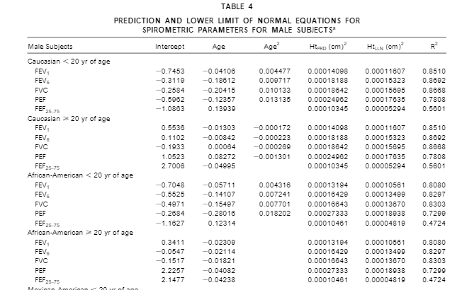
US Reference Equations (NHANES)
Hankinson, Am J Respir Crit Care Med,1999.

Slide 7
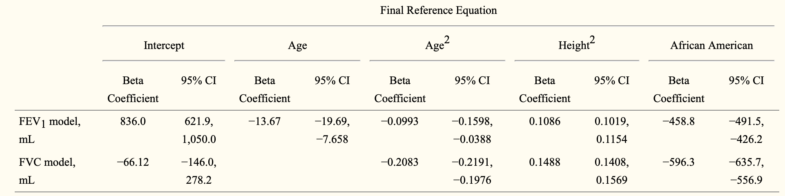
Avoiding “Separate but Equal” Reference Equations (NHANES)
FEV1 predicted from 1999 NHANES equation for white women (circles) and NHANES-derived equation for women, additive scale (squares).
Replicated in MESA Lung
Kiefer, Am J Epidemiol, 2011

Slide 8
Global Lung Initiative
Men
Women
Cooper, Breathe, 2019
Notes:
NOT MENTIONED BY OSLER

Slide 9
% Predicted FVC Distribution and Mortality by Race (ARIC)
Race-specific equations
One equation (ignores race)
Burney, Int J Epidemiol 2011

Slide 10
Conclusions
Long history of scientific racism and lung function
Reference equations for lung function derived in “healthy” groups suggest race/ethnic differences in lung “function” (actually volumes)
Risk-based evaluation suggests that race-based equations misclassify risk
Notes:
Keep for a back up slide and/or be ready to answer this question.

Slide 11
Hypothesis
Percent of predicted lung function predicts risk of incident chronic lower respiratory disease (CLRD) events
Inclusion of terms for self-reported race/ethnicity does not improve prediction of CLRD events
Notes:
Keep for a back up slide and/or be ready to answer this question.

Slide 12
Methods
MESA Lung spirometry
  Exam 3-4; 2004-06
CLRD events (primary or secondary hospitalization for COPD or asthma exacerbation) adjudicated, 2004-2018
Self-reported race/ethnicity coded following 2000 Census approach
Hankinson, Chest, 2010
Oelsner, Ann ATS, 2016
Notes:
Keep for a back up slide and/or be ready to answer this question.

Slide 13
Reference Equations
Race/ethnic-specific (NHANES III) equations
  %pred FEV1_{white} = 0.5536 - 0.01303(age) - 0.000172(age²) + 0.00014098(ht²)
  %pred FEV1_{black} = 0.3411 - 0.02309(age) + 0.00013194(ht²)
  %pred FEV1_{hispanic} = 0.6306 - 0.02928(age) + 0.00015204(ht²)
  %pred FEV1_{asian} = 0.88(0.5536 - 0.01303(age) - 0.000172(age²) + 0.00014098(ht²))
Single equation for all race/ethnic groups
  %pred FEV1_{all} = 0.5536 - 0.01303(age) - 0.000172(age²) + 0.00014098(ht²)
Hankinson, Am J Respir Crit Care Med,1999
Hankinson, Chest, 2010
Notes:
Keep for a back up slide and/or be ready to answer this question.

Slide 14
Statistical Analysis
Descriptive statistics by standard, race/specific equations and single equation
Cox proportional hazards models
  Age used as time with left truncation at age at lung function measurement
  Crude analyses
  Adjusted model: BMI, educational attainment, smoking status, pack-years, blood pressure, HDL, LDL, total cholesterol, fasting blood glucose, history of hypertension and diabetes
Notes:
Keep for a back up slide and/or be ready to answer this question.

Slide 15
Baseline Characteristics (N=3937)
 | White (N=1,422) | Asian (N=625) | Black (N=1,012) | Hispanic (N=878)
Age, mean | 66 | 65 | 66 | 64
Height (cm) , mean | 169 | 162 | 168 | 162
Weight (lb) , mean | 176 | 139 | 186 | 170
BMI (kg/m²), mean | 28.0 | 24.0 | 29.8 | 29.4
Women, % | 49 | 49 | 51 | 51
Smoking status, %
Never | 39 | 70 | 40 | 47
Former | 52 | 25 | 46 | 44
Current | 9 | 5 | 14 | 9
Pack-years, median | 16 | 24 | 24 | 19

Slide 16
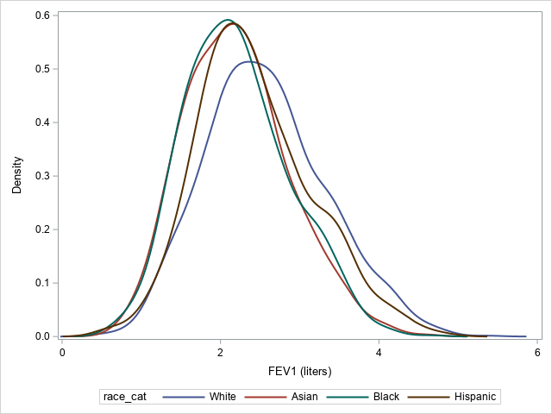
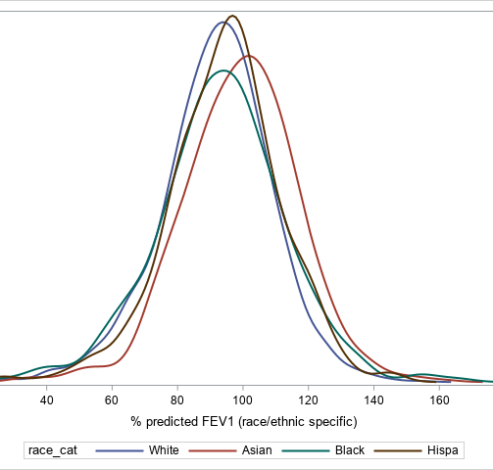
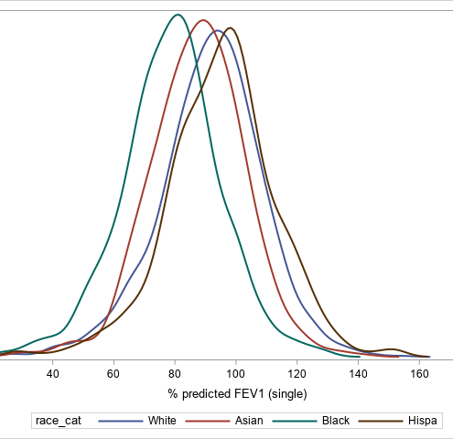
Distribution of FEV1 by Race/ethnicity
%predicted FEV1, race-specific equations
%predicted FEV1, single equation
FEV1 (L)
Notes:
Keep for a back up slide and/or be ready to answer this question.

Slide 17
Lung Function and Incident CLRD Stratified by Race/ethnicity
 | White | Asian | Black | Hispanic
At risk | 1,367 | 617 | 979 | 854
IDR/10,000 py | 90 | 53 | 93 | 76
 | HR (95% CI) | HR (95% CI) | HR (95% CI) | HR (95% CI)
% predicted FEV1/ SD
Race/ethnic specific | 0.44 (0.37, 0.53) | 0.58 (0.42, 0.80) | 0.49 (0.39, 0.60) | 0.40 (0.31, 0.52)
Single | - | 0.58 (0.42, 0.80) | 0.49 (0.39, 0.60) | 0.39 (0.30, 0.50)
% predicted FVC/ SD
Race/ethnic specific | 0.60 (0.50, 0.73) | 0.77 (0.55, 1.08) | 0.67 (0.54, 0.85) | 0.50 (0.38, 0.65)
Single | - | 0.77 (0.55, 1.07) | 0.67 (0.54, 0.86) | 0.50 (0.38, 0.65)

Slide 18
Prediction of Incident CLRD
Stratified by Race/ethnicity
 | Lung Function Measure | C-stat for Reference Equation |  | P-value
 |  | Race/ethnic-Specific | Single
White | %pred FEV1 | 0.75 | - | -
 | %pred FVC | 0.67 | - | -
Asian | %pred FEV1 | 0.68 | 0.68 | 0.91
 | %pred FVC | 0.52 | 0.52 | 0.91
Black | %pred FEV1 | 0.66 | 0.67 | 0.46
 | %pred FVC | 0.58 | 0.58 | 0.60
Hispanic | %pred FEV1 | 0.76 | 0.74 | 0.44
 | %pred FVC | 0.70 | 0.68 | 0.44

Slide 19
Prediction of Incident CLRD Unstratified (all)
Lung Function Measure | C-statistic for Reference Equation |  | P-value
 | Race/ethnic-specific | Single
Unadjusted
%pred FEV1 | 0.71 | 0.71 | 0.84
%pred FVC | 0.62 | 0.62 | 0.93
Adjusted
%pred FEV1 | 0.75 | 0.77 | 0.77
%pred FVC | 0.72 | 0.72 | 0.52
Adjusted for BMI, educational attainment, smoking status, smoking pack-years, systolic and diastolic blood pressure, HDL, LDL, total cholesterol, fasting blood glucose levels, and history of hypertension and diabetes

Slide 20
Prediction of All-cause Mortality Unstratified (all)
Lung Function Measure | C-statistic for Reference Equation |  | P-value
 | Race/ethnic-specific | Single
Unadjusted
%pred FEV1 | 0.55 | 0.54 | 0.12
%pred FVC | 0.55 | 0.53 | 0.03
Adjusted
%pred FEV1 | 0.71 | 0.71 | 0.67
%pred FVC | 0.71 | 0.71 | 0.25
Adjusted for BMI, educational attainment, smoking status, smoking pack-years, systolic and diastolic blood pressure, HDL, LDL, total cholesterol, fasting blood glucose levels, and history of hypertension and diabetes

Slide 21
Limitations
Initial analyses
Modest sample size, particularly for Asians
Not stratified by sex
Notes:
Keep for a back up slide and/or be ready to answer this question.

Slide 22
Conclusions
Reference equations for lung function derived in “healthy” groups suggest race/ethnic differences in lung “function” that misclassify risk
Race-specific reference equations do not improve prediction of incident lung disease or mortality beyond a single reference equation

Slide 23

Acknowledgements
MESA investigators, staff and participants!!!
R01-HL077612, R01-HL093081
Lung

