Slide 1
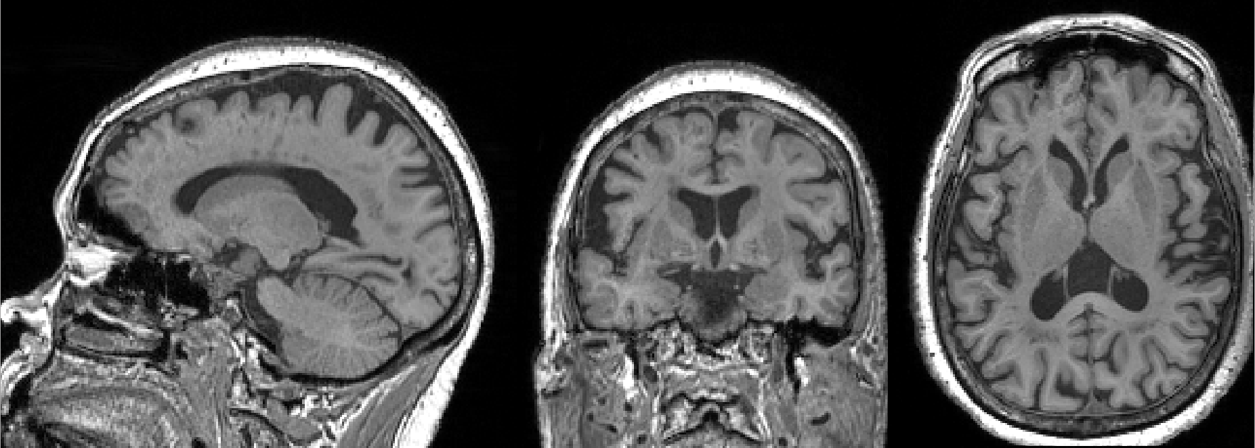

Cardiovascular Disease Risk Factors and Brain MRI Measures: the Multi-Ethnic Study of Atherosclerosis

Slide 2
Writing Group
Thomas R. Austin
R. Nick Bryan
Lin Yee Chen
Christos Davatzikos
Lisa M. Desiderio
Guray Erus
Philip Greenland
Mohamad Habes
Barbara N. Harding
Timothy M. Hughes
W.T. Longstreth Jr.
Ilya M Nasrallah
Wendy Post
Steven J. Shea
Susan R. Heckbert

Slide 3
Background
Traditional CVD risk factors—age, hypertension, smoking, diabetes, physical activity— are associated with low gray matter volume and high white matter (WM) lesion volume
Most studies include Whites only
Clinically-detected atrial fibrillation (AF) is associated with accelerated cognitive decline, but little information about subclinical AF and brain morphologic changes is available

Slide 4
Research Questions
Are traditional CV risk factors associated with brain volumes and with three measures of WM injury?
Is clinically- and/or monitor-detected AF associated with the same brain MRI measures?

Slide 5
Exposures: Analysis 1
Traditional CV risk factors
Age
Body Mass Index
Smoking Status
HDL & LDL Cholesterol
Kidney Function - eGFR
Systolic BP
Hypertension Medication
Diabetes

Slide 6
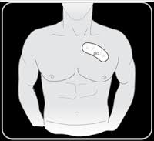
Exposures: Analysis 2
(N = 120)
AF: Prevalent atrial fibrillation or flutter
Clinically-detected up to E6 (diagnosis codes, Medicare claims, or self-report) OR Zio Patch-detected E6, up to 28-day monitoring
  Intermittent: prevalent AF but not continuous on Zio Patch (N=100)
  Continuous: prevalent AF, 100% of time on Zio Patch (N=20)

Slide 7
Analysis Sample
N | 1,032
Female (%) | 53
Age, yrs, mean(SD) | 73 (8)
Race/Ethnicity
White (%) | 40
Chinese-American (%) | 15
African-American (%) | 25
Hispanic (%) | 20
Cigarette Use
Never (%) | 48
Former (%) | 46
Current (%) | 6
BMI, mean(SD) | 28 (5)
HDL Cholesterol, mean(SD) | 60 (18)
LDL Cholesterol, mean(SD) | 107 (35)
Systolic BP, mmHg, mean(SD) | 127 (20)
Hypertension Medication (%) | 59
Diabetes (%) | 22
Prevalent AF (%) | 12
1,535 with E6 Patch Monitoring
Median interval between patch monitoring & brain MRI: 17 months
1,061 with Brain MRI
Analysis Sample
1,032 with complete covariate data

Slide 8
Outcomes: Brain Volumes
Volume Measures
Total Brain Volume (gray matter + white matter) (mL)
Total Gray Matter Volume (mL)
Total White Matter Volume (mL)

Slide 9
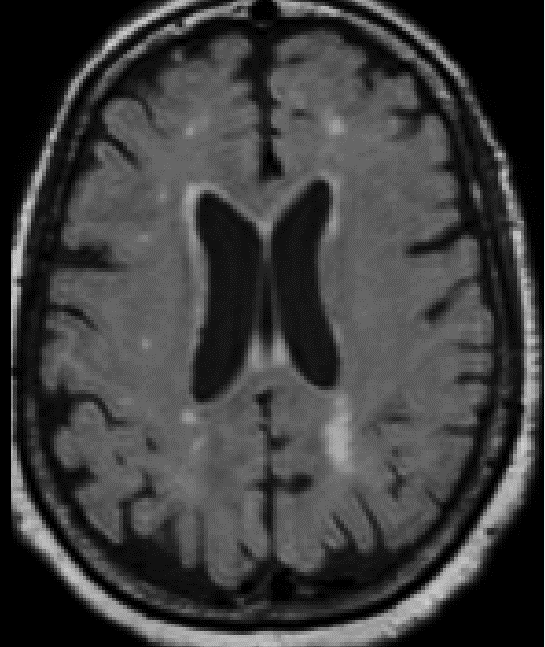
Outcomes: Brain MRI Measures
Measures of White Matter Injury
Total WM Lesion Volume (mL)
Total WM Fractional Anisotropy (FA)
Total WM Apparent Diffusion Coefficient (ADC)

Slide 10
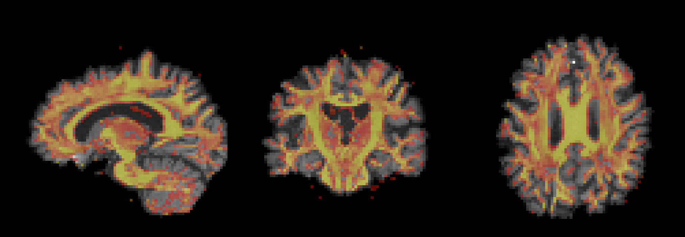
Outcomes: Brain MRI Measures
Measures of White Matter Injury
Total WM Lesion Volume (mL)
Total WM Fractional Anisotropy (FA)
Total WM Apparent Diffusion Coefficient (ADC)

Slide 11
Statistical analysis
Multivariable linear regression with robust standard errors
  WM lesion volume log-transformed
  FA and ADC standardized
  All models adjusted for MESA site
  Volume measures adjusted for total intracranial volume (ICV)

Slide 12
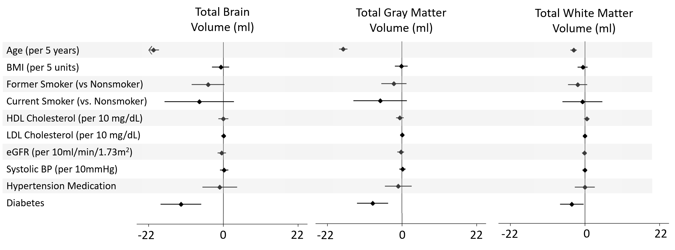
Results: CVD Risk Factors & Volumes (Multivariable*)
*regression models adjusted for all risk factors above in addition to sex, race/ethnicity, site, and total intracranial volume.

Slide 13
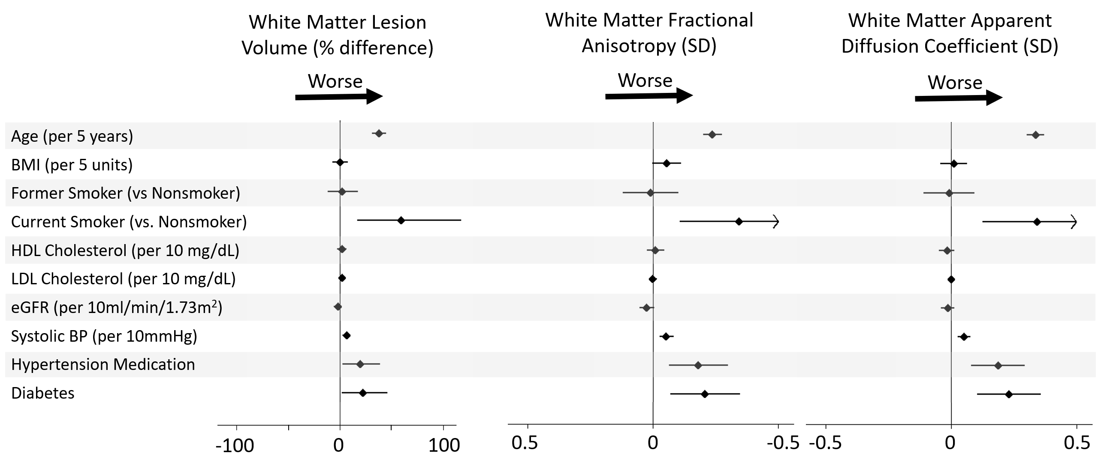
Results: CVD Risk Factors & WM Injury (Multivariable*)
* regression models adjusted for all risk factors above in addition to sex, race/ethnicity, site, and total intracranial volume (for WM lesion volume)

Slide 14
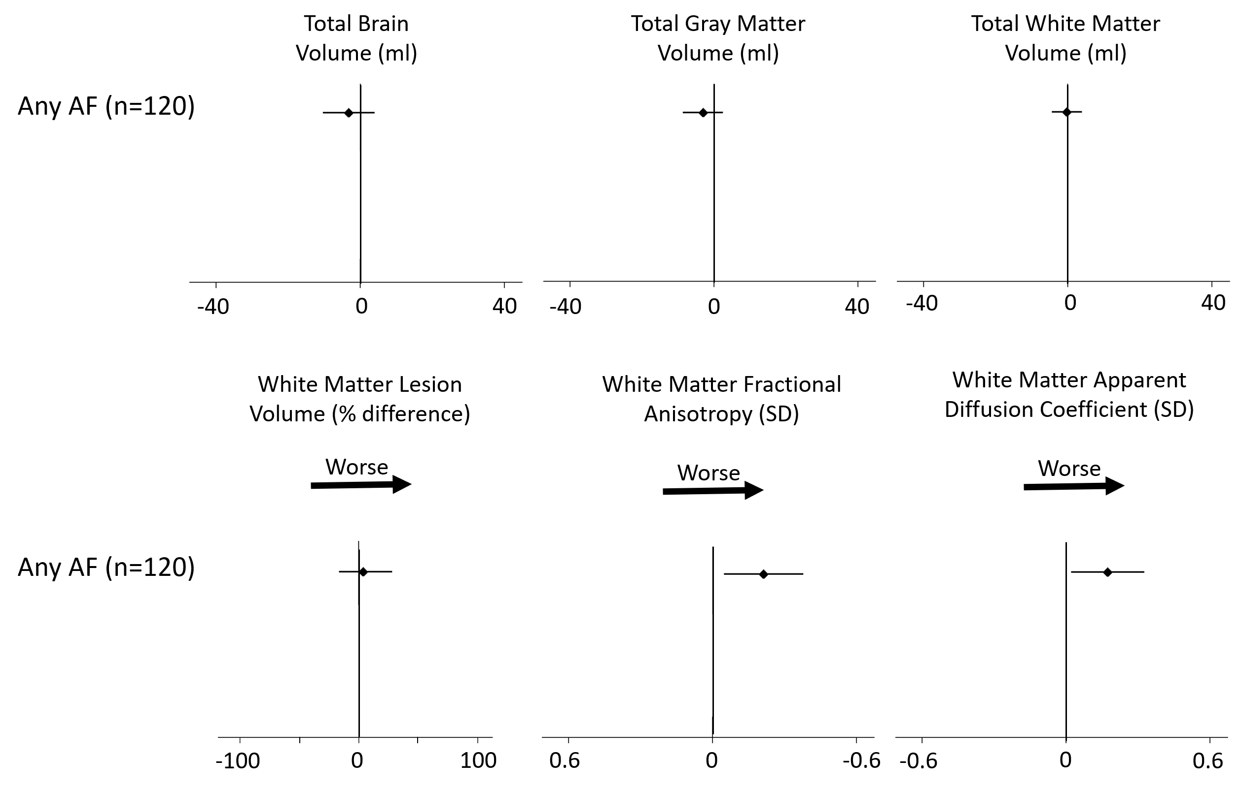
Analysis 2 Results: Atrial Fibrillation
Regression models adjusted for age, race/ethnicity, sex, site, BMI, smoking, HDL cholesterol, LDL cholesterol, eGFR, SBP, hypertension medication, diabetes status, and total intracranial volume (for volume measures)

Slide 15
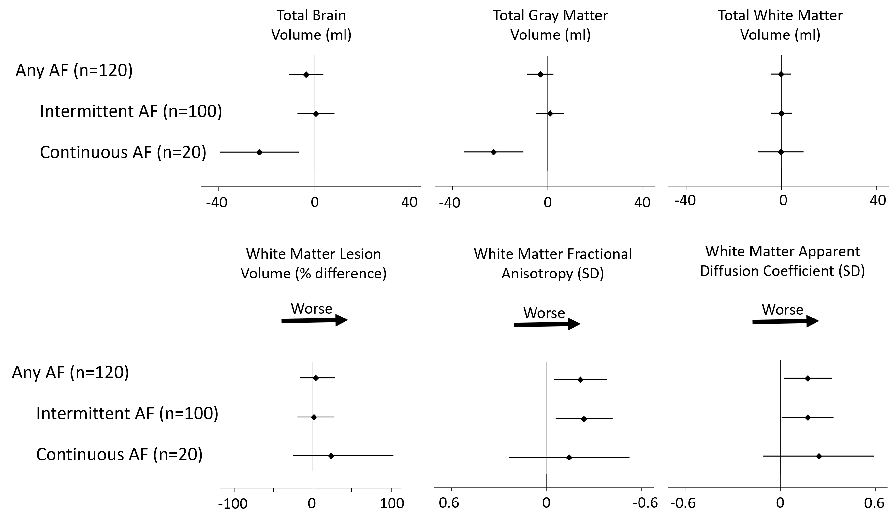
Analysis 2 Results: Atrial Fibrillation (cont.)
Regression models adjusted for age, sex, race/ethnicity, site, BMI, smoking, HDL cholesterol, LDL cholesterol, eGFR, SBP, hypertension medication, diabetes status, and total intracranial volume (for volume measures)

Slide 16
Limitations
Cross-sectional analyses
Imperfect AF ascertainment
Healthier subset of MESA participants
Residual Confounding

Slide 17
Conclusions
Age, current smoking, diabetes and hypertension associated with greater WM injury
  We did not detect an association between kidney function, cholesterol, or BMI and WM injury
AF associated with greater WM injury
Continuous AF associated with low gray matter volume

Slide 18
Relation to Existing Literature
Associations of brain volumes and white matter lesion volume with advanced age, hypertension, smoking, and diabetes are well-established
MESA data add to the growing literature on newer measures of WM injury
The findings related to AF and WM injury have not been seen in other cohorts.

Slide 19
Next Steps
Additional brain MRI measures
  Region-specific analyses
  Cerebral microbleeds
  Cerebral blood flow, vascular reactivity, functional connectivity, infarcts
  Computer-based pattern classification of brain atrophy: AD & brain aging indices
Additional exposures
  Supraventricular and ventricular ectopy on Zio Patch

Slide 20
Thank You!

Slide 21
Extra Slides

Slide 22
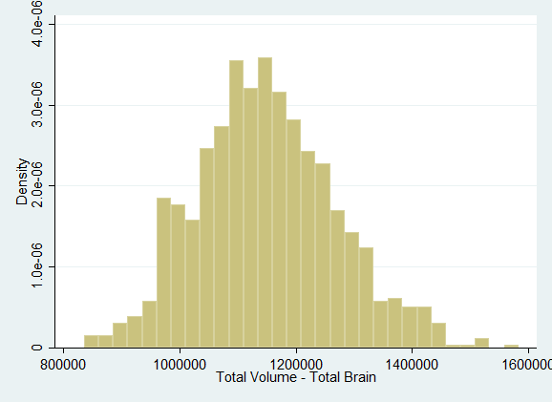
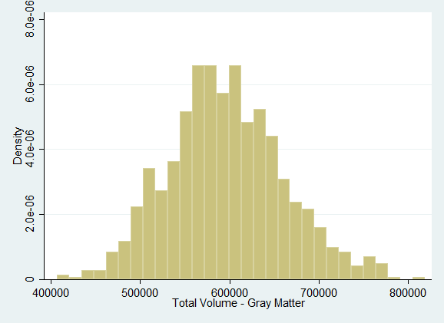
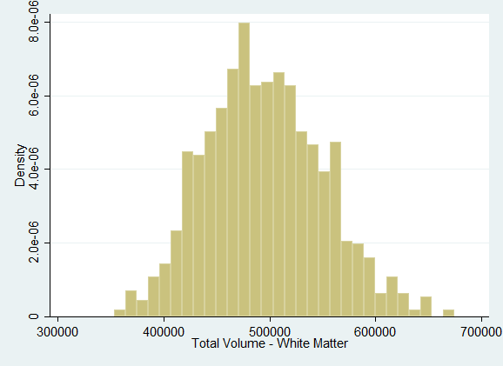
Brain MRI Measure Distributions
Total Gray Matter Volume (μl)
Total White Matter Volume (μl)
Total Brain Volume (μl)

Slide 23
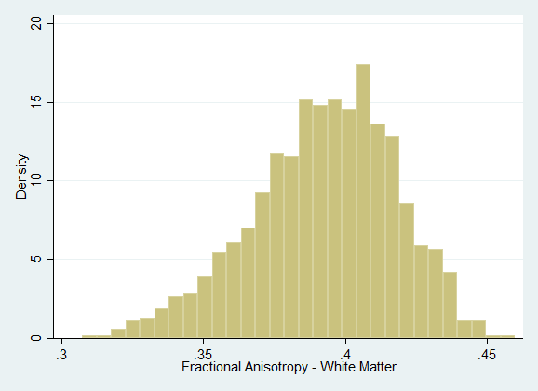
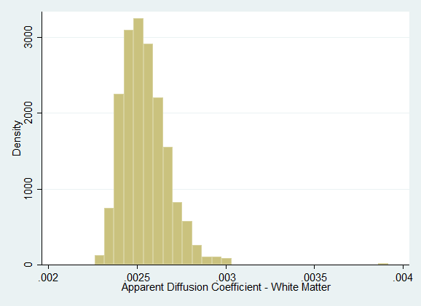
Brain MRI Measure Distributions (cont.)
Total White Matter Lesion Volume (μl)
White Matter Fractional Anisotropy
White Matter Apparent Diffusion Coefficient
Log-Transformed Total White Matter Lesion Volume

Slide 24
Correlation Between WM Injury Measures
FA & ADC
FA & WML Volume
ADC & WML Volume
Correlation Coefficient = -0.81
Correlation Coefficient = -0.48
Correlation Coefficient = 0.61

Slide 25
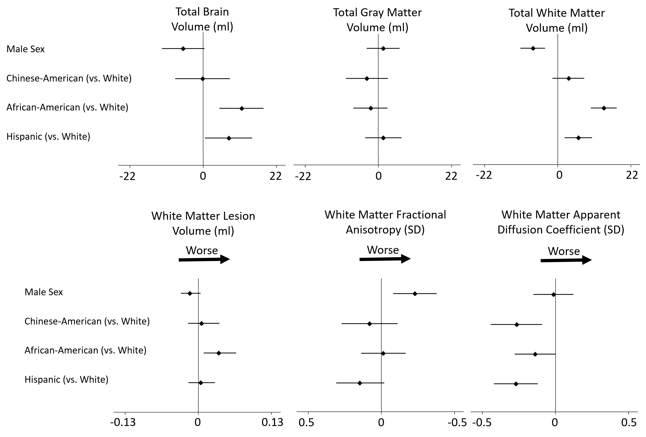

Gender and Race/Ethnicity in Multivariable Model
Regression models adjusted for age, race/ethnicity, sex, site, BMI, smoking, HDL cholesterol, LDL cholesterol, eGFR, SBP, hypertension medication, diabetes status, and total intracranial volume (for volume measures)

Slide 26
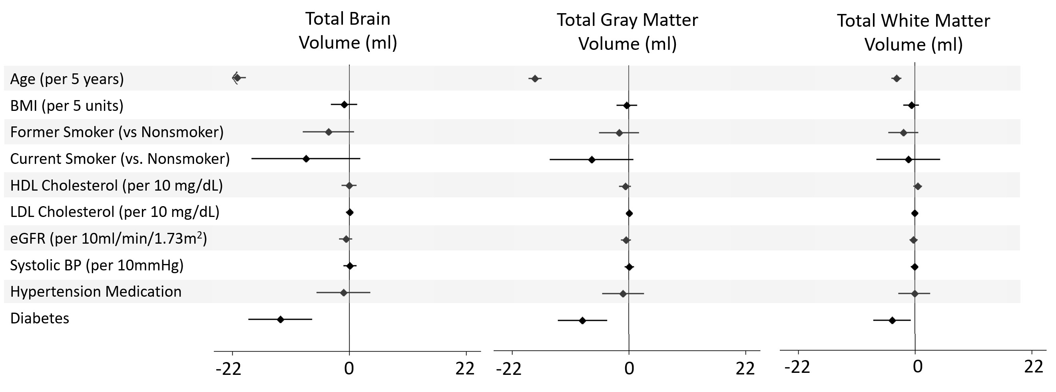
8-level Categorical Education Included In Adjustment Model
*regression models adjusted for all risk factors above in addition to sex, race/ethnicity, site, education, and total intracranial volume.

Slide 27
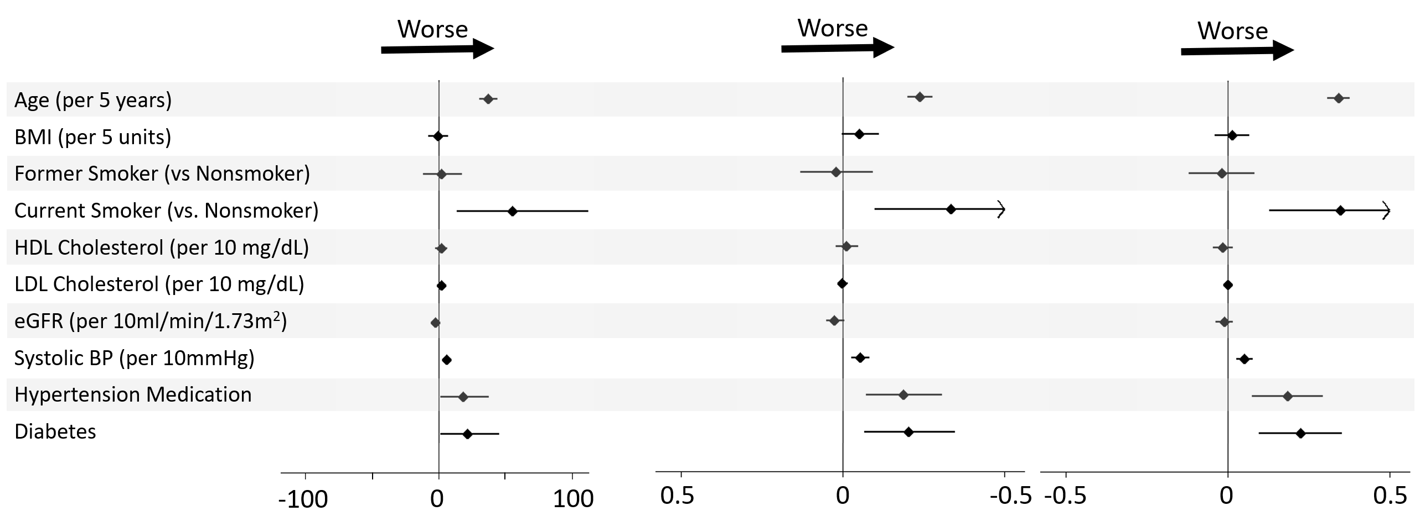
8-level Categorical Education Included In Adjustment Model (cont.)
*regression models adjusted for all risk factors above in addition to sex, race/ethnicity, site, and (for WML Volume) total intracranial volume.

Slide 28
Identification of AF
 |  | ICD-9/10
 |  | No AF | AF
E6 Self-Report | No AF | 936 | 33
 | AF | 30 | 29
 |  | ZioPatch
 |  | No AF | AF
E6 Self-Report | No AF | 932 | 30
 | AF | 40 | 19
 |  | ICD-9/10
 |  | No AF | AF
ZioPatch | No AF | 904 | 47
 | AF | 34 | 15

