Slide 1
Preliminary Results and Next Steps
MESA Virtual SC
June 29, 2020

Slide 2
Outline MESA Memory & MIND
Vascular Contributions to Dementia
Highlight Preliminary Results – Memory & MIND
Next Steps

Slide 3
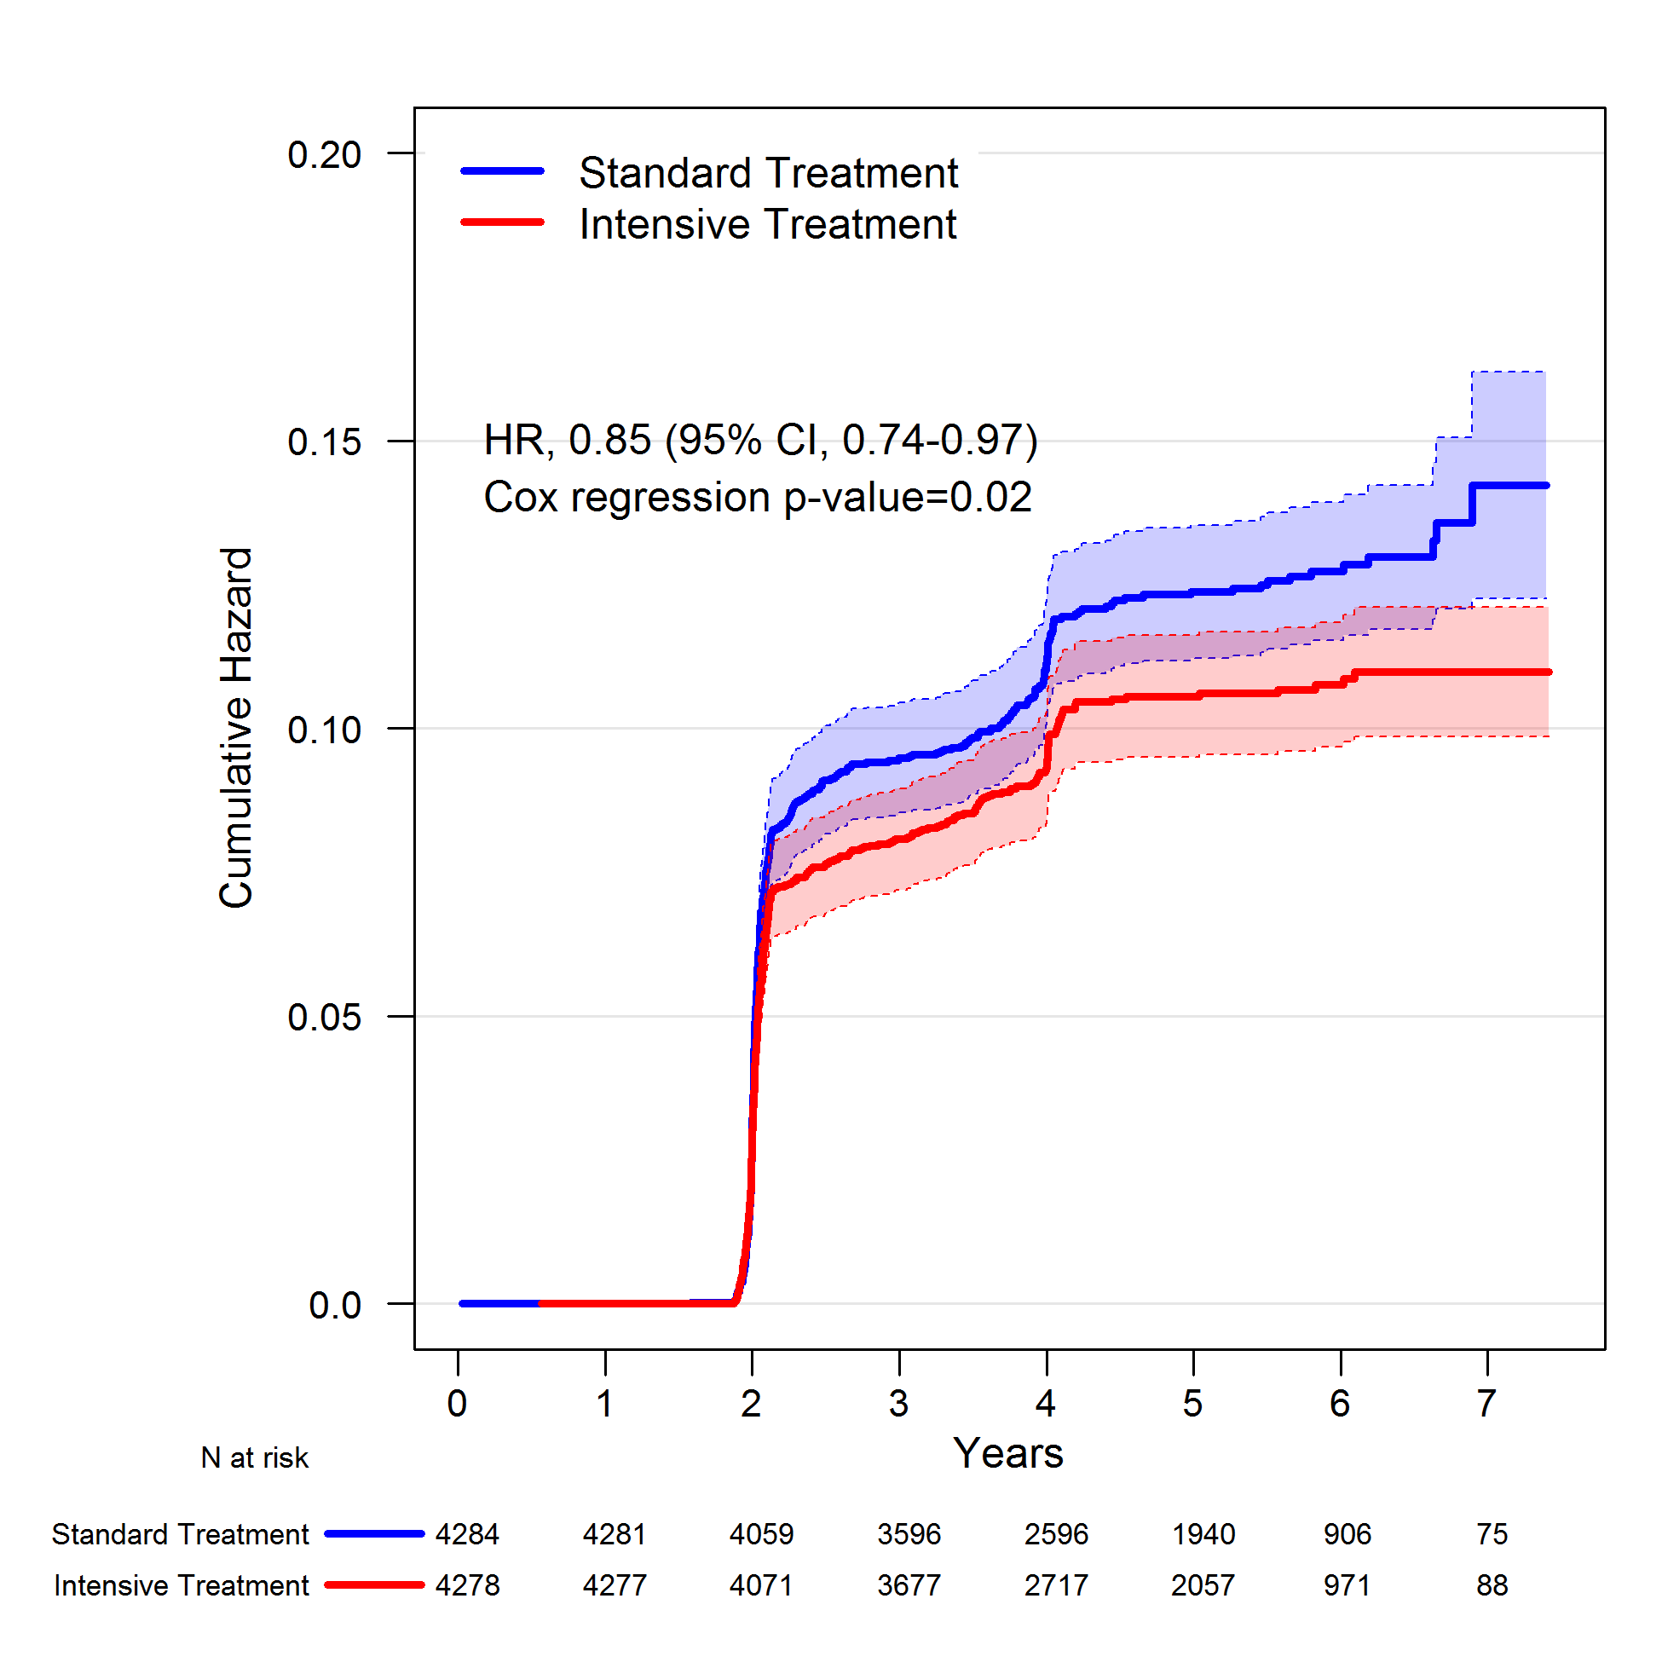
Background on Vascular Contributions to Dementia (VCID)
Targeting VCID is recognized as a key prevention strategy for AD and related dementias (ADRD)
Evidenced by SPRINT-MIND trial results
Unclear how vascular disorders contribute to specific dementia pathology and subsequent cognitive decline
Further, health disparities in CVD and ADRD
Williamson et al. JAMA 2019

Slide 4
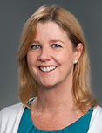
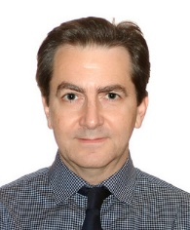
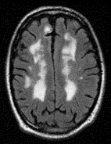
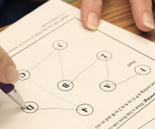
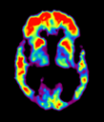
MESA Memory Study (R01AG054069, PI: Hughes, WFU only) Multisite MESA-MIND Study (R01AG058969 MPI: Hughes, Hayden, Luchsinger)
Centers
Wake Forest
Johns Hopkins
Columbia
Minnesota
Northwestern
UCLA
Enroll 2,500 MESA participants two visit across all 6 sites
Repeated cognitive testing (CASI + UDS v3) and brain MRI
Adjudication of cognitive impairment
Aβ-PET imaging sub-set of 1,000
(WFU, JHU, Columbia)
Memory (WFU)
Cog
MRI
PET
Cog
MRI
Exam 5
Exam 6
MIND A
MIND B
2010 2012 2014 2016 2018 2020 2022 2024

Slide 5
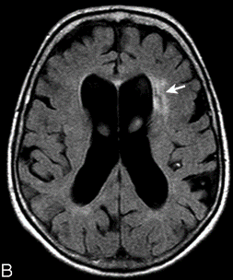
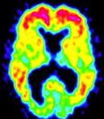
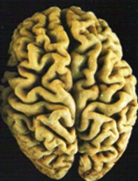
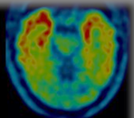
Linking Subclinical CVD and Dementia Pathology
Small Vessel
Vascular
Dementia
Atherosclerosis
Arteriosclerosis
Cardiac Function
Amyloid
‘Mixed’
Dementia
Neuro-
degeneration
Tau
Alzheimer’s
Disease
Notes:
Next, we wanted to look at the individual and combined contribution of AB and WMH. In this age group most participants have AB deposition and some WMH.
So we used a median split to define high WMH and combined it with AB-status

Slide 6
Highlighted Preliminary Results MESA Memory & MIND
Objective Cognitive Impairment
Subjective Memory Impairment
Vascular Risk & Cognitive Decline
Vascular Risk & Imaging
Next Steps

Slide 7
Adjudicated Cognitive Diagnoses by Consensus Conference
MESA Memory (Exam 6, WFU only)
MESA MIND (All sites, Visit A 2019-2021)
ongoing
Exam 6 (WFU) | 320 / 360
Cognitively Normal | 210 (66%)
Mild Cognitive Impairment | 78 (25%)
Dementia | 14 (4%)
Other/Cannot classify | 18 (5%)
MIND Visit A | 312 / 650
Cognitively Normal | 224 (72%)
Mild Cognitive Impairment | 70 (22%)
Dementia | 4 (1%)
Other/Cannot classify | 14 (5%)
Algorithmic classification strategy (Normal, MCI, and Dementia)
Cognitive domain scores (e.g. memory, executive function, speed of processing, attention)
Subjective cognitive impairment

Slide 8
Subjective Cognitive Decline Differs by Racial/Ethnic Groups and Socio-Demographic Factors
Khadijah Winkey, Timothy Hughes, Bonnie Sachs, Annette Fitzpatrick, Suzanne Craft, Laura Baker, Susan Heckbert, David Jacobs, Allison Caban-Holt, Steve Rapp, and Kathleen Hayden
2020 Alzheimer’s International Conference (AAIC) Featured Research Session (FRS) organized by Diversity and Subjective Cognitive Disorders Professional Interest Areas

Slide 9
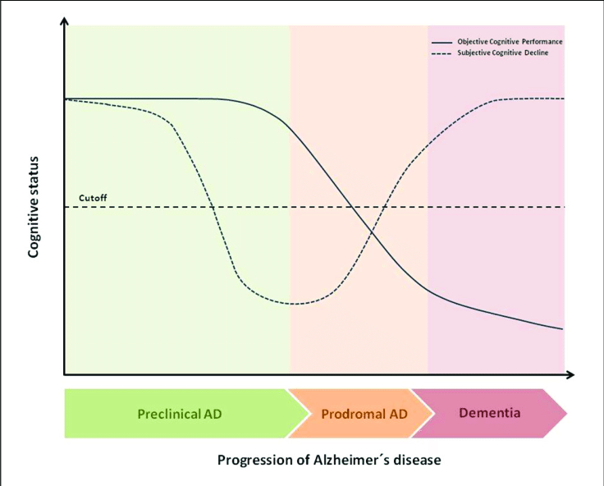
Subjective Memory Concerns Vary by Sociodemographic Factors
Cognitive Change Index 12 memory items (CCI-12) during annual follow-up call (FU19)
Published CCI-12 thresholds
Mild Cognitive Impairment (MCI, CCI-12>=16)
Severe impairment (dementia, CCI-12>=23)
MESA objective cognitive testing with 3 tests in 2010-12 and 2016-18
Cognitive Abilities Screening Instrument (CASI)
Digit Symbol Coding (DSC)
Digit Span (DS) forwards and backwards
Ávila-Villanueva. Frontiers in Aging Neuroscience 2017
FU19
Exam 5
Exam 6
MIND A
MIND B
Risacher et al. Alz & Dem 2015
Risacher et al. Alz & Dem 2017
2010 2012 2014 2016 2018 2020 2022 2024

Slide 10
SCD is common and varies by racial/ethnic group
Subjective Memory Impairment
MCI range: 52%-72%
Dementia range: 29% to 44%

Slide 11
Summary of Results
CCI data available on 3,676 MESA-MIND participants (aged 60-95)
Prevalence of mild SCD (CCI≥16) across racial/ethnic groups ranged between 52% to 72%.
Sociodemographic factors
CCI was weakly and inversely correlated with cognitive decline over 6 years (driven by White participants)
Lower Odds of SCD | Higher Odds SCD
African-American OR=0.80(0.68-0.95) | Hispanic OR=1.69(1.38-2.08)
Higher education OR=0.80(0.68-0.95) | Older age (per year) OR=1.03(1.02-1.04)
Men OR=0.84(0.73-0.96) | Diabetes OR=1.53(1.20 -1.96)
Annual income >$75,000 OR=0.80(0.68-0.95) | Birth in West US or Mexico OR=1.75(1.17-2.62)
 | No health insurance OR=1.42(1.09-1.84)
Models adjusted for age, gender, race and education

Slide 12
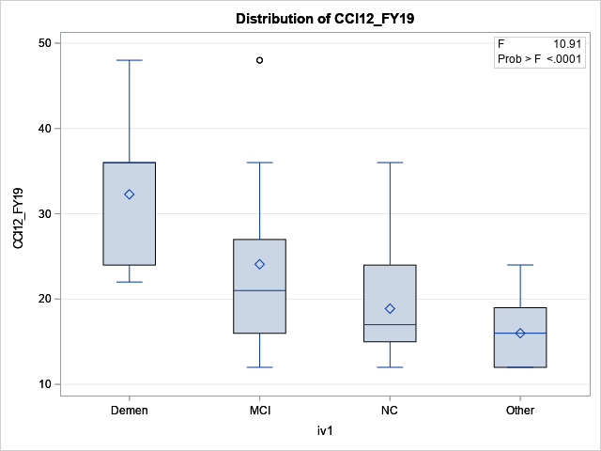
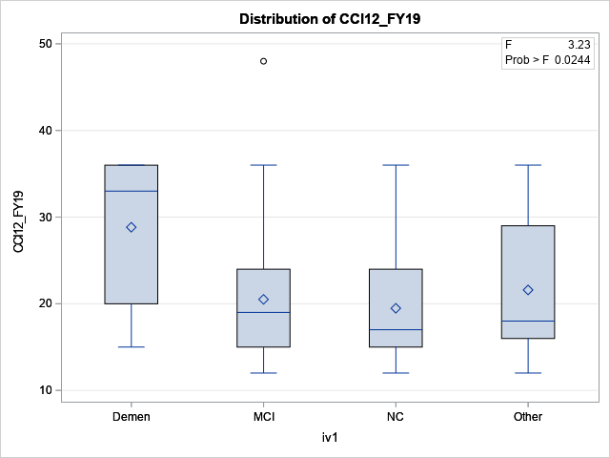
Subjective Memory Concerns and Cognitive Status
White(n=139)
African Americans (n=142)
Dementia MCI Normal Other
Dementia MCI Normal Other

Slide 13
Association of Vascular Risk Scores with Cognitive Performance and the Role of Race/Ethnicity: The Multi-Ethnic Study of Atherosclerosis
Christopher Schaich, Joseph Yeboah, Mark Espeland. Laura Baker, Jingzhong Ding, Kathleen Hayden, Bonnie Sachs, Suzanne Craft, Stephen Rapp, Jose Luchsinger, Annette Fitzpatrick, Susan Heckbert, Wendy Post, Gregory Burke, Norrina Allen, Timothy Hughes
Submitted to JAMA Neurology

Slide 14
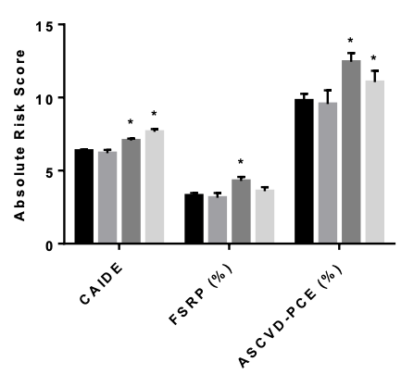
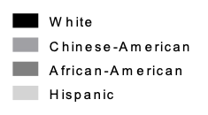
Risk CVD and Dementia Differs By Race/Ethnicity
CAIDE
(Cardiovascular Risk Factors, Aging, and Incidence of Dementia)
CVD
Afib
LVH
Education
Physical Inactivity
Obesity
APOE-4
Framingham Stroke Risk Score
Age
Gender
SBP
Smoking
Anti-HTN
Diabetes
Cholesterol
Race
HDL
Lipid Meds
ASCVD PCE
ASCVD
CVD Events
FSRS
CAIDE
Dementia
Midlife
Late-life

Slide 15
Vascular Risk is Associated with Cognitive Decline
Schaich et al. “Association of Vascular Risk Scores with Cognitive Performance and the Role of Race/Ethnicity: The Multi-Ethnic Study of Atherosclerosis”. Submitted to JAMA Neurology
Exam1 Vascular Risk Scores and CASI at Exam 5 (CASI, 2010-12) by Racial/Ethnic Group
Exam1 Vascular Risk Scores and Decline in CASI at Exams 5 to 6

Slide 16
Associations among Vascular Risk Factors, Multimodal Neuroimaging Biomarkers, and Cognition: Multi-Ethnic Study of Atherosclerosis (MESA)
Samuel Lockhart, Chris Schaich, Suzanne Craft, Bonnie Sachs, Stephen Rapp, Youngkyoo Jung, Christopher Whitlow, Kiran Sai, Benjamin Williams, Gregory Burke, Alain Bertoni, Kathleen Hayden, Timothy Hughes
Sam Lockhart, PhD
Manuscript revision in process

Slide 17
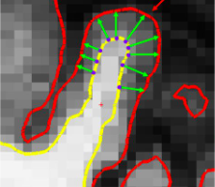
Methods – Neuroimaging
Amyloid PET - [11C] Pittsburgh Compound B Standardized Uptake Volume Ratios (SUVR>1.2) 6 regions prone to AD
3T MRI – brain volumes, cortical thickness, white matter hyperintensity volumes, and detailed vascular neurology reads
Sam Lockhart, PhD
Manuscript revision in process

Slide 18
Vascular Risk and Neuroimaging Abnormalities
Associations between Vascular Risk and Imaging (n=154)
 | t-value | p-value | Race interaction p
Amyloid (PET SUVR)
ASCVDª | 0.04 | 0.968 | 0.971
FSRP^{b} | 1.57 | 0.119 | 0.185
CAIDE^{c} | 2.72 | 0.007 | 0.840
WMH Volume (MRI)
ASCVDª | 2.24 | 0.027 | 0.731
FSRP^{b} | 3.16 | 0.002 | 0.672
CAIDE^{c} | 2.98 | 0.003 | 0.224
Cortical Thickness (MRI)
ASCVDª | -3.93 | <0.001 | 0.013*
FSRP^{b} | -3.17 | 0.002 | 0.016*
CAIDE^{c} | -2.50 | 0.013 | 0.774
ª Adjusted for education and APOE-ε4
^{b} Adjusted for education, race, and APOE-ε4
^{c} Adjusted for race
*interactions – stronger association in White participants
Sam Lockhart, PhD
Manuscript revision in process

Slide 19
Next Steps: Collaborating with Ancillary Studies
Glucose variability (Chaffin, under-review)
Sleep (Redline, Purcell, under-review)
Exosomes (Deep, pending)
Stress (Kershaw, under-review)
Frailty (Baldwin, pending)
24 Activity monitoring (Palta, under-review)
Neighborhoods - III (Hirsch, July submission)

Slide 20
Acknowledgements
Wake Forest ADRC
Suzanne Craft
Sam Lockhart
Kathleen Hayden
Steve Rapp
Bonnie Sachs
Chris Whitlow
Youngkyoo Jung
Eric Fischer
WFU MESA FC
Greg Burke
Alain Bertoni
Katy Melius
Khadijah Winkey
Chris Schaich
MESA FC staff
MESA Steering and AS Committees
UPenn MRI Processing
Nick Bryan
Ilya Nasrallah
Lisa Desiderio
Funding
P30 AG049638 (Craft)
R01 AG054069 (Hughes) R01 AG058969 (Hughes)
Participants

