Slide 1
Exam 7 Plans and Preparation
June 29, 2020

Slide 2
Outline
Timeline
Core Exam Components
Ancillary Study Proposals

Slide 3
Timeline

Slide 4
Timeline

Slide 5
Timeline
Exam 7 AS/Grant proposals
Grant Proposals submissions Oct/Nov 2020
1st/only
2nd submissions
Ancillary Study proposals submissions due August 2020

Slide 6
Timeline
Exam 7 Prep Jan–Oct 2021
Essential documents, Authorizations, …
Task Area B proposals/budget
Protocol January – March (Design Committee)
Operations Manual (Clinical Operations)
sIRB
OSMB Review
Programming
Site preparation (Hiring, training, certification, …)
Central Training
Pilot

Slide 7
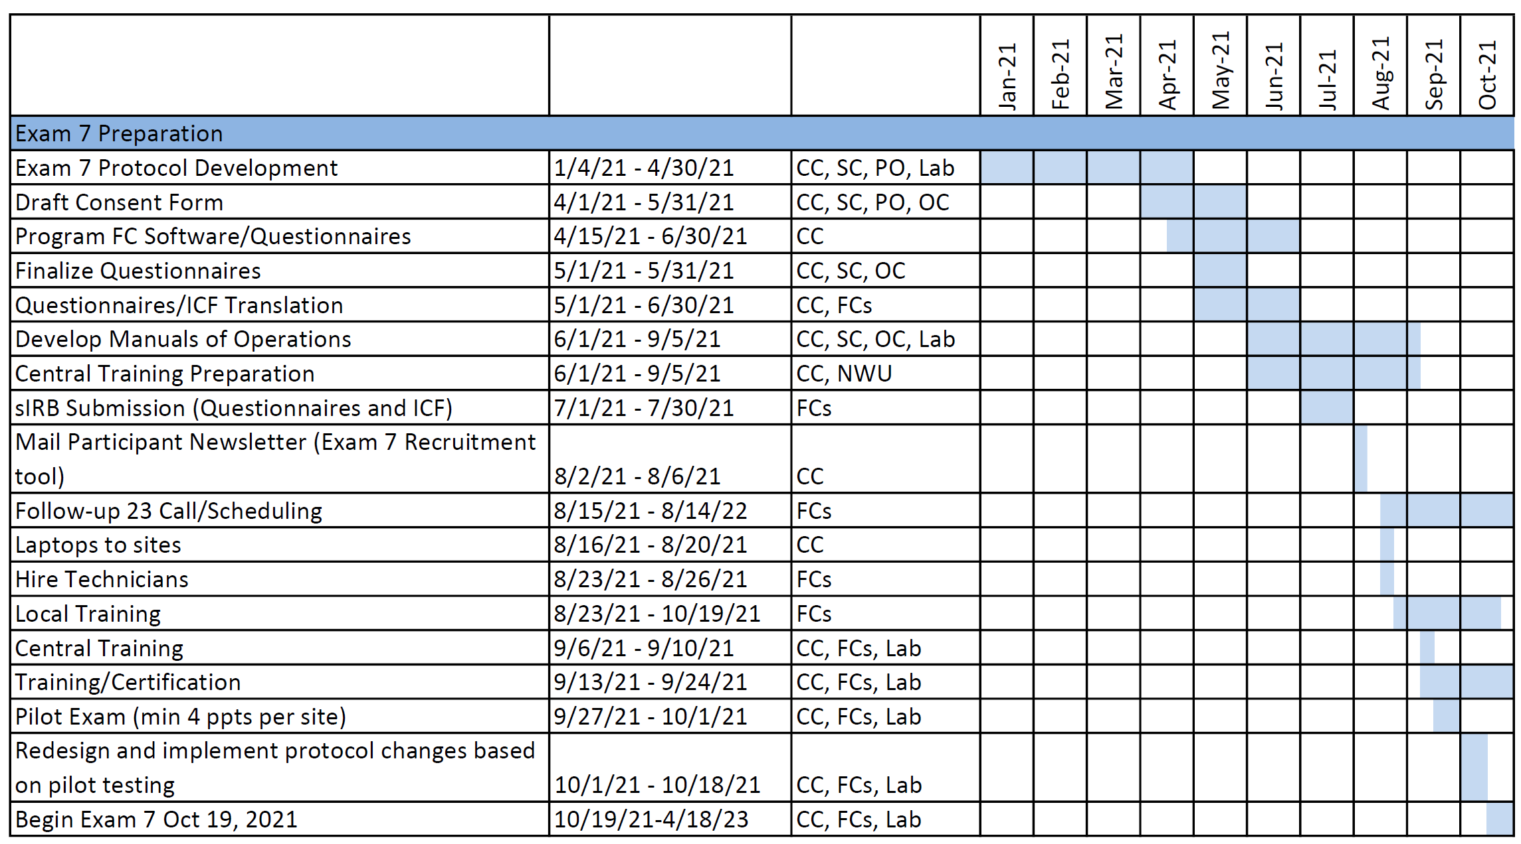
Timeline (suggested)

Slide 8
Timeline
Exam conduct 18 months
Oct 19, 2021 - Apr 18, 2023
Exam Closeout 3 months
Apr 19 – July 18, 2023

Slide 9
Exam 7 Core Parameters
3,000 target
 | Exam 7 Estimate (2022 CY)
3: WFU | 475 (15.8%)
4: COL | 530 (17.7%)
5: JHU | 410 (13.6%)
6: UMN | 505 (16.8%)
7: NWU | 555 (18.6%)
8: UCLA | 525 (17.6%)
Total | 3,000 (100%)

Slide 10
Exam 7 Core Parameters
Emphasis on retention
Suggested approach: Participant Chooses how much they want to do
Complete everything possible outside of the clinic
phone, online, mail, home, …
Total time commitment <8 hrs
Core Exam ~90 minutes
Ancillary studies have added ~30-90 minutes each (based on Exam 5 and 6)

Slide 11
Exam 7 Core components
Reception and consent
Anthropometry
Blood pressure
Specimen collection and lab processing
Blood volume 70mL total
chol, glucose, A1c, creatinine, AS, QC, Repository, …
Spot Urine collection
creatinine, albumin

Slide 12
Exam 7 Core components
Medical History
Personal History
Health and Life
Medications
Physical Activity
FFQ/Diet?

Slide 13
Exam 7 Ancillary Components
Follows Exam 5 & 6 Model
Ancillary Studies -> exciting science
Single integrated Exam
Avoid delayed or “soft” start

Slide 14
Exam 7 Ancillary Component Highlights (Proposed)

