Slide 1
Presented on behalf of the COVID-19 Working Group by
Elizabeth Oelsner, MD, MPH (Division of General Medicine, Columbia University)
at the MESA Steering Committee Meeting, June 29, 2020

Slide 2
Timeline of MESA COVID-19 Response
COVID-19 cases, by date
United States, CDC
https://www.cdc.gov/coronavirus/2019-ncov/cases-updates/cases-in-us.html (Accessed May 24, 2020)
Notes:
March 17: NOSI
March 18: AS submitted
March 31: Supplement submitted
April 10: questionnaire deployed

Slide 3
Timeline of MESA COVID-19 Response
COVID-19 cases, by date
United States, CDC
NOSI
announced
https://www.cdc.gov/coronavirus/2019-ncov/cases-updates/cases-in-us.html (Accessed May 24, 2020)

Slide 4
Timeline of MESA COVID-19 Response
COVID-19 cases, by date
United States, CDC
Ancillary Study
NOSI
announced
https://www.cdc.gov/coronavirus/2019-ncov/cases-updates/cases-in-us.html (Accessed May 24, 2020)

Slide 5
Timeline of MESA COVID-19 Response
COVID-19 cases, by date
United States, CDC
ASC/SC approval
Ancillary Study
NOSI
announced
https://www.cdc.gov/coronavirus/2019-ncov/cases-updates/cases-in-us.html (Accessed May 24, 2020)

Slide 6
Timeline of MESA COVID-19 Response
COVID-19 cases, by date
United States, CDC
ASC/SC approval
NOSI
Sub.
Ancillary Study
NOSI
announced
https://www.cdc.gov/coronavirus/2019-ncov/cases-updates/cases-in-us.html (Accessed May 24, 2020)

Slide 7
Timeline of MESA COVID-19 Response
COVID-19 cases, by date
United States, CDC
Questionnaire finalized
ASC/SC approval
Questionnaire deployed
NOSI
Sub.
Ancillary Study
NOSI
announced
https://www.cdc.gov/coronavirus/2019-ncov/cases-updates/cases-in-us.html (Accessed May 24, 2020)

Slide 8
Timeline of MESA COVID-19 Response
COVID-19 cases, by date
United States, CDC
WG
WG
WG
WG
Questionnaire finalized
ASC/SC approval
Questionnaire deployed
NOSI
Sub.
Ancillary Study
NOSI
announced
https://www.cdc.gov/coronavirus/2019-ncov/cases-updates/cases-in-us.html (Accessed May 24, 2020)

Slide 9
Timeline of MESA COVID-19 Response
COVID-19 cases, by date
United States, CDC
WG
WG
WG
WG
Questionnaire finalized
ASC/SC approval
Questionnaire deployed
NOSI
Sub.
LOR
LOR
LOR
Ancillary Study
NOSI
announced
https://www.cdc.gov/coronavirus/2019-ncov/cases-updates/cases-in-us.html (Accessed May 24, 2020)

Slide 10
Timeline of MESA COVID-19 Response
COVID-19 cases, by date
United States, CDC
WG
WG
WG
WG
Questionnaire finalized
ASC/SC approval
Questionnaire deployed
OSMB
report
NOSI
Sub.
LOR
LOR
LOR
Ancillary Study
NOSI
announced
https://www.cdc.gov/coronavirus/2019-ncov/cases-updates/cases-in-us.html (Accessed May 24, 2020)

Slide 11
Timeline of MESA COVID-19 Response
SC
meeting
COVID-19 cases, by date
United States, CDC
WG
WG
WG
WG
Questionnaire finalized
ASC/SC approval
Questionnaire deployed
OSMB
report
NOSI
Sub.
LOR
LOR
LOR
Ancillary Study
NOSI
announced
June 28, 2020
https://www.cdc.gov/coronavirus/2019-ncov/cases-updates/cases-in-us.html (Accessed June 28, 2020)

Slide 12
Timeline of MESA COVID-19 Response
SC
meeting
COVID-19 cases, by date
United States, CDC
WG
WG
WG
WG
Questionnaire finalized
ASC/SC approval
Questionnaire deployed
OSMB
report
NOSI
Sub.
LOR
LOR
LOR
Ancillary Study
NOSI
announced
June 28, 2020
https://www.cdc.gov/coronavirus/2019-ncov/cases-updates/cases-in-us.html (Accessed June 28, 2020)

Slide 13
Hypotheses: COVID-19 Ancillary Study
Aims
Subclinical chronic lung disease will predict risk of severe COVID-19
Subclinical cardio-metabolic disease will predict risk of severe COVID-19
Associations will be modified by clinical and socio-demographic factors
Significance
Address the NOSI (NOT-HL-20-757) research interest regarding “host factors, including… existing cardiac [and] respiratory… conditions, that predispose persons to acquire SARS-CoV-2 or to develop severe COVID-19 disease.”
Identify high-risk cardiopulmonary structural features that are translatable to clinical CT scans
Help to focus prevention measures on high-risk individuals rather than the entire population, thereby mitigating the public health and economic devastation of the pandemic
Cardiopulmonary risk factors for COVID-19 illness in older adults: the Multi-Ethnic Study of Atherosclerosis

Slide 14
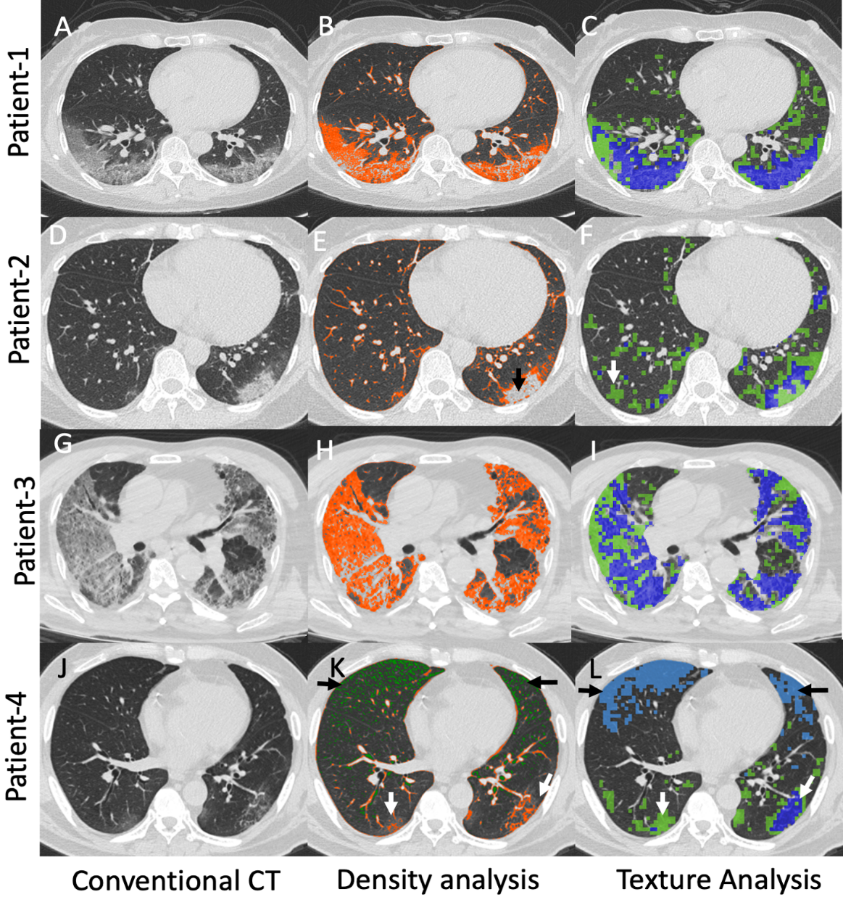
Approach: COVID-19 Ancillary Study
Questionnaire
Events ascertainment and adjudication
Chest imaging ascertainment
Deep learning to compare clinical imaging at time of COVID-19 illness versus prior research CT and to explore additional imaging information to explain COVID-19 pneumonia severity and characteristics
Nagpal P… Hoffman EA. Novel Coronavirus Disease 2019 (COVID-19): Potential for Advanced Imaging Applications (submitted).

Slide 15
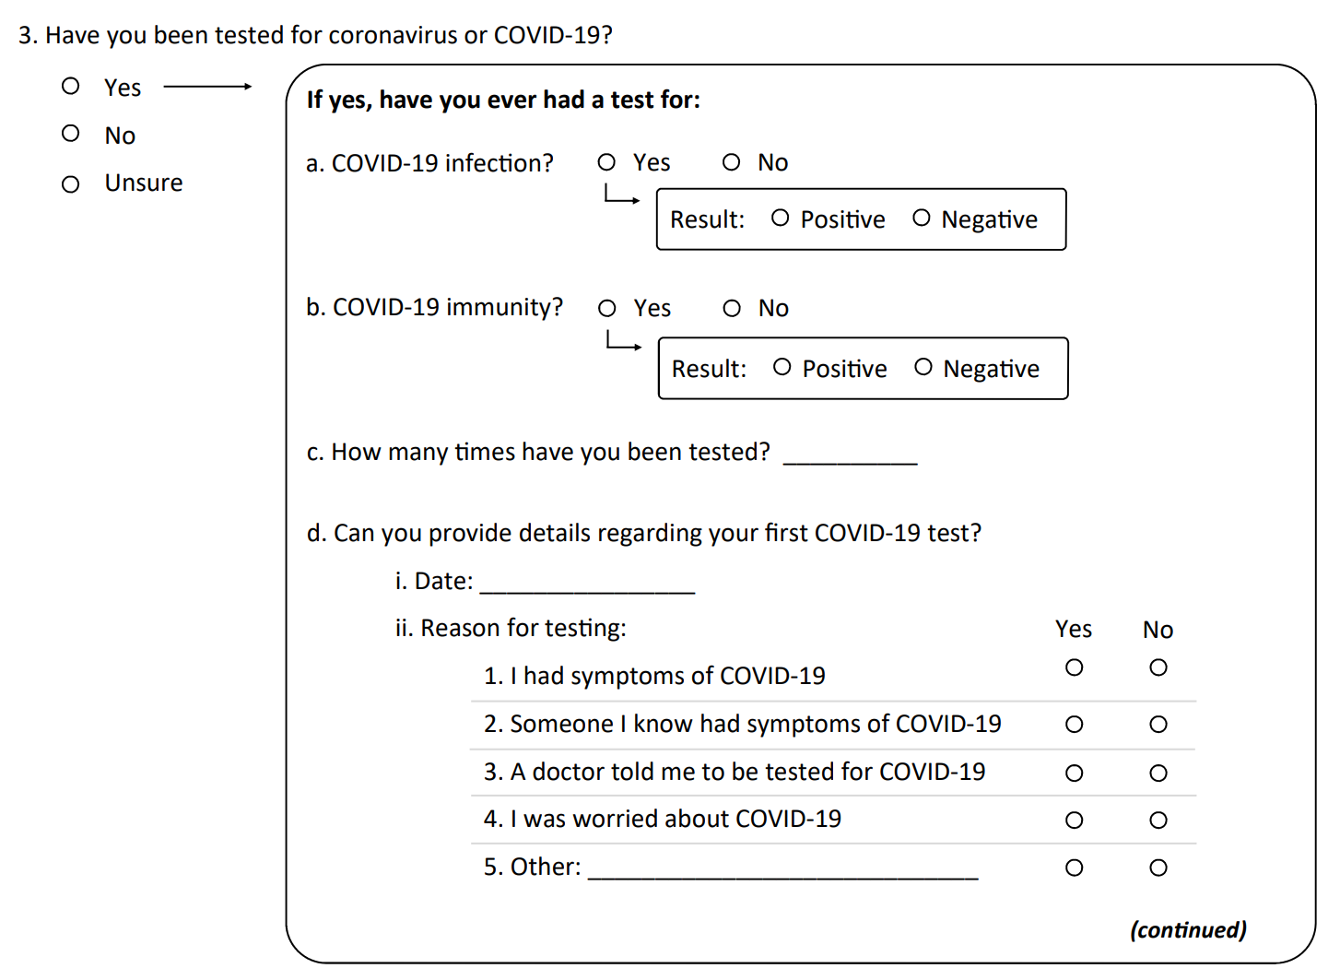
Questionnaire: COVID-19 Ancillary Study
Multiple domains
Infection and immunity
Motivations for testing
Health care utilization and imaging
Medication use
Symptoms (modified FLU-PRO)
Recovery
Exposures
Behavioral modifications
Tobacco use
Influenza vaccination
Translated into Spanish and Chinese
Publicly available (MESA, PhenX)
Adapted for use in other studies
https://www.phenxtoolkit.org/covid19/
https://www.mesa-nhlbi.org/MESACOVID19/

Slide 16
Preliminary results: COVID-19 baseline questionnaire
Site | Target | Attempted
3: Wake Forest | 705 | 399 (57%)
4: Columbia | 738 | 718 (97%)
5: Johns Hopkins | 581 | 534 (92%)
6: Minnesota | 703 | 152 (22%)
7: Northwestern | 752 | 728 (97%)
8: UCLA | 827 | 152 (18%)
Total | 4306 | 2683 (62%)
*% of Attempted
** % of Completed Questionnaires
https://www.mesa-nhlbi.org/MESACOVID19/

Slide 17
Preliminary results: COVID-19 baseline questionnaire
Site | Target | Attempted | Pending* | Declined* | Completed*
3: Wake Forest | 705 | 399 (57%) | 152 (38%) | 5 (1%) | 242 (61%)
4: Columbia | 738 | 718 (97%) | 113 (16%) | 12 (2%) | 593 (83%)
5: Johns Hopkins | 581 | 534 (92%) | 124 (23%) | 4 (1%) | 406 (76%)
6: Minnesota | 703 | 152 (22%) | 0 (0%) | 2 (1%) | 150 (99%)
7: Northwestern | 752 | 728 (97%) | 115 (16%) | 96 (13%) | 517 (71%)
8: UCLA | 827 | 152 (18%) | 7 (5%) | 2 (1%) | 143 (94%)
Total | 4306 | 2683 (62%) | 511 (19%) | 121 (5%) | 2051 (76%)
*% of Attempted
** % of Completed Questionnaires
https://www.mesa-nhlbi.org/MESACOVID19/

Slide 18
Preliminary results: COVID-19 baseline questionnaire
Site | Target | Attempted | Pending* | Declined* | Completed* | COVID-19 Diagnosis** | COVID-19 Hospitalization**
3: Wake Forest | 705 | 399 (57%) | 152 (38%) | 5 (1%) | 242 (61%) | 1 (0.4%) | -
4: Columbia | 738 | 718 (97%) | 113 (16%) | 12 (2%) | 593 (83%) | 15 (2.5%) | 7 (1.2%)
5: Johns Hopkins | 581 | 534 (92%) | 124 (23%) | 4 (1%) | 406 (76%) | 2 (0.5%) | 5 (1.2%)
6: Minnesota | 703 | 152 (22%) | 0 (0%) | 2 (1%) | 150 (99%) | 1 (0.7%) | 2 (1.3%)
7: Northwestern | 752 | 728 (97%) | 115 (16%) | 96 (13%) | 517 (71%) | 3 (0.6%) | 3 (0.6%)
8: UCLA | 827 | 152 (18%) | 7 (5%) | 2 (1%) | 143 (94%) | 1 (0.7%) | -
Total | 4306 | 2683 (62%) | 511 (19%) | 121 (5%) | 2051 (76%) | 23 (1.1%) | 17 (0.8%)
*% of Attempted
** % of Completed Questionnaires
https://www.mesa-nhlbi.org/MESACOVID19/

Slide 19
Prevalence of cases in MESA versus US general population
Site | MESA | General population | Comparison
Wake Forest | 0.4% | 0.6% | - 0.2%
Columbia | 2.5% | 2.0% | + 0.5%
Johns Hopkins | 0.5% | 1.1% | - 0.6%
Minnesota | 0.7% | 0.6% | + 0.1%
Northwestern | 0.6% | 1.1% | - 0.5%
8: UCLA | 0.7% | 0.5% | + 0.2%
Total | 1.1% | 0.8% | + 0.3%
https://www.nytimes.com/interactive/2020/us/coronavirus-us-cases.html (accessed June 28, 2020)

Slide 20
Preliminary results: COVID-19 baseline questionnaire
17% with at least one symptom consistent with COVID-19 since March 1st
2% self-reported possible COVID-19
33% not yet recovered from symptoms
2% reported that health care provider suspected COVID-19
14% test-positive rate
Courtesy of UW CC; based on data updated June 26, 2020

Slide 21
Preliminary findings: MESA COVID-19
Observation
Rapid response
Opportunity
Leading data and experience

Slide 22
Preliminary findings: MESA COVID-19
Observation
Rapid response
Participant enthusiasm
Opportunity
Leading data and experience
Psychosocial impact

Slide 23
Preliminary findings: MESA COVID-19
Observation
Rapid response
Participant enthusiasm
COVID-19 symptoms common
Opportunity
Leading data and experience
Psychosocial impact
Serology

Slide 24
Preliminary findings: MESA COVID-19
Observation
Rapid response
Participant enthusiasm
COVID-19 symptoms common
COVID-19 diagnoses and hospitalizations relatively rare
Opportunity
Leading data and experience
Psychosocial impact
Serology
Cross cohort collaboration
Ongoing follow-up

Slide 25
Preliminary findings: MESA COVID-19
Observation
Rapid response
Participant enthusiasm
COVID-19 symptoms common
COVID-19 diagnoses and hospitalizations relatively rare
Geographic variability
Opportunity
Leading data and experience
Psychosocial impact
Serology
Cross cohort collaboration
Ongoing follow-up
Site-specific timelines

Slide 26
Additional COVID-19 projects in MESA
Opportunity | Study | Lead Investigators
Psychosocial | COVID-19 Stress | Teresa Seeman, Ana Diez Roux, Lizzy Oelsner
Serology | Longitudinal epidemiology of COVID-19 using SARS-CoV-2 saliva antibodies in MESA* | Wendy Post, Jerry Rotter
Cross cohort collaboration | Cross-Cohort Collaboration for COVID-19 Research (C4R)* | Lizzy Oelsner, Greg Burke, Bruce Psaty
Genomics | ACE Study | Ani Manichaikul, Xiuqing Guo
 | HOST Genetics Study | Jerry Rotter, Xiuqing Guo, Lizzy Oelsner
Imaging | MESA Exam 7 CT and MRI post-COVID-19 | Matt Budoff, Joao Lima
Cardiovascular | Adjudication of MI type in COVID-19 | Andrew deFilippis, Khurram Nassir, Mike Blaha
Biomarkers | Clinical History And Biomarkers For Rapid Triage Of Early Stage COVID-19 And Long Term Sequelae In MESA* | David Jacobs, Daniel Duprez, Bharat Thyagarajan
*Letter of request for consideration of rapid funding

Slide 27
Additional COVID-19 projects in MESA
Opportunity | Study | Lead Investigators
Psychosocial | COVID-19 Stress | Teresa Seeman, Ana Diez Roux, Lizzy Oelsner
Serology | Longitudinal epidemiology of COVID-19 using SARS-CoV-2 saliva antibodies in MESA* | Wendy Post, Jerry Rotter
Cross cohort collaboration | Cross-Cohort Collaboration for COVID-19 Research (C4R)* | Lizzy Oelsner, Greg Burke, Bruce Psaty
Genomics | ACE Study | Ani Manichaikul, Xiuqing Guo
 | HOST Genetics Study | Jerry Rotter, Xiuqing Guo, Lizzy Oelsner
Imaging | MESA Exam 7 CT and MRI post-COVID-19 | Matt Budoff, Joao Lima
Cardiovascular | Adjudication of MI type in COVID-19 | Andrew deFilippis, Khurram Nassir, Mike Blaha
Biomarkers | Clinical History And Biomarkers For Rapid Triage Of Early Stage COVID-19 And Long Term Sequelae In MESA* | David Jacobs, Daniel Duprez, Bharat Thyagarajan
*Letter of request for consideration of rapid funding

Slide 28
COVID-19 Stress (Seeman/Diez Roux/Oelsner)
Domain | Source | Questions
COVID-19 diagnosis, testing, and health care utilization | MESA COVID-19 follow-up questionnaire | 1 (status) 3 (testing) 5 (hospitalization)
Non-COVID-19 healthcare effects | MESA COVID-19 follow-up questionnaire | 9 (acute care) 10 (medication) 11 (chronic care)
Financial consequences | MACS/WIHS CCS | D1 (outcomes)
 | NHATS | 53 (management)
Social context and social support | MESA COVID-19 follow-up questionnaire | 12 (living situation) 13 (household members)
 | MESA Stress 2 | 1-6 (social support) 25-27 (UCLA loneliness scale)
Psychological consequences | MACS/WIHS CCS | F1 (10-item CES-D; PROMIS emotional disturb./anxiety)
 | MESA Stress 2 | 7-16 (Cohen’s Perceived Stress)
 | NHATS | 45 (post-traumatic symptoms)
Behavioral consequences | NHATS | 25 (change in activities, including alcohol, cigarette, and marijuana use)
Discrimination | MESA E1 Health and Life | Everyday discrimination scale
Ascertain psychosocial and behavioral impacts of COVID-19 pandemic period
Common data elements across other cohort studies
Repeated questions from MESA Stress ancillary study
Planned R01 submission October 2020

Slide 29
Longitudinal epidemiology of COVID-19 using SARS-CoV-2 saliva antibodies in MESA(Post/Rotter)
Aims to determine the following among MESA participants:
Prevalence and incidence of symptomatic and asymptomatic infection with SARS-CoV-2 using saliva-based antibody testing and assay for the presence of virus.
Predictors of symptomatic and asymptomatic SARS-CoV-2 infection and clinical course, taking advantage of the multiple measures of subclinical cardiovascular and pulmonary disease, as well as extensive biomarker and multi-omics assessments.
Time course of decay of SAR-CoV-2 antibodies among participants who test positive.
Sensitivity and specificity of saliva based antibody testing compared to a gold standard plasma based assay. Also, to explore additional biomarkers (eg, soluble ACE2) as predictors of disease.
Courtesy of Drs Post and Rotter

Slide 30
Approach: Electric Field-Induced Release and Measurement (EFIRM)
Sampling at 0, 2, 4, 8, 12, and 16 months (6 samples/participant)
Results provided by the lab to the CC within 7 days of receipt of the sample and then mailed to participants
Field centers notified of positive RNA tests (active infection; expected to be rare) so that participants can be notified to contact their primary care physician for further management
Courtesy of Drs Post and Rotter

Slide 31
Cross-cohort collaboration for COVID-19 Research (C4R)
Cohort | N, alive | Retention rate, % | Age range, years | Racial/ethnic composition, %
 |  |  |  | White | African-American | Hispanic-Latinx | Asian-American | American Indian | Other
ARIC Study | 6,913 | 88 | 75-97 | 77 | 23 | - | - | - | -
CARDIA Study | 4,594 | 91 | 53-66 | 50 | 50 | - | - | - | -
Framingham Heart Study | 7,574 | 92 | 26-108 | 86 | 3 | 4 | - | - | 7
HCHS-SOL | 15,602 | 80 | 30-87 | - | - | 100 | - | - | -
Jackson Heart Study | 3,900 | 77 | 38-102 | - | 100 | - | - | - | -
MASALA Study | 1,150 | 83 | 46-92 | - | - | - | 100 | - | -
MESA | 4,400 | 89 | 65-103 | 40 | 26 | 21 | 13 | - | -
Strong Heart Study | 3,025 | 90 | 31-105 | - | - | - | - | 100 | -
TOTAL C4R population | 47,158 (100%) | 85% | 31-105 | 15,894 (34%) | 9,158 (19%) | 16,829 (36%) | 1,722 (4%) | 3,025 (6%) | 530 (1%)

Slide 32
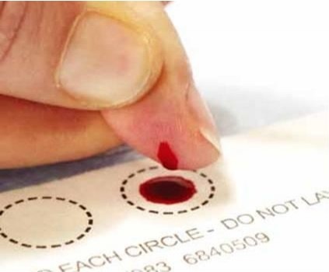
Approach: C4R
Questionnaire (MESA COVID-19 Questionnaire)
Events ascertainment
Serology (phlebotomy at scheduled cohort exam, home self-collection of dried blood spot)
Harmonization Center (PI Oelsner)
Biorepository and Central Laboratory (PI Tracy)
Operational coordination (PI Couper)
Anticipated number of SARS-CoV-2 infections and severe COVID-19 events based on a range of assumptions and a total population of N=47,158.
 |  | Seroprevalence
 |  | 5% | 10% | 25% | 50% | 70%
Total infected |  | 2,358 | 4,716 | 11,709 | 23,579 | 33,011
Proportion hospitalized | 5% | 118 | 236 | 589 | 1,179 | 1,651
 | 10% | 236 | 472 | 1,179 | 2,358 | 3,301
 | 15% | 354 | 707 | 1,768 | 3,537 | 4,952

Slide 33
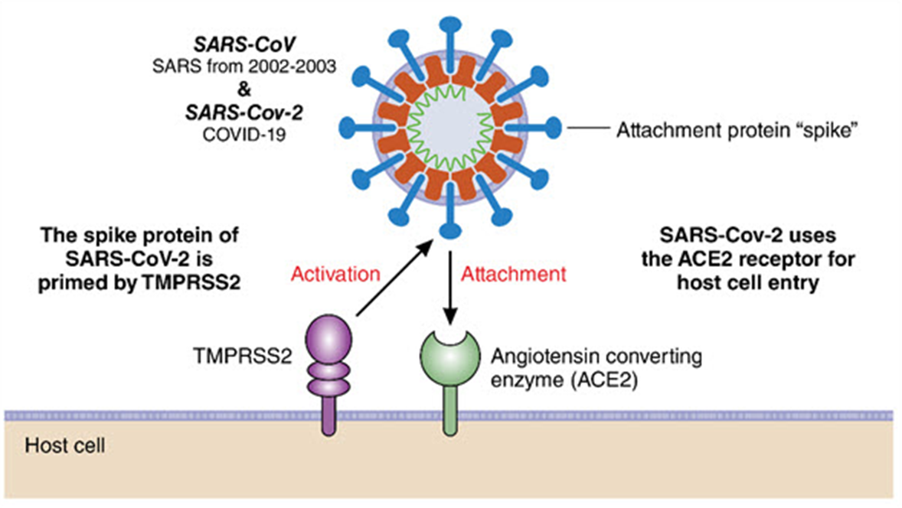
ACE Study (Manichaikul/Guo)
Collaborative effort with SCALLOP and the SOMAscan Group, a consortium for collaborative proteomic studies using SOMAscan platform
Identify ACE2 protein quantitative trait loci (pQTLs)
Investigate
Mechanisms of identified cis- and trans-pQTL by functional annotation
Pleiotropic effects of ACE2 pQTLs
Evaluate if
ACE2 proteins are causal in selected traits (e.g., CHD, stroke)
Effects of ACEi/ARB use
Circulation 2020
Courtesy of Drs Manichaikul and Guo

Slide 34
Next steps
Continued data collection on COVID-19 endpoints
Accelerated analyses of COVID-19-related data
Refinement/piloting of events adjudication and serology protocols
Funding applications (e.g., “stage II” for letters of request)
Continued innovation and collaboration

Slide 35
COVID-19 Working Group
Lead: Jerome Rotter
Norrina Bai Allen
Matthew Allison
Graham Barr
Lyndia C Brumback
Matt Budoff
Gregory L. Burke
Ya-Ju Chang
Mary Cushman
Ana Diez Roux
Daniel Duprez
Annette L Fitzpatrick
Susan Heckbert
Karen D Hinckley Stukovsky
David Jacobs
Craig Johnson
Joao Lima
Robyn L McClelland
Elizabeth Oelsner
Jim Pankow
Wendy Post
Bruce M Psaty
Ana Diez Roux
Steve Shea
Teresa Seeman
Bharat Thyagarajan
Russell Tracy
Kayleen Williams

Slide 36
Aims: Cross-Cohort Collaboration on COVID-19 Research
The C4R initiative will rapidly generate not only a community-based estimate of the incidence of COVID-19 events but also an inception cohort of COVID-19 cases relatively free of referral and disease spectrum biases. Activities will be operationally coordinated and provide a platform or framework for collaborative and cohort-specific work to answer critical research questions, including:
What are the major determinants of incidence and clinical severity of SARS-CoV-2 infection, and related disparities, in the US general population? | Does COVID-19 increase the long-term risk of atherosclerotic cardiovascular disease (ASCVD) and related thromboembolic events?
How is subclinical CVD associated with risk of severe COVID-19? | How do features of the innate and adaptive immune systems affect SARS-CoV-2 susceptibility?
How does obesity increase COVID-19 risk? | What are genomic risk determinants for COVID-19?
What are the psychosocial effects of the COVID-19 pandemic? | Are there existing drugs that could be repurposed for SARS-CoV-2 prevention or treatment?
How will the COVID-19 pandemic alter trajectories of health and disease?

Slide 37
Table 4. Preliminary case definitions for major COVID-19 endpoints based on data collected in C4R via questionnaire (Tier 1A), events ascertainment (Tier 1B), and serology (Tier 1C). *Criteria for severe COVID-19 illness.
COVID-19 Endpoint | Definite | Probable
Mortality* | Death certificate indicating COVID-19 as cause of death | Proxy report of COVID-19 death
Intubation/ECMO* | Hospital records confirming receipt/duration of mechanical ventilation/ECMO for COVID-19 | Proxy/self-report of mechanical ventilation/ECMO for COVID-19
ICU utilization* | Hospital records confirming receipt/duration of ICU care for COVID-19 | Proxy/self-report of ICU-level care
Hospitalization* | Hospital records confirming receipt and duration of hospital-based care for COVID-19 | Proxy/self-report of hospitalization for COVID-19
Infection | Proxy/self-report of positive test for SARS-CoV-2 (infection or Ig) Definite COVID-19 hospitalization or death Other healthcare records with positive test for SARS-CoV-2 (infection, Ig) Antibodies to SARS-CoV-2 on C4R serology | Proxy/self-report of being diagnosed with COVID-19 by a healthcare provider without confirmatory test Probable COVID-19 hospitalization or death
Antibody response | Proxy/self-report of receipt (and date) of positive test for SARS-CoV-2 Ig Healthcare records reporting positive test for SARS-CoV-2 antibodies Antibodies to SARS-CoV-2 on C4R serology
Symptoms | Self-report of symptoms in the context of definite infection Hospital records confirming symptoms in the context of definite COVID-19 hospitalization | Self-report of symptoms in the context of probable infection
Recovery | Self-report of recovery in the context of definite infection | Self-report of recovery in the context of probable infection
Exposures | Self-report of COVID-19 exposures
Behavioral consequences | Self-report of behavioral modifications, self-isolation, medication adherence, healthcare access, stress

Slide 38
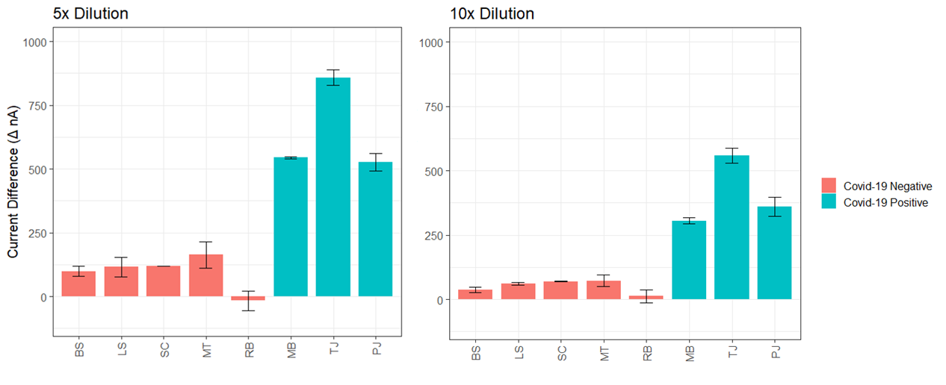
Approach: EFIRM saliva testing for serology
21 Day Stability at Ambient Temperature
Place Between Cheek and Gum for 2 – 5 min

