Slide 1
Ancillary Study Update: Memory / Alzheimer’s Disease
Timothy Hughes, PhD

Slide 2
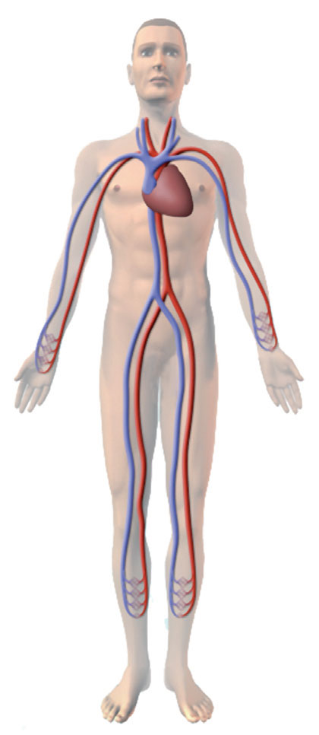
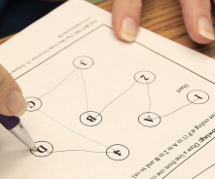
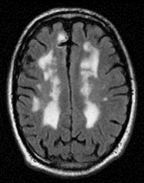
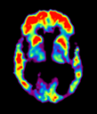
MESA Memory (PI: Timothy Hughes) (n=540, WFU only)
Goal - Determine how (micro- vs. macro-) vascular risk factors relate to dementia pathology and AD risk.
Repeat CASI, DSC and DS
Detailed cognitive battery (UDS v3, used by all NIH-funded AD Centers)
Physical exam by clinician
Cognitive adjudication (normal, MCI, dementia subtypes)
Brain MRI
β-amyloid PET imaging
Optional LP substudy (n=200, 40%)
Funded: R01 AG054069 (Hughes) P30 AG049638 (Craft)
Exams 1-6
Cog
MRI
PET
Cog
MRI
2016 2017 2018 2019 2020 2021

Slide 3
Recruitment Waves / Study Flow
MESA Memory Only
*
Overlap AFib
Phase 1
Cognitive Adjudication
Phase 2
Cognitive Adjudication
*

Slide 4
Progress in Exam 6
Table. MESA Tracking – Completion of All Components
Projected Total Exam 6, N=675 | Cognitive Testing |  | MRI |  | Aβ-PET |  | Optional LP*
 | Phase 1 | % | n | % | n | % | n | %
AFIB | 128 | 19%
Complete | -- |  | -- |  | -- |  | --
Memory | 131 | 19%
Complete | 131 | 100% | 98 | 87% | 37 | 31% | 1 | 2%
Total Sample | 259 | 38% | 241 | 93% | 248 | 96% | 44 | 21%
Target sample size (n=540, 80%); *optional LP (n=200)

Slide 5
Feasibility
Memory and Epigenetics studies (n=1,050)
500+ cognitive tests (98% at WFU and JHU)
Two phase cognitive adjudication
Phase 1 (100%); Phase 2 (32%)
46% confirmed cognitively impaired (MCI and AD)
Consent rates (WFU)
93% MRI
96% PET
34% optional LP

Slide 6
MESA Memory (PI: Timothy Hughes) (n=540, WFU only)
Image processing
Retinal architecture Exams 1 and 5 (SIVA by Tien Wong)
Vascular Neurology Reads (by WF Neuroradiology)
Infarcts, lacunae, microinfarcts, microbleeds, etc.

Slide 7
Antecedent
Cardiovascular Dysfunction
Neuroimaging Abnormalities
Age-Related Dementia
Small Vessel Disease
Vascular
Cognitive Impairment
Microvascular
Amyloid Pathology
Mixed
Dementia
Macrovascular
Neuro-degeneration
Alzheimer’s
Disease
MESA Study
MESA Memory Study

Slide 8
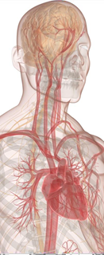
Figure 1 (a-c). Heart-carotid pulse wave velocity (hcPWV) is associated with multiple forms of dementia-related pathology.
OR(95%CI)
= 1.31(1.01, 1.71)
OR(95%CI)
1 = 1.27(0.93-1.74)
2+ = 1.80(1.26-2.59)
Arterial Stiffness
OR(95%CI)
= 1.48(1.01, 2.06)
Unpublished Data: manuscript under review
Models adjusted for age, BMI, gender, race and APOE-ε4

Slide 9
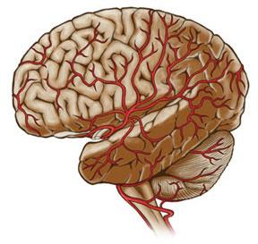
Ancillary Study Proposal Update: ‘Multisite AD’ study
Timothy Hughes, PhD
Kathleen Hayden, PhD
Jose Luchsinger, MD

Slide 10
MESA Multisite AD proposal (Hughes, Hayden, Luchsinger)
Full cohort extension of MESA Memory leveraging Epigenetics of AD and MESA AFib
Enroll 3,000 (75% eligible) following Exam 6
Repeated cognitive testing and MRI
Amyloid PET in a subset (33%)
Initial estimates are that 12% of WFU participants are cognitively impaired (MCI to AD)
Exam 7
Exam 8
Cog
MRI
PET
Cog
MRI
2016 2017 2018 2019 2020 2021 2022 2023

Slide 11
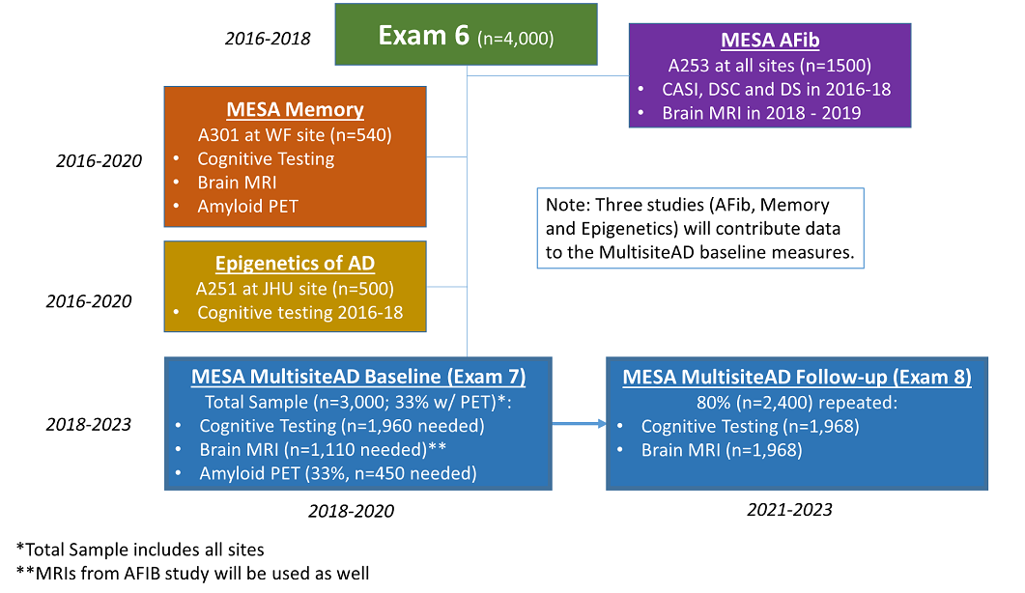
Leveraging Data

Slide 12
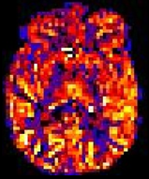
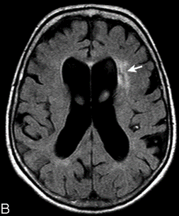
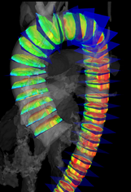
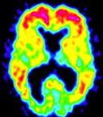
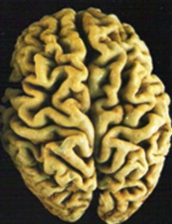
Aims Mechanistic Links Between Peripheral Vascular Disease and Dementia Pathology
Cerebral
Blood
Flow
Vascular
Dementia
Small Vessel Disease
SA1b
Amyloid Pathology
Mixed
Dementia
SA1a
SA1d
Arterial
Stiffness
SA1c
Neuro-
degeneration
Alzheimer’s
Disease
Race/Ethnicity
Gender
APOE-ε4
Notes:
Next, we wanted to look at the individual and combined contribution of AB and WMH. In this age group most participants have AB deposition and some WMH.
So we used a median split to define high WMH and combined it with AB-status

Slide 13
AD Study
MESA CC
Johns
Hopkins
Wake Forest
Minnesota
Columbia
North-western
UCLA
AD Study
AD Study
(n=532)
(n=677)
(n=646)
AD Study
AD Study
(n=753)
(n=663)
(n=696)
AD Study
MESA Multisite AD Proposal
MESA Sites
Multisite AD Study
Potential Ancillary Studies
Exam 7, 2019 – 2020
Exam 8, 2021 – 2023
Notes:
Facilitate building robust collaborations between MESA field centers and local AD Centers/Programs.
Such collaborations are new recommendations for NIH-funded AD Centers.
Large budget grant to NIA fund Exam 7 and Exam 8
Ample opportunity to link up additional ancillary CVD studies

Slide 14
Summary of AD Initiatives
Successful recruitment of Exam 6 participants into MESA Memory and Epigenetics of AD.
Higher than expected consent rates to MRI and PET.
MESA Multisite AD grant (all sites) under review to add visits, framework for ‘Exams 7 and 8’.
Ancillary to the Ancillary = Full MESA Exam?

