Slide 1
Mobility, Health and Disease
Stephen B. Kritchevsky, PhD
Section on Gerontology and Geriatric Medicine
Sticht Center for Healthy Aging and Alzheimer’s Prevention
Wake Forest School of Medicine

Slide 2
Outline
Mobility (esp. Walking Speed) is a strong risk factor for future health events
Contributors to Impaired Mobility
Functional Brain Networks and Mobility
Why might MESA be the study to push the envelop

Slide 3
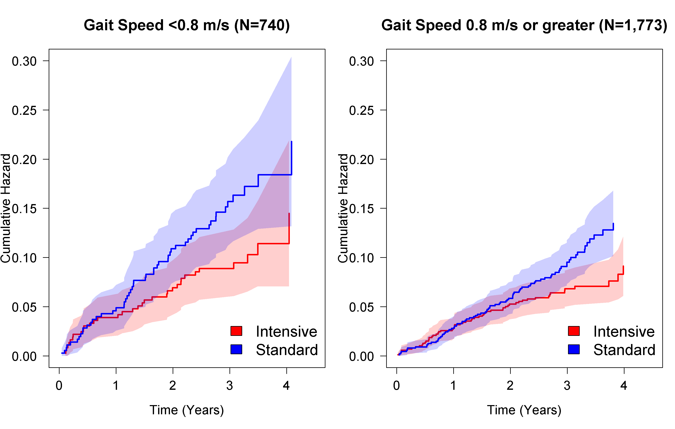
Cumulative Hazards for SPRINT Primary Outcome by Gait Speed
HR: 0.65 95% CI: 0.41 to 1.02
HR: 0.68 95% CI: 0.48 to 0.95
Interaction p-value = 0.732

Slide 4
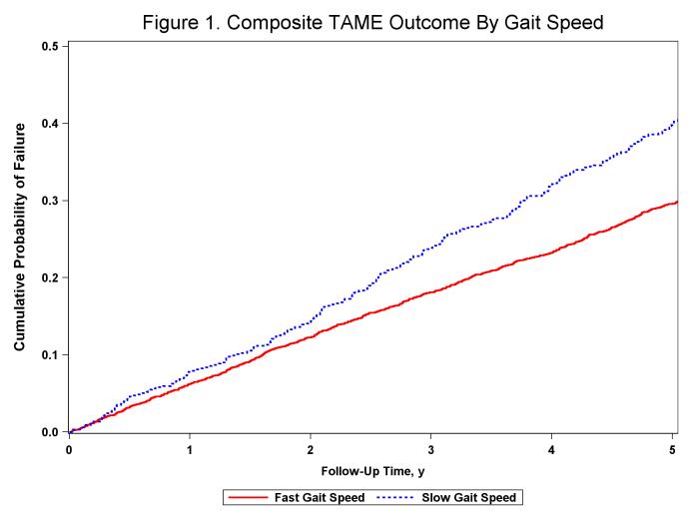
Gait Speed < 1.0 m/s Predicts Worsening Comorbidity: The Health ABC Study (well-Functioning 70-79 year olds)
Composite: New Onset CVD, Cancer, Dementia or Death

Slide 5
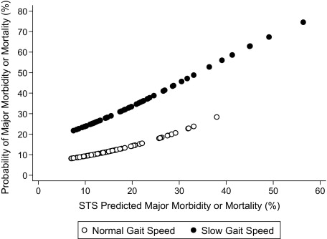
Gait Speed as an Stress Resistance Indicator
< 0.83 m/s
≥ 0.83 m/s
Figure 3 Predicted Probability of Mortality or Major Morbidity According to Gait Speed and the STS Risk Score Slow gait speed (solid circles) conferred a 2- to 3-fold increase in risk for any given level of Society of Thoracic Surgeons (STS) predicted m...
Outcome: post-op death, stroke, renal failure, prolonged ventilation, sternal wound infection, need for reoperation.
Jonathan Afilalo , Mark J. Eisenberg , Jean-François Morin , Howard Bergman , Johanne Monette , Nicolas Noiseux , ...
Gait Speed as an Incremental Predictor of Mortality and Major Morbidity in Elderly Patients Undergoing Cardiac Surgery
Journal of the American College of Cardiology, Volume 56, Issue 20, 2010, 1668 - 1676
http://dx.doi.org/10.1016/j.jacc.2010.06.039

Slide 6
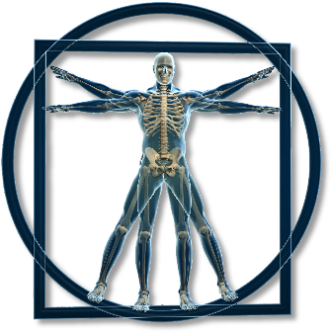
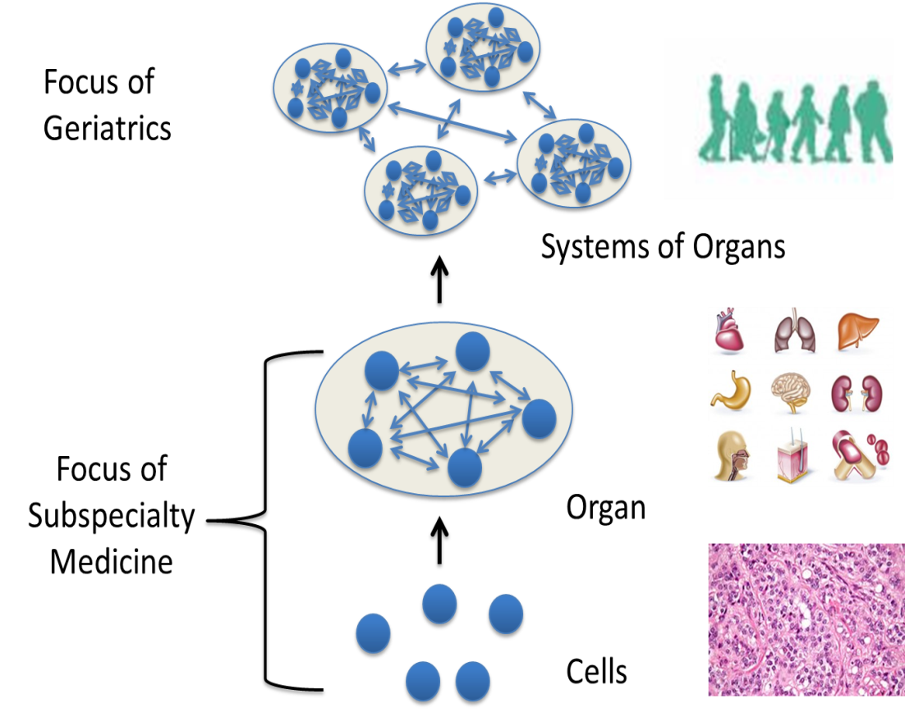
What is slow gait a sign of?
Restricted Life Space
Fatiguability
The Patient’s
Lived
Experience
Depression
Self-Rated Health
Pain
IL-6
Circulating Mito Resp. Capacity
Cognitive Speed / Function
VO2 Max
White Matter Burden
Low EGFR / High Cystatin C
FEV1
Anemia
Cardiac Output
Muscle perfusion
Muscle strength
Motor Units
Capillary Density
Type I : Type II Fiber Ratio
Neuromuscular Junction
Troponin Splice Variants

Slide 7
Brain Measures Associated with Lower Extremity Function and Gait Speed
Brain Volume
White Matter Hyperintensities
Fractional Anisotropy
Micro-infarcts
Beta-Amyloid Deposition

Slide 8
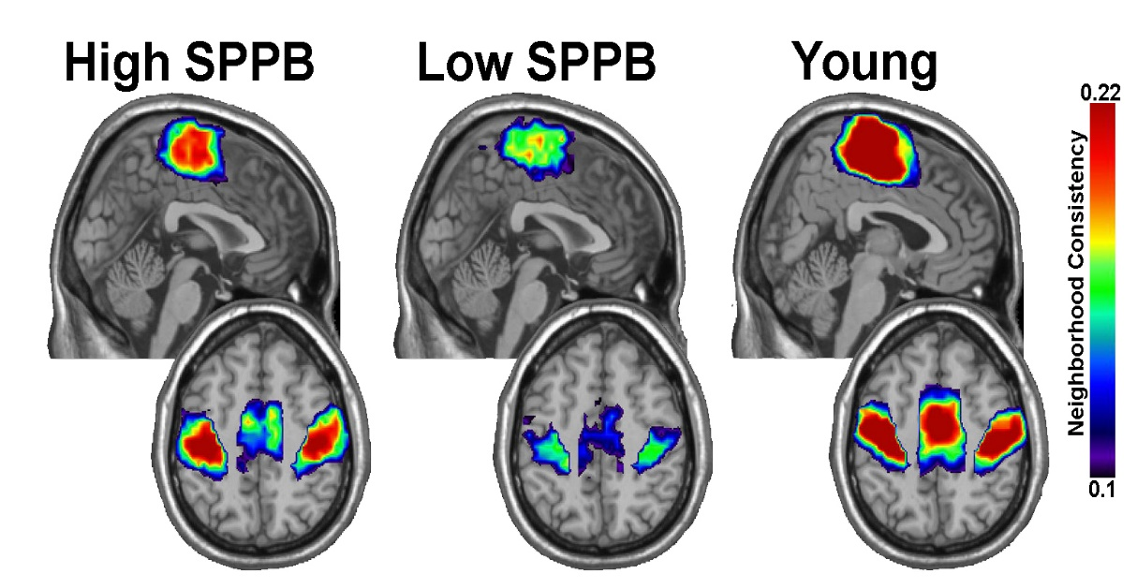
Sensory Motor Cortex Community Structure using BOLD Imaging in the Resting State
Hugenschmidt CE, et al. . Graph theory analysis of functional brain networks and mobility disability in older adults.
J Gerontol A Biol Sci Med Sci. 2014 Nov;69(11):1399-406.

Slide 9
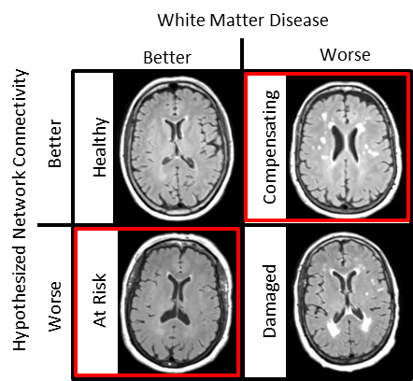
What’s the Relationship between Anatomical Damage, Functional Connectivity and Physical Function?
High SPPB
Low SPPB

Slide 10
Research Questions
Does brain functional connectivity differ according to physical function?
Is brain functional connectivity’s relationship with physical function independent of brain pathology?
Do these patterns predict worsening physical function?
Exploratory questions: Do physiologic measures like blood pressure, obesity, metabolic syndrome associate with patterns of brain connectivity? If so, do these patterns predict deteriorating metabolic health?

Slide 11
Why MESA?
Strong inventory of physiologic measures
Already collecting health outcome measures
Follow-up and the possibility of longitudinal analyses
Wake Forest/Forsyth county site already collecting brain MRI images that can be used to derive brain connectivity metrics
Physical function add-ons are relatively brief (~30 minutes)
Expanded Short Physical Performance Battery from the Health ABC Study
4 meter usual paced walk
Standing balance
Chair Stands
Balance Walk
Standing on Force Plate (3 conditions)
Dual Task (walking and verbal fluency task)

