Slide 1


Slide 2
Mission
Develop a Consortium of Cohorts to Promote Large-Scale Research on Aging Across the Life Course
  A life-course perspective on aging and utilize novel and sophisticated longitudinal methodologies to understand an individuals’ complete life experience rather than as separate, discrete periods.

Slide 3
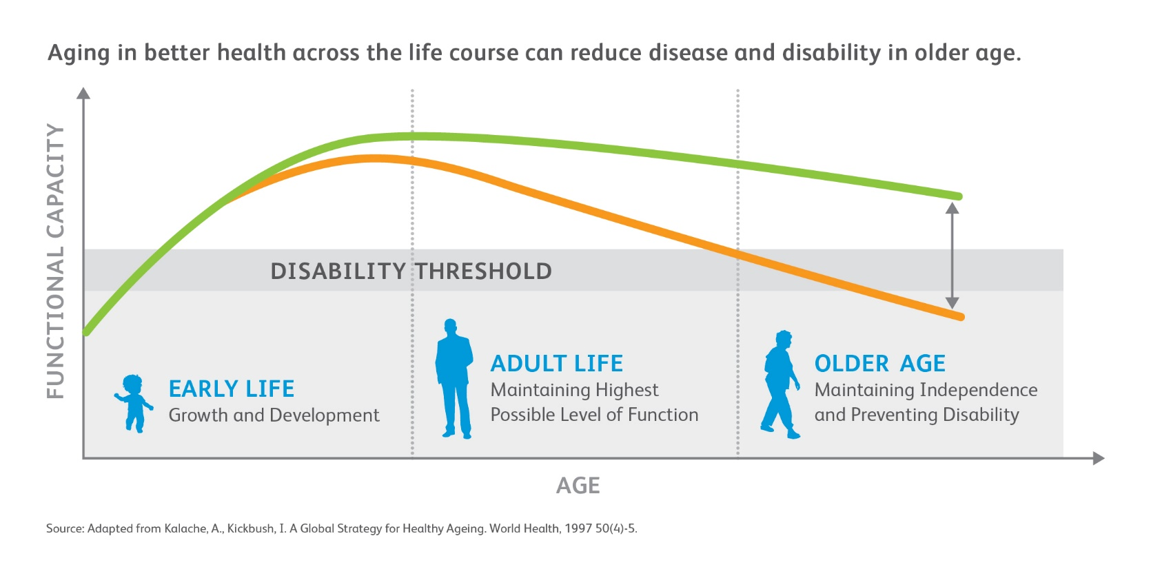
Life Course Perspective on Healthy Aging
Accumulation of risk factor exposures

Slide 4
Aims
Scientific Aims
  Cardiovascular Health Across the Lifespan and Its Impact on the Compression of Morbidity
  Life-Course Exposure to Traditional and Novel Cardiovascular Risk Factors and Cognitive Function in Old Age
  Omics of Healthy Aging Across the Life Course
  Early Life Influences on Novel MRI Markers of Resilience and Brain Aging
Infrastructure Aims
  Develop the Infrastructure to Conduct Rigorous Harmonization and Facilitate Use of the Pooled Data
Methodologic Aims
  Develop and apply innovative statistical and epidemiologic methods for data pooling, harmonization and the creation of a synthetic cohort

Slide 5
Proposed CHANGE Consortium Cohorts

Slide 6
Proposed CHANGE Consortium Cohorts

Slide 7
Advantages of a Synthetic Cohort
To date studies have simply pooled or linked cohorts of different ages to extrapolate lifetime patterns (without taking into account differences in the populations)
Synthetic cohorts offer the opportunity for time and cost efficiency, and is hypothesis generating
They can take into account temporal changes and aid in prediction about future trends

Slide 8
Preliminary Findings: Validating the Creation of a Synthetic Cohort Using Pooled Longitudinal Cohort Data
≥

Slide 9
BMI
BMI, kg/m²
Overall
CARDIA
(18-30)
MESA
(50-59)
CHS
(80-90)

Slide 10
BMI: Bland Altman plot
+1.96 SD
Mean
-1.96 SD

Slide 11
    Observed and Imputed BMI Values By Cohort and Overall from Ages 18 to 90
Observed Values by Cohort
Imputed Values by Cohort
Imputed Values Overall

Slide 12
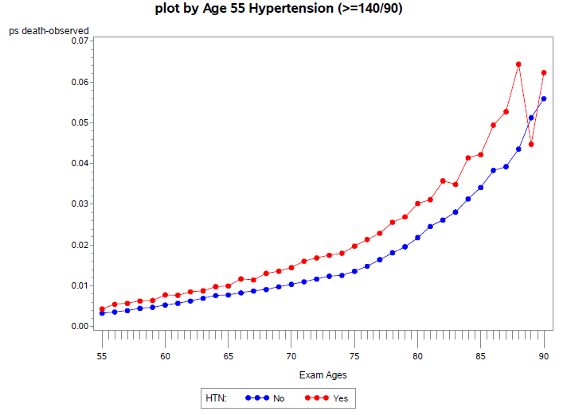
Association of HTN with Mortality

Slide 13
U19 Proposal to NIA
Complex Integrated Multi-Component Projects in Aging Research (U19)
  “This FOA allows for applications that propose large-scale, complex research projects with multiple highly integrated components focused on a common research question relevant to aging. Such projects will likely involve an integrated multidisciplinary team of investigators within a single institution or a consortium of institutions.”
Cooperative Agreement with NIA

Slide 14
Structure
Scientific Project #1
Scientific Project #3
Administrative Core
Biostatistics Core
Bioinformatics Core
Imagining Core
Scientific Project #4
Scientific Project #2
Can include up to 9 scientific Projects

