Slide 1



Santosh Kumar
Utility of Collecting High-frequency Mobile Sensors Data in Health Research
Director, MD2K Center of Excellence
Professor & Lillian and Morrie Moss Chair of Excellence
Department of Computer Science, University of Memphis

Slide 2
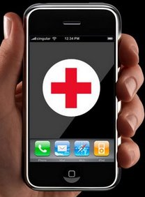
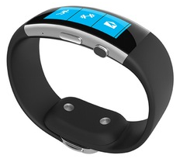
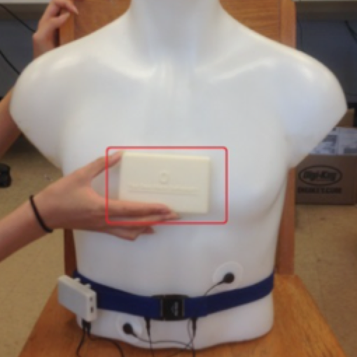
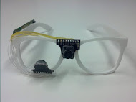


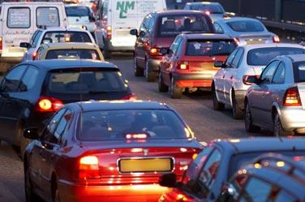

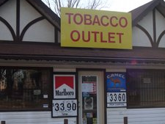
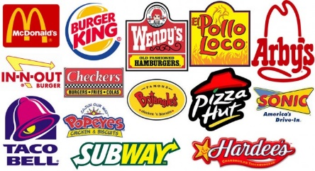
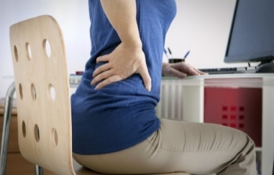
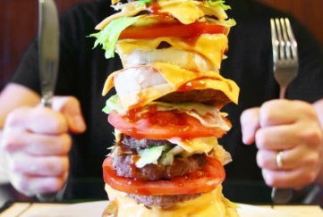

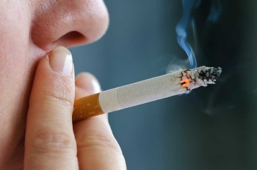

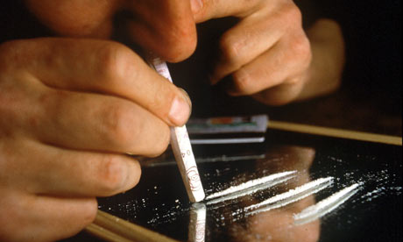

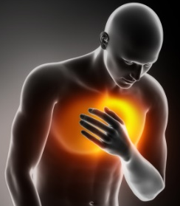
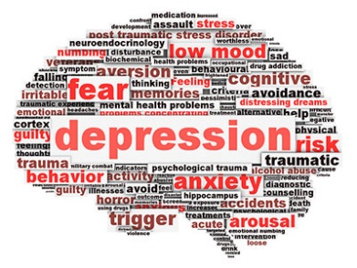
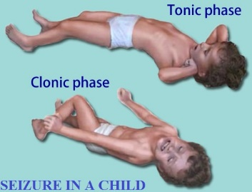
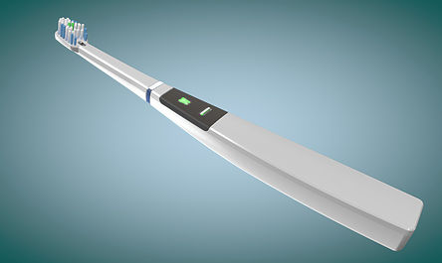
Measuring Exposures, Behaviors, and Outcomes
Mobile Sensors
Smartwatch
Chestbands
Smart Eyeglasses
Exposures
Behaviors
Outcomes

Slide 3
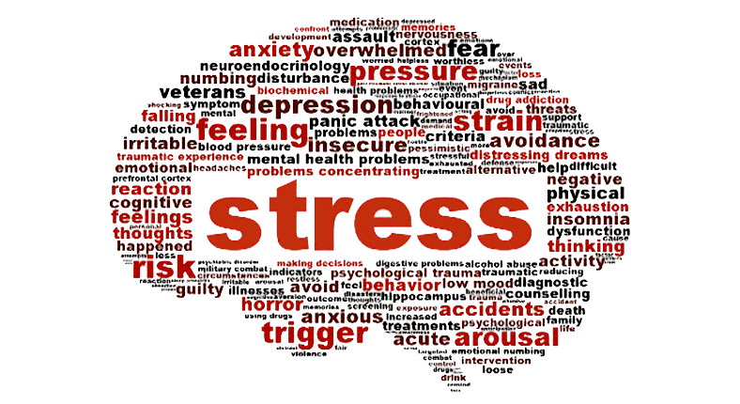
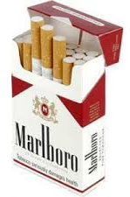
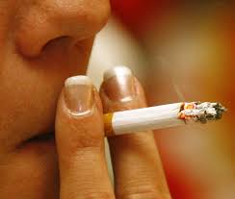
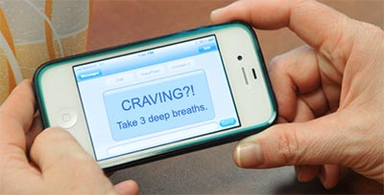
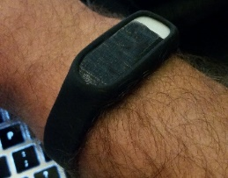
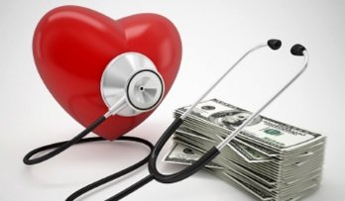
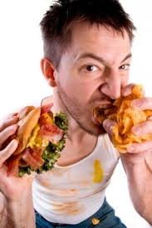
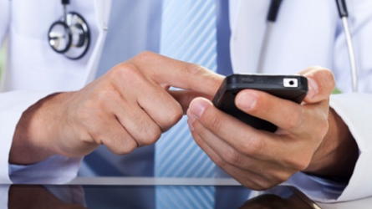
Harnessing the Power of Mobile Sensing
Detect
Predict
Adapt
Notes:
No subject-specific training
Novel methodology

Slide 4
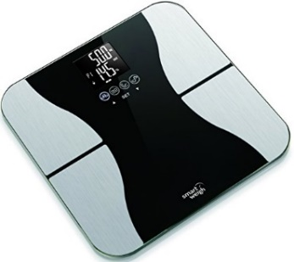
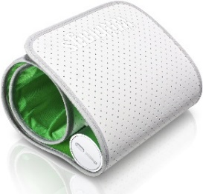
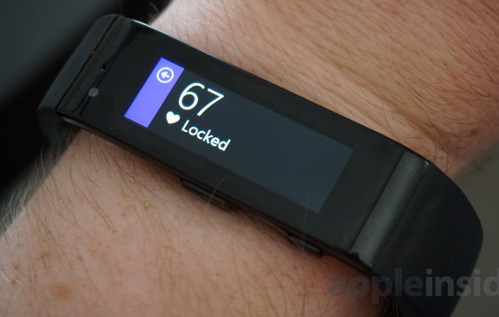
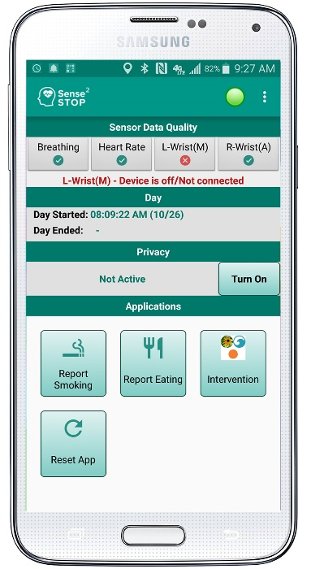
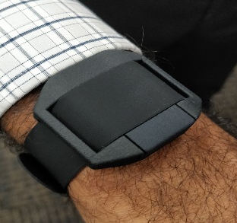
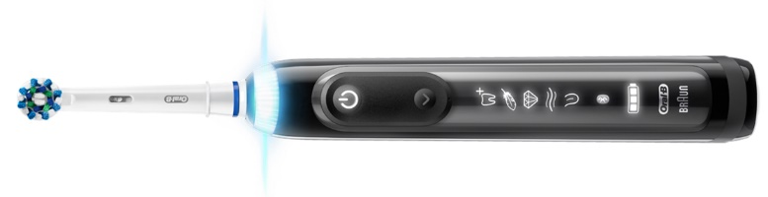
Mobile Sensor Data Sources in MD2K
Microsoft Band:
accelerometers, gyroscopes, HR
AutoSense sensors: ECG,
respiration, accelerometers
MotionSense HRV:
accelerometers, gyroscopes, PPG
EasySense (contactless) sensors: heart motion, lung motion, lung fluid level
Smartphone sensors: GPS, accelerometers, self-report
Smart toothbrush: brushing, Pressure
Notes:
No subject-specific training
Novel methodology

Slide 5
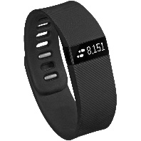
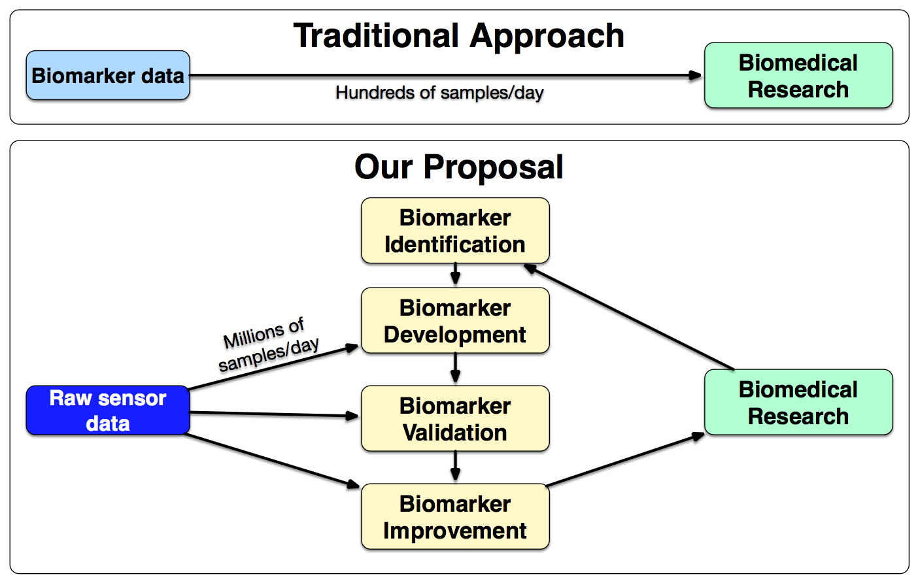
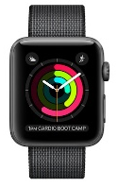
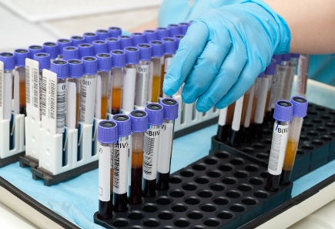
Utility of Collecting High-frequency Sensor Data

Slide 6
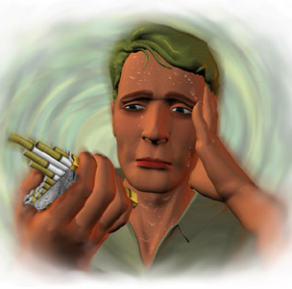
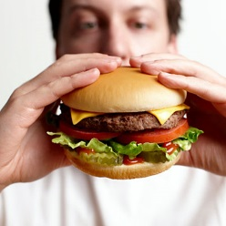
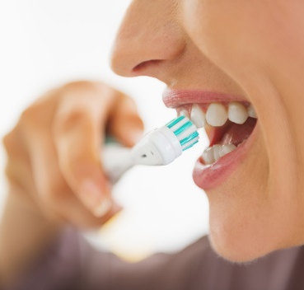
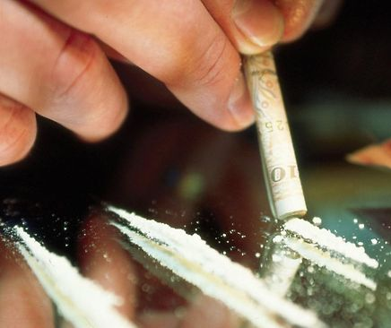

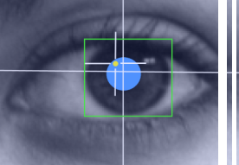
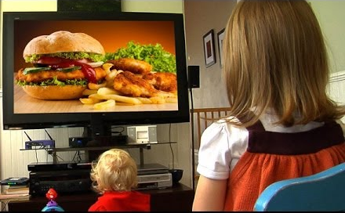
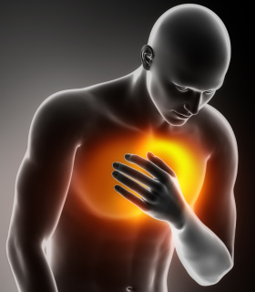
Sensor-derived Markers from MD2K
Notes:
No subject-specific training
Novel methodology

Slide 7
MD2K Mobile Software Platform (open-source)

Slide 8
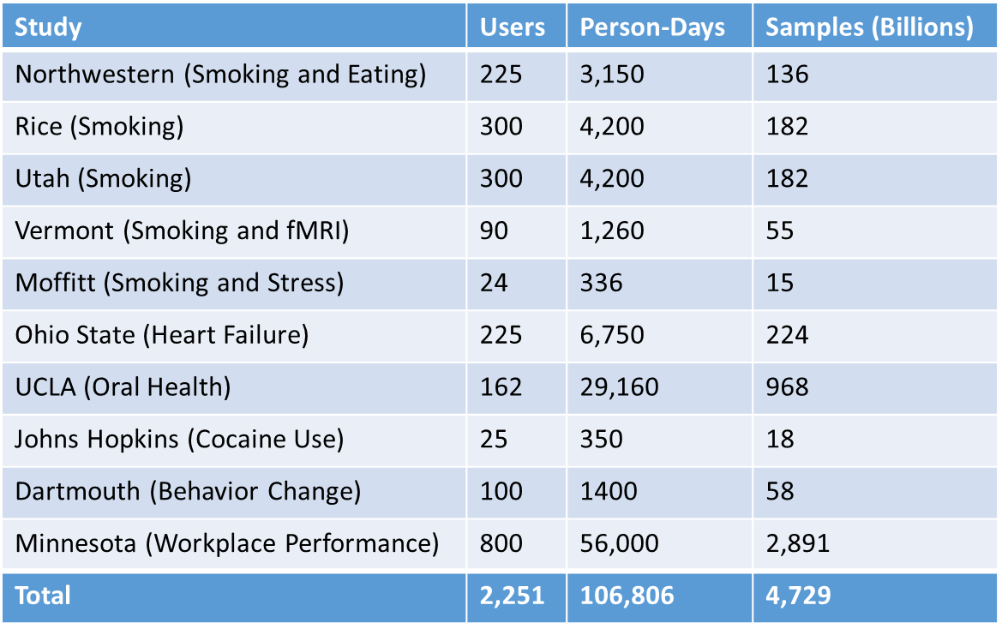
Field Studies Using MD2K Software
Entire ecosystem (sensors, software, cloud) to be available end of 2017

Slide 9
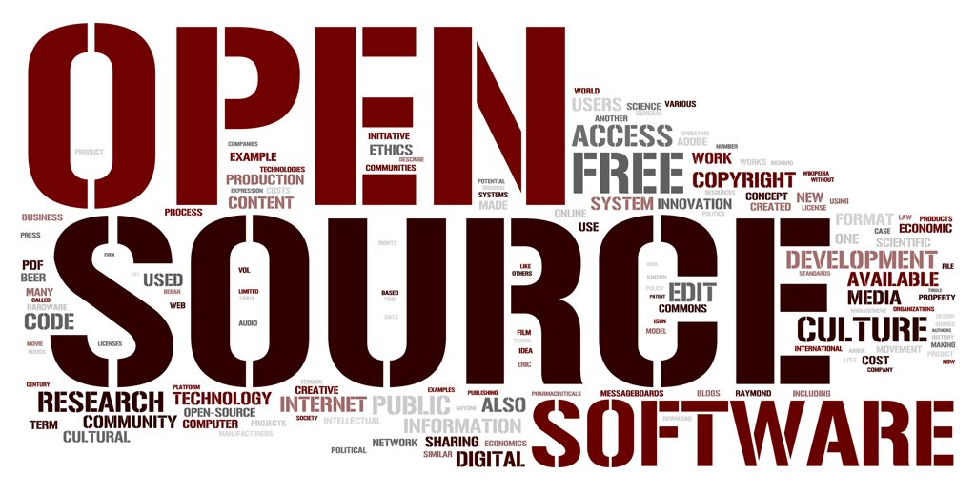

MD2K Resources
mHealth
Hub
Science,
Software,
Data
News,
Meetings
Jobs
Discussion
Forums
Match-
Making
Courses
Tutorials
Projects,
Products
github.com/MD2Korg
mHealthHub
mhealth.md2k.org/
mhealth.md2k.org/mhealth-training-institute
md2k.org
info@md2k.org

