Slide 1
MESA Frailty
Matthew Baldwin, MD, MS
Herbert Irving Assistant Professor of Medicine
Columbia University

Slide 2
NIA U19
Collaborative multicomponent award
May 25, 2018 submission
Four R01-equivalent projects
$2M direct costs/year
Data Science and Administrative Core
5-year duration
Full application by invitation
Based on letter of intent with project aims

Slide 3
Pathogenesis of Physical Frailty & Sarcopenia in Mice & Humans
Develop and test a novel biomarker signature
Unique to frailty
Allows early detection
Amenable to intervention
Biomarkers
Serum Osteocalcin
Mitochondrial function
Serum FGF-21 and GDF-15
Mitochondrial health index in PBMCs
Mitochondrial function at the neuromuscular junction
Substantia Nigra (SN) Dopamine

Slide 4
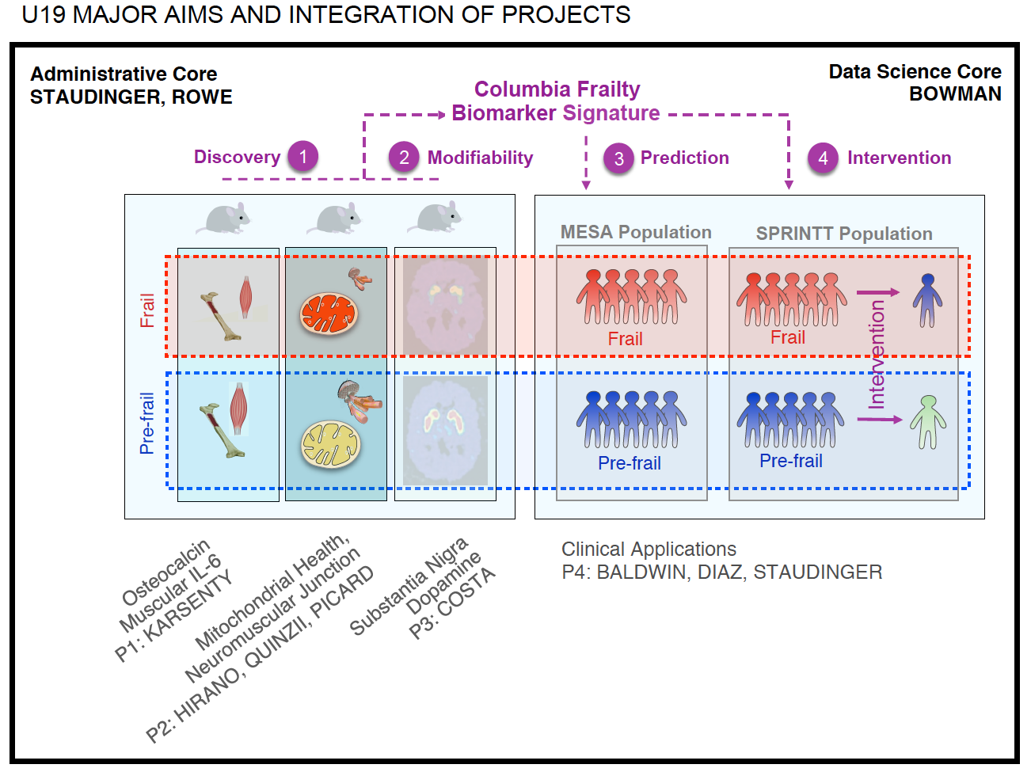

Slide 5
MESA Frailty
Project 4, AIM 1: Assess the concurrent and predictive validity of novel biomarkers of frailty in older adults.
Project 3, Aim 3: Assess the association between substantia nigra dopamine level and functional capacity in older adults.

Slide 6
Novel Frailty Biomarkers Concurrent Validity
Study Design
Cross-sectional, Exam 7
Participants
Columbia/UCLA
Exposure Variables
SN Dopamine levels (FDOPA PET CT brain), subsample by frailty status
Mitochondrial Health Index in PBMCs
Serum FGF-21 and GDF-15
Serum Osteocalcin
Outcome Variables
Frailty: Short Physical Performance Battery (SPPB)
Sarcopenia: FNIH Sarcopenia (DXA lean mass & grip)

Slide 7
Novel Frailty Biomarkers Predictive Validity (of Frailty)
Study Design
Retrospective cohort study
Participants
Columbia/UCLA Exam 7 participants
Also with clinic visit for Exam 2
Exclude home visits, minimize sampling those with prevalent frailty
Exposure Variables
Serum Osteocalcin (Exam 2)
Mitochondrial function (Exam 2)
Serum GDF-15 and FGF-21
Outcome Variables
Frailty: SPPB (Exam 7)
Sarcopenia: FNIH sarcopenia (Exam 7)
Change in physical activity survey scores (Exams 2, 3, 5, 6, 7)

Slide 8
Novel Frailty Biomarkers Predictive Validity (of Clinical Outcomes)
Study Design
Prospective cohort study
Participants
Columbia/UCLA Exam 7 participants
Exposure Variables
SN Dopamine levels (FDOPA PET CT)
Mitochondrial Health Index in PBMCs
Serum FGF-21 and GDF-15
Serum Osteocalcin
Outcome Variables (annual telephone follow-up x 3 years)
Basic ADL disability
Hospitalization
Institutionalization
Mortality

Slide 9
Substantia Nigra Dopamine & Functional Capacity
Study Design
Cross Sectional, Exam 7
Participants
Participants with FDOPA PET CT
Exposure Variable
SN Dopamine level
Outcome Variables
6MWT
Home actigraphy
Abdominal muscle mass on L4 – L5 Abdominal CT image*
Locomotion (psoas)
Stabilization (rectus abdominus, obliques, paraspinal)
*Remigio-Baker RA, Allison MA et al. BMC Psychiatry, 2015

