Slide 1
Future of MESA Thoughts on Biospecimens & Emerging Analytical Tools

Slide 2
Traditional & Emerging Biospecimens
Fluids
Serum (still required for some assays, especially clin chem)
Plasma
EDTA (most requested, if only one, get this)
Packed cells: use to isolate DNA for WGS, epigenomics
Citrate (coagulation activity assays)
Heparin (some cell prep protocols)
Platelet Poor Plasma vs. Platelet Free Plasma (critical for microvesicle work and secreted platelet biomarkers)
Special additives
PaxGene (RNA)
Protease inhibition (e.g., SCAT tubes for coagulation)
Anti-oxidation (e.g., oxidized epitopes on lipid particles)
Urine
Timed vs. spot or early morning
additives

Slide 3
Traditional & Emerging Biospecimens
Vascular cells
Cell Prep Tubes (CPT; allows preparation of PBMCs)
Direct analysis vs. cryopreservation
On-site bead separations
What’s in this Biospecimen?
Monocytes, Lymphocytes, Endothelial cells, Endothelial progenitors cells
Potentially: other rare cells (e.g., cancer)
Adipose Tissue
Sub-Q, not visceral, by suction biopsy
Can be frozen but not cryopreserved
What’s in this Biospecimen?
Adipocytes, endothelial cells, vascular cells; you can sort them
Pre-adipocytes: particularly potent (plastic) partially differentiated stem cells

Slide 4
Traditional & Emerging Biospecimens
Skeletal Muscle
Needle biopsy – painful, difficult;
What’s in this biospecimen?
Muscle cells, small amounts of vascular cells
Stool
Home Visit vs. “van-based” vs. traditional field center
Home Visit: keep samples in coolers, transport to lab or ship overnight;
“van-based”: bring van to a local site; limited processing; also can do some imaging;
Field center: theoretically all options are open

Slide 5
Where are Biomarkers Going: types of markers
Isoforms
Specificity
Sensitivity
Microvesicles
Micro- and lnc-RNA
Non-human genetic sequences

Slide 6
Protein Isoforms: higher specificity of biomarkers
Many different versions
Examples of known versions
Coagulation factors: Prothrombin
Total prothrombin
Prothrombin gamma-carboxylated isoforms
Prothrombin carboxypeptidase isoforms
Thrombin:AntiThrombin Complex
Cell-surface Biomarkers: IL-6 receptor (sIL6R)
Surface of apoptotic, activation, or secreted plasma membrane-derived microvesicles
Cleaved via metalloprotease-mediated ectodomain shedding
Cleaved via extracellular protease (e.g., neutrophil elastase)
Secreted as a soluble alternate splice form
Carboxypeptidase and aminopeptidase isoforms
IL-6:sIL-6R Complex (in all four possible forms)
IL-6:sGP130:sIL-6R Complex (in all four possible forms)

Slide 7
Microvesicles:
Often from cells that are either activating or dying; is the “cargo” targeted or stochastic?
Also proteins and
metabolites
Can we use frozen plasma samples collected as platelet-poor plasma?

Slide 8
Viral DNA
Some estimates: >8% of human genome of “recognizably viral origin” (McPherson JD, et al., Nature 409(6822):934–941).
Endogenous RetroViruses (ERVs): Ancient infections in germline cells;
most no longer code for the virus due to mutations;
Some have been co-opted to human function (now consider ”human” sequence?)
Somatic Viral Infections: recent infections of partially differentiated stem cells whose progeny yield enough of the sequenced genomes to be observed at the sequencing coverage
Unknown: the impact on health of:
The number different viruses/person
The number of different insertions/person
The location of the insertion(s) in the human genome
The SNPs and variants in the insertions

Slide 9
Where are Biomarkers Going: types of assays
Proteins
Platforms
Traditional (ELISAs, ClinChem, activities, etc)
-omic (Luminex, SomaLogic, O-link, Quanterix, LC/MS/MS
Metabolites
Many, many platforms/modes
RNA
RNA-Seq (bulk-Seq)
Single cell-Seq (sc-Seq)
DNA
Human variation (WGS, genotyping for common or rare variants)
Regulation (methylation-Seq, chip-based)
Non-human sequences (~8% of total; endogenous retroviruses, somatic infections)

Slide 10
Where are Biomarkers Going: types of samples
Cryopreserved Cells
Cytometery (flow, CyToF, cell sorting)
iPSCs
RNA-Seq, sc-Seq
Epigenomics

Slide 11
Molecular Transducers of Physical Activity Consortium (MoTrPAC)
Program Overview
N=~3,000 total
N=~300 pediatric
Molecular Transducers
Participant characteristics
Age, sex, fitness, response to training
of Physical Activity
Participant characteristics Genes Proteins Peptides Lipids
Human volunteers
Metabolomics,
Physical activity
transcriptomics,
genomics, etc.
Sugars Hormones Epigenetics mRNA
ncRNA
Animals
Tissue Samples
Human blood, muscle, adipose
Animal heart, liver, lung, brain

Slide 12
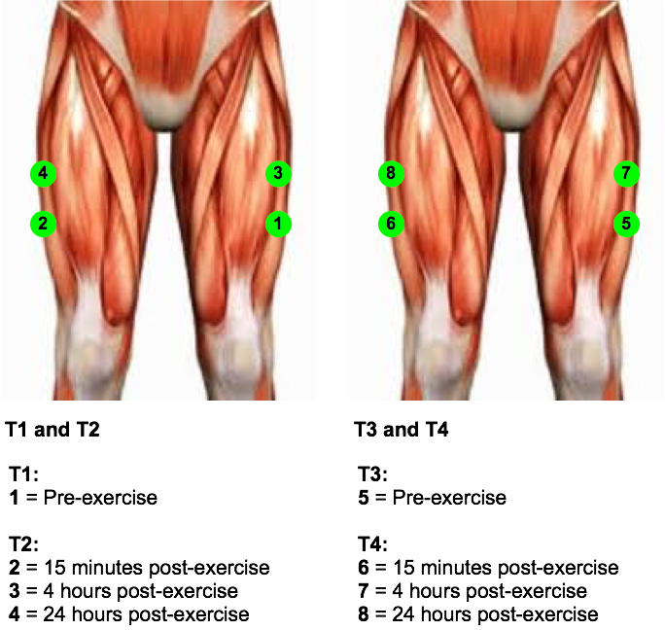
MoTrPAC

Slide 13
MoTrPAC

Slide 14
MoTrPAC Assays
Metabolomics
Untargeted-RPLC: hydrophobic compounds
Untargeted-HILIC: hydrophilic compounds
Untargeted GC: volatile compounds
Lipidomics
Amino Acids
Acylcarnitines
Organic acids
Nucleotides
Sphingolipids
Ketoacids
Ceramides
Acyl-CoAs
Oxylipins
Eicosanoids
Vitamins
Steroids
Oxylipins
Organic acids
Lipidomics -PUFA
Proteomics
Global Proteome
Phosphoproteome
Acytlproteome
SomaLogic
Sequencing-Based
Transcriptomics
ATAC-seq
Methylome
WGS

