Slide 1
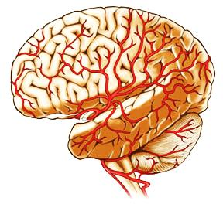
Ancillary Study Proposal Update: Multisite MESA-AD Study
AD
Timothy Hughes, PhD
Kathleen Hayden, PhD
Jose Luchsinger, MD
Greg Burke, MD, MSc
On behalf of MESA investigators

Slide 2
AD
Submitted to NIA on 3/5/2018
Study Section review on 06/22/2018
36 co-Investigators
8 Budgets
22.6M Total

Slide 3
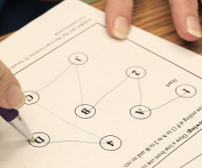
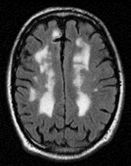
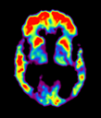
MESA-AD Proposal (MPI: Hughes, Hayden, Luchsinger, Burke)
Full cohort extension of ‘MESA Memory’ leveraging ‘Epigenetics of AD’ and ‘MESA AFib’
Enroll 3,000 (75% eligible) following Exam 6
Repeated cognitive testing and MRI
Aβ PET in a subset (n=1,500 at CUMC, JHU and WFU)
Cog
MRI
PET
Cog
MRI
Exam 6
Exam 7
Exam 8
2017 2018 2019 2020 2021 2022 2023 2024

Slide 4
Exam 7 (2019 – 2022) n = 3,000
Exam 8 (2022 – 2024) n = 2,400
AD Study
MESA CC
Johns
Hopkins
Wake Forest
Minnesota
Columbia
North-western
UCLA
AD Study
AD Study
(n=532)
(n=677)
(n=646)
AD Study
AD Study
(n=753)
(n=663)
(n=696)
AD Study
MESA-AD Proposal
MESA Sites
Multisite AD Study
Notes:
Facilitate building robust collaborations between MESA field centers and local AD Centers/Programs.
Such collaborations are new recommendations for NIH-funded AD Centers.
Large budget grant to NIA fund Exam 7 and Exam 8
Ample opportunity to link up additional ancillary CVD studies

Slide 5
Exam 6 (n=4,000)
2016-2018
Exam 7 (n=3,000)
2019-2022
Exam 8 (n=2,400)
2022-2024
MESA AFib
A253 at all sites (n=1500)
CASI, DSC and DS
MESA AFib
All sites (n=1200)
Brain MRI
MESA Memory
A301 at WF site (n=540)
Cognitive Testing
Brain MRI
Amyloid PET
MESA Memory
A301 at WF site (n=430)
Cognitive Testing
Brain MRI
Epigenetics of AD
A251 at JHU site (n=500)
Cognitive testing
Epigenetics of AD
A251 at JHU site (n=400)
Cognitive testing
MESA-AD (Exam 7)
(n=3,000)
Cognitive Testing, n*=2,170
Brain MRI, n*=1,500
Amyloid PET, n*=1,000
MESA-AD (Exam 8)
80% repeated (n=2,400)
Cognitive Testing
Brain MRI
n* = number needed for complete enrollment.
Total n for MESA-AD PET is 1,500

Slide 6
MESA-AD Design
Procedures | ‘Exam 7’ (2019-2022) | Follow-up ‘Exam 8’ (2022-2024)
Enrollment & Consenting | X | X
Clinical Evaluation | X | X
Medication Review | X | X
Physical Exam, Blood Collection | X | X
Cognitive Assessment (in-person) CASI, DSC, DS UDS-3 | X | X
Brain MRI (volume, blood flow) | X | X
β-amyloid PET Imaging | X
MESA ‘Classic’ / Ancillary Measures | ? | ?
CASI: Cognitive Abilities Screening Instrument; DSC: Digit Symbol Coding; DS: Digit Span;
UDS-3: Uniform data set v3 used by all Alzheimer’s Centers

Slide 7
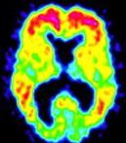
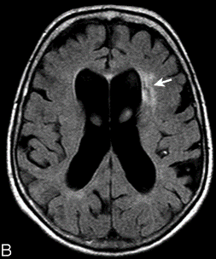
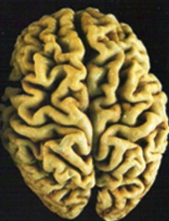
Aims: Subclinical Vascular Disease and Dementia Pathology
Alzheimer’s Disease
Amyloid Pathology
‘Mixed
Dementia’
Vascular
Dementia
Subclinical
Atherosclerosis
Arteriosclerosis
Small Vessel
vs.
Clinical CVD
Framingham
ASCVD-PCE
SA1a
Small Vessel Disease
SA1b
SA2
SA1c
Neuro-
degeneration
Molecular Changes
SA3
Effect Modifiers
Parent MESA Study
(2000 – 2018)
MESA-AD Study
(2019 – 2024)
Notes:
Aim 1: We hypothesize that mid-life subclinical vascular risk factors and summary composites (developed by factor analysis representing atherosclerosis, arteriosclerosis and small vessel disease) are associated with AD biomarker severity independent of clinical CVD risk scores (e.g., Framingham, CAIDE), specifically:
Sub-aim 1a: greater burden of Aβ deposition ([¹¹C] Pittsburgh compound B uptake);
Sub-aim 1b: greater burden of cSVD (e.g., reduced cerebral perfusion, increased white matter disease);
Sub-aim 1c: greater AD-patterned neurodegeneration (e.g., hippocampal atrophy and cortical thinning).
Aim 2: We hypothesize that key subclinical vascular factors (e.g., arterial stiffness, arterial calcification) and summary composites predict incident cognitive impairment, greater cognitive decline over ~12 years (2010-12 to 2022-24), cortical thinning, and hippocampal volume loss over 3 years.
Aim 3: We hypothesize that integrated ‘multi-omic’ analysis approaches using unique ‘omics data available in 1,800 MESA participants repeated over 6+ years (e.g., genomics, epigenomics, transcriptomics and metabolomics) will identify common molecular pathways from gene networks (e.g., autophagy) linking subclinical vascular changes to AD-related outcomes.
We will also explore whether individual or combinations of vascular factors are more strongly related to changes in cerebral blood flow, microstructural integrity, cognitive and AD biomarker profiles within each racial/ethnic group and by sex in the context of genetic risk (e.g., APOE and ABCA7).

Slide 8
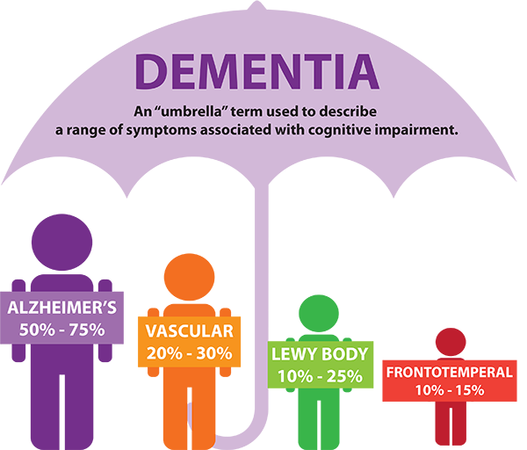
AD is most often ‘Mixed Dementia’
Vascular
AD +
Vascular
‘Pure’ AD
Schneider et al. Neurology 2007 and Annal Neruol 2009

Slide 9
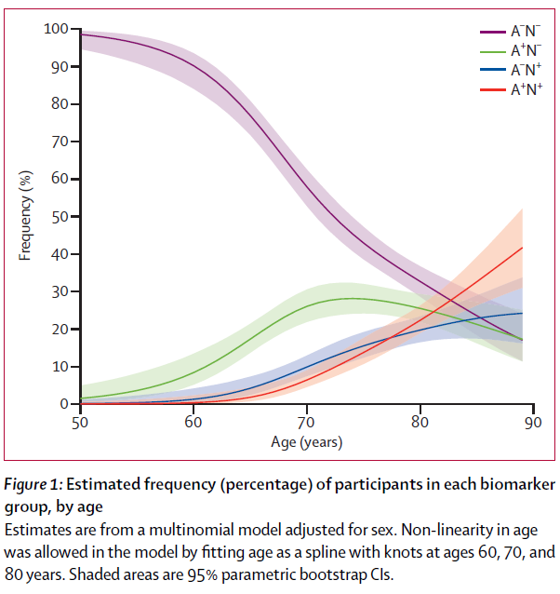
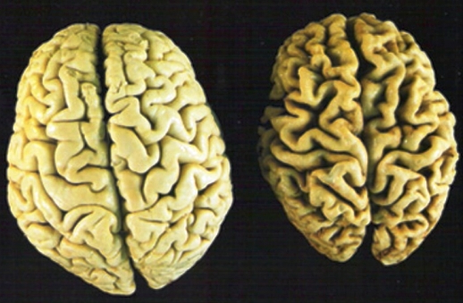
β-Amyloid
A- A+
Neurodegeneration
N- N+
Tau
T- T+
Missing ‘T’ for A/T/N Criteria
Jack et al. Lancet Neruology Vol 13 October 2014

Slide 10
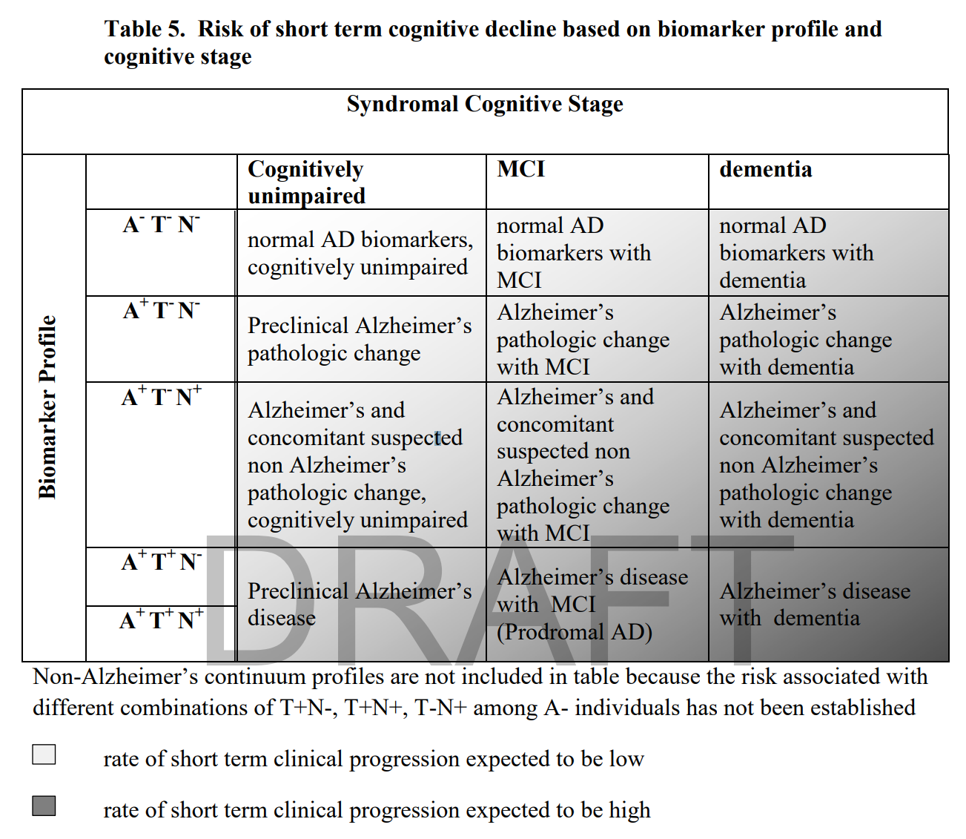
A/T/N Criteria New Standard for Research Diagnosis of AD https://www.alz.org/aaic/downloads/nia-aa-draft-11-27-2017.pdf
A+
T+
N+

Slide 11
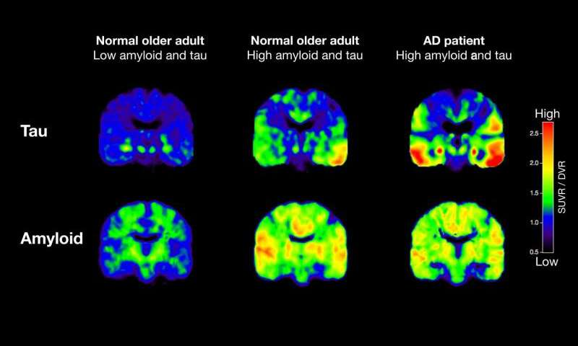
Tau ‘T+’ Tracks More Closely with AD Progression
https://medicalxpress.com/news/2016-03-pet-scans-reveal-key-alzheimer.html
Modified from Schöll, Lockhart et al., Neuron 2016

Slide 12
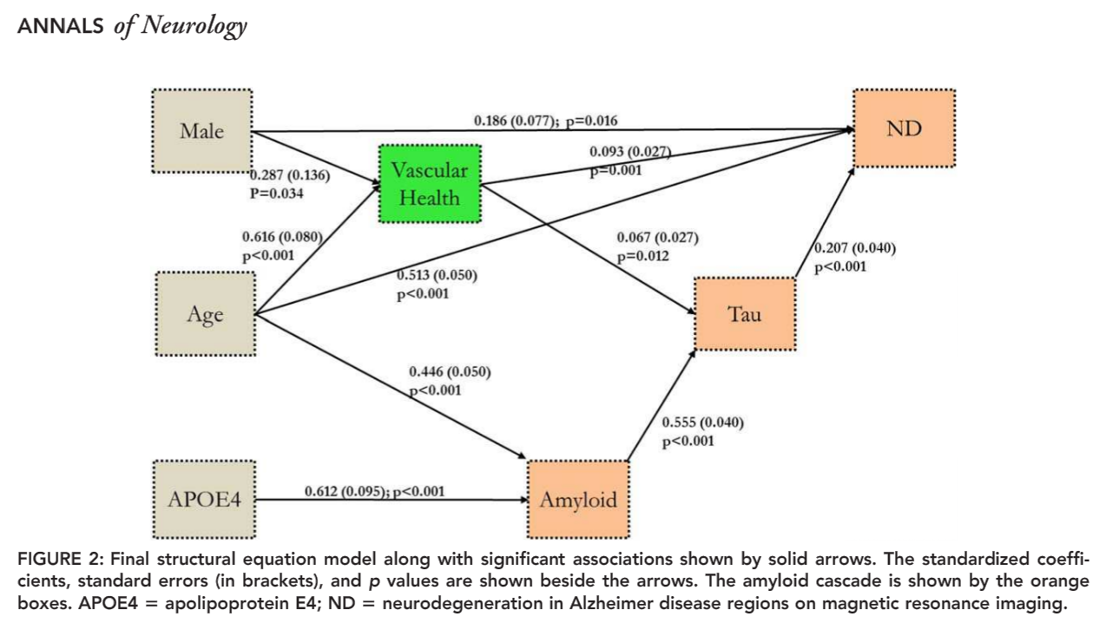
Vascular Risk Factors for Tau Pathology?
Vemuri et al. Annals of Neurology 2017

Slide 13
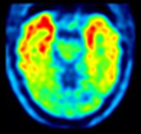
MESA: Tau Estimates of Risk for Alzheimer’s Disease (METER-AD)
Goal to add Tau-PET scans at WF site to proposed ‘Exam 7’ (2019-22) and ‘Exam 8’ (2022-24).
SA1: Tau-PET with: Aβ, MRI and vascular risk factors.
SA2: Tau-PET predicts: cog decline, changes on MRI.
SA3: Tau-PET explain racial/ethnic disparities in AD.
Sam Lockhart, PhD
Assistant Professor
WF ADCC
Cog, MRI, Aβ
Tau
Tau
Exam 6
Exam 7
Exam 8
2017 2018 2019 2020 2021 2022 2023 2024

Slide 14
+ METER
AD
Alzheimer’s Disease
Amyloid Pathology
Sub-Clinical CVD
Tau Pathology
Neuro-
degeneration
Vascular
Dementia
Small Vessel Disease

Slide 15
+ METER
AD
Alzheimer’s Disease
Amyloid Pathology
Sub-Clinical CVD
Mixed
Dementia
Vascular
Dementia
Tau Pathology
Neuro-
degeneration
Small Vessel Disease

Slide 16
Many, Many Thanks
MESA Steering Committee
MESA Coordinating Center
Wake Forest AD Center
MESA Sites
JHU (Post, Lyketsos)
Columbia (Shea, Luchsinger)
Northwestern (Allen, Liu)
Minn (Folsom)
UCLA (Watson)
WFU (Burke and Team)
MESA Participants

Slide 17
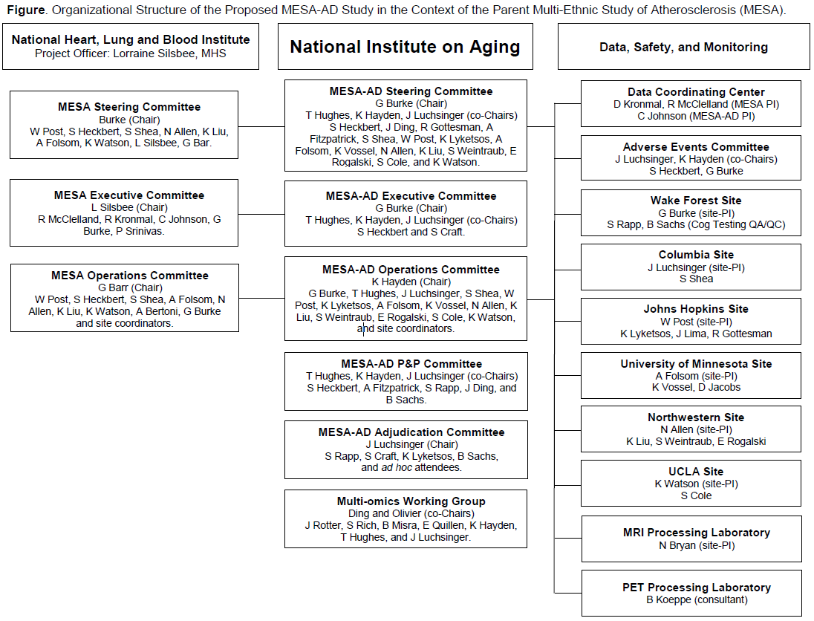

Slide 18
Table. Number of Participants from Ancillary Studies Leveraged for MESA-AD Study by Data Type
 | Data Collected by the |  | Data Leveraged (bolded) from |  |  |  |  | MESA-AD Totals
 | Proposed Study |  | Ongoing MESA Ancillary Studies
 | MESA-AD Study |  | VASCAD (PI Hughes) |  | AFib (PI Heckbert) | Epigenetics of AD (PI Ding)
Participating sites | All sites |  | WFU only |  | All sites | JHU only^
 | Exam 7 | Exam 8 | Exam 6 | Exam 7 | Exam 6-7 | Exam 6 | Exam 7 | Exam 7 | Exam 8
Collection Years | 2019-21 | 2022-24 | 2016-19 | 2019-21 | 2016-19 | 2016-18 | 2019-21 | 2019-21 | 2022-24
Cognitive Data
CASI, DSC, DS | 1370 | 2400 | 500 | 430 | 1200 |  |  | 3000 | 2400
UDS v3 | 2170 | 2400 | 500 | 430 |  | 500 | 400^ | 3000 | 2400
Imaging Data
Brain MRI | 1370 | 2400 | 500 | 430 | 1200 |  |  | 3000 | 2400
Aβ-PET* | 1000 |  | 500 |  |  |  |  | 1500
Uniform Data Set version 3 (UDS v3) enable cognitive adjudication (normal, MCI and dementia subtypes).
*PET imaging at 3 sites (Wake Forest, Columbia and Johns Hopkins).
‡AFib funded MRI and cognitive data on 1500. Shown the 1200 that do not overlap with VASCAD.
^Epigenetics of AD (n=1800) leverages cognitive data from WFU participants in VASCAD.
*MESA-AD (MPI: Hughes, Hayden, Luchsigner and Burke) resubmitted to NIA March 5, 2018. Brings Exam 7 and * to all MESA sites.

