Slide 1
Comparison of Ambulatory Blood Pressure Monitoring and Home Blood Pressure Monitoring in the Diagnosis of Masked Hypertension among Older Adults
Yuichiro Yano, MD, PhD
Department of Preventive Medicine, University of Mississippi Medical Center
Daichi Shimbo, MD
Department of Medicine, Columbia University
Paul Muntner, PhD
Department of Epidemiology, University of Alabama at Birmingham

Slide 2
Background
High blood pressure (BP) variability leads to a discrepancy in the diagnosis of hypertensive BP using measurements in and outside of the clinic.
25-40% of older adults with non-hypertensive BP in the clinic have hypertensive BP outside of the clinic, a phenotype called masked hypertension.

Slide 3
Masked hypertension revealed by 24-hour ambulatory blood pressure monitoring (ABPM)
280
Awake BP
Asleep BP
Awake BP
240
200
SBP
180
140
120
DBP
80
c
90
40
Hypertensive out-of-clinic BP
0
Normotensive clinic BP
Normotensive clinic BP
矢野裕一朗 苅尾七臣. Annual Review循環器 2010
矢野裕一朗 苅尾七臣. Annual Review循環器 2010

Slide 4
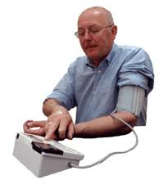
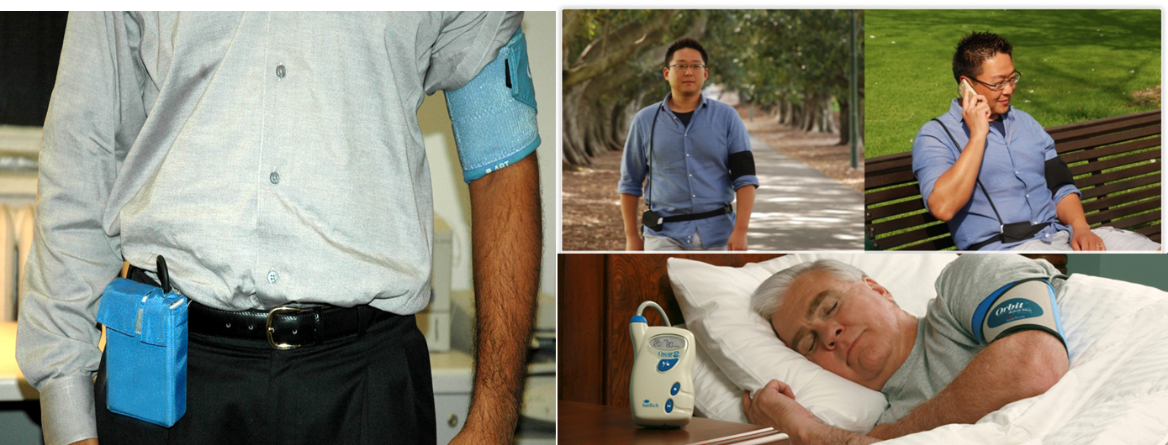
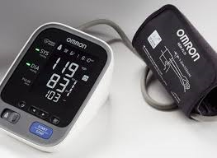
Out-of-clinic BP measurements
24-hour ABPM (reference standard)
Home BP monitoring (HBPM)
Individual measuring person’s BP at home in a resting condition
Typically twice in the morning and twice in the evening, for several days.
Not including BP measurements during sleep
Wearable, oscillometric BP device
Automatically measure and record BPs at prescribed intervals (every 15-30 minutes) over an 24-hour period

Slide 5
The knowledge gap
Little is known among older adults whether HBPM is comparable to ABPM for identifying masked hypertension

Slide 6
Aim 1: Determine the concordance in the diagnosis of masked hypertension defined using in-home BP versus BP measurements on ABPM.
Hypotheses: 1.1) 30% of adults with sustained normotension defined using in-home BP will be categorized as masked hypertension when defined using awake BP; 1.2) 50% of adults with sustained normotension defined using in-home BP will be categorized as masked hypertension when defined using awake and asleep BP; and 1.3) These discordance will be larger in African Americans than other racial/ethnic groups.

Slide 7
Aim 2: Determine factors associated with the discordance in the diagnosis of masked hypertension defined using in-home BP versus awake BP on ABPM.
Hypothesis: Physical activity and orthostatic BP change will be associated with the discordance in the diagnosis of masked hypertension defined using in-home BP versus awake BP

Slide 8
Secondary Aim (subgroup study): Compare the association of masked hypertension defined using in-home BP versus BP measurements on ABPM with LV hypertrophy.
Hypotheses: 1.1) The association of masked hypertension with LV hypertrophy will be weaker when defined using in-home BP versus awake BP; and 1.2) The association of masked hypertension with LV hypertrophy will be stronger when defined using asleep and awake BP versus awake BP alone.

Slide 9
Procedures
Participants will undergo ABPM and HBPM with an accelerometer in a random order.
We will enroll 600 participants aged 65 years or older; 150 whites, 150 African Americans, 150 Hispanics, and 150 Chinese. Within each group, the sample will be 50% female and 50% participants are not taking antihypertensive medication.
Half of them will conduct echocardiography to achieve secondary aim.

