Slide 1

Metabolically Healthy Obesity:
Resilience or just a matter of time?
Morgana Mongraw-Chaffin, PhD, MPH

Slide 2
Conflict of Interest
I have nothing to disclose.

Slide 3
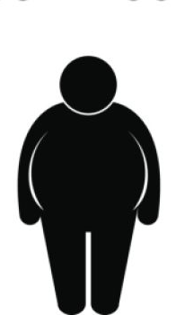
Metabolically Healthy and Unhealthy Obesity
Healthy Obesity
Unhealthy Obesity
Obesity by BMI
Low waist circumference
No diabetes
No hypertension
High HDL cholesterol
Low triglycerides
Obesity by BMI
High waist circumference
Diabetes
Hypertension
Low HDL cholesterol
High triglycerides

Slide 4
Two Unresolved Questions about Healthy Obesity:

Slide 5
Is metabolically healthy obesity a stable condition?
What percentage of MHO remain that way over time?
38% after 25 years (Kaur et al.)
30% after 8 years (Appleton et al.)
48% after 6 years (Soriguer et al.)
Kaur et al. Does metabolic health in overweight and obesity persist? – Individual variation and
cardiovascular mortality over two decades. Europ J Endocrin. 2016;175:133-143

Slide 6
What is the CVD risk from metabolically healthy obesity?
Zheng et al. The long-term prognosis of cardiovascular disease and all-cause mortality for metabolically healthy obesity: a systematic review and meta-analysis. J Epidemiol Community Health. 2016;70:1024-1031

Slide 7
MHO and Risk for CVD
Cardiovascular events risk for metabolically healthy obesity in different subgroups compared with metabolically healthy normal weight
Zheng et al. The long-term prognosis of cardiovascular disease and all-cause mortality for metabolically healthy obesity: a systematic review and meta-analysis. J Epidemiol Community Health. 2016;70:1024-1031

Slide 8
Is healthy obesity a stable condition?

Slide 9
Hypotheses
Transition from metabolically healthy obesity to metabolic syndrome will be common
Greater severity and longer duration of obesity will be associated with greater incident metabolic syndrome

Slide 10
Results: Prevalence of MetS
48% of those with MHO transitioned to MetS in 10 years
48% for those without any measured obesity across completed follow up
72% for participants with obesity at any visit
Obesity Level | Prevalence of MetS
I | 69%
II | 76%
III | 78%

Slide 11
Transition from Healthy to Unhealthy Obesity in MESA
Mongraw-Chaffin et al. JCEM. 2016; 101(11): 4117-4124

Slide 12
What is the cardiovascular disease risk
from healthy obesity?

Slide 13
Hypotheses
Heterogeneity in CVD risk will be explained by transition from MHO to MUO
The obesity/CVD relationship will be significantly and substantially mediated by metabolic syndrome

Slide 14
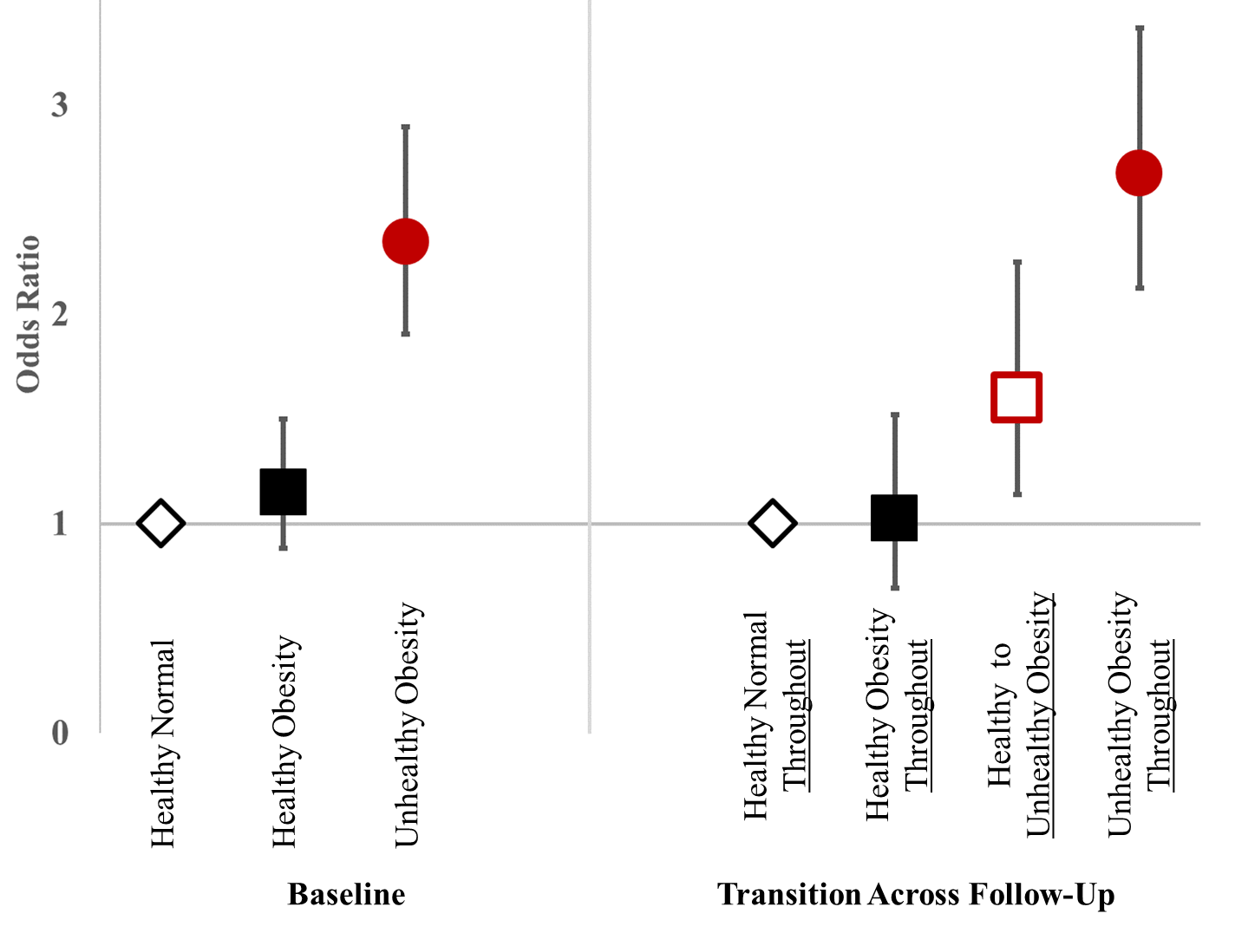
Transition from Healthy to Unhealthy Obesity
and CVD
BUT
48% became unhealthy!
Cardiovascular Disease
(Odds Ratio)
Heart Disease Risk

Slide 15
Transition from Healthy to Unhealthy Obesity
and CVD
Cardiovascular Disease
(Odds Ratio)
Heart Disease Risk

Slide 16
Mediation
62% (44-100%)
Obesity
MetS
CVD
Mongraw-Chaffin et al. JACC. 2018; 71(17): 1857-1865

Slide 17
Summary
Healthy obesity is a transient condition and few individuals are resilient to obesity given time
Continued obesity is a major contributor to MetS and continued MetS is a major contributor to CVD
Healthy obesity is a risk factor for CVD in almost half of individuals across 12 years
Weight loss and lifestyle management for CVD risk factors should be recommended to all individuals with obesity

Slide 18
Acknowledgements
Co-authors
  Cheryl Anderson
  Gregory Burke
  Meredith Foster
  Nowreen Haq
  Rita Kalyani
  Pamela Ouyang
  Christopher Sibley
  Russel Tracy
  Dhananjay Vaidya
  Mark Woodward
MESA
I would like to thank the other investigators, the staff, and the participants of the MESA study for their valuable contributions.
MESA is supported by contracts and grants from NHLBI and NCRR

Slide 19
Thank You!
Any Questions?

Slide 20
MetS and CVD in participants with obesity
Notes:
CHDS, but the work I was really interested in was about women’s reproductive health and how that affects later life risk for CVD.
Pre-eclampsia work at CHDS
this work while at Hopkins

Slide 21
MHO with CVD and all-cause mortality
Notes:
CHDS, but the work I was really interested in was about women’s reproductive health and how that affects later life risk for CVD.
Pre-eclampsia work at CHDS
this work while at Hopkins

