Slide 1
Long-term blood pressure control and progression in arterial stiffness: Impact of diabetes and ageing
Yacob Tedla, PhD
Research Assistant Professor
Center for Health Information Partnership
Feinberg School of Medicine
Northwestern University
Notes:
Thanks merci for that wonderful introduction. Today I will present some of the research work I have done in the past 2 years and specifically we will see the impact of long-term BP control, long-term BPV and long-term optimal health behavior on the progression of arterial stiffness.
This is a practice presentation for an invited talk at the 2018 MESA Steering Committee meeting to be presented in Maryland at the end of this month.
My presentation will focus on the impact of long-term BP control, BP variability and optimal health behavior on the progression of arterial stiffness over 10 years time.

Slide 2
Acknowledgment
Collaborators
Northwestern University, Department of preventive medicine
Philip Greenland, MD
Mercedes Carnethon, PhD
Kiang Liu, PhD
Laura Colangelo, MS
University of Wisconsin Madison, Division of Cardiovascular Medicine
James H. Stein, MD
Adam D. Gepner, MD
John Hopkins University, School of Medicine
Dhananjay Vaidya, MPH, PhD
Notes:
I would like to start by acknowledging my mentors and collaborators of the research work I did in the past 2 years. I would like to give special thanks to Dr. Greenland and Dr. Carnethon for being extraordinary mentors and the guidance they offered on my research work and career advices they have given me. I am also thankful to the other collaborators from this department as well as UW-Madison D Pop Health, Division of Cardiology, John Hoplins Uni, Uni of Washington, and the NIH. All these individuals has made significant contribution on the work I am presenting today.
I would like to acknowledged my mentors and collaborators for this research work and I would like to give special thanks to Phil and Merci who are still mentoring me on all research works I am doing.

Slide 3
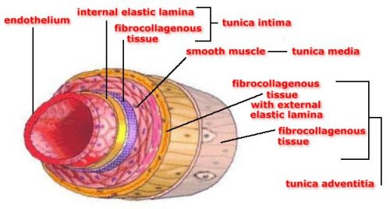
Arterial stiffness
Arterial stiffness = rigidity of the arterial wall = loss of elasticity
Arterial stiffness results from
Degradation of elastin
Excess collagen deposition
Hypertrophy of smooth muscle layer
Notes:
Arterial stiffness simply means losing the elastic property of the artery. It is the hardening or rigidity of the arterial wall. Stuffer arteries are less able to increase their diameter and accommodate the changes in pressure induced either by contraction of the heart or high blood pressure and this cause adverse effect on organs like the heart, kidney and brain.
This graph shows that large arteries are made up of an outermost layer (tunica adventitia) composed of connective tissue and collagen fibers, a middle layer (the tunica media) composed of smooth muscle cells and elastic layers, and an innermost layer (tunica intima) made up of endothelial cells.2, 30 Between inner and middle and middle and outer layer there is an elastic protein called Elastin (the distensible material) and there is also the structural protein collagen (the stiff material). The relative content of collagen and elastin within the arterial wall is regulated and kept in balance by an enzymatic (metalloproteinase) process of production and degradation.29
Factors such as hypertension, aging, diabetes, and arterial wall inflammation cause dysregulation of this balance and lead to degradation and fatigue of the elastic layer, excess collagen deposition, and hypertrophy of the smooth muscle layer, which causes arteries to lose their elastic property and to loss capacity to stretch and recoil in response to changes in blood pressure.
Arterial stiffness simply means rigidity or loss of elasticity of the arterial wall. In humans, large arteries are made up of three layers, an inner layer of endothelim, middle layer of smooth muscle cell and an outer later of connection tissue. In between the inner and middle layer as well as the middle and our letter, there an elastic protein called elastin and a collagen which is a more rigid structural protein. The relative content of collagen and elastin within the arterial wall is regulated and kept in balance by an enzymatic (metalloproteinase) process of production and degradation. Exposure to certain risk factors like high BP and aging cause the degradation of elastic, excess deposition of collagen and hypertrophy of smooth muscle cell layer. All these structural and functional changes makes arterial wall to be harder and stiffer.

Slide 4
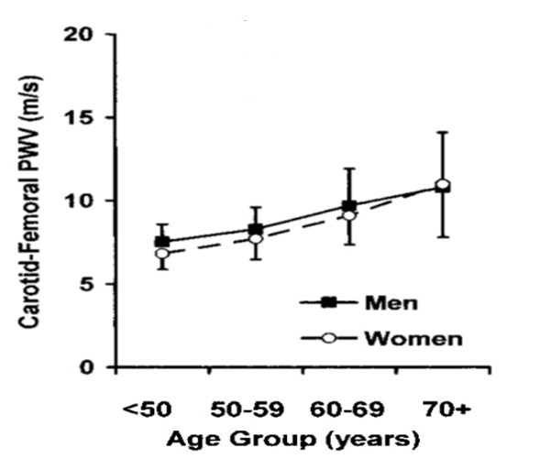
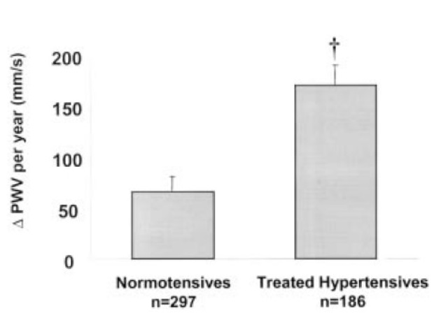
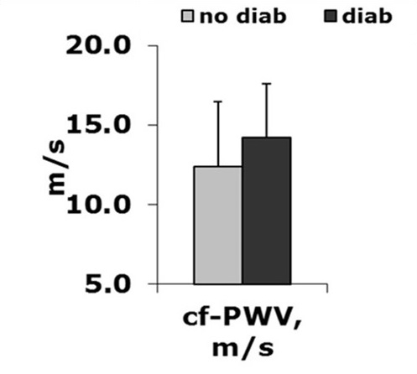
Major risk factors of arterial stiffness
Age
Hypertension
Diabetes
Mitchell et al, Hypertension. 2004;43:1239-1245
Benetos et al. Circulation 2002, 105:1202-7
Agnoletti. 26th ESH. Paris (France), June, 2016
Notes:
The three major risk factors for arterial stiffness are aging, high blood pressure, and diabetes.5-9 The adjusted risk of arterial stiffness is six times higher among the elderly than in middle age adults.10 Even among healthy individuals with no risk factors for arterial stiffness, (no hypertension, no diabetes, have healthy behviors), PWV increases linearly with age and ranges from a mean of 6.2 m/s among people <30 years to a mean of 10.9 m/s among people >70 years.33 . PWV progression is also three times higher in poorly controlled than in well-controlled hypertensive patients.5 Interestingly, aortic stiffness is also found to be an independent predictor of the development of hypertension in normotensive subjects.35 Liao et al.36 found that a one standard deviation increase in arterial stiffness was associated with a 15% increase in risk of future hypertension development adjusting for other major risk factors. Thus, there is a continuous vicious cycle between hypertension and arterial stiffness, where uncontrolled hypertension increases large artery stiffness and this, in turn, worsens hypertension that leads to increase in large-artery stiffness.37 Also, diabetic patients have twice the risk of having stiffer arteries than non-diabetic patients after adjusting for other risk factors.8 However, when stratified by hypertension status, diabetes was a significant predictor of arterial stiffness among hypertensive patients but not in non-hypertensive individuals.8
While large- and central-artery stiffness progresses with age, the elastic properties of the smaller and peripheral arteries change little 34 or not at all with increasing age.6
The distribution of pulse wave velocity (PWV) among healthy individuals with no known risk for arterial stiffness differs substantially by age and sex, and is higher among men and the elderly.33 The mean PWV is 7.4 m/s among females and 8.2 m/s among males.

Slide 5
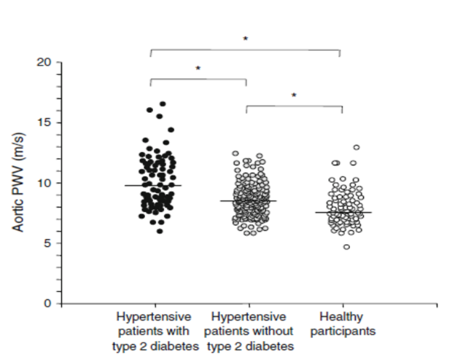
Major risk factors of arterial stiffness
Vascular structural damages (i.e. elastin degradation, collagen deposition, SMC hypertrophy) get worse in hypertensives with diabetes and older hypertensives
    Consequently, BP control may not be enough to slow progression of arterial stiffness in these patients
Bruno et al. Diabetologia 2012;55:1847-55
Benetos et al. Circulation 2002, 105:1202-7
Notes:
The increase in pressure on the walls of arteries among hypertensive patient, causes structural and functional damage on the wall of the artery and thus stiffens arterial wall. In fact microscopic examination of the vessel wall among hypertensive patients consistently show higher degradation of elastin, collagen deposition and SMC hypertrophy.
The effect of hypertension on arterial stiffness may be modified by age and diabetes. For instance, the rate of cfPWV progression per year was more than twice higher among hypertensive patients above age 50 years (cfPWV = 244+23 mm/s) than among hypertensive patients less than 50 years (cfPWV = 102+41 mm/s).19 Similarly, the effect of hypertension on arterial stiffness (cfPWV >12m/s) was found to be three times higher among patients with diabetes than in those without diabetes.88
One aim of our study is to look at whether controlling BP decrease the progression of arterial stiffness simialry among hypertensive patients with diabetes as compared to hypernsives without diabers as well as among older hypertensive patients as compared to younger hypertnsives.
Hypertension causes arterial stiffness through functional and structural changes in the walls of the arteries.54, 55 Young hypertensive adults tend to have increased resistance in peripheral arteries and arterioles, creating an increase in pressure on the walls of large and central arteries, which makes arterial elastic layer to stretch and become stiffer.55 Prolonged elevated blood pressure also leads to hypertrophy and hyperplasia of the arterial smooth muscle cell layer.
Isolated or increased systolic blood pressure and decreased diastolic blood pressure are commonly seen among the elderly and results in widened pulse pressure.37, 55 This is accompanied by fissuring and fracturing of the
elastin protein, collagen proliferation, and calcium deposition that induces further stiffness of arterial walls.37, 55
Talk about first aim

Slide 6
Study aim
To investigate the association between long-term BP control and 10-year progression in arterial stiffness among hypertensive patients and assess if age and diabetes modify this association.
Notes:
The EHLS is a longitudinal population-based study of hearing impairment among 3753 adult residents of Beaver Dam, Wisconsin at baseline (1993-1995).28
From 1987 to 1988, 5924 residents of Beaver Dam, Wisconsin between the ages 43 to 84 years were identified through a private census and were invited to participate in a study of ocular disorders.56 Subjects who participated in the ocular study and were alive by 1993 (n= 4541) were eligible to participate in the EHLS, and of those, 3753 (82.6%) participated in the baseline (1993–1995) of EHLS.57 The 5-year follow-up data collection was made from 1998 to 2000 (n = 2,800), followed by a 10-year follow-up examination from 2003–2005 (n = 2,395) and 15-year follow-up examination from 2009–2010 (n = 1,812).57 The main reason for nonparticipation during each of the follow-up examinations was death, refusal to participate, and loss to follow-up.28, 57, 58
The primary outcome variable (arterial stiffness) was measured only in the 15 years of follow-up evaluation. Additional data collected at baseline and during the 5, 10 and 15 years follow-up evaluation are: socio-demographic factors, economic indicators, medical history, activity of daily living, sleep behaviors, general health status, depression, medication use, chronic diseases, cognitive status, lifestyle factors, occupation and leisure activities, and hearing capacity. Examinations conducted are hearing, olfaction (sense of smell), and memory assessment, as well as blood pressure measures, an ultrasound scans of the carotid arteries in the neck, measurement of pulse wave velocity, and drawing blood to measure cholesterol, HbA1c, and inflammatory markers. The EHLS was approved by the UW Institutional Review Board.

Slide 7
Data source
Multi-Ethnic Study of Atherosclerosis (MESA)
Longitudinal population based study from six centers in the United states
Participants are 6814 men and women (mean age 62, range 54-84 yrs) with diverse ethnicity and no CV events at baseline
Main study variables | Visit 1 (N=6814) 2000-2002 | Visit 2 (N=6239) 2002-2004 | Visit 3 (N=5946) 2004-2005 | Visit 4 (N=5818) 2005-2007 | Visit 5 (N=4655) 2010-2011
Arterial stiffness | X |  |  |  | X
Blood pressure | X | X | X | X
Adjusted covariates | X
Notes:
57.7% were women in EHLS

Slide 8
Eligible participants
Compared to all eligible
participants, those with
measured arterial stiffness at
visits 1 and 5 were:
younger
had lower systolic BP
less likely to be hypertensive
less likely to be diabetic
Notes:
Aim 1. Furthermore, participants who survived to visit 5 and had arterial stiffness measurement were slightly younger, less obese, had lower SBP and higher eGFR and more likely to be diabetic at baseline than all eligible MESA participants.
We have made a sensitivity analysis weighting by the inverse probability of being a participant in our study among all eligible participants and compared the the weighted and unweighted estimates.
In the MESA, there were 2051 participants with hypertension across all visits 1 to 4 and 906 of those had ultrasonography image of the common carotid artery at visits 1 and 5 and complete date on adjusted covariates.
In the MESA, there were 2,314 participants who had complete data for systolic BP for at least three visits out of the total five visits and were not also taking antihypertensive medications at all the visits. Among those, 1,122 had ultrasonography imaging of the common carotid artery at both visits 1 and 5 and complete data on adjusted variables.

Slide 9
Outcome (arterial stiffness) measurement
Ultrasound images of the common carotid artery were taken at visits 1 and 5
Supine brachial BP was taken immediately before ultrasound
Distensibility coefficient = ΔA/(A_{d} * PP)
= (D_{s}²-D_{d}²)/(D_{d}² * PP)
Where ,
Ds and Dd are the internal diameters of artery at peak-systole and end-diastole, and PP is brachial pulse pressure.
Percent change in DC = ((Visit 5 – Visit 1) / |Visit 1|) * 100
Eur Heart J. 2006;27:2588-2605
Notes:
Ultrasound images of the common carotid artery were taken at visits 1 and 5 approximately 1 cm below the carotid bulb. At visit 1, B-mode ultrasound video image of a longitudinal
section of the right common carotid artery, was taken using a Logiq 700 ultrasound system and recorded in a videotape. Video images were digitized at high resolution using a medical digital recording. Similar
recording was made at visit 5 using the same ultrasound and digitizing equipment; however, the video images were directly digitized using the medical digital recording settings without use of videotape. Immediately, before obtaining ultrasound images, supine brachial BP was taken at visits 1 and 5 using a standardized protocol with an automated upper arm sphygmomanometer
Carotid artery systolic and diastolic diameters were determined by the largest and smallest diameters during the cardiac cycle. Three measurements were taken to derive mean internal diameter at peak systole and mean internal and external diameters at end diastole of carotid artery from two to three consecutive cardiac cycles.
European Society of Hypertension (ESH)/European Society of Cardiology (ESC) guidelines for the management of arterial hypertension suggested the measurement of aortic PWV, which is considered the gold standard method for assessing AS
CF-PWV measures the stiffness of the common carotid artery, aorta, and ilio-femoral artery.60 Two pulse wave sensors were placed at the sites of the common carotid artery and ilio-femoral artery. These sensors were connected through cables to a Complior® System (Artech Medical, Pantin, France)62 - an electronic device that measures and displays the pulse waves of a proximal and distal artery on a computer screen. A USP cable connected the complior to a computer screen. Once the sensors detected the pulse waves, participants were asked to not make any movement, talk, swallow and breathe. About 10 pulse waves were recorded for each participant. The transit time was measured as the time delay between the detection of the pulse wave in the common carotid and the ilio-femoral.62 The distance between the carotid and femoral artery recording sites was measured on the surface of the body using a tape measure. CF-PWV was calculated as distance (meters) divided by transit time (seconds).60 CF-PWV is a widely used non-invasive method and is considered the gold-standard for the measurement of arterial stiffness.60, 61

Slide 10
Data Analysis
Multiple linear regression model
Weighted by inverse probability of having arterial stiffness measurement at visits 1 and 5 (i.e. probability of being participated in our study)
Bootstrapping (1000 re-samples) to calculate CI
Notes:
A set of variables (Z) satisfies the adjustment criteria for identifying the effect of X (exposure) on Y (outcome) in a DAG if:
No node in Z is a descendant of X (i.e. not on a causal path from X to Y)
Conditioning on Z blocks every back-door path from X and Y that contains an arrow in to X (i.e. no open back-door path left from X to Y after conditioning on Z)
If Z satisfies the adjustment criterion , then conditioning on Z alone is sufficient to control confounding.
Aim 1
Age
Gender
Race
Alcohol intake
Smoking status
Physical activity
Body mass index (BMI)
Hypercholesterolemia
Diabetes
Chronic kidney disease
C-reactive protein
Baseline arterial stiffness

Slide 11
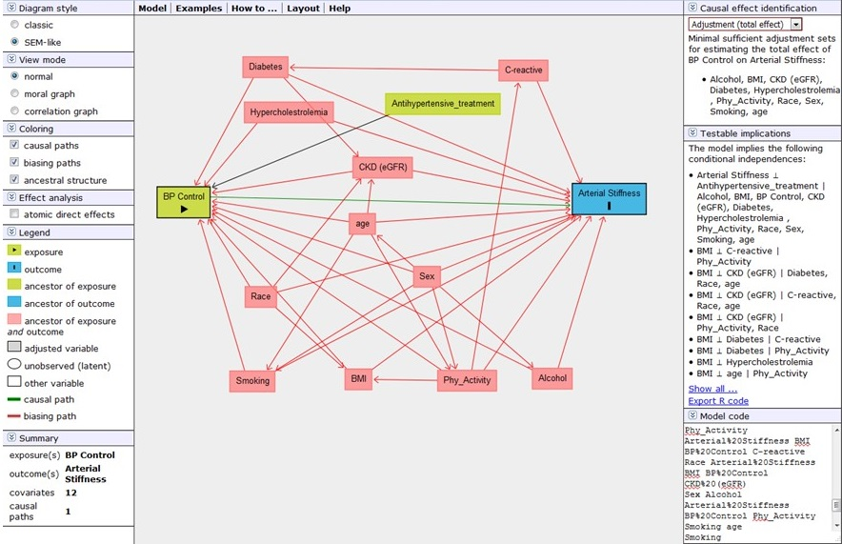
Confounders selection
Directed acyclic graph (DAG) using DAGitty following backdoor criterion (adjustment criterion)
DAGitty has an algorithm to apply the adjustment criterion (http://dagitty.net/dags.html)
Textor et al. Epidemiology. 2011;22:745
Notes:
Directed acyclic graph (DAG) followed by Pearl's backdoor criterion to identify minimum set of adjusting variables
Traditional methods of adjusting for "potential confounders" may introduce conditional associations and bias rather than minimize it.
One method to help understand whether bias is potentially reduced or increased when conditioning on covariates is the graphical representation of causal effects between variables.
Using this approach, epidemiologic biases can be categorized as either lack of conditioning on a common cause (known as confounding bias), or conditioning on a common effect of two parents (or descendant of the common effect; known as selection bias/colloider bias).
One may require fewer covariates in the model, thus the statistical efficiency of the analysis is increased (i.e. there are more degrees of freedom if one uses fewer covariates), i.e you new few parameters to estimate.
Front-Door: A set of variables Z is said to satisfy the front-door criterion relative to an ordered pair of variables (X,Y) iff:
1. Z intercepts all directed paths from X to Y;
2. there is no back-door path from X to Z; and
3. all back-door paths from Z to Y are blocked by X

Slide 12
Identified Potential Confounders
Minimal sufficient adjustment set to estimate the independent association between BP control and arterial stiffness are:
Age
Gender
Race
Alcohol intake
Smoking status
Physical activity
Body mass index (BMI)
Hypercholesterolemia
Diabetes
Chronic kidney disease
C-reactive protein
Baseline arterial stiffness

Slide 13
Results
Table 1. Baseline demographic and behavioral characteristics by status of BP control
Characteristics (N=906) | All participants |  | Uncontrolled At 4 visits | Controlled at 4 visits
 | Mean (SD) |  | Mean (SD) | Mean (SD) |  | P-value
Age (years) | 63.7 (9.1) |  | 66.3 (8.9) | 61.5 (8.9) |  | <0.001
Male (%) | 44.1 |  | 36.6 | 46.6 |  | 0.05
Ethnicity (%)
White | 34.4 |  | 26.8 | 42.6 |  | 0.01
Black | 35.6 |  | 39 | 30.7
Chinese | 10.9 |  | 13 | 10.1
Hispanic | 19.1 |  | 21.1 | 16.6
Former drinker (%) | 23.2 |  | 30.9 | 19.3 |  | 0.03
Current drinker (%) | 55.7 |  | 43.1 | 60.8
Pack years of smoking | 10.1 (19.7) |  | 8.7 (17.6) | 12.3 (23.7) |  | 0.09
Activity (MET-hr/wk) | 94.0 (100.9) |  | 86.1 (74.8) | 100.1 (88.8) |  | 0.10
BMI (kg/m²) | 29.1 (5.2) |  | 28.4 (5.1) | 29.0 (5.0) |  | 0.29
Notes:
Fourteen percent of the participants had uncontrolled BP at all 4 visits, 15% had controlled BP at only 1 visit, 17% had controlled BP at only 2 visits, 22% had controlled BP at 3 visits, and 32% had controlled BP at all 4 visits. Mean DC was 2.8x10-3 mmHg-1 at baseline and decreased to 2.6x10-3 mmHg-1 at visit 5 and mean YEM was 3.6x103 mmHg at baseline and increased to 4.2x103 mmHg at visit 5.
more likely to be younger, male, White, current smoker, smoked less, exercise more, and had lower BMI.

Slide 14
Results
Table 2. Baseline clinical characteristics by status of BP control
Characteristics | All participants |  | Uncontrolled At 4 visits | Controlled at 4 visits
 | Mean (SD) |  | Mean (SD) | Mean (SD) |  | P-value
Systolic BP (mm Hg) | 136.9 (21.3) |  | 158.9 (16.3) | 118.7 (13.2) |  | <0.001
Diastolic BP (mm Hg) | 75.0 (10.5) |  | 79.8 (10.1) | 70.1 (8.3) |  | <0.001
Treated for HPT (%) | 84.0 |  | 52 | 100 |  | <0.001
Diabetes mellitus (%) | 16.8 |  | 16.3 | 16.9 |  | 0.99
Total cholesterol (mg/dL) | 191.1 (35.1) |  | 198.6 (33.7) | 188.4 (38.0) |  | 0.007
HDL (mg/dL) | 51.4 (15.0) |  | 53.0 (16.0) | 49.8 (15.1) |  | 0.06
GFR (ml/min/1.73m²) | 76.0 (15.9) |  | 75.8 (16.1) | 77.1 (16.1) |  | 0.45
Notes:
treated for hypertension, to have lower systolic and diastolic BP, total cholesterol, triglycerides, low density lipoprotein, (LDL), YEM, and to have higher DC at baseline.

Slide 15
Results (aim 1)
Percent of participants with controlled BP by visit number
Distensibility coefficient at visits 1 and 5
Notes:
Disseleration in DC was lower by 10 percentage points

Slide 16
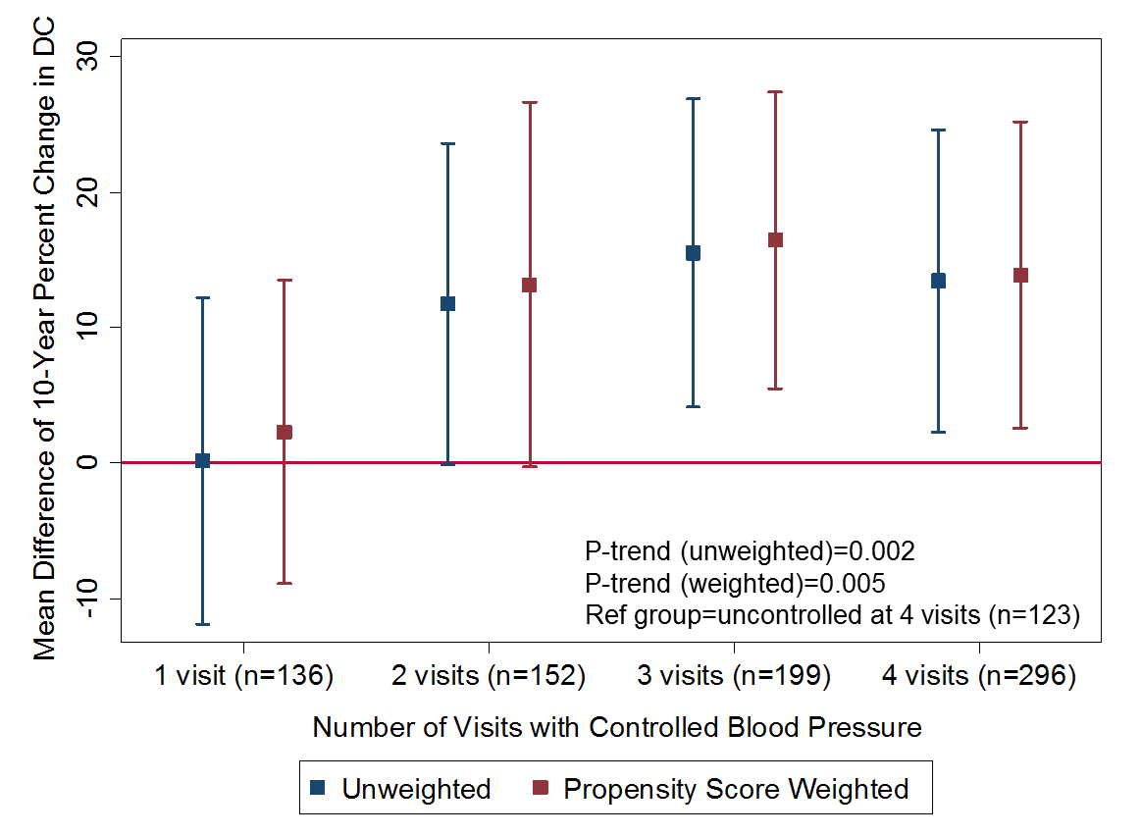
Results (aim 1)
Multivariate regression for the association between numbers of visits with controlled blood pressure and 10-year change in carotid artery stiffness among hypertensive individuals
All participants (n=906)
Models adjusted for age, sex, race, study site, smoking, alcohol intake, physical activity, body mass index, duration of diabetes, total cholesterol, high density lipoprotein, glomerular filtration rate, CRP, antihypertensive medication class, and baseline DC.
Tedla YG et.al. J Hypertens. 2017 Apr;35(4):862-869
Notes:
The mean 10-year percent change in DC among those with controlled BP at 3 o4 4 visits was higher by about 20 percentage points when compared to those with uncontrolled BP at all 4 visits.
Disseleration in DC was lower by 10 percentage points

Slide 17
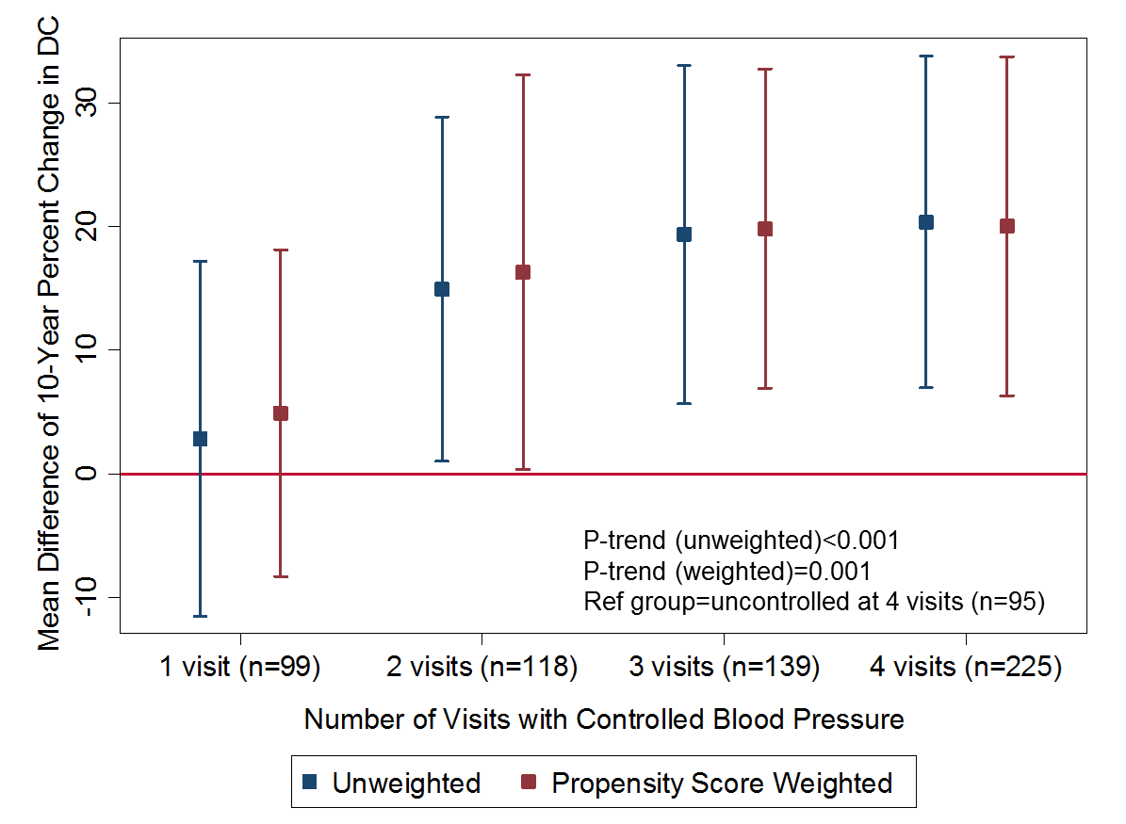
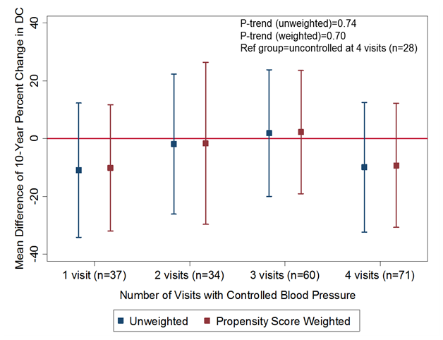
Results (aim 1)
Multivariate regression for the association between numbers of visits with controlled blood pressure and 10-year change in carotid artery stiffness among hypertensive individuals by diabetes mellitus
Non-diabetic (n=676)
Diabetic (n=230)
Abbreviations: DC, distensibility coefficient. Models adjusted for age, sex, race, study site, smoking, alcohol intake, physical activity, body mass index, duration of diabetes, total cholesterol, high density lipoprotein, glomerular filtration rate, CRP, antihypertensive medication class, and baseline DC.
Tedla YG et.al. J Hypertens. 2017 Apr;35(4):862-869
Notes:
The mean 10-year percent change in DC among those with controlled BP at 3 o4 4 visits was higher by about 20 percentage points when compared to those with uncontrolled BP at all 4 visits.
Disseleration in DC was lower by 10 percentage points

Slide 18
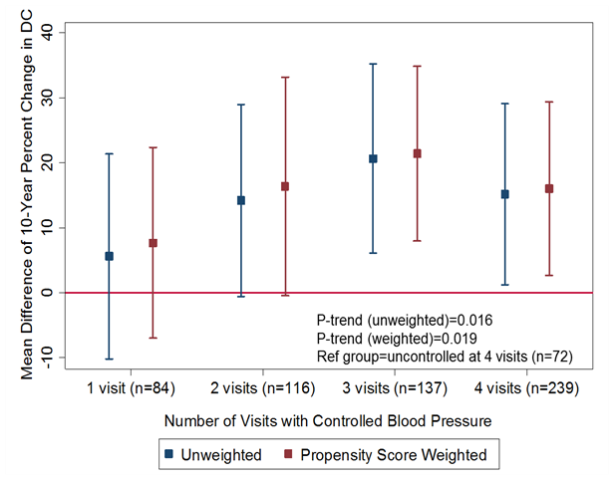
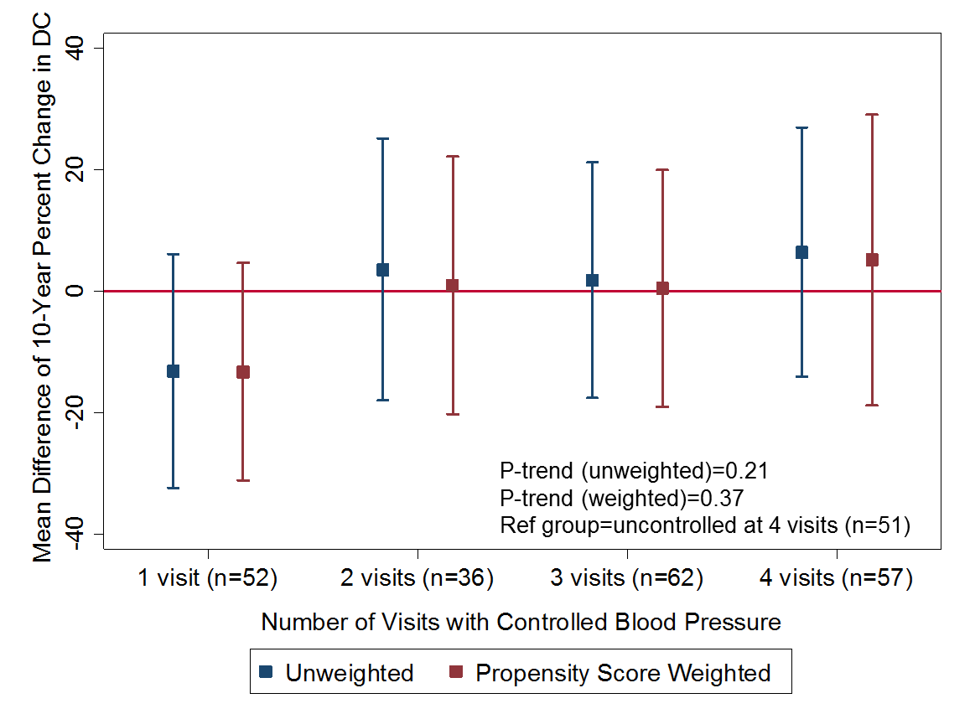
Results (aim 1)
Multivariate regression for the association between numbers of visits with controlled blood pressure and 10-year change in carotid artery stiffness among hypertensive individuals by age
< 70 years (n=648)
>=70 (n=258)
.
Models adjusted for age, sex, race, study site, smoking, alcohol intake, physical activity, body mass index, duration of diabetes, total cholesterol, high density lipoprotein, glomerular filtration rate, CRP, antihypertensive medication class, and baseline DC.
Tedla YG et.al. J Hypertens. 2017 Apr;35(4):862-869
Notes:
Disseleration in DC was lower by 10 percentage points

Slide 19
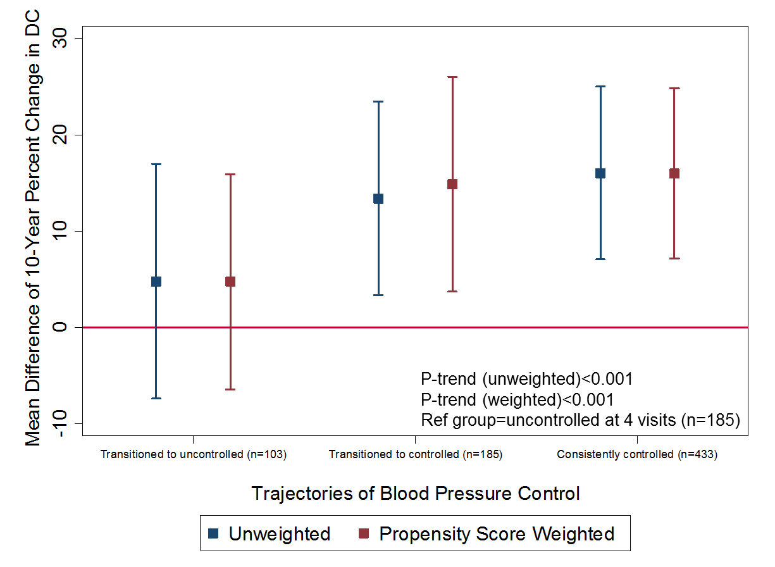
Results (aim 1)
Multivariate regression for the association between trajectories of status of BP control and 10-year change in carotid artery stiffness among hypertensive individuals
Trajectories of status of BP control among hypertensive participants (n=906)
All participants (n=906)
Models adjusted for age, sex, race, study site, smoking, alcohol intake, physical activity, body mass index, duration of diabetes, total cholesterol, high density lipoprotein, glomerular filtration rate, CRP, antihypertensive medication class, and baseline DC.
Notes:
Disseleration in DC was lower by 10 percentage points

Slide 20
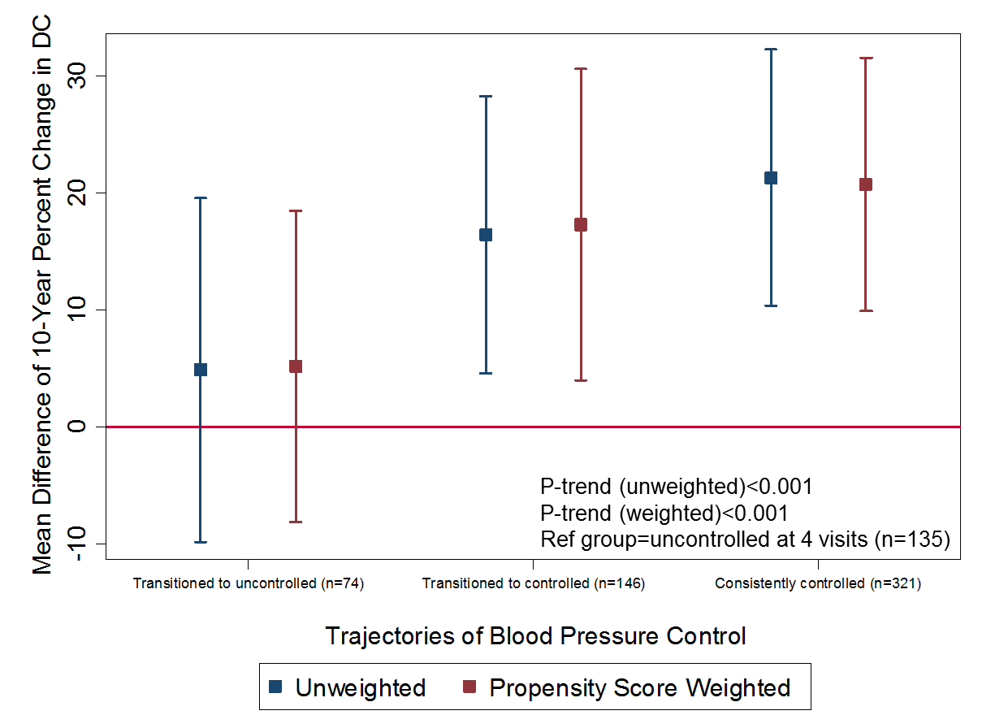
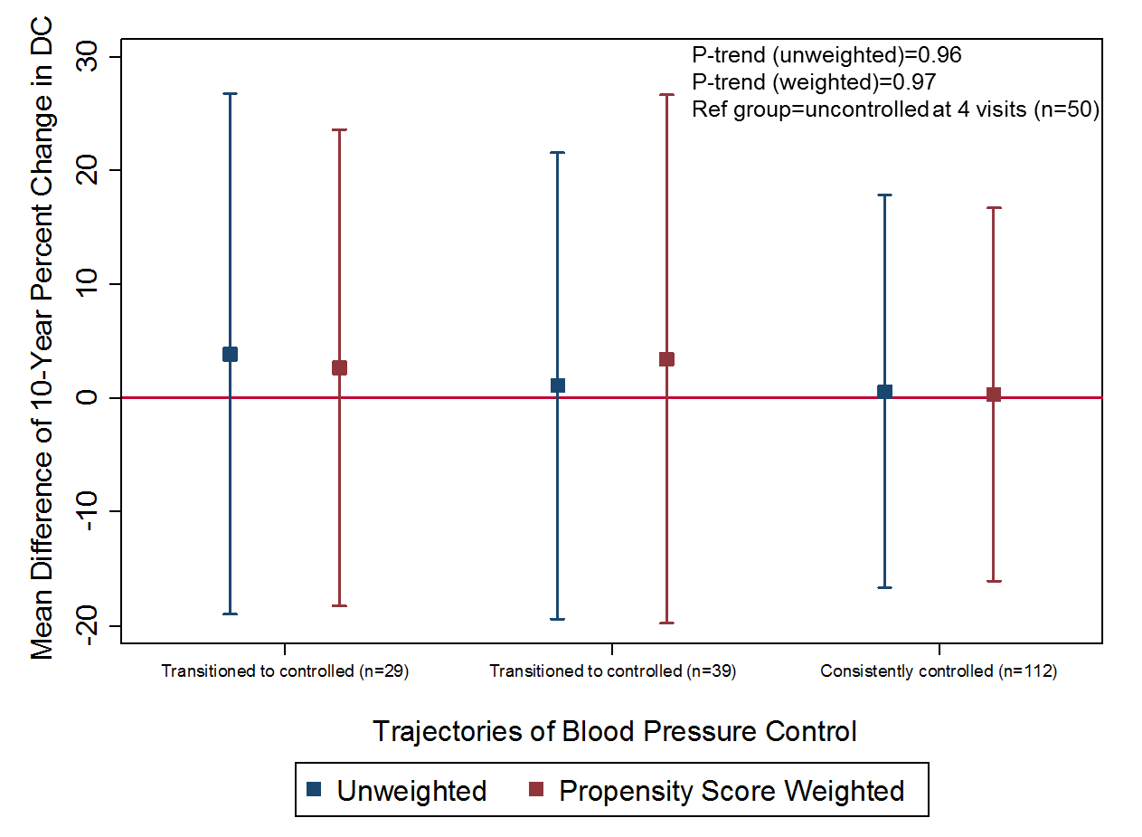
Results (aim 1)
Multivariate regression for the association between trajectories of status of BP control and 10-year change in carotid artery stiffness among hypertensive individuals by diabetes and age
Non-diabetic (n=676)
Diabetic (n=230)
Models adjusted for age, sex, race, study site, smoking, alcohol intake, physical activity, body mass index, duration of diabetes, total cholesterol, high density lipoprotein, glomerular filtration rate, CRP, antihypertensive medication class, and baseline DC.
Notes:
Disseleration in DC was lower by 10 percentage points

Slide 21
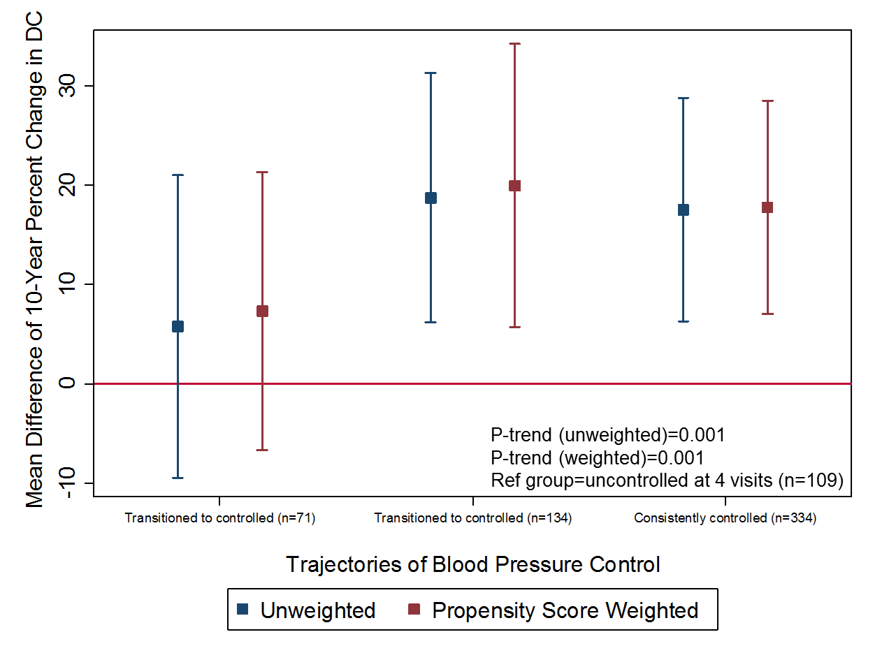
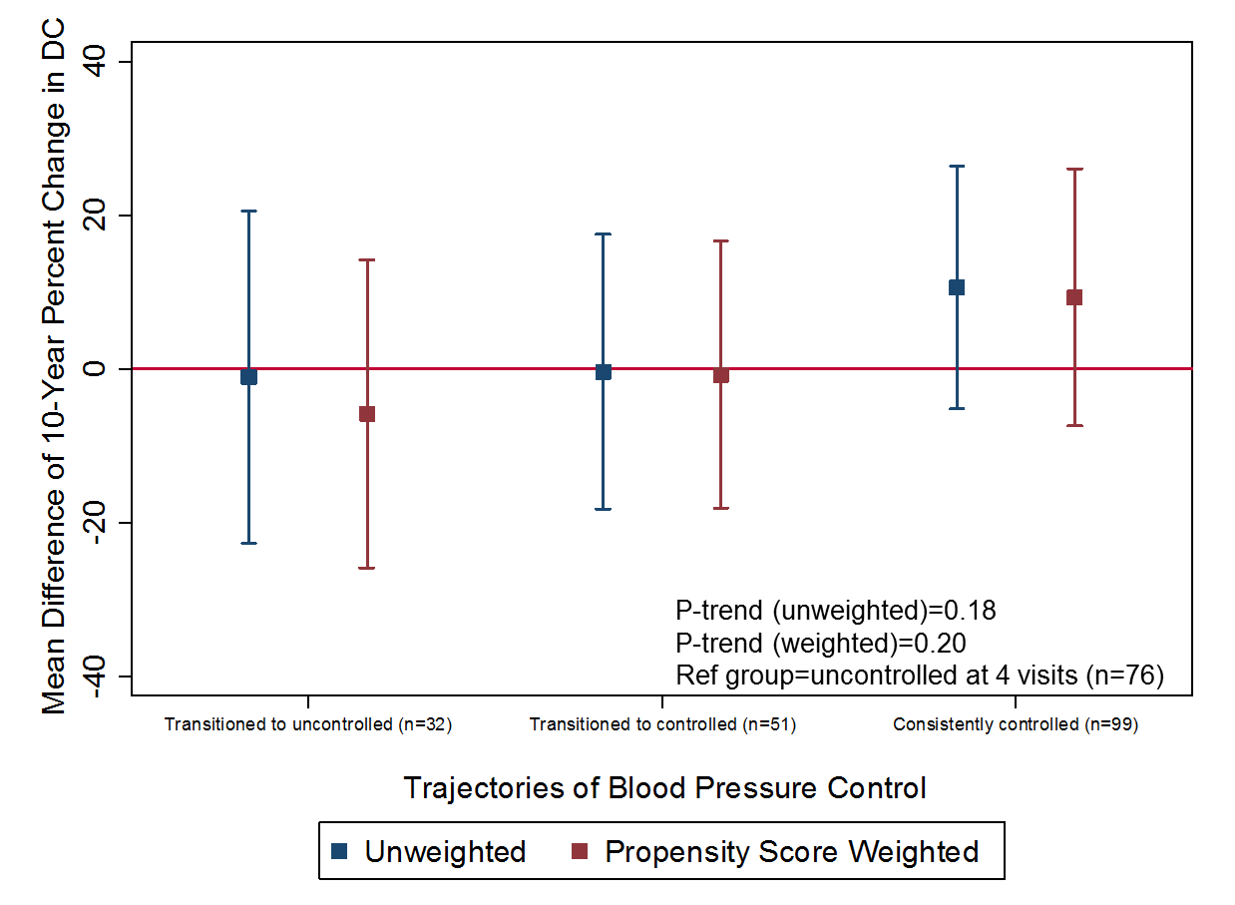
Results (aim 1)
Multivariate regression for the association between trajectories of status of BP control and 10-year change in carotid artery stiffness among hypertensive individuals by diabetes and age
< 70 years (n=648)
>= 70 (n=258)
Models adjusted for age, sex, race, study site, smoking, alcohol intake, physical activity, body mass index, duration of diabetes, total cholesterol, high density lipoprotein, glomerular filtration rate, CRP, antihypertensive medication class, and baseline DC.
Notes:
Disseleration in DC was lower by 10 percentage points

Slide 22
Conclusion
Long-term controlled BP was associated with slower progression of arterial stiffness only among hypertensives who are non-diabetic and those aged <70 years.
Among diabetic and elderly hypertensive patients, the progression of arterial stiffness among individuals with consistently controlled BP is not different from that of those with persistently uncontrolled BP.
Controlling BP alone may not be enough to slow progression of arterial stiffness among hypertensive patients with concomitant diabetes and elderly hypertensive patients, further research would be needed to explore strategies to slow the progression of arterial stiffness among these patients.

Slide 23
Limitations
During a mean follow-up time of 9.5 years, BP was obtained only at 5 visits and this may not accurately reflect participants’ level of BP during that follow-up time.
Brachial BP was used as a proxy for carotid BP in the calculation of DC. Brachial pulse pressure was shown to overestimate central pulse pressure among younger individuals.
Notes:
Strengths
The first studies to show:
Long-term control of BP is not associated with a slower progression in carotid arterial stiffness among hypertensive patients with diabetes and older hypertensive patients.
Higher long-term SBP variability is associated with greater progression of arterial stiffness progression independent of mean BP.
Larger sample size and participants with diverse ethnic backgrounds is likely to increase generalizability of our findings.

Slide 24
Thanks
Questions and suggestions

Slide 25
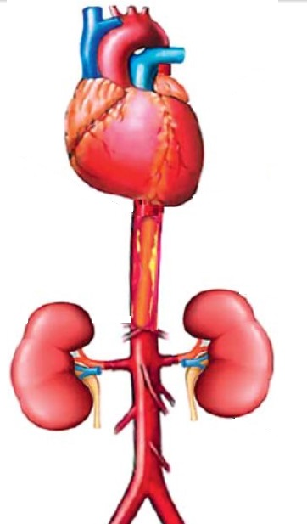
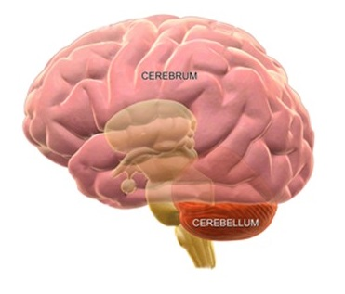
Vascular consequences of arterial stiffness
Increases myocardial work load
- Left ventricular hypertrophy
- Left ventricular failure
Decrease in myocardial perfusion
- Myocardial infarction (MI).
Increases shear stress
- Atheromatous plaque, MI
Widened pulse pressure and greater pressure fluctuations
- Microvascular damage
- Renal impairment
- Stroke, memory loss, white matter
hyperintensity, alzheimer disease
Increases shear stress
- Atheromatous plaque, stroke, renal
impairment
Jia et al, Cardiorenal Med 2014;4:60–71
Zeki Al Hazzouri, J Alzheimers Dis. 2014;42
Notes:
Arterial stiffness has been con
When large arteries stiffer, they are less able to accommodate the volume of blood ejected from the left ventricle.2 Increased force is required to stretch stiffened arteries to accommodate the ejected blood ejected.2, 46 The increased force needed to stretch stiffened arteries is compensated by harder contractions of the ventricles, and over time, this increased work load leads to left ventricular hypertrophy and eventually left ventricular failure.2, 46
In addition, reduced reservoir capacity and elasticity of the aorta leads to an increase in systolic pressure and a fall in diastolic pressure. The fall in diastolic pressure causes a reduction in the amount of blood perfusion to the cardiac muscles. This causes additional damage to the already hypertrophic heart muscles, eventually leading to myocardial infarction.47, 48
Finally, arterial stiffness increases shear stress,50 the frictional force of blood flow against the arterial wall. This impairs endothelial production of nitric oxide and increases inflammatory activity and therefore promotes development of athermanous plaque within the arterial wall and increases the risk of MI.29, 48
The increase in systolic pressure and reduction in diastolic pressure widens pulse pressure, which exposes the vascular system of the brain and kidneys to greater pressure fluctuations and increases the risks of microvascular damage in the kidney and brain and as a result arterial stiffness has been shown to associate with stroke, memory loss, alzhemer’s disease and chronic kidney disease.
PWV >12m/s Increases risk of CV events, CV mortality and all-cause mortality by twofold. 1 m/s in increase in PWV Increases risk of CV events, CV mortality, and all-cause mortality by 15%.
Arterial stiffness also predicts development of stroke and progression of renal impairment. After adjusting for other risk factors, the risk of stroke related death increases by 40% for each 4 m/s increase in PWV (RR = 1.39, 95% CI: 1.0 8-1.72).51 Among subjects initially with estimated glomerular filtration rate (eGFR), a measure of the level of function of kidneys,52 of greater than 60 ml/min/1.73 m2 and without proteinuria, the risk of developing an eGFR <60 ml/min/1.73 m2 increased by 36% for each 1 m/s increase in PWV.53 An increase of 1 m/s in brachial-ankle PWV has been also associated with an increase of 36% on the risk of having an estimated glomerular filtration rate (eGRF) <60ml/min/1.73m2 after 5 years of follow-up.
The term ‘endothelial dysfunction’ refers to a maladapted endothelial phenotype characterized by reduced nitric oxide (NO) bioavailability, increased oxidative stress, elevated expression of proinflammatory and prothrombotic factors, and reduced endothelial derived vasodilation [17] .
Fourth, uric acid may accelerate AS development. Mechanisms implicated for increased AS in patients with uricemia include chronic fluid overload, arterial calcifications, inflammation, sympathetic nervous system overactivity, activation of RAAS, increased lipid oxidation, and abnormalities in the NO system

Slide 26
Results (aim 1)
Multivariate regression for the association between numbers of visits with hypertension treatment and 10-year change in carotid artery stiffness among hypertensive individuals
All participants (n=906)
Models adjusted for age, sex, race, study site, smoking, alcohol intake, physical activity, body mass index, duration of diabetes, total cholesterol, high density lipoprotein, glomerular filtration rate, CRP, and baseline DC.
Notes:
The mean 10-year percent change in DC among those with controlled BP at 3 o4 4 visits was higher by about 20 percentage points when compared to those with uncontrolled BP at all 4 visits.
Disseleration in DC was lower by 10 percentage points

Slide 27
Results (aim 1)
Multivariate regression for the association between numbers of visits with hypertension treatment and 10-year change in carotid artery stiffness among hypertensive individuals by diabetes mellitus
Non-diabetic (n=676)
Diabetic (n=230)
Abbreviations: DC, distensibility coefficient. Models adjusted for age, sex, race, study site, smoking, alcohol intake, physical activity, body mass index, duration of diabetes, total cholesterol, high density lipoprotein, glomerular filtration rate, CRP, and baseline DC.
Notes:
The mean 10-year percent change in DC among those with controlled BP at 3 o4 4 visits was higher by about 20 percentage points when compared to those with uncontrolled BP at all 4 visits.
Disseleration in DC was lower by 10 percentage points

Slide 28
Results (aim 1)
Multivariate regression for the association between numbers of visits with hypertension treatment and 10-year change in carotid artery stiffness among hypertensive individuals by age
Less than 70 years (n=648)
70 years and above (n=258)
.
Models adjusted for age, sex, race, study site, smoking, alcohol intake, physical activity, body mass index, duration of diabetes, total cholesterol, high density lipoprotein, glomerular filtration rate, CRP, and baseline DC.
Notes:
Disseleration in DC was lower by 10 percentage points

Slide 29
Confounders selection
Directed acyclic graph (DAG) using DAGitty following backdoor criterion (adjustment criterion)
A set of variables (Z) satisfies the adjustment criteria for identifying the effect of X (exposure) on Y (outcome) in a DAG if:
No node in Z is a descendant of X (i.e. not on a causal path from X to Y)
Conditioning on Z blocks every back-door path from X and Y that contains an arrow in to X (i.e. no open back-door path left from X to Y after conditioning on Z)
If Z satisfies the adjustment criterion , then conditioning on Z alone is sufficient to control confounding.
Greenland PJ, Robins JM. Epidemiology. 1999;10:37-48
Notes:
Directed acyclic graph (DAG) followed by Pearl's backdoor criterion to identify minimum set of adjusting variables
Traditional methods of adjusting for "potential confounders" may introduce conditional associations and bias rather than minimize it.
One method to help understand whether bias is potentially reduced or increased when conditioning on covariates is the graphical representation of causal effects between variables.
Using this approach, epidemiologic biases can be categorized as either lack of conditioning on a common cause (known as confounding bias), or conditioning on a common effect of two parents (or descendant of the common effect; known as selection bias/colloider bias).
One may require fewer covariates in the model, thus the statistical efficiency of the analysis is increased (i.e. there are more degrees of freedom if one uses fewer covariates), i.e you new few parameters to estimate.
Front-Door: A set of variables Z is said to satisfy the front-door criterion relative to an ordered pair of variables (X,Y) iff:
1. Z intercepts all directed paths from X to Y;
2. there is no back-door path from X to Z; and
3. all back-door paths from Z to Y are blocked by X

Slide 30
Short-Term Aerobic Exercise Reduces Arterial Stiffness in Older Adults With Type 2 Diabetes, Hypertension, and Hypercholesterolemia
Effect of acute and long-term aerobic exercise on arterial stiffness in the elderly.
Improved Arterial Compliance by a Novel Advanced Glycation End-Product Crosslink Breaker

