Slide 1
Opioids, gabapentinoids, and atrial arrhythmias in MESA
James Floyd, MD, MS
University of Washington
Departments of Medicine and Epidemiology

Slide 2
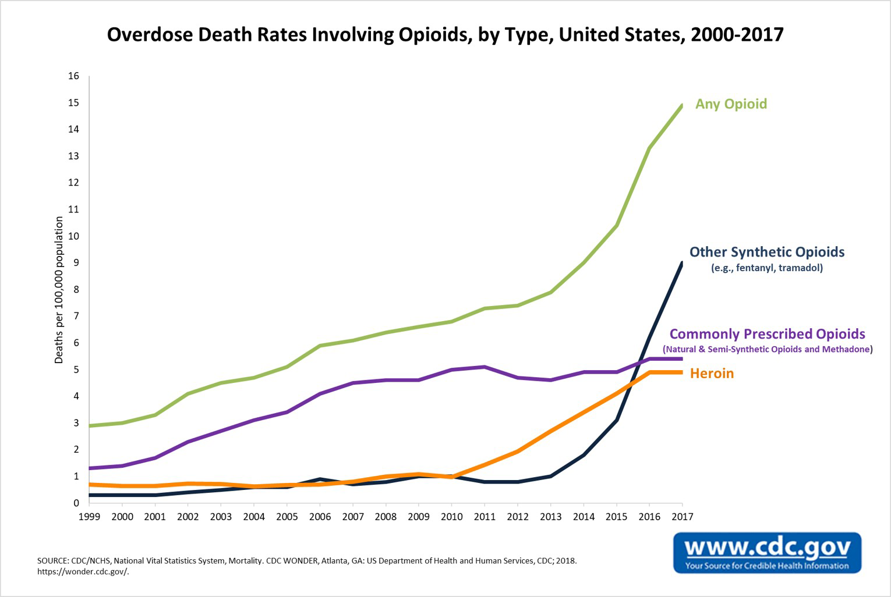
Opioid epidemic
~400,000 deaths from opioid overdose over the past 20 years, nearly 50,000 in 2017 alone (CDC, NCHS)

Slide 3
Notes:
Changes in medical practice throughout the country, development and implementation of guidelines, even state laws restricting quantity and strength of opioid medications
WA has been a leader in this area

Slide 4
OPIOIDS
(CDC)
GABAPENTINOIDS
(MEPS, UK CPRD)
Notes:
There have been some reductions in opioid prescribing, perhaps even deaths
What has filled the gap? Gabapentinoid (bind voltage gated Ca channels found on excitable cells)
MEPS – overall prevalence about 4% but among comorbidity more than 20%

Slide 5
Benefits and risks in treatment of pain
Effectiveness
  Opioids – no long term RCTs showing improvement in function
  Gabapentinoids – narrow indications for diabetic neuropathy, postherpetic neuralgia, and fibromyalgia (pregablin)
Adverse effects
  Opioids – dependence, addiction, sedation, respiratory depression, death, cardiovascular toxicity?
  Gabapentinoids – sedation, dizziness, cognitive impairment, falls, death, cardiovascular toxicity?
Notes:
Because there is limited or no benefit in most situations where these drugs are used to treat chronic pain, any safety issues are of major importance

Slide 6
Cardiovascular risk
Both opiates and gabapentinoids may have adverse effects on myocardial contractility, oxygenation, perfusion after ischemia, and electrical conduction (e.g., QT prolongation)
Limited prior research (mostly on CHD) suggests potential adverse cardiovascular effect of opiates and gabapentinoids
MESA AF ancillary study provides an opportunity to evaluate relationships between use of these drugs and unbiased, high-quality measures of atrial arrhythmias
Notes:
What prelim evidence suggests CV toxicity?

Slide 7
Questions
1) Longitudinal analysis: Are the use of opioid and gabapentinoid medications associated with incidence of clinically-detected atrial fibrillation?
2) Cross-sectional analysis: Are the use of opioid and gabapentinoid medications associated with presence of atrial arrhythmias detected with extended ambulatory ECG monitoring?

Slide 8
Methods
Drug exposure: current use from medication inventory at each Exam
Outcome 1: Clinically-detected AF during longitudinal follow up
  Hospital discharge diagnosis code for AF and Aflutter
  FFS Medicare: Inpatient, outpatient, and carrier claims for AF/Aflutter
Outcome 2: ECG monitor-detected atrial arrhythmias (Exam 6)
  Up to 14 days of monitoring, some had 2 monitoring periods
  Frequency of premature atrial contractions (PACs) – log-transformed
  Presence of any SVT (>= 4 consecutive PACs)
  Frequency of runs of SVT – log-transformed

Slide 9
Methods
Analysis 1
  Longitudinal assessment of medication use and incident AF (excluded participants with prevalent AF at Exam 1)
  Time-varying assessment of medication use from Exams 1-5
  Potential confounders assessed at Exam 1 (age, site, height, weight, diabetes, treated HTN, SBP, smoking, alcohol use)
  Cox regression to estimate incident AF HRs and 95% CIs
Analysis 2
  Cross-sectional assessment of medication use and monitor-detected arrhythmias at Exam 6
  Potential confounders assessed at Exam 6 (age, site, height, weight, diabetes, treated HTN, SBP, smoking, alcohol use, physical activity, self-perceived health, self-reported pain, prior MI, prior stroke, prior CHF)
  Linear and logistic regression to estimate geometric mean ratio and ORs

Slide 10
Medication use

Slide 11
Analysis 1 characteristics
Exam 1
 | No opioid (n=6,016) | Opioid (n=636) | No gaba (n=6,412) | Gaba (n=240)
Age, mean (sd) | 62 (10) | 63 (10) | 62 (10) | 63 (9)
Female | 48% | 37% | 48% | 34%
White | 38% | 43% | 38% | 43%
Chinese | 13% | 3% | 12% | 8%
African American | 27% | 31% | 28% | 27%
Hispanic | 22% | 23% | 22% | 22%
Diabetes | 12% | 15% | 12% | 23%
Current smoker | 13% | 18% | 13% | 14%
Weight, mean(SD), lb | 172 (38) | 186 (40) | 173 (38) | 181 (39)
SBP, mean(SD), mmHg | 126 (21) | 129 (23) | 126 (21) | 129 (23)
Notes:
~10% ever user opioid, ~4% ever user gabapentinoid
Opioid and GABA – less female, more white, more DM/smoking, higher weight and SBP

Slide 12
Analysis 1 results
N=6,652, 982 AF events, mean f/u 12.4 yrs

Slide 13
Analysis 1 results
N=6,652, 982 AF events, mean f/u 12.4 yrs
PRIMARY
Opioid use |  | Gabapentinoid use
Unadjusted HR (95%CI) | Adjusted HR (95%CI) | Unadjusted HR (95%CI) | Adjusted HR (95%CI)
1.33 (1.00, 1.76) | 1.17 (0.88, 1.56)

Slide 14
Analysis 1 results
N=6,652, 982 AF events, mean f/u 12.4 yrs
PRIMARY
Opioid use |  | Gabapentinoid use
Unadjusted HR (95%CI) | Adjusted HR (95%CI) | Unadjusted HR (95%CI) | Adjusted HR (95%CI)
1.33 (1.00, 1.76) | 1.17 (0.88, 1.56) | 1.28 (0.83, 1.97) | 1.06 (0.69, 1.64)

Slide 15
Analysis 1 results
N=6,652, 982 AF events, mean f/u 12.4 yrs
PRIMARY
Opioid use |  | Gabapentinoid use
Unadjusted HR (95%CI) | Adjusted HR (95%CI) | Unadjusted HR (95%CI) | Adjusted HR (95%CI)
1.33 (1.00, 1.76) | 1.17 (0.88, 1.56) | 1.28 (0.83, 1.97) | 1.06 (0.69, 1.64)
SENSITIVITY: Require drug use at > 1 visit
Opioid use |  | Gabapentinoid use
Unadjusted HR (95%CI) | Adjusted HR (95%CI) | Unadjusted HR (95%CI) | Adjusted HR (95%CI)
1.16 (0.77, 1.74) | 1.10 (0.73, 1.66) | 1.10 (0.60, 2.00) | 1.07 (0.69, 1.66)

Slide 16
Analysis 2 characteristics
Exam 6
 | No opioid (n=1,357) | Opioid (n=78) | No gaba (n=1,349) | Gaba (n=86)
Age, mean (sd) | 73 (8) | 73 (9) | 72 (8) | 75 (9)
Female | 51% | 62% | 51% | 53%
Diabetes | 22% | 37% | 22% | 36%
Current smoker | 6% | 12% | 6% | 6%
Weight, mean(SD), lb | 171 (38) | 170 (38) | 170 (38) | 180 (36)
SBP, mean(SD), mmHg | 127 (20) | 126 (18) | 127 (20) | 124 (19)
Fair/poor health | 13% | 26% | 13% | 36%
Moderate/extreme pain | 18% | 58% | 19% | 44%
History MI | 3% | 1% | 2% | 5%
History CHF | 1% | 5% | 1% | 3%

Slide 17
Analysis 2 results
PACs
SVT

Slide 18
Analysis 2 results
PACs
SVT

Slide 19
Analysis 2 results
2 (<1%) with no PACs, 255 (18%) with no runs of SVT
Opioid use |  | Gabapentinoid use
Unadjusted GMR | Adjusted GMR | Unadjusted GMR | Adjusted GMR
1.04 (0.68, 1.56) | 1.05 (0.70, 1.57)
PAC
(frequency)
Opioid use |  | Gabapentinoid use
Unadjusted OR | Adjusted OR | Unadjusted OR | Adjusted OR
1.16 (0.77, 1.74) | 1.10 (0.73, 1.66)
SVT
(yes/no)
Opioid use |  | Gabapentinoid use
Unadjusted GMR | Adjusted GMR | Unadjusted GMR | Adjusted GMR
1.16 (0.82, 1.65) | 1.19 (0.84, 1.69)
SVT
(frequency)

Slide 20
Analysis 2 results
2 (<1%) with no PACs, 255 (18%) with no runs of SVT
Opioid use |  | Gabapentinoid use
Unadjusted GMR | Adjusted GMR | Unadjusted GMR | Adjusted GMR
1.04 (0.68, 1.56) | 1.05 (0.70, 1.57) | 2.13 (1.44, 3.17) | 1.81 (1.23, 2.67)
PAC
(frequency)
Opioid use |  | Gabapentinoid use
Unadjusted OR | Adjusted OR | Unadjusted OR | Adjusted OR
1.16 (0.77, 1.74) | 1.10 (0.73, 1.66) | 1.10 (0.60, 2.00) | 1.07 (0.69, 1.66)
SVT
(yes/no)
Opioid use |  | Gabapentinoid use
Unadjusted GMR | Adjusted GMR | Unadjusted GMR | Adjusted GMR
1.16 (0.82, 1.65) | 1.19 (0.84, 1.69) | 1.49 (1.07, 2.07) | 1.43 (1.03, 1.99)
SVT
(frequency)

Slide 21
Conclusions
No evidence of drug associations with risk of clinically-detected AF
  Limited power to detect small- or moderate-sized effects
Unable to evaluate drug associations with presence of monitor-detected AF or degree of AF burden, limited sample size
Potential association between gabapentinoids and supraventricular ectopy (biomarker for AF and stroke risk) and frequency of SVT

Slide 22
Acknowledgements
MESA FC investigators and staff
MESA CC
Susan Heckbert
Bruce Psaty
Barbara Harding
Thanks to MESA participants

