Slide 1

MESA P&P REPORT
SC Meeting 3/27/19
Steve Shea
Moyses Szklo
Robyn McClelland

Slide 2
P&P Membership
Member | Site/Affiliation
Moyses Szklo, MD, DrPH | Johns Hopkins University – Chair
Steven Shea, MD, MS | Columbia University – Co-Chair
Norrina B. Allen, PhD | Northwestern University
Matthew Allison, MD, MPH | UCSD
Alain Bertoni, MD | Wake Forest University
Michael Blaha, MD | Johns Hopkins Hospital
Lyndia Brumback, PhD | University of Washington
Andrew DeFilippis, MD, MSc | University of Louisville
Susan Heckbert, MD, PhD | University of Washington
Joao Lima, MD | MRI Reading Center
Kiang Liu, PhD | Northwestern University
Robyn McClelland, PhD | Coordinating Center, Univ. of Washington
Joseph Polak, MD, MPH | Tufts-NEMC Ultrasound Reading Center
Benjamin Smith, MD | Columbia University

Slide 3
  For proposals that involve the specific aims of the MESA contract and/or Exam 6 ancillary studies, the PI(s) should be the senior MESA author for all such proposals until 1 year after completion of the MESA contract or the ancillary study (or the PI should name a surrogate or waive participation).
  Approved at MESA SC Meeting 3/18.

Slide 4
    It is the responsibility of all first and Senior MESA authors to maintain accurate author lists and to notify P&P of any changes to these.
  55 notices were sent to authors of proposals aged 36 months or more as of November 1, 2018.

Slide 5
  MESA now has 1,916 approved paper proposals:
  1,269 papers published or in press
  131 penultimate drafts approved for submission
  20 penultimate drafts in revision and review process
  496 papers in progress

Slide 6
  30 MESA abstracts were submitted to AHA Scientific Sessions for November, 2018. 30/30 accepted.
  15 MESA abstracts were submitted to the AHA EPI/Lifestyle meeting scheduled for March, 2019.
  15/15 accepted.
  55 MESA abstracts were submitted to 32 different conferences other than the AHA meeting listed above. These conferences will be held between April, 2018, and September, 2019.

Slide 7
Summary of MESA Authorship: Approved Proposals as of February 20, 2019
“Site is represented” counts papers with authors, coauthors, sponsors, and analysts from a site;
“authors represented” counts only first authors and coauthors from a site.
* Not affiliated with above
 | Number of first authors represented |  | Number of authors represented |  | Number of papers on which site is represented
 | Main papers (N = 876) | All papers (N = 1916) | Main papers (N = 876) | All papers (N = 1916) | Main papers (N = 876) | All papers (N = 1916)
Coordinating Center | 12 | 15 | 25 | 30 | 303 | 631
Project Office | 3 | 3 | 12 | 13 | 98 | 191
Field Centers
Wake Forest | 37 | 49 | 79 | 110 | 451 | 740
Columbia | 20 | 60 | 65 | 125 | 244 | 588
Johns Hopkins | 72 | 108 | 147 | 233 | 513 | 1015
Minnesota | 18 | 25 | 36 | 47 | 245 | 460
Northwestern | 37 | 56 | 78 | 114 | 327 | 574
UCLA | 12 | 23 | 40 | 61 | 91 | 250
Reading Centers
CT | 12 | 17 | 24 | 45 | 216 | 458
MRI | 17 | 33 | 39 | 62 | 289 | 612
Tufts-NEMC Ultrasound | 1 | 1 | 3 | 3 | 81 | 153
Wisc. Ultrasound Blood | 8 | 13 | 12 | 20 | 184 | 448
USC Nutrition | 0 | 0 | 1 | 1 | 6 | 6
ECG | 3 | 3 | 4 | 4 | 72 | 116
Retinal | 1 | 3 | 4 | 8 | 16 | 71
Other* | 393 | 693 | 1171 | 1896 | 1052 | 2322

Slide 8
Central Analyst Local Analyst
Main Study 599 283
Ancillary Studies 696 343
Total 1295 (67.4%) 626

Slide 9
Accounting of Paper Status: Summary of Manuscripts as of February 20, 2019
 | Total Main & Ancillary |  | Main Study | Ancillary Studies
Papers Published or In Press | 1269 |  | 586 | 683
Pen Drafts Approved | 131 |  | 61 | 70
Pen Drafts in Review | 20 |  | 9 | 11
Pen Drafts Pending | 496 |  | 220 | 276
0 – 3 months (from approval) >3 – 6 months >6 – 9 months >9 – 12 months >12 months | 47 31 32 33 353 |  | 31 11 15 16 147 | 16 20 17 17 206
Total Papers Approved | 1916 |  | 876 | 1040
N >12 months = 324 in 2017
N >12 months = 337 in 2018

Slide 10
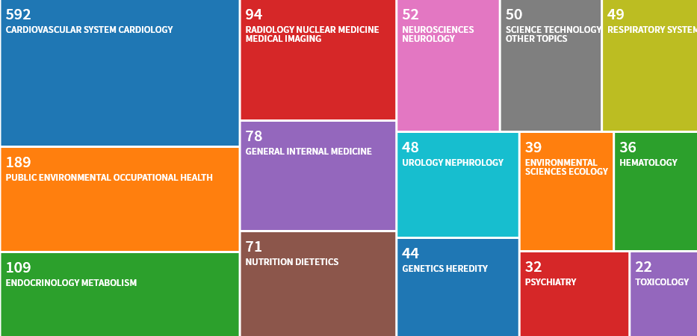
Research Area Distribution of MESA Articles
Notes:
Shows breadth of our research.

Slide 11
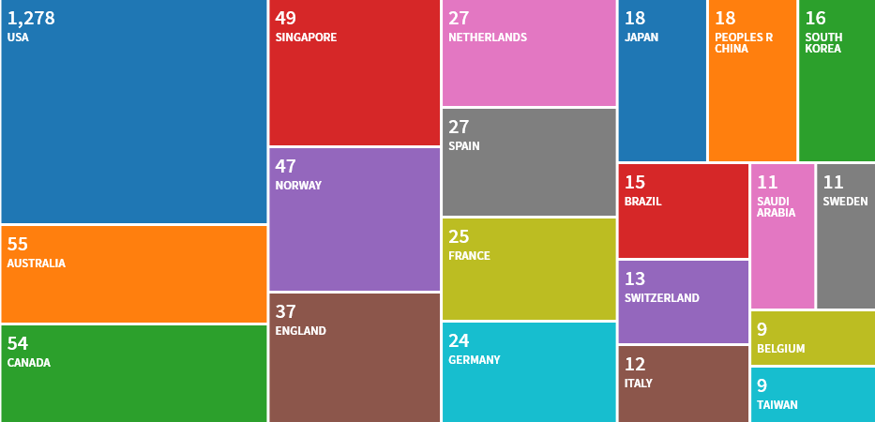
Distribution of Author Affiliations by Country
Notes:
Shows our openness to collaborations and MESA’s position as an international resource.

Slide 12
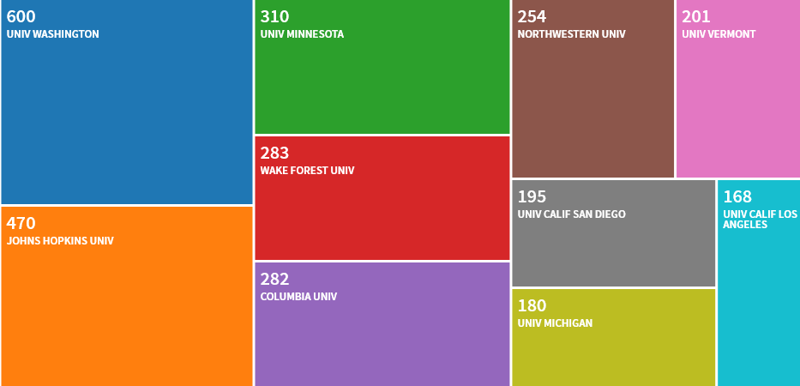
Distribution of Author Affiliations by Institution
Notes:
Shows our equality of distributions across the sites. JHU would include both MRI papers and FC papers. Similarly UW would include MESA Air work as well as CC work. UCLA would include the CT reading center as well as UCLA FC.

Slide 13
Proposals (n=2842)
Cumulative by Year
Proposals (n=2983)
Cumulative by Year Through 12/31/18
Slide courtesy of Robyn McClelland

Slide 14
MESA Publications (n=1557)
Cumulative by Year Through 12/31/18
Slide courtesy of Robyn McClelland

Slide 15
Abstracts (n=1537)
Cumulative by Year Through 12/31/18
Slide courtesy of Robyn McClelland
Notes:
Includes Air and Genetics.

Slide 16
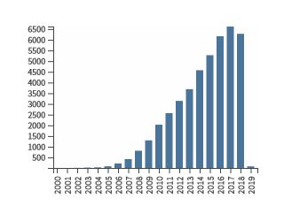
MESA Citations by Year
Multi-Ethnic Study of Atherosclerosis in “topic”
Web of Science search
Citations in Each Year
Citations in Each Year
Average citations per article: 32.6
h-index: 94
Slide courtesy of Robyn McClelland

Slide 17
Advanced Metrics
2015
BS ratio = Abstracts (N=1047)/Publications (N= 735) = 1.42
BS/H ratio = 1.42/64 = 0.022
2016
BS ratio = Abstracts (N=1195)/Publications (N= 877) = 1.36
BS/H ratio = 1.36/73 = 0.019
2017
BS ratio = Abstracts (N=1320)/Publications (N=1034) = 1.28
BS/H ratio = 1.28/78 = 0.016
2018
BS ratio = Abstracts (N=1537)/Publications (N=1557) = 0.987
BS/H ratio = 0.987/94 = 0.011

