Slide 1
Clinical and Subclinical CVD Risk Composites and Cognitive Decline
Timothy Hughes, MPH, PhD
---
MESA Cognitive Working Group
March 29, 2018

Slide 2
In Two Parts…
Glimpse of Cognitive Change Data MESA Exam 5 to Exam 6
Relationship with CVD risk scores:
Clinical CVD
Subclinical CVD

Slide 3
Validity Checks - CASI
 | Years | N Admin | % Valid* | % English | CASI ≤20 | Total Valid
Exam 5 | 2010-12 | 4582 | 98% | 82% | <1% | 4392
Exam 6 | 2016-18 | 1806 | 96% | 87% | <1% | 1647
*Valid at administration includes a text field for reason invalid requires in depth reconciliation.

Slide 4
CASI – Valid at Administration
Value VALID6F | n | %
Missing | 118 | 6.1
1 = 'Valid' | 1647 | 85.7
1 = 'Valid’ *yet >2SD below the mean | 84 | 4.37
2 = 'Prob invalid- poor hearing' | 24 | 1.2
3 = 'Prob invalid- poor eyesight' | 13 | 0.7
4 = 'Prob invalid- impaired motor control' | 0 | 0.0
5 = 'Prob invalid- language barrier' | 10 | 0.5
6 = 'Prob invalid- impaired alertness and attentiveness' | 0 | 0.0
7 = 'Prob invalid- significant physical/mental discomfort' | 2 | 0.1
8 = 'Prob invalid- other reasons' | 24 | 1.3

Slide 5
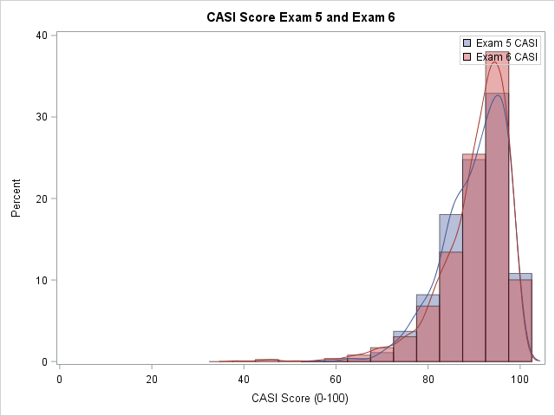
CASI Performance Exams 5 and 6
CASI | n | Mean | SD | Min | 50th | Max
Exam 5 | 4392 | 87.9 | 8.4 | 23 | 89 | 100
Exam 6 | 1647 | 90.2 | 7.6 | 38 | 92 | 100

Slide 6
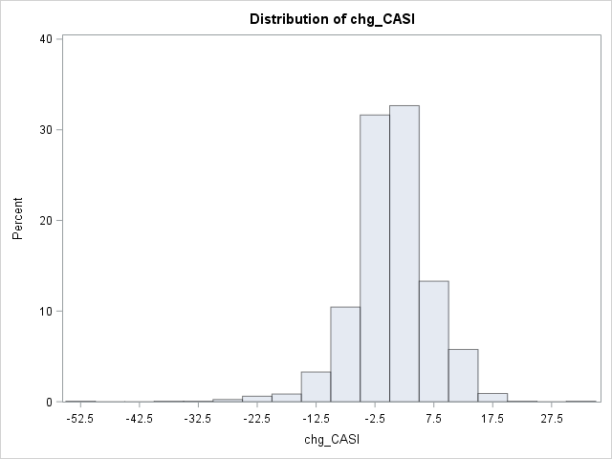
CASI Change
CASI | n | Mean | SD | Min | 50th | Max
Change Ex 5 to 6 | 1647 | 0.1 | 6.6 | -52 | 0 | 34

Slide 7
Demographics of Change in CASI
 | Beta | (SE) | p-value
Age | -0.27 | (0.03) | <0.0001
White | 4.58 | (0.84) | <0.0001
AA | 2.81 | (1.07) | 0.0888
Chinese | 0.44 | (0.88) | 0.6136
Hispanic | -- | -- | Ref
Education | 3.67 | (1.71) | 0.0320
Gender | 0.04 | (0.54) | 0.9398
SBP | 0.46 | (0.74) | 0.5343
Cholesterol | -1.22 | (1.21) | 0.3131
APOE-4 | -0.78 | (0.63) | 0.2154
Ex 5 CASI | 0.79 | (0.03) | <0.0001

Slide 8
Associations Between Antecedent Vascular Risk Scores and Cognitive Function and Decline: the Multi-Ethnic Study of Atherosclerosis.
Oral Presentation at
Alz. Assoc. Int. Conf. 2018
July 24, 2018

Slide 9
Vascular Risk Scores for AD and Related Dementias
Vascular Risk Score (e.g. FRS and CAIDE) associated with:
< Poorer cognitive function (exec, speed & memory)
> Risk of dementia
> White matter disease (20+ years)
> Cerebral infarctions (10+ years later)
> CSF Tau
< Brain volume (cortical thickness and hippocampal)
-- No associations with brain amyloid or other neuropath
Kaffashian. Neurology 2013
Vupriene. JAD 2015
Stephen. JAD 2017
Hooshmand. J Int Med 2018
Enach NBA 2016

Slide 10
CVD Risk and Cognitive Deceline
What MESA offers that few studies have:
Unique (clinical and subclinical) vascular phenotyping over the mid-to-late-life transition
Multi-ethnic sample (differential risks)
Repeated cognitive assessments
We hypothesize:
Vascular profiles relate to cognitive decline
Interaction between race/ethnicity

Slide 11
Methods – Participants and Clinical Vascular Data
Leverage MESA vascular data
Baseline (45-84 years of age, mean±SD = 60±9, 2000-02)
Repeated over six clinical exams (2000-02 to 2016-18)
Clinical risk scores
Framingham (FRS) - age, sex, smoking, systolic BP, BP meds, total and HDL cholesterol
Cardiovascular Risk Factors, Aging, and Incidence of Dementia (CAIDE) - age, educational level, hypertension, hypercholesterolemia, obesity, and physical inactivity
Atherosclerotic CVD Pooled Cohort Equation (PCE) - age, gender, diabetes, smoking, family history of heart attack, total and HDL cholesterol, systolic blood pressure, lipid and BP meds

Slide 12
Methods – Subclinical Vascular Data
Exam 1 CVD Measures
Atherosclerosis | Arteriosclerosis | Small vessel
CAC | Pulse wave velocity | Albumin / creatinine
Aortic calcium | ABI>1.4 | retinal abnormalities
ABI<9 | Pulse pressure >60 | C2, small artery elasticity
carotid IMT | Wave reflection magnitude
 | Pulse pressure amplitude
 | Augmentation index
 | C1, large artery elasticity
 | US - Distensibility coefficient
 | US - Young's modulus
 | Flow mediated dilation
Step 1 - use clinical cutpoints if available or split continuous variables into upper, lower and 'middle' quintiles.
Step 2 - develop clustering approach to determine weights for each component
*either approach must be able to account for missingness of components.

Slide 13
Methods – Subclinical Vascular Data
Novel Subclinical CVD risk scores
Atherosclerosis (sAtheroCVD)
Coronary Artery Calcification (0=0, 1-100=1, >100=2)
Ankle-Brachial Index (1-1.4=0, 0.9-1.0 and >1.4=1, <0.9=2)
Carotid intima-media thickness (<20th percentile=0, 20th-80th percentile=1, >80th percentile=2)
Arteriosclerosis
Small vessel disease

Slide 14
Methods – Statistics
General linear models standardized vascular z-scores to CASI score (Exam 5) and decline (Exams 5 to 6).
Adjusted for race/ethnicity and all components of CAIDE (age, educational level, hypertension, hypercholesterolemia, obesity, APOE ε4 and physical inactivity) as needed.
Interactions were assessed for race/ethnicity and each risk score.

Slide 15
Results - CVD Risk Scores
Vascular Risk Scores by Racial/Ethnic Groups in MESA
Baseline | Total (n=4392) |  | White (n=1815) |  | Chinese (n=482) |  | African-American (n=1162) |  | Hispanic (n=933)
Risk Score | Mean | SD | Mean | SD | Mean | SD | Mean | SD | Mean | SD
CAIDE | 2.31 | 1.92 | 1.77 | 1.54 | 1.87 | 1.81 | 2.54 | 1.80 | 3.29 | 2.30
FRS | 12.90 | 9.07 | 11.95 | 8.62 | 11.96 | 8.95 | 14.24 | 9.31 | 13.57 | 9.40
PCE | 0.11 | 0.11 | 0.10 | 0.10 | 0.10 | 0.10 | 0.12 | 0.10 | 0.11 | 0.12
sAtheroCVD | 1.50 | 1.02 | 1.58 | 1.02 | 1.24 | 0.90 | 1.62 | 1.08 | 1.35 | 0.98
ns
ns
Referent

Slide 16
Results – Exam 5 CASI
Association of antecedent vascular risk scores with global cognitive performance 10 years later in MESA
Exam 1 (2000-02) Risk Scores | Total (n=4392) |  |  |  | White (n=1806) |  | Chinese (n=482) |  | African American (n=1157) |  | Hispanic (n=933)
 | n | R² | beta | (SE) | beta | (SE) | beta | (SE) | beta | (SE) | beta | (SE)
CAIDE | 4339 | 0.21 | -2.21 | 0.12 | -1.25 | 0.19 | -2.15 | 0.40 | -2.06 | 0.24 | -3.18 | 0.23
FRS | 4385 | 0.27 | -1.34 | 0.11 | -1.75 | 0.15 | -1.07 | 0.37 | -1.11 | 0.21 | -1.04 | 0.26
PCE | 4364 | 0.29 | -1.80 | 0.11 | -2.36 | 0.15 | -1.24 | 0.38 | -1.38 | 0.23 | -1.63 | 0.24
sAtheroCVD | 4259 | 0.27 | -1.01 | 0.11 | -1.20 | 0.16 | -1.75 | 0.43 | -0.58 | 0.22 | -0.96 | 0.30
Represents covariate adjusted standardized beta(SE) for: Framingham RS [age, sex, smoking, total and HDL cholesterol, systolic BP, BP medications] adjusted for education, race, BMI, HDL, physical activity and APOE-4; Atherosclerotic Cardiovascular Disease – Pooled Cohort Equation [(PCE), includes: gender, age, diabetes, smoking, family history of heart attack, total and HDL cholesterol, systolic blood pressure, lipid and blood pressure lowering medication] adjusted for education, BMI, physical activity and APOE-4; Cardiovascular Risk Factors, Aging, and Incidence of Dementia [(CAIDE), includes: age, educational level, hypertension, hypercholesterolemia, obesity, and physical inactivity], adjusted for race only, as CAIDE include all covariates above. sAtheroCVD adjusted for elements of CAIDE. *p-values <0.01. All interactions with race p<0.05.

Slide 17
Results – Change in CASI (limited to JHU and WFU) for AAIC 2018
Associations with Cognitive Change Exam 5 to 6 (6 years)
 | Change CASI (n=651) |  |  |  |  | race interaction
 | n | R² | beta | (SE) | p-value
Baseline Risk Factors (Exam 1; 2000-02)
CAIDE | 656 | 0.01 | -0.32 | 0.98 | 0.744 | 0.824
FRS | 668 | 0.02 | -1.57 | 0.85 | 0.066 | 0.611
PCE | 661 | 0.03 | -3.11 | 1.05 | 0.003 | 0.131
sAtheroCVD | 644 | 0.03 | -1.98 | 0.88 | 0.024 | 0.743
*All models include components of CAIDE (age, educational level, hypertension, hypercholesterolemia, obesity, APOE ε4 and physical inactivity) as needed.

Slide 18
Results – Change in CASI All Sites (Preliminary)
Associations with Cognitive Change Exam 5 to 6 (6 years)
 | Change CASI (n=1642) |  |  |  |  | race interaction
 | n | R² | beta | (SE) | p-value
Baseline Risk Factors (Exam 1; 2000-02)
CAIDE | 1621 | 0.01 | -0.30 | 0.20 | 0.141 | 0.079
FRS | 1642 | 0.02 | -0.82 | 0.19 | <0.001 | 0.543
PCE | 1632 | 0.03 | -1.53 | 0.26 | <0.001 | 0.075
sAtheroCVD | 1621 | 0.03 | -0.76 | 0.20 | <0.001 | 0.763
*All models include components of CAIDE (age, educational level, hypertension, hypercholesterolemia, obesity, APOE ε4 and physical inactivity) as needed.
Similar, but weaker associations with Exam 5 Clinical CVD scores

Slide 19
Results – Change in CASI by Race all sites (Preliminary)
Exam 1 (2000-02) | White (n=738) |  |  | Chinese (n=181) |  |  | African American (n=454) |  |  | Hispanic (n=259)
 | beta | (SE) | p-value | beta | (SE) | p-value | beta | (SE) | p-value | beta | (SE) | p-value
CAIDE | -0.64 | 0.31 | 0.039 | -0.06 | 0.64 | 0.929 | 0.53 | 0.39 | 0.168 | -0.72 | 0.47 | 0.126
PCE | -1.06 | 0.40 | 0.009 | -1.44 | 0.85 | 0.091 | -1.62 | 0.47 | 0.001 | -2.03 | 0.67 | 0.003

Slide 20
Preliminary Conclusions
Clinical and subclinical vascular risk scores predicted global cognitive performance
The magnitude of these associations differed by race/ethnicity.
Only the atherosclerotic risk scores (PCE and subclinical atherosclerosis, not FRS and CAIDE) predicted cognitive decline over time.

Slide 21
Future Directions
Ongoing analyses extend to:
Effect modification by stroke and APOE-ε4
Cognitive domains
Account for language differences
Clean up change data
Account for learning effects
CASI transformations (log and IRT)

Slide 22
Thank you. Any questions?

Slide 23
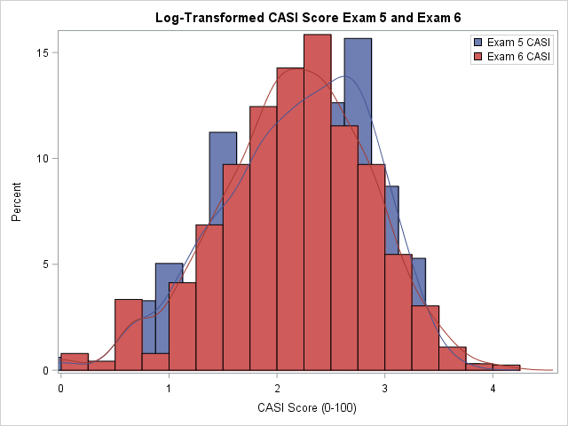
Log Transformed CASI
= log(101-CASISum6c)

