Slide 1
Lung-gut interactions in chronic lung diseases Concept Proposal for a MESA Ancillary Study
Lizzy Oelsner
Columbia University
28 March 2019

Slide 2
“…no more hotly debated topic in aerodigestive medicine”
Reflux
Dysphagia
Chronic lung disease
Very common diseases
Frequent comorbidities
Multiple bi-directional mechanisms hypothesized
Rosen R & Rahbar R, JAMA Otolaryng Head Neck Surg 2018

Slide 3
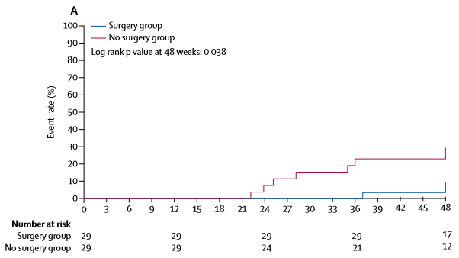
Treating reflux and respiratory health outcomes
Surgical treatment of reflux preserves lung function
Post-lung transplant (Ann Thorac Surg 2011)
Interstitial pulmonary fibrosis (Lancet Respir Med 2018)
Proton pump inhibitor (PPI) therapy does not
Children with uncontrolled asthma (JAMA 2012)
No trial data in COPD
Self-reported GERD and self-reported PPI use associated with more COPD exacerbations (Respir Med 2015)
WRAP-IPF
N=58
10% FVC decline or death

Slide 4
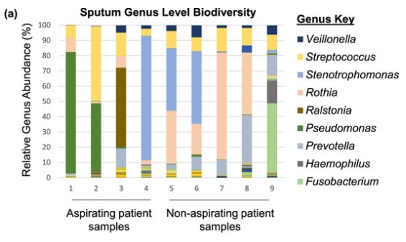
Beyond pH: bile acids and microbiome
Bile acid in BALF and phospholipids
50 post-lung transplant patients
(D’Ovidio, Am J Transplant 2006)
Bile acid in sputum and pulmonary microbiome
9 cystic fibrosis patients
(Reen, Sci Reports 2016)
Sphingomyelin

Slide 5
Major limitations of current “aerodigestive” research
Indices of digestive disorders and intermediates (e.g., microbiome)
Invasive (e.g., endoscopy, esophageal pH, manometry)
Imprecise (e.g., self-report)
“Independent” (e.g., ENT versus GI focused)
Measurements of lung disorders
Invasive (e.g., bronchoscopy)
“Holistic” (e.g., lung function as global measure)
Relative paucity of studies relating digestive/swallowing disorders to COPD and its endo-types
Populations
Small interventional/invasive studies of clinical disease
Large, general population-based studies are lacking
No prospective data on lung-gut disease interactions

Slide 6
Hypotheses
Aspiration
Swallowing
Hiatal hernia
Mechanism
Phospholipids
Chronic lung disease
Emphysema
Chronic bronchitis
Fibrosis
Asthma
Esophagus
Diaphragm
Surfactant
Microbiome

Slide 7
Proposed Aims
Among 500 randomly-sampled MESA participants, to test if novel MRI biomarkers of upper GI function are associated with:
Lower lung function, increased bronchodilator responsiveness
Increased apical emphysema and emphysema/fibrosis on CT
Alterations in the oral microbiome
Among 6,814 MESA Exam 1 participants, to test if novel cardiac CT biomarkers of GI function are prospectively associated with:
Accelerated lung function decline and increase in emphysema
Clinical respiratory events and all-cause mortality

Slide 8
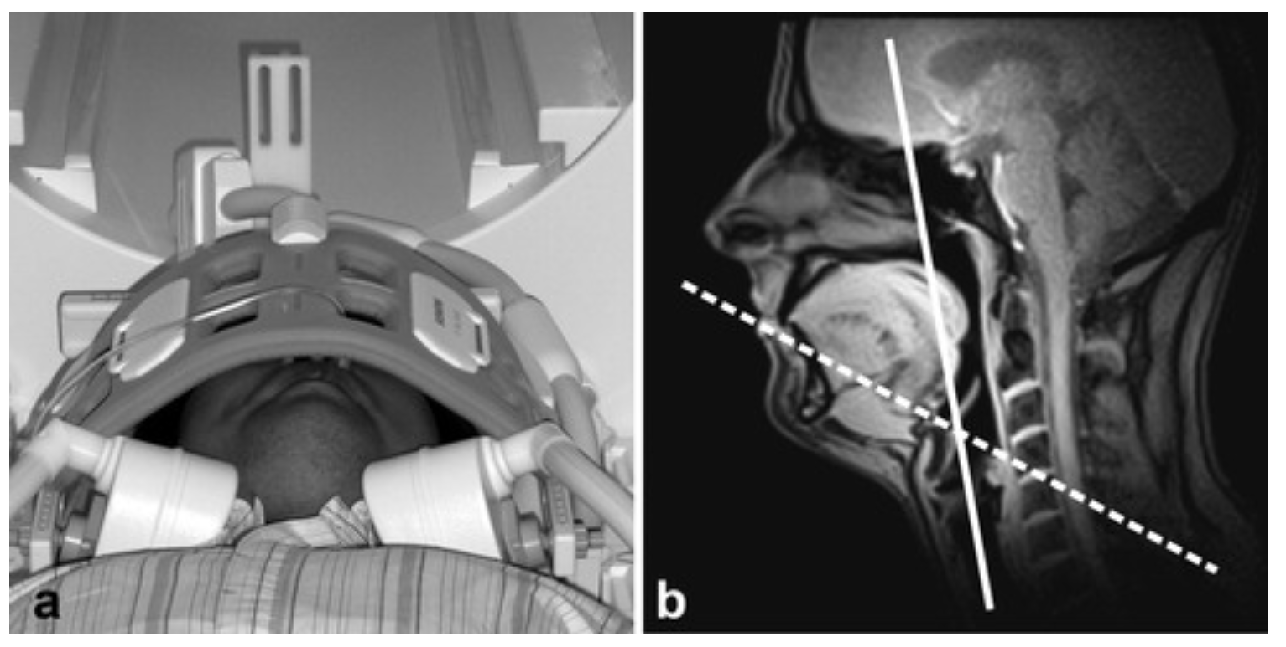
Novel MRI biomarkers for GI function (swallowing, aspiration)
Real-time MRI
Oral contrast (5mL pineapple juice thickened with yeast)
Aspiration as primary functional biomarker of interest
Zhang, JMRI 2012. Lingala, JMRI 2016.

Slide 9
Novel MRI biomarkers for GI function (reflux, sliding hernia)
Real-time MRI
Oral contrast (5mL pineapple juice thickened with yeast)
Variation over the respiratory cycle
Valsalva maneuver
Reflux as primary functional biomarker of interest
Zhang, Sci Rep 2015.

Slide 10
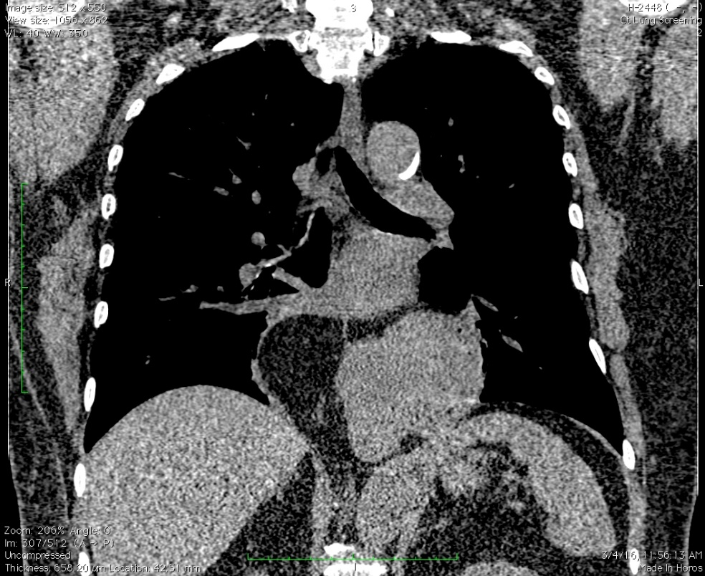
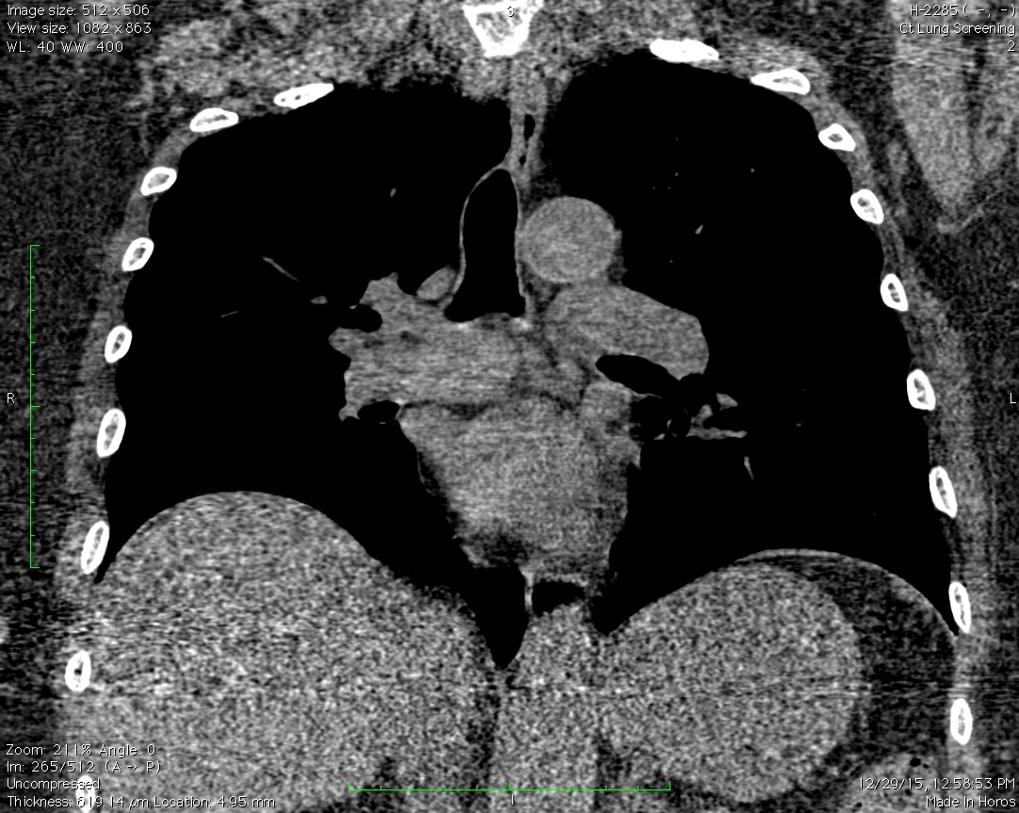
Novel CT biomarkers for GI structure (hernia, esophagus)
Non-contrast chest CT (MESA COPD)

Slide 11
Aim 1 Associations between GI function on MRI and lung disease in MESA
Random sample of ~500 MESA participants
Screening for dysphagia via “water swallow test” (exclusion criterion for oral contrast)
Real time MRI with oral contrast
Non-contrast CT chest
Sampling for oral microbiome
Pre/post bronchodilator spirometry

Slide 12
Aim 2 Associations between GI structure on CT and respiratory outcomes in MESA
Read MESA Exam 1 cardiac CTs for novel CT biomarkers (e.g., hiatal hernia, patulous esophagus)
Test associations with:
Decline in lung function
Progression in percent emphysema
Incident hospitalization/mortality for
COPD
Asthma
Pneumonia
All-cause mortality

Slide 13
Impact
Accomplishment of the proposed Aims would:
Establish the prognostic significance of innovative, non-invasive imaging biomarkers of upper GI function that could be suitable for risk stratification
Identify novel mechanisms for the development and progression of chronic lung diseases that could be targeted by specific medical/surgical therapies

Slide 14
Next steps
Ancillary Study proposal
Develop pilot/preliminary data
Power calculations
Identify/recruit multi-disciplinary collaborators

Slide 15
Thank you!

Slide 16
***Existing modalities for evaluating upper GI (UGI) structure/function are limited
Videofluoroscopy (VFSS) (modified barium swallow) | Gold standard. Patient eats/drinks foods mixed with barium while radiographic images are observed on a video monitor and recorded on videotape
Fiberoptic endoscopic examination of swallowing (FEES) | Clinical standard. Transnasal laryngoscope can identify aspiration and pharyngeal retention only after the swallow
Manometry/pH probe | To evaluate motility d/o, GERD
Electromyography | To evaluate motor unit d/o
Esophagoscopy | To r/o cancers
Water swallow test | Identified 80% of stroke patients who were aspirating (DePippo, Arch Neurol 1992)
Potential advantages of MRI
Non-invasive
No ionizing radiation
Spatial and temporal resolution
Soft tissue characterization

Slide 17
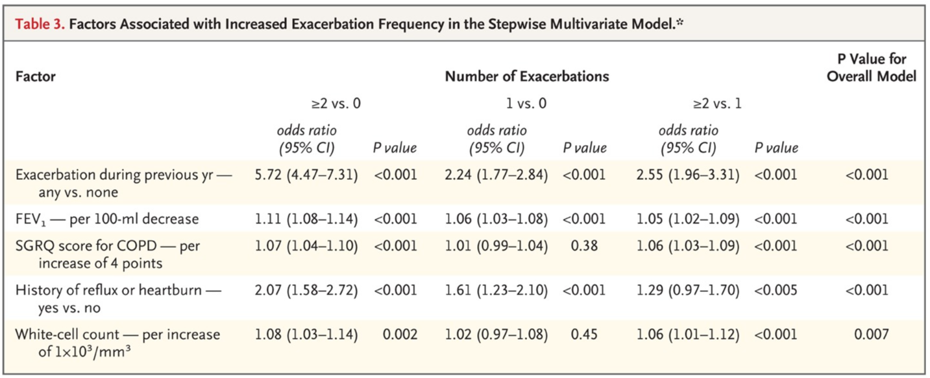
GERD linked to COPD exacerbation risk
Hurst et al, NEJM 2010

Slide 18
PPI therapy ineffective for asthma and COPD
RCT of lansoprazole for children with poorly controlled asthma
(JAMA 2012)
Observational data on self-reported PPI/H2RA treatment among COPD patients with self-reported GERD in ECLIPSE
(Benson, Respir Med, 2015)

Slide 19
Anti-reflux surgery effective post-lung transplant and in interstitial lung disease
Observational study of 297 patients post lung transplant
(Hartwig MG, Ann Thorac Surg 2011)
RCT of 58 IPF patients with abnormal acid GER randomized to laparascopic anti-reflux surgery
(Raghu, NEJM 2018)
10% FVC decline or death

Slide 20
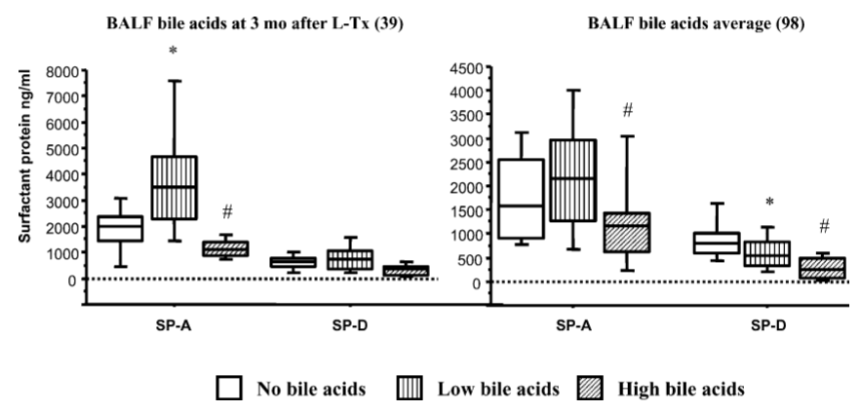
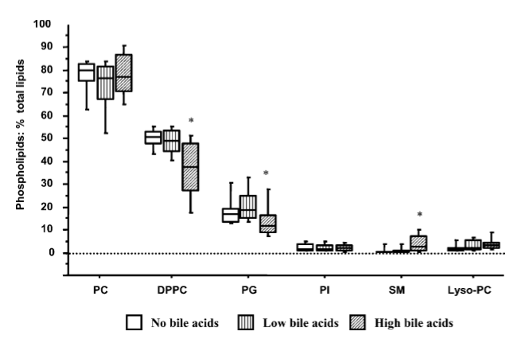
Bile acid reflux post-lung transplant
N = 50 post-transplant patients
Abnormal pH testing or BALF bile acid have impaired pulmonary surfactant phospholipids and surfactant-associated proteins
Sphingolipids including sphingomyelin (SM), previously associated with emphysema in murine models and with percent emphysema in MESA
D’Ovidio, 2006

Slide 21
Bile acid reflux in cystic fibrosis
In vivo, bile aspirating patient samples were colonized primarily by Proteobacterial pathogens which ranged from 50–90% of the total relative microbial abundance.
In vitro, bile acids also associated with pseudomonal biofilm activity, antimicrobial resistance, and redox functions
Reen, 2016

Slide 22
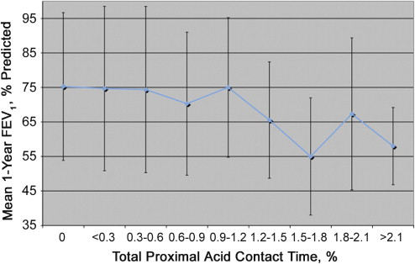
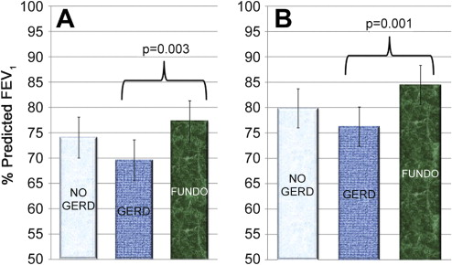
Fundoplication post-lung transplant
N = 297 post-transplant patients
Esophageal pH, lung function
Abnormal esophageal pH associated with lower peak allograft function, diminished 1-year FEV₁; early fundoplication appears to preserve lung allograft function
Hartwig, 2011

Slide 23
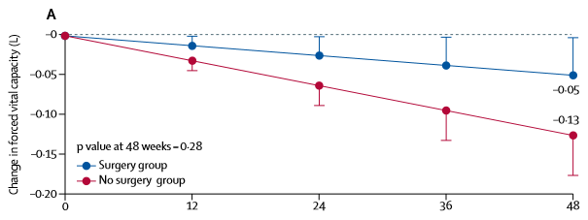
Anti-reflux surgery in IPF
N=58 IPF patients with abnormal acid GER and preserved FVC
Intervention = laparascopic anti-reflux surgery (WRAP-IPF)
Outcome = change in FVC at week 48
Laparoscopic anti-reflux surgery in patients with IPF and abnormal acid GER is safe and well tolerated. A larger, well powered, randomized controlled study of anti-reflux surgery is needed in this population.
10% FVC decline or death
Raghu, 2018

Slide 24
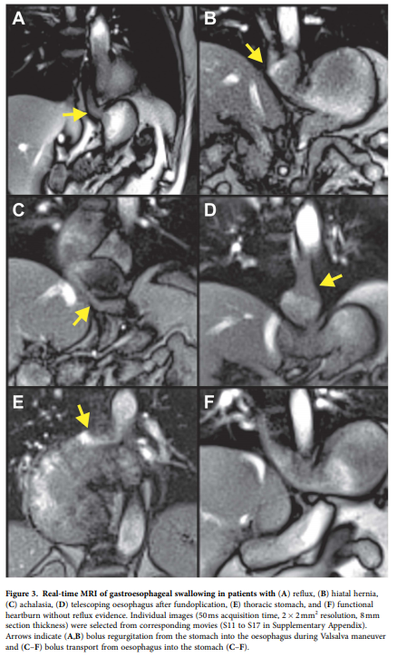
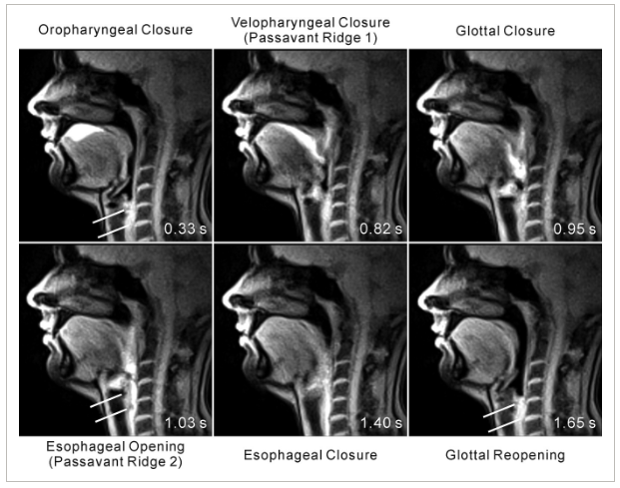
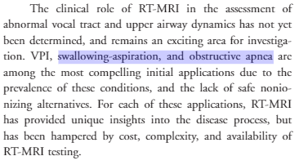
Novel MRI biomarkers of UGI function are under development thanks to methodological advances
Lingala, 2016.

Slide 25
Pilot data from MESA-COPD Chest CT show that measurement of UGI structure is feasible
idno | HH Present | Patulous esophagus
1 | no | yes
2 | no | no
3 | yes | no
4 | yes | yes
5 | no | no
6 | no | no
7 | no | no
8 | yes | no
9 | no | no
10 | no | no
11 | no | yes
12 | no | no
Large hiatal hernia
Retained material in esophagus
GEJ abnormalities are common and easily identified/measured (3 minutes/case) in MESA COPD random sample

