Slide 1
SPECIFIC AIMS
SPECIFIC AIM 1: To determine the longitudinal, cumulative and cross-sectional associations between ASCVD risk factors and coronary atherosclerotic burden and composition measured by CCTA among racial and ethnic subgroups of women and men enrolled in the MESA.
SPECIFIC AIM 2: To examine the associations between novel CCTA markers of pericoronary fat and ASCVD risk factors and treatment, and coronary atherosclerotic burden and composition among MESA enrollees.
SPECIFIC AIM 3: To compare the burden of atherosclerotic plaque and obstructive CAD severity in relation to baseline CAC measures of plaque volume and density among a propensity-matched cohort of long-term statin users and non-users.

Slide 2
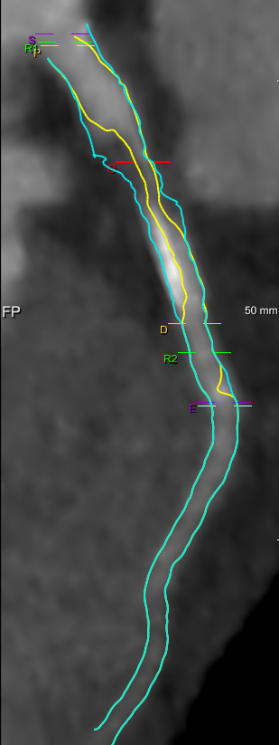
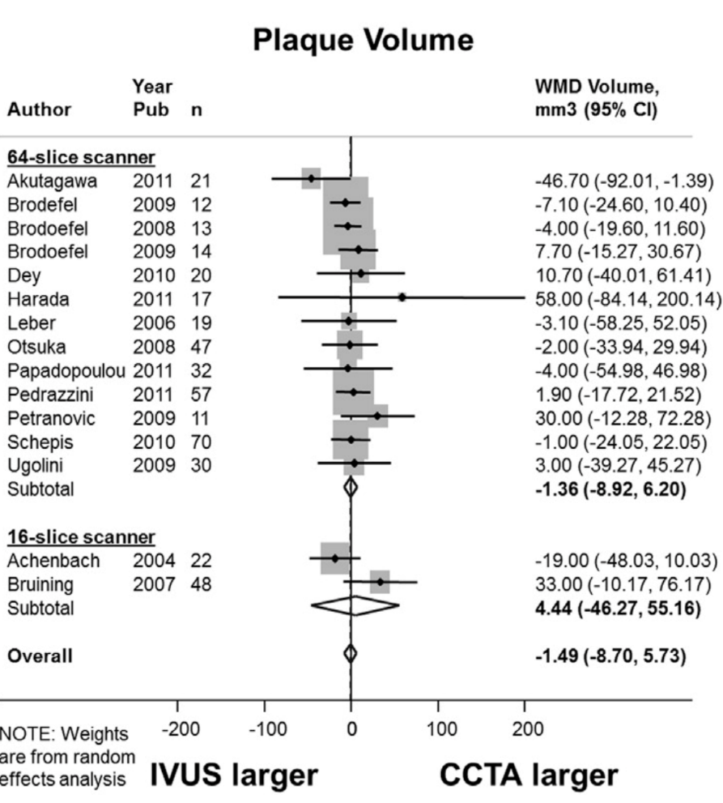
Coronary CT Angiography uniquely enables comprehensive evaluation of atherosclerosis.
Meta-analysis of 42 studies comparing CT to IVUS.
Three-dimensional measures
All major epicardial vessels and branches
0.5 mm cross-sectional characterization of plaque and lumen
1360 patients undergoing CT and IVUS
1.49 mm³ difference between CT / IVUS (p=NS)
AUC for plaque volume = 0.97
Source: Fischer C et al. JCCT 2013

Slide 3
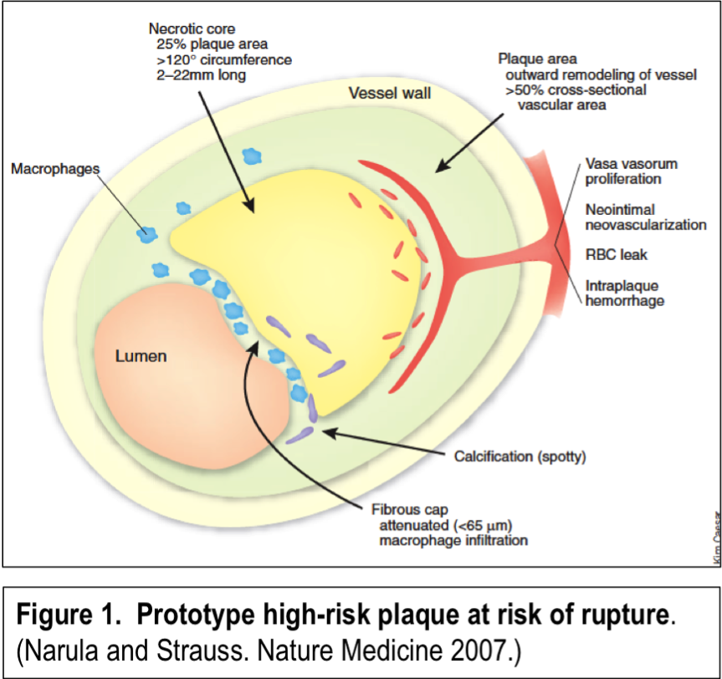
Identification of High Risk Atherosclerosis
High Risk Plaque Features
High plaque burden
Positive remodeling
Necrotic core
Spotty calcification
(Thin fibrous cap)
(Macrophage infiltration)
(Intraplaque hemorrhage)
Source: Virmani et al. N Engl J Med 1997; Narula and Strauss Nat Med 2007

Slide 4
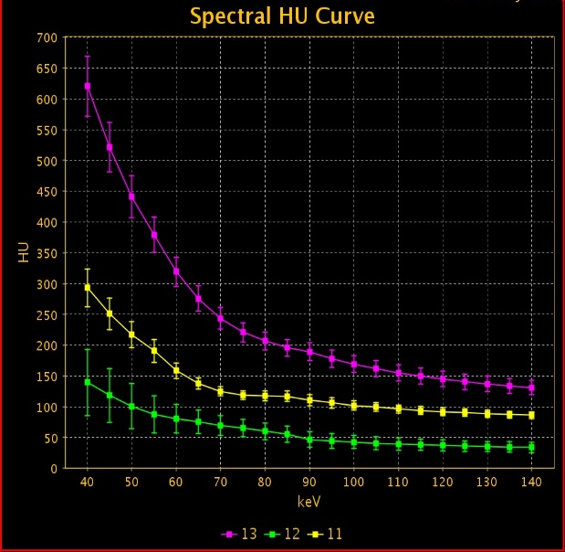
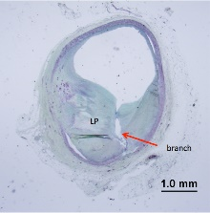
CT Enables Atherosclerotic Plaque Quantification and Characterization
Dual Energy Coronary CT Angiography
>90% specificity
for necrotic core
Atherosclerotic plaque characteristics
Stenosis (%DS, %AS, MLD, MLA)
Non-obstructive stenoses
Plaque burden (volume, area, thickness)
Plaque composition (non-calcified, calcified)
“Lipid dense” necrotic core (low attenuation plaque)
Arterial remodeling (positive, negative, intermediate)
Napkin ring sign and “Spotty” calcifications (<3 mm length)
Absolute material density (dual energy CT)
Others (location, length, diffuseness, bifurcations, etc.)
Source: Thomsen C and Abdulla J, Eur Heart J Cardiovasc Imaging 2016; Rodriguez-Granillo GA et al. Eur Heart J Cardiovasc Imaging 2016; Danad I et al. JACC Cardiovasc Imaging 2015

Slide 5
METHODS Study Population
Study Population
2,000 participants in MESA at exam 6
no prior CVD event, renal disease, contrast allergy, or prior radiation exposure >20 mSv in MESA
In December 2013, there were 3,681 potential participants based on above criteria
Investigators at all 6 MESA sites have agreed to participate

Slide 6
METHODS Low Dose CTA
Novel radiation reduction techniques
prospective ECG trigger, iterative reconstruction, low dose acquisition
full cardiac imaging with <2 mSv dose
Permits measurement of critical parameters
non-calcified plaque and vulnerable plaque
stenosis, coronary remodeling
lumen diameters, LV mass
epicardial fat and coronary calcium

Slide 7
Why CT Angiography?
Predicts CV outcomes better than CAC + Risk Factors
Stronger Associations with C-RP, total cholesterol and LDL-Cholesterol than CAC
MACS (PI - Post HL095129-01) demonstrated associations with NCP and HIV status, not CAC (Annals, April 2014)
Plaque distribution and markers of vulnerable plaque may have greatest prognostic significance

Slide 9
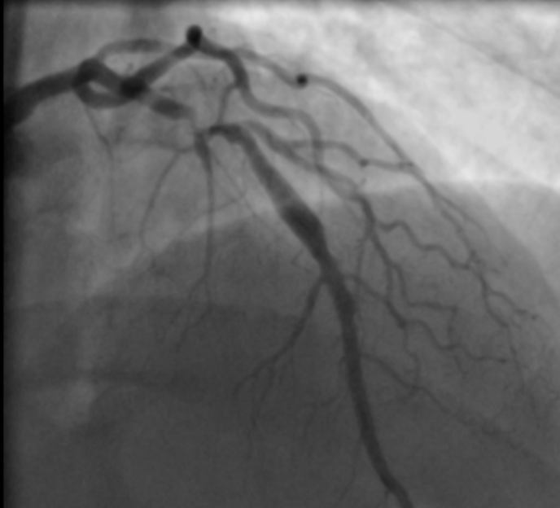
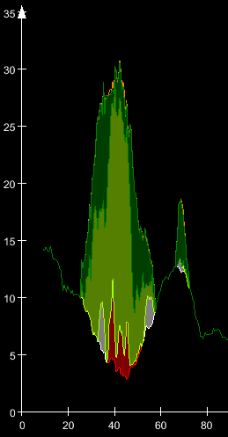
Case 1: 52 y/o man with high cholesterol
Left Anterior Descending Artery
Dense calcium: >350 HU
Fibrous: 131 - 350 HU
Fibro-fatty: 31 - 130 HU
Necrotic core: -30 - 30 HU
ST elevation myocardial infarction
Vessel wall
Lumen
Remodeling index: 2.95
Area (mm²)
plaque
Positive remodeling
Low attenuation plaque
Spotty calcification
Napkin ring sign
2 days later
4 / 4 High Risk Plaque Features
Distance from ostium (mm)
Source: van Rosendael, A et al. JACC Cardiovasc Imaging 2018 (preliminary)

Slide 10
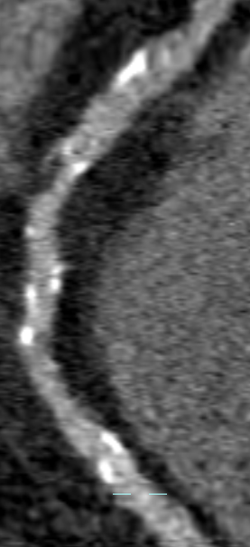
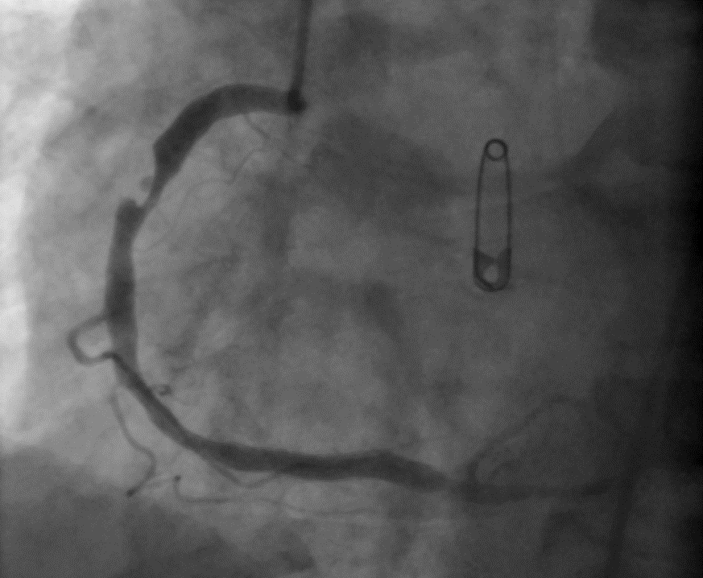
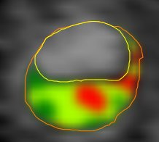
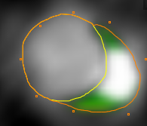
Case 2: 62 year old man with high cholesterol and tobacco history
Right Coronary Artery
Stable plaque
Non-ST Elevation Myocardial Infarction
2 / 4 High Risk Plaque Features
Positive Remodeling and Necrotic Core
-30 HU
Stable plaque
44 days later
Source: van Rosendael, A et al. JACC Cardiovasc Imaging 2018 (preliminary)

Slide 11
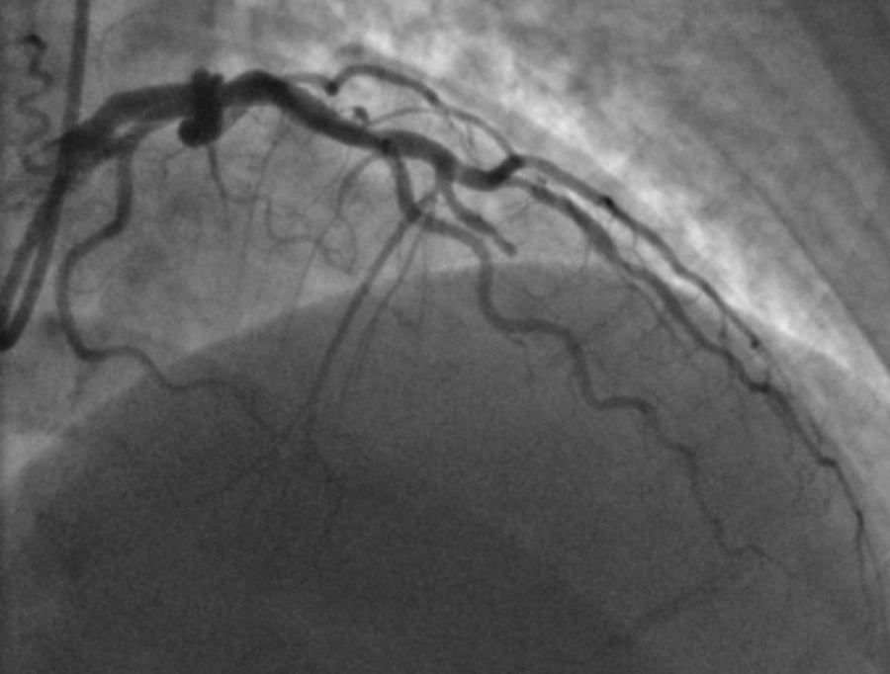
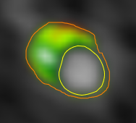
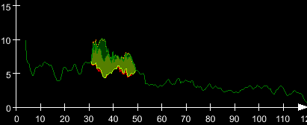
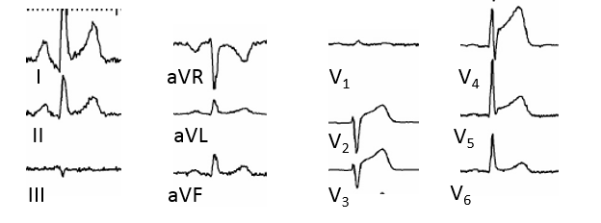
Case 3: 57 year old woman with high blood pressure
Left Anterior Descending Artery
ST Elevation Myocardial Infarction
1 / 4 High Risk Plaque Features
Positive Remodeling
Remodeling index: 1.6
Area (mm²)
Distance from ostium (mm)
975 days later
Source: van Rosendael, A et al. JACC Cardiovasc Imaging 2018 (preliminary)

Slide 12
PARADIGM: CAD Progression and Response to Statins
Prospective observational cohort study
N=1,255, 13 sites, 7 countries
Quantitative CT evaluation for APCs
Medication
Lab testing, including lipid panels
Source: Lee SE et al. JACC Cardiovasc Imaging 2018

Slide 13
PARADIGM: CAD Progression and Response to Statins
N=781
N=474
No difference in stenosis >50% by statin treatment
33% reduction in high-risk plaques at 3.8 year follow-up for patients treated with statins
Source: Lee SE et al. JACC Cardiovasc Imaging 2018

Slide 14
Thank You.

