Slide 1
MESA: mHealth Ancillary
Seth S. Martin, MD, MHS
Michael J. Blaha, MD, MPH
Wendy S. Post, MD, MS
Notes:
9am to 10:30am
Future of MESA Scientific Discussion
Frailty and healthy aging - Dr. Shea
Kidney - Dr. Kestenbaum
Environmental Health Activities and Opportunities - Dr. Kaufman
Mobile Health – Martin, Blaha, Post

Slide 2
Seth Martin: Background in MESA and mHealth
Preventive Cardiologist, Associate Professor at JHU
MESA co-investigator since cardiology fellowship
Pubs on lipids, CAC, CV risk; faculty mentor to multiple trainees
mHealth background
NIH mHealth training institute 2015
mActive trial → automated tracking-texting increased physical activity, pub in JAHA, now being tested in multiple clinical populations (pHTN, HIV) via NIH funding, plus offshoot of mActive-Smoke exploring real-time PA-smoking association
Instant Blood Pressure → landmark study invalidating popular cuffless BP app, pub in JAMA IM, plus 4 other pubs, led to FTC lawsuit and informed FDA regulation
Corrie → 1st cardiology CareKit app/platform; comprehensive functions including med tracking, vitals tracking, patient education, follow up appointment scheduling, medical wallet

Slide 3
What is mHealth?
“mHealth is the use of mobile and wireless devices (cell phones, tablets, etc.) to improve health outcomes, health care services, and health research.”
- NIH
https://grants.nih.gov/grants/guide/pa-files/PAR-14-028.html

Slide 4
Why mHealth?
Future of cohort studies
Opens door for new inquiry
More efficient data collection
Exploration of real-time associations of behaviors: moving from visit-to-visit to minute-minute level
Real-world data from outside the research center
Retrospective survey → real-time measurement
Subjective → objective
Identify new phenotypes → precision medicine
Microrandomized and traditional randomized trials of behavioral interventions
Notes:
New inquiry that is only accomplished via mHealth or at least better accomplished because the data are better: more accurate, prospective, objective, with richer detail
If move from visit-to-visit to minute-minute level, get closer to causal inference?

Slide 5
What can we gather via mHealth
Smartphone apps:
eConsent
Medical tracking
Education
Appointment scheduling
and more
Smartwatches:
Heart rate
Physical activity
Afib detection
Bluetooth connected devices:
Blood pressure
Weight
Pulse Ox
Glucose
and more

Slide 6
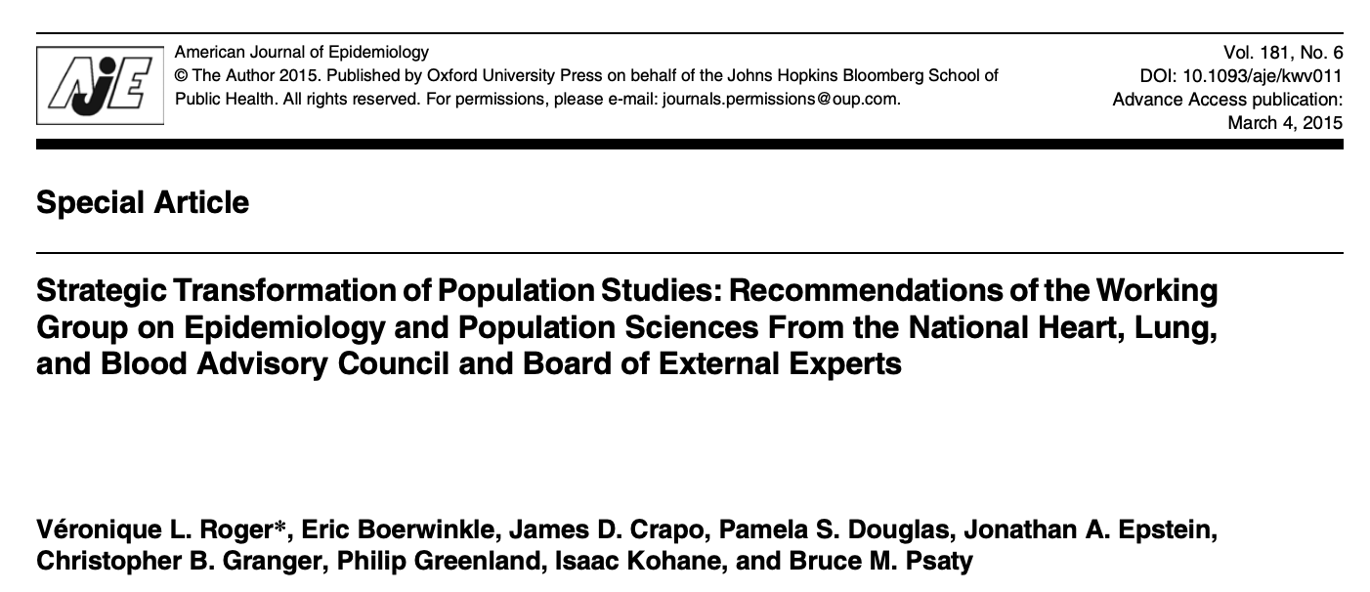
“…the rapidly emerging field of data sciences and the advent of new digital data sources, which range from electronic devices used by individuals to databases within healthcare systems, greatly expand the opportunities for population science…the new tools that have emerged can serve as novel platforms for epidemiologic research, including the use of digital tools and mobile health applications to ascertain exposure and the availability of electronic, administrative, and medical records data to sample populations and ascertain outcomes.”

Slide 7
The Framingham investigators are already doing this
1R01HL141434-01A1, PI Murabito, Joanne
To enhance and deploy a digital mobile health cardiovascular monitoring system, Framingham Heart Study-Novel Examination using Technology (FHS-NExT)
Custom smartphone application (app) and data from a smartwatch (heart rate/steps) and digital blood pressure cuff
FHS Generation 3 (Gen3) and multi-ethnic Omni 2 participants

Slide 8
FHS-NeXT Specific Aims
Aim 1. Enhance the FHS-NExT smartphone app to promote adherence and compare the new FHS-NExT app CVD risk factor surveys against conventional measures in the FHS Research Center.
Aim 2. Identify factors associated with successful long-term use of the FHS-NExT system, including the app, smartwatch, and digital BP device
Aim 3. Examine relations of novel exercise capacity measures by cardiopulmonary exercise testing (CPET) with average resting HR and daily step counts from smartwatch recordings over 30 days.
Aim 4. Examine relations of arterial stiffness by tonometry with mean weekly BP and mean BP variability over 6 months.

Slide 9
Why MESA?
Older Age
Multi-Ethnic
Diverse SES

Slide 10
What do we know already?

Slide 11
Have Internet Access? (Jan 2014-June 2015)
 | Total | Yes
WFU | 730 | 383 | 52%
Col | 735 | 398 | 54%
JHU | 721 | 359 | 50%
UMN | 797 | 445 | 56%
NWU | 883 | 617 | 70%
UCLA | 862 | 251 | 29%
Total | 4728 | 2453 | 52%
Notes:
Follow-up 15 Personal Status Form (Jan 2014-June 2015)

Slide 12
Have Internet Access? By Age & Race/Ethnicity (Jan 2014-June 2015 - Incomplete Dataset)
 | Yes
45-54 | 366 | 71%
55-64 | 330 | 58%
65-74 | 170 | 39%
75+ | 22 | 22%
Total | 888 | 55%
 | Yes
White | 545 | 68%
Chinese | 101 | 58%
Af American | 149 | 51%
Hispanic | 93 | 26%
Total | 888 | 55%

Slide 13
Do you have access to a smartphone, tablet, iPad, Kindle, or similar device? (Jan 2014-June 2015)
 | Total | Yes | %
WFU | 728 | 243 | 33%
Col | 728 | 237 | 33%
JHU | 709 | 156 | 22%
UMN | 792 | 265 | 33%
NWU | 874 | 261 | 30%
UCLA | 855 | 188 | 22%
Total | 4686 | 1350 | 29%

Slide 14
What kind of device is it? (choose all that apply)
(Jan 2014-June 2015)
 | iPhone |  | android phone |  | other smart phone |  | iPad |  | kindle |  | other tablet
 | Yes | % of total | Yes | % of total | Yes | % of total | Yes | % of total | Yes | % of total | Yes | % of total
WFU | 56 | 8% | 188 | 26% | 0 | 0% | 4 | 1% | 4 | 1% | 0 | 0%
Col | 97 | 13% | 66 | 9% | 10 | 1% | 80 | 11% | 15 | 2% | 15 | 2%
JHU | 123 | 17% | 2 | 0% | 0 | 0% | 46 | 6% | 13 | 2% | 2 | 0%
UMN | 131 | 17% | 41 | 5% | 34 | 4% | 89 | 11% | 29 | 4% | 16 | 2%
NWU | 153 | 18% | 76 | 9% | 6 | 1% | 68 | 8% | 4 | 0% | 5 | 1%
UCLA | 83 | 10% | 15 | 2% | 23 | 3% | 82 | 10% | 7 | 1% | 21 | 2%
Total | 643 | 14% | 388 | 8% | 73 | 2% | 369 | 8% | 72 | 2% | 59 | 1%

Slide 15
Willing to use an app for MESA data collection? (of those with internet access and a smart device) (Jan 2014-June 2015)
 | Yes |  | Maybe |  | Total
WFU | 1 | 0% | 0 | 0% | 235
Col | 106 | 50% | 17 | 8% | 213
JHU | 91 | 59% | 8 | 5% | 154
UMN | 146 | 58% | 33 | 13% | 252
NWU | 107 | 42% | 49 | 19% | 257
UCLA | 69 | 43% | 4 | 2% | 162
Total | 520 | 41% | 111 | 9% | 1273
Notes:
Follow-up 15 Personal Status Form (Jan 2014-June 2015)

Slide 16
Opportunities

Slide 17
Overarching Scientific Goal
To embed a digital/mHealth cohort within MESA as a model for efficient, scalable, and real-world population based data collection

Slide 18
Potential Aims
#1: To understand patterns of mHealth technology use in MESA, a demographic underrepresented in mHealth studies
#2: To determine the tech literacy of MESA participants
#3: To evaluate the association of use of mHealth with cardiovascular risk factors, subclinical atherosclerosis, and events

Slide 19
Other Example Survey Questions of Interest
Do you use text messaging on your mobile phone?
Do you use health apps?
If so, which ones?
Have you used apps to track:
Physical activity? Diet? Medications? Other?
Have you ever used a smart watch / fitness tracker (e.g., Fitbit or Apple Watch)?
If so, which one? If so, what is your motivation for using it?
Are you currently using it? If so, how long?
Do you engage in any health challenges through digital technology (ex. Fitbit step challenges with family and friends)?
Do you use social media such as Facebook, twitter, or Instagram?

Slide 20
OPPORTUNITIES
Cognitive assessments on the smartphone
Engage spouse / caregivers of patients with dementia

Slide 21
Potential Limitations
Lack of validation of sensors → opportunity for validation studies
Cognitive decline → opportunity to engage spouse/caregiver
Selective use of mHealth devices by participants → opportunity to understand and address reasons for selective use (e.g., tech literacy)
Technical challenges → opportunity to lead on best practices in technical support for cohort studies

Slide 22
Increase Retention by Engaging MESA Participants through Text Messages, Social Media, and an App?
Newsletter
Lay press releases
Happy birthday messages

Slide 23
Summary
Embed a digital/mHealth cohort within MESA as a model for efficient, scalable, and real-world population based data collection
Answer scientific questions only answered, or better answered, through mHealth
Platform to identify new phenotypes/subgroups, explore real-time associations, and conduct RCTs
May have practical advantages such as increasing retention of participants
Future of cohort studies and unique opportunity in MESA to work with older, multi-ethnic, diverse SES population – a group that could stand to benefit the most from mHealth but is largely being ignored in the mHealth field

Slide 24
Questions for Discussion
Start at JHU site vs all MESA sites?
Explore collaboration with Framingham investigators to use FHS-NeXT app vs building own?
Comfort with randomized controlled trials of behavior modification? (e.g., targeting physical activity, smoking, blood pressure monitoring)
Other questions or concerns?

Slide 25
Thank You

