Slide 1


Environmental Factors:
Existing Measures and New Opportunities
Joel D. Kaufman

Slide 2
The Environment in Cardiovascular Disease
Broad vision of what constitutes “The Environment”
What do we mean as The Environment in the concept of Gene-Environment Interactions
Evolving set of terms: “Exposome”, “Pollutome”, “Envirome”
Exposome: encompasses life-course environmental exposures (including lifestyle factors), from the prenatal period onwards. (Wild, 2005)
  Often described in context of measurement using sensors, biomarkers, “omics” technologies
In Cardiovascular Epidemiology, Challenge of Incorporating Potential Environmental Risk Factors is in Getting the Measurement Right.

Slide 3
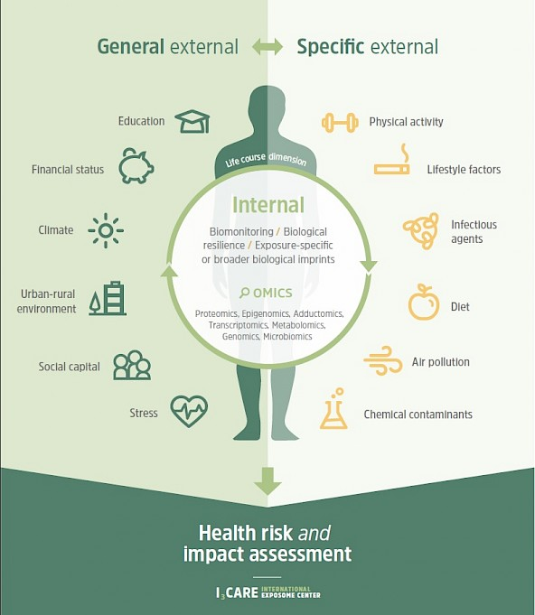
Environmental Factors
Modifiable at Individual Level
Modifiable at Community Level
Modifiable at Societal/National Level
Non-modifiable?
Tendency to focus on individual risk factor modification, but….
IRAS, Univ Utrecht

Slide 4
Challenges To Characterizing Exposure
Correct Time of Exposure
  “Critical Window”
  Time of Interest Depends on Effect of Interest
Correct Spatial Distribution of Exposure
Individual Sources of Exposure Variation
Often unreasonable fondness for biomarkers of exposure, and for new measurement technologies
  Better to focus on understanding sources of variation and correlation structure with other risk factors

Slide 5
MESA Air: Data Availability
Air pollution predictions for MESA Classic, MESA Air New Recruits, and MESA Family recruited in to MESA Air
  PM_{2.5}, Ozone, NO_{X}, NO₂
  Through Exam 6
100s of geographic covariates (e.g., land use, distance to roadway, census variables)

Slide 7
MESA Air: What’s Next?
Refinements and extensions to air pollution prediction models
Daily air pollution model for PM_{2.5} in Baltimore
  Proof of concept for transition to daily scale models
  Use of “Low-Cost Monitors”
Out of area predictions on a two-week scale (national spatio-temporal models)

Slide 8
Built Environment in MESA: Publications
Moore et al. 2013: Home and work environments and BMI
Johnson et al. 2018: BE and sleep
Billings et al. 2015: Neighborhood walking environment and sleep apnea
Barrientos-Gutierrez et al. 2017: Neighborhood physical environment and BMI
Hirsch et al. 2014: Residential relocation and walking and BMI
Hirsch et al. 2014: Changes in BE and BMI and waist circumference
Christine et al. 2015: Physical and social environments and T2DM
Braun et al. 2016: Walkability and cardiometabolic risk factors
Kaiser et al. 2016: Neighborhood environments and hypertension

Slide 9
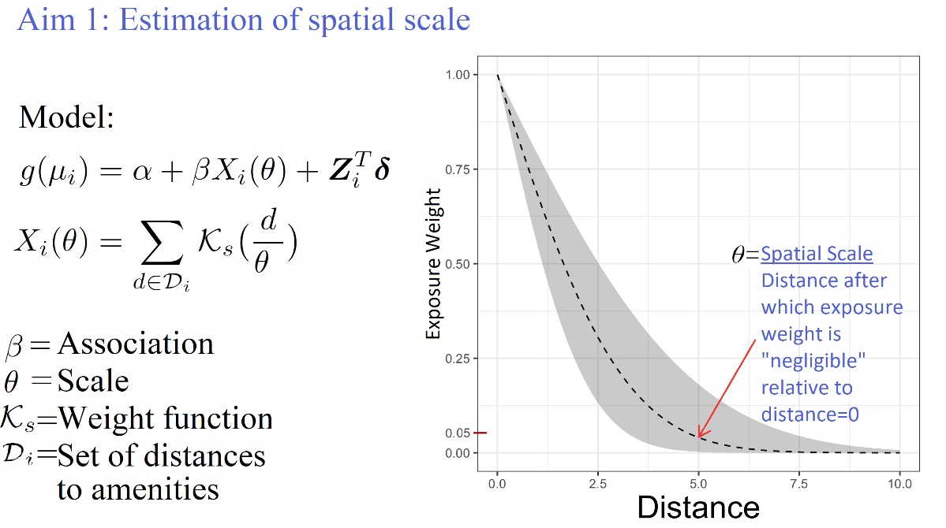
Refining Built Environment Measures in MESA: Sanchez R01
Address geographic and temporal scale in built environment features
Define novel measures of exposure to multiple environment features
Quantify the bias in built environment health effect estimates

Slide 10
Building off of Built Environment
Greenspace
  Many existing measures included in MESA Air database
  Neighborhood parks and cognition (AC 654)
  Greenspace and T2DM (AL 326)
Incorporation of GPS tracking data
Interactions between BE and physical activity

Slide 11
Pooled cohorts & Big Data
Currently investigating the shape of the relationship between exposure to low concentrations of air pollution and CVD using pooled cohort data and electronic health records
Could be expanded to other endpoints (e.g., breast cancer)

Slide 12
Metal exposure in MESA (Navas-Acien)
Funded R01: low-level arsenic exposure and CVD
  Urinary arsenic (total and species) at baseline and Exam 5
Planned R01: lead and cadmium and CVD
  To be measured in whole blood

Slide 13
Understanding the Environment in Cardiovascular Epidemiology
Rapid improvement in exposure assessment methods
Getting the Exposure right makes a huge difference
Ideal to align exposure assessment with time of interest
Reducing exposure measurement error is important and leads to more robust inferences

Slide 14
What Makes Sense for Exam 7?
Exposome concept
  Reality of existing work versus conceptual frame
    Can we do something more comprehensive in MESA?
      Combine biomarkers of exposure with spatio-temporal modeling
Opportunities in MESA
    MESA needs to fund exam components
    Fundable proposals probably will feature linkage to novel health outcomes
      Promising outcomes with plausible environmental links

