Slide 1
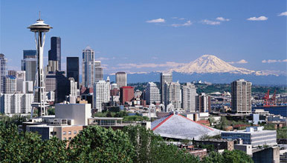
NEW METHODS OF MEASURING KIDNEY FUNCTIONS
Bryan Kestenbaum MD MS
University of Washington
Division of Nephrology
Kidney Research Institute
Seattle Washington

Slide 2
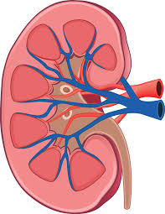
THE KIDNEYS PERFORM MULTIPLE HOMEOSTATIC FUNCTIONS
Filtration of freely circulating substances
Retention of important proteins
Secretion of protein-bound organic solutes and drugs
Synthesis of essential hormones and amino acids
Electrolyte, water, and acid-base balance
Remote signaling

Slide 3
THE ASSESSMENT OF KIDNEY DISEASE IS GLOMERULOCENTRIC
Filtration of freely circulating substances GFR
Retention of important proteins Albuminuria
Secretion of protein-bound organic solutes and drugs
Synthesis of essential hormones and amino acids
Electrolyte, water, and acid-base homeostasis
Signaling

Slide 4
THE ASSESSMENT OF KIDNEY DISEASE IS GLOMERULOCENTRIC
Filtration of freely circulating substances GFR
Retention of important proteins Albuminuria
GFR estimated from serum creatinine (or cystatin C) with age, race, sex
Albuminuria measured from spot urine sample
No validated methods for reliably assessing other kidney functions

Slide 5
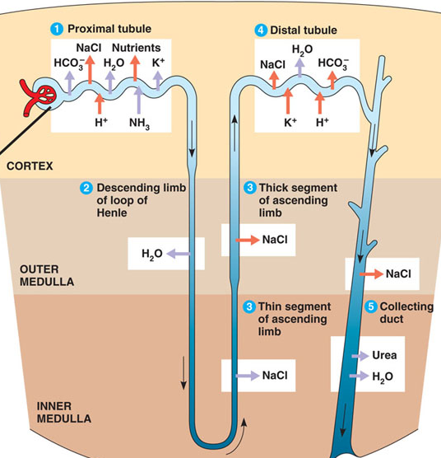
KIDNEY FUNCTIONS ARE ANATOMICALLY DISTINCT
Reabsorption
Synthesis
Secretion
Acid-base balance
Salt-water balance

Slide 6
GFR INCONSISTENTLY RELATED TO KIDNEY HISTOLOGY
62 year old woman with diabetes
eGFR = 32 ml/min/1.73m²
43 year old man with diabetes
eGFR = 32 ml/min/1.73m²

Slide 7
GFR INCONSISTENTLY RELATED TO METABOLIC COMPLICATIONS
62 year old woman with diabetes
eGFR = 32 ml/min/1.73m²
43 year old man with diabetes
eGFR = 32 ml/min/1.73m²
Parathyroid hormone 347 pg/mL
Bicarbonate 20 mEq/L
Hemoglobin 9 g/dL
Parathyroid hormone 51 pg/mL
Bicarbonate 26 mEq/L
Hemoglobin 14 g/dL

Slide 8
THE KIDNEYS PERFORM MULTIPLE HOMEOSTATIC FUNCTIONS
Filtration of freely circulating substances
Retention of important proteins
Secretion of protein-bound organic solutes and drugs
Synthesis of essential hormones and amino acids
Electrolyte, water, and acid-base balance
Remote signaling

Slide 9
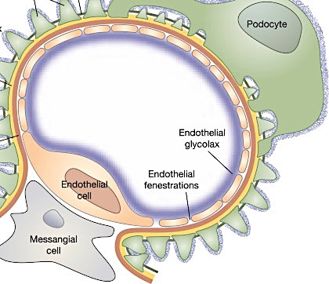
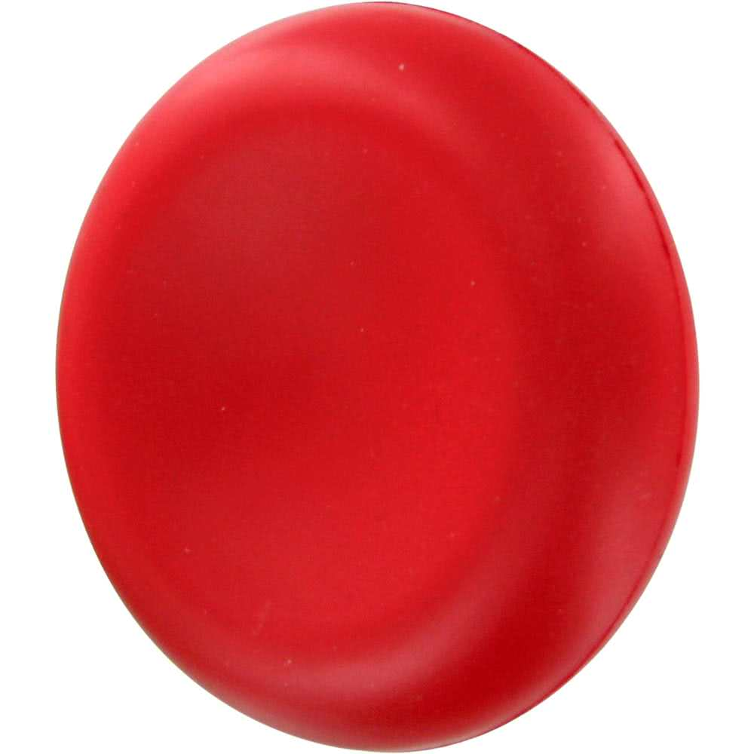
THE GLOMERULUS FILTERS LOW MOLECULAR WEIGHT SOLUTES
$≈$20% kidney blood flow is filtered

Slide 10
THE PROXIMAL TUBULES SECRETE ORGANIC SOLUTES INTO URINE
$≈$80% kidney blood flow
Peri-tubular capillary
Proximal tubule
Urine

Slide 11
THE PROXIMAL TUBULES SECRETE ORGANIC SOLUTES INTO URINE
Wang, Kestenbaum, CJASN 2018

Slide 12
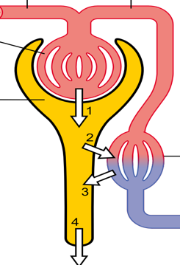
TUBULAR SECRETORY CLEARANCE DIFFERS FROM GFR
Glomerular filtration
Tubular secretion
 | Filtration | Secretion
Proportion of renal blood flow | 20-25% | Up to 80%
Can remove protein bound solutes | No | Yes
Kidney route of drug clearance | Secondary | Primary

Slide 13
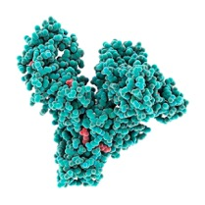
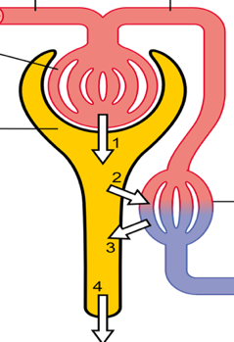
HOW TO MEASURE TUBULAR SECRETORY CLEARANCE?
Avidly secreted
Minimally filtered
Can be measured reliably
Find ideal secretory solute
X
Albumin
Urine

Slide 14
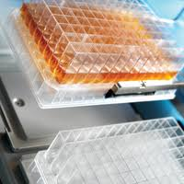
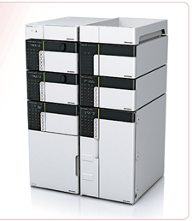
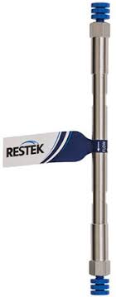
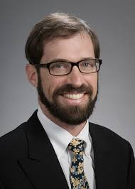
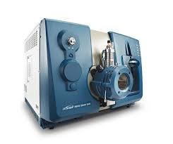
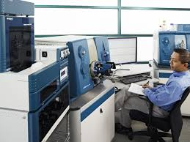
DEVELOPMENT OF NEW LC/MS ASSAYS FOR SECRETORY SOLUTES

Slide 15
 | Mean plasma concentration (ng/ml) | Diurnal CV plasma over 24-hours | Clearance (ml/min)
Hippurate | 666.6 | 47.4 | 598
Cinnamoylglycine | 10.4 | 26.8 | 157
Indoxyl sulfate | 600.9 | 21.0 | 62
p-cresol sulfate | 2113.3 | 26.6 | 21
3-hydroxyhippurate | 14.7 | 44.4 | 4032
Adipic acid ND | 253.9 | 28.2 | 10
Dimethyluric acid ND | 17.0 | 39.0 | 737
Isovalerylglycine | 5.5 | 30.2 | 485
Kynurenic acid | 9.3 | 14.9 | 147
Pantothenic acid | 47.6 | 11.9 | 36
Pyridoxic acid | 10.3 | 8.5 | 801
Suberic acid ND | 246.7 | 25.9 | 11
Succinic acid ND | 1499.3 | 26.9 | 4
Tiglylglycine | 4.2 | 22.4 | 409
Trimethyluric acid | 1.3 | 49.2 | 414
Xanthosine | 3.8 | 13.0 | 236

Slide 16
MEASUREMENT PROPERTIES IN NORMAL INDIVIDUALS
 | Mean plasma concentration (ng/ml) | Diurnal CV plasma over 24-hours | Kidney clearance (ml/min)
Isovalerylglycine | 5.5 | 30.2 | 485
Tiglylglycine | 4.2 | 22.4 | 409
Xanthosine | 3.8 | 13.0 | 236
Cinnamoylglycine | 10.4 | 26.8 | 157
Kynurenic acid | 9.3 | 14.9 | 147
Indoxyl sulfate | 600.9 | 21.0 | 62
Pantothenic acid | 47.6 | 11.9 | 36
p-cresol sulfate | 2113.3 | 26.6 | 21

Slide 17
MEASUREMENT OF SECRETORY CLEARANCE IN CRIC STUDY
Chronic Renal Insufficiency Cohort (CRIC) Study
Clinic-based study of 3,939 non-dialysis CKD patients from 14 sites
Random sample underwent iothalamate measurements of GFR
Completed 24-hour urine collection at baseline
Long-term follow-up
We measured candidate secretory solutes in paired plasma and 24-hour urine samples from all available CRIC participants at baseline

Slide 18
CALCULATION OF SECRETORY SOLUTE CLEARANCES
REQUIRES TIMED URINE COLLECTION
Clearance_{X} (ml/min) = Urine concentration_{X} (mg/ml) * Urine volume (ml/min)
Plasma concentration_{X} (mg/ml)
Steady state assumption
Plasma concentration of X remains constant over duration of urine collection period

Slide 19
SOLUTE CLEARANCES VERSUS MEASURED GFR
1,212 CIRC participants who completed iothalamate GFR measurements
 | Median clearance (IQR) ml/min/1.73m² | Correlation with iGFR*
Iothalamate GFR | 46 (33, 60) | -
Isovalerylglycine | 209 (136 - 315) | 0.44
Tiglylglycine | 166 (108 - 258) | 0.50
Kynurenic acid | 85 (59 - 120) | 0.54
Xanthosine | 73 (44 - 109) | 0.28
Cinnamoylglycine | 53 (30 - 91) | 0.22
Indoxyl sulfate | 30 (21 - 44) | 0.49
Pantothenic acid | 19 (11 - 29) | 0.42
P-cresol sulfate | 10 (6 - 15) | 0.42
*All p-values <0.001

Slide 20
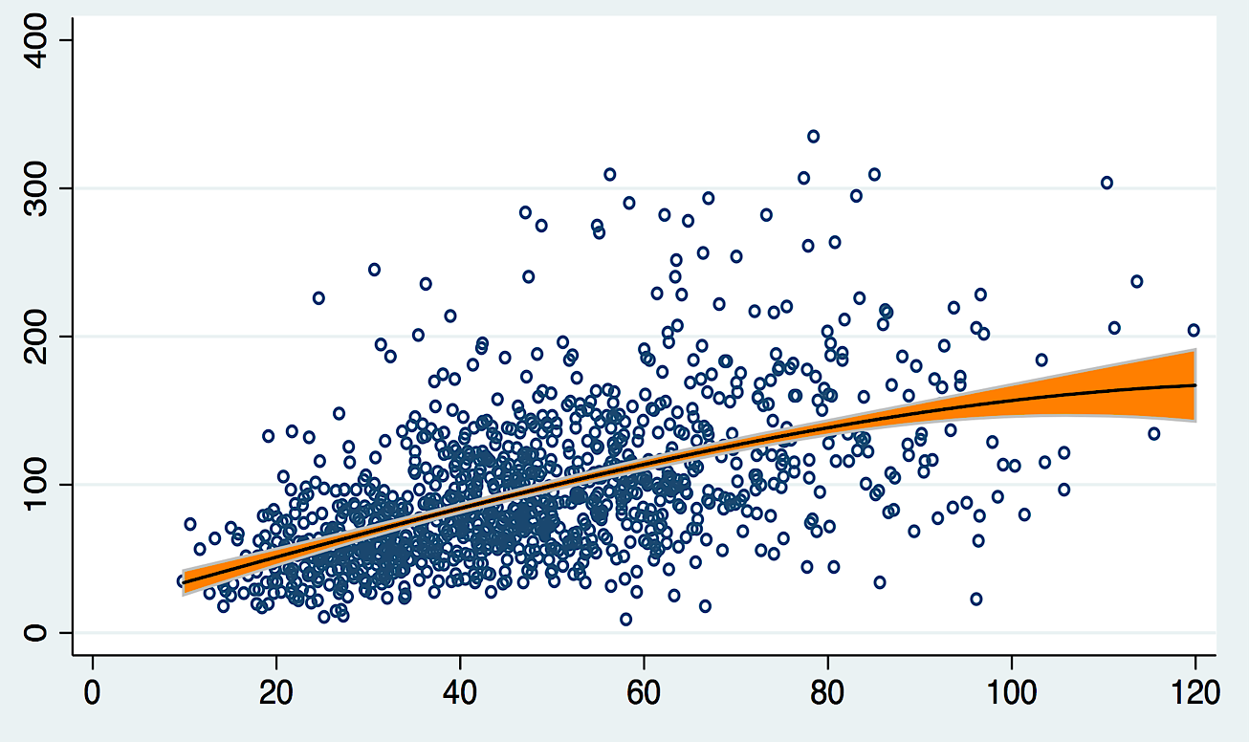
SOLUTE CLEARANCES VERSUS MEASURED GFR
$ρ$ = 0.54
Kynurenic acid clearance (ml/min/1.73m²)
Iothalamate GFR (ml/min/1.73m²)

Slide 21
ASSOCIATION OF SECRETORY CLEARANCE WITH PROGRESSION
3,349 CRIC participants with complete secretory clearance data
CKD progression: 50% decline in eGFR, dialysis, or kidney transplantation
1,161 progression events over median follow-up of 6.0 years
Solute clearance per 50% lower | Adjusted hazard ratio | P-value
Cinnamoylglycine | 1.12 | <0.001*
Indoxyl sulfate | 1.15 | <0.001*
P-cresol sulfate | 1.09 | 0.009*
Isovalerylglycine | 1.13 | 0.001*
Kynurenic acid | 1.21 | <0.001*
Pantothenic acid | 1.19 | <0.001*
Tiglylglycine | 1.07 | 0.027
Xanthosine | 1.14 | <0.001*
Adjusted for age, race, sex, study site, baseline eGFR-CRIC, 24-hour urine albumin, BMI, diabetes, smoking, systolic blood pressure, history of cardiovascular disease, ACE or ARB use

Slide 22
SECRETION PRIMARY MECHANISM OF KIDNEY DRUG ELIMINATION
OAT1-3 | OCT2
Furosemide | Metformin
Hydrochlorothiazide | Beta blockers
Cephalosporins | Cisplatin
Penicillins | Cimetidine
Acyclovir | Lamivudine
Zidovudine | Varenicline (Chantix)
Losartan
NSAIDs
Statins

Slide 23
KIDNEY DRUG DOSING BASED ON GLOMERULAR FILTRATION
Cefazolin drug dosing information

Slide 24
THE KIDNEYS PERFORM MULTIPLE HOMEOSTATIC FUNCTIONS
Filtration of freely circulating substances
Retention of important proteins
Secretion of protein-bound organic solutes and drugs
Synthesis of essential hormones and amino acids
Electrolyte, water, and acid-base balance
Remote signaling

Slide 25
GFR ESTIMATING EQUATIONS ARE IMPRECISE
Measured GFR ml/min/1.73m²
eGFR CKD-EPI ml/min/1.73m²
Levey
Ann Int Med 2009

Slide 26
NEWER METHODS FOR ESTIMATING GFR
Administer fluorescent injectate of large 150-kD and small 5-kD dextrans
Obtain three blood draws over three hours
Rizk JASN 2018

Slide 27
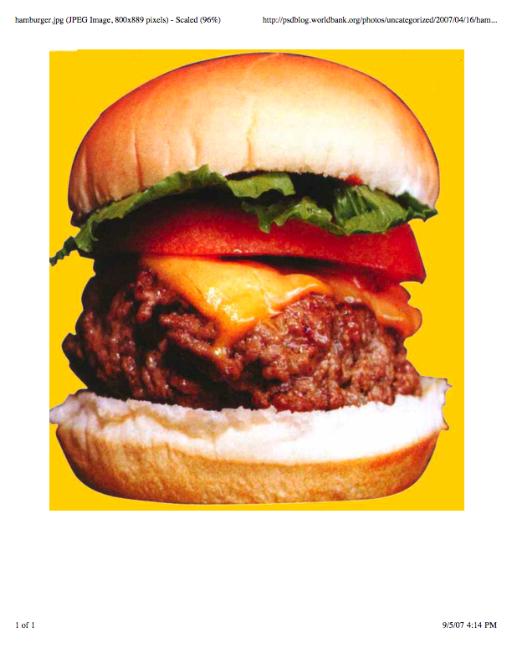
NEWER METHODS FOR ESTIMATING GFR
“Renal functional reserve”
Capacity to increase GFR after stimulation ($≥$20%)
Blunted renal functional reserve reported in
Aging
Some kidney diseases (diabetic nephropathy, scleroderma, PIGN)
Use limited by lack of standardized test methodology

Slide 28
THE KIDNEYS PERFORM MULTIPLE HOMEOSTATIC FUNCTIONS
Filtration of freely circulating substances
Retention of important proteins
Secretion of protein-bound organic solutes and drugs
Synthesis of essential hormones and amino acids
Electrolyte, water, and acid-base balance
Remote signaling

Slide 29
MAXIMAL URINARY CONCENTRATION AND CKD PROGRESSION
2,084 patients with chronic kidney disease from NephroTest study
Median mGFR = 40 (IQR 29, 55) ml/min/1.73m²
Median urine osmolarity (uOSM) = 482 (IQR 402, 591) mOsm/kg-H₂O
M3 adjusted for mGFR, urine ACR, age, race, sex, site, obesity, HTN, diabetes, smoking, CVD, ACE/ARB, cause of CKD, serum Na⁺
Tabibzadeh AJKD 2019

Slide 30
THE KIDNEYS PERFORM MULTIPLE HOMEOSTATIC FUNCTIONS
Kidney function | Test | Procedure
Glomerular filtration | eGFR | Serum creatinine, cystatin C
Glomerular filtration | mGFR | Administer tracer, collect blood
Glomerular reserve | Stimulated mGFR | Administer tracer, collect blood
Glomerular permeability | Albuminuria | Spot urine albumin
Tubular secretion | Solute clearance | Timed urine and paired blood
Concentrating ability | Urine osmolarity | Spot urine after overnight fast
Sodium handling | Salt sensitivity | Many
Acid-base balance | Acid excretion | Administer HCL, collect urine
Synthetic function | EPO, AA, calcitriol | ? Serum markers

Slide 31
FUTURE DIRECTIONS AND ONGOING RESEARCH
CONTACT
Bryan Kestenbaum
University of Washington
Kidney Research Institute; Seattle, WA
brk@uw.edu

Slide 32
THANK YOU
Andy Hoofnagle
Astrid Suchy-Dicey
Matt Rivara
Yan Chen
Ke Wang
Rick Newitt
Jess Becker
Jennifer Wallace
Thomas Laha
Jonathan Himmelfarb
Ian de Boer
Cathy Yeung
Mario Kratz
Rucille Monetenegro
Linda Manahan
SKS study staff
CRIC Study investigators
NIDDK

