Slide 1
MESA-Frailty
R01 AG 065555
Review in June, 2019
Matthew Baldwin, MD, MPH

Slide 2
Specific Aims
Identify CVD risk factors for subclinical cerebrovascular disease in areas of motor control associated with frailty in racially/ethnically diverse older adults.
Assess the concurrent and predictive validity of serum osteocalcin and novel serum markers of mitochondrial myopathy as biomarkers of frailty.

Slide 3
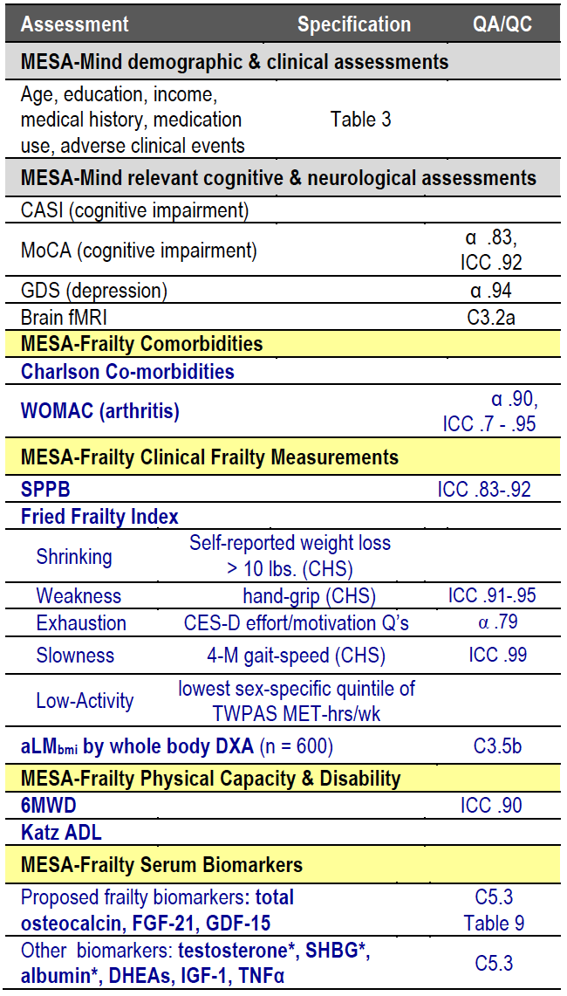

Slide 4
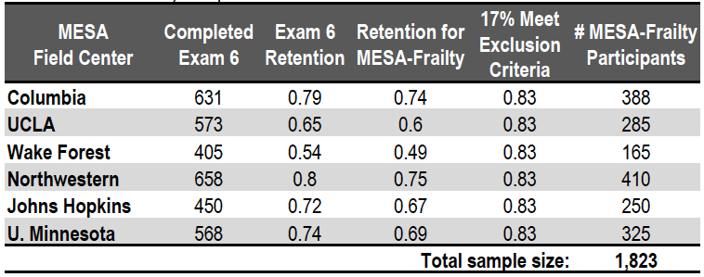
MESA-Frailty Sample
Budgeted for 10% to be home visits

