Slide 1
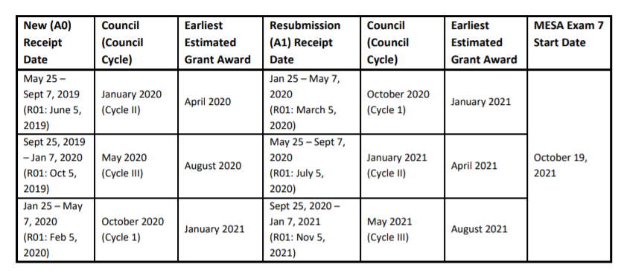
MESA Exam 7 Ancillary Studies Timetable

Slide 2
Proposed Strategies for Exam 7 Ancillary Studies
Note: Exam 7 is contingent on having a funded ancillary study collecting participant data
All ancillary studies with participant burden should be funded and set to begins at the start of Exam 7 to avoid:
Missing or calling back participants
Implementing mid-cycle changes in protocol
Increased burden on the clinic staff
When possible, we encourage Ancillary Studies to be conducted in the entire cohort at all sites
this allows the full cohort to participate in Exam 7 at all sites
At an early stage we should consider if proposed ancillary study ideas may be more scientifically competitive when combined
We may centrally request sharing of R01 funds In the event of duplicate budgetary items between studies in order to meet an overall study need
For example, we pooled funds to assess lipid/lipoprotein levels

