Slide 1
MESA Genetics Committee Meeting Report
Stephen Rich
Reporting for the Genetics Committee
March 28, 2019
8:45am

Slide 2
MESA Genetics Committee
Wednesday, March 27, 2019, 8:30-10pm (Judiciary Suite)
Agenda:
Introduction (Rich)
MESA Genetics P&P (Post)
MESA Return of Results (Lin)
TOPMed & MESA (Rich)
TOPMed MESA Multi-Omics Pilot (Rich)
TOPMed MESA Analytic Example (Taylor)
Other discussion (All)
Adjourn

Slide 3
GREETINGS! From Jerry & Ida

Slide 4
40th Annual Meeting of the Endocrine Society and the Diabetes Association of the R.O.C. (Taiwan)
SDG: Symposium-Diabetes 6
Professor Yii-Der Ida Chen Honorary Symposium
Insulin resistance: the genetic and physiologic inter-relationship between type 2 diabetes and cardiovascular disease; and the interface between Taiwan and California: both the legacy of Professor Yii-Der Ida Chen.
Jerome I. Rotter, M.D.
Director, Institute for Translational Genomics and Population Sciences
LABioMed at Harbor-UCLA Medical Center
Departments of Pediatrics and Human Genetics, UCLA
March 30-31, 2019

Slide 5
MESA Genetics P&P
Member | Site/Affiliation
Wendy Post, MD, MS | Johns Hopkins University
Stephen Rich, PhD | University of Virginia
Xiaohui Li, MD, MS | LA BioMed/Harbor UCLA
Ani Manichaikul, PhD | University of Virginia
Alexis C Wood, PhD | Baylor College of Medicine
James Pankow, PhD, MPH | University of Minnesota
Tamar Sofer, PhD | Harvard Medical School
Jennifer Wessel, PhD, MPH | Indiana University

Slide 6
MESA Genetics P&P Summary
 | All
Proposals approved | 659
Pen Draft Pending (Proposals approved; pen draft not yet approved) | 257
Withdrawn | 68
Pen Draft approved | 323
Published | 278
Pen Draft approved; not yet published | 58
 | Pending Pen Draft | Pen Drafts not published
0-3 months | 8 | 12
3-6 months | 6 | 10
6-9 months | 10 | 4
9-12 months | 11 | 6
12+ months | 222 | 26

Slide 7
Return of Results
“Actionable Incidental Findings”
Bethesda, MD
March 27-28, 2019
Henry J Lin, MD, and Kaye Roll
On behalf of MESA RoR Committee

Slide 8
Prior to TOPMed
Exomechip
(MESA SHARe)
WES (ESP)
Actionable IF Identified
Plan to return results via notification/retesting
Then came TOPMed

Slide 9
Khera et al (unpublished manuscript)
TOPMed publication described predicted “pathogenic” variants in 49 genes examined with relevance to sudden cardiovascular death (SCD)
Pathogenic variants included “clinically actionable” by the ACMG or the Geisinger Health System
Analytic plan and proposal (approved by both the MESA Genetic and TOPMed Publication committees) used MESA as a cohort in the second arm of the paper
41 of 4,524 (0.9%) MESA participants carried a pathogenic or likely pathogenic variant
These individuals had 3.24-fold higher risk of cardiovascular death over a median follow-up of 14.2 yrs
These variants are present in approximately 1% of adults free of known cardiovascular disease or symptoms

Slide 10
ESP, ExomeChip, and TOPMed
Clinically actionable variants based on Amendola et al (2015), Khera et al (unpublished)
MESA participant eligibility to receive IFs
Actionable variants are found in genes implicated in:
hypercholesterolemia
coronary artery disease
aortopathy/dissection
hypertrophic cardiomyopathy
long QT syndrome
alpha-1-antitrypsin deficiency
cardiac arrhythmias
No funding resources for return of results
May be more incidental findings as more genomic studies and analyses are performed

Slide 11
Flow Chart Summary
DCC Notifies Field Center of Actionable IF
Field Center Contacts Participants
Field Center Confirms
Subject Wants Results
Field Center Confirms
Subject DOES NOT Want Results
Field Center
Sends Letter

Slide 12
TOPMed and MESA

Slide 13
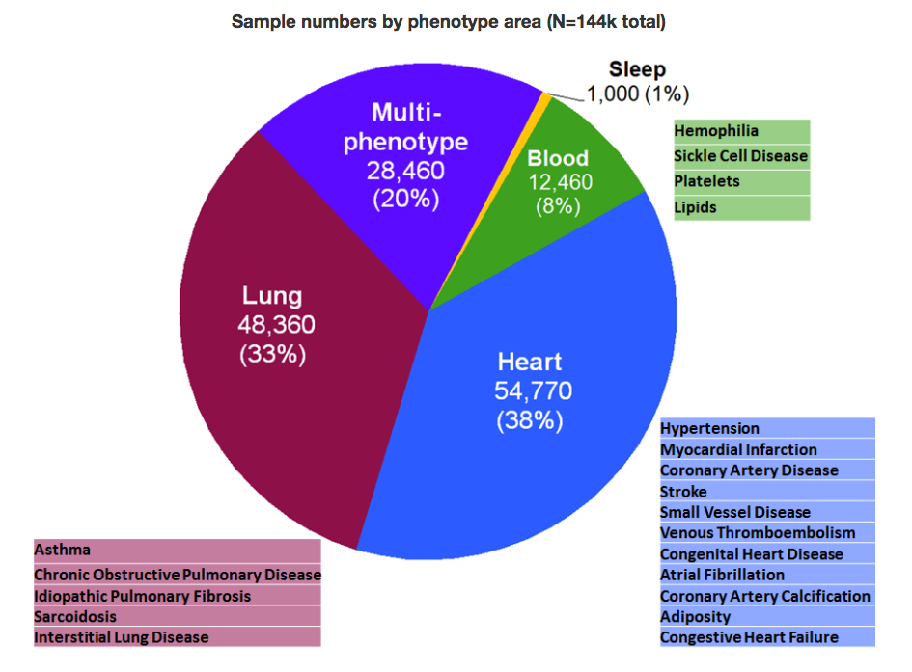
TOPMed: What’s New?
Data and Materials
Participant diversity
European (58,570, 40%)
African (45,840, 32%)
Hispanic (23,500, 16%)
Asian (13,700, 10%)
Other (3,410, 2%)
WGS, median depth 39X
Freeze 5 ~65K samples, 438M SNVs, 33M indels
Freeze 6 ~102K samples
Now at Freeze 8

Slide 14
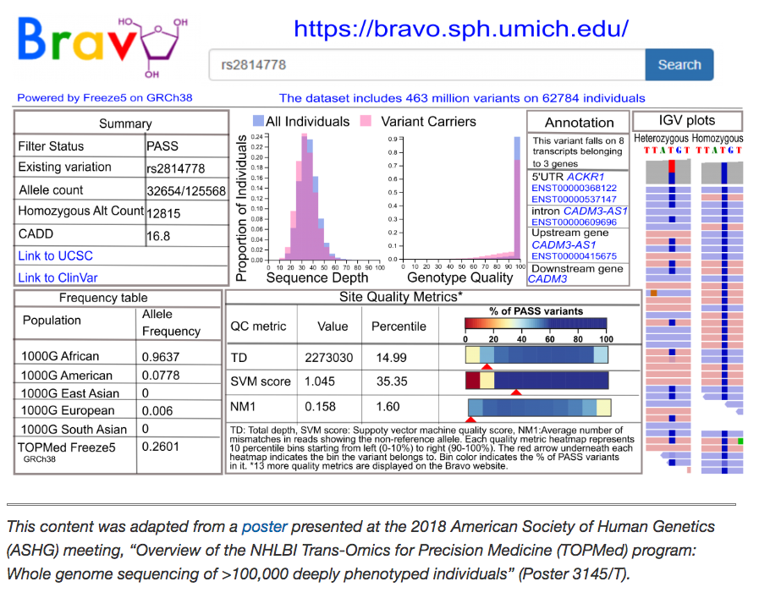
TOPMed: Bravo (variant server)
BRAVO

Slide 15
TOPMed: Nature publications
Nature is preparing a special issue of sequencing
Release of exome sequence data in UK Biobank
NHLBI TOPMed
(NHGRI CCDG? NIA ADSP? NCI? Others?)
TOPMed contributions
Primary paper describing the study and population genetic results
Two phenotype-specific papers
Andrew Johnson, Platelet aggregation
May Montasser, lipids in the Amish
Additional 13 manuscript presubmission abstracts were submitted as a group to Nature Editors for review, agreed to take for consideration in Nat Commun and Nat Genet (also Communications Biology, a new open access Nature publication)

Slide 16
TOPMed: Trans-Omics for Precision Medicine
Whole Genome Sequencing
RNA-Seq
DNA methylation
Plasma metabolomics
Targeted
Non-targeted
Plasma Proteomics (SomaLogics)
TOPMed MESA Multi-Omics Pilot Project

Slide 17
TOPMed/MESA Multi-omics Pilot Data
EXAM 1
2000-2002
RNA-seq: PBMCs (n = 1251)
Methylation: whole blood (n = 936)
Proteomics: plasma (n = 1017)
Metabolomics: plasma (n = 1000)
EXAM 5
2010-2012
RNA-seq: PBMCs (n = 936), T cells (n = 417), monocytes (n = 416)
Methylation: whole blood (n = 936), PBMCs (n = 96 ), T cells (n = 96), monocytes (n = 96)
Proteomics: plasma (n = 1017)
Metabolomics: plasma (n = 1000)
Courtesy Silva Kasela

Slide 18
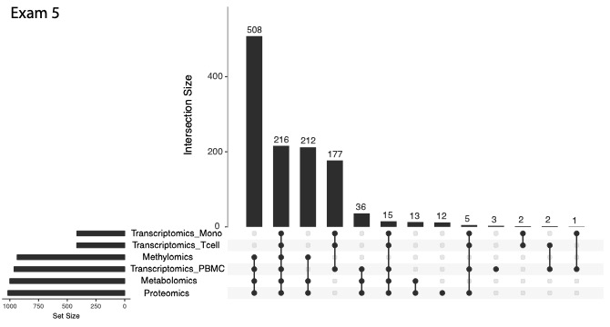
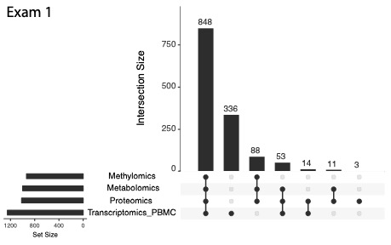
Overlap between ‘omics datasets
Courtesy Silva Kasela

Slide 19
TOPMED MESA MULTIOMICS PILOT PROJECT: Heart Failure: Sub-Clinical MRI, Metabolomics, Proteomics, & SNPs
Kent Taylor, on behalf of MESA working groups:
MESA Field Centers
MESA Data Coordinating Center
MESA MRI, Echo, and HF Investigators
MESA SHARE Investigators
MESA CardioMetaboChip Investigators
and MESA TOPMED Pilot Project working groups:
TOPMED Pilot Project Design
TOPMED Best Practices
TOPMED MRI, Echo, and HF
TOPMED Data Generation Group & Core Laboratories
TOPMED Data Coordinating Center
TOPMED Informatics Research Center
Lundquist Institute
Institute for Translational Genomics and Population Sciences

Slide 21
Discussion: This view of the multi-omics data landscape unites:
HF biomarker symmetric dimethyl arginine
MI biomarker creatine kinase M-type
Shifts in di- and tri-acylglycerols
Leigh syndrome MT haplogroup (includes a LV mass phenotype)
Some, but not all
CAD GWAS loci
Lipid regulatory genes
Metabolic regulatory genes & proteins
eQTLs
∴ Observation of some previously identified biomarkers suggests the method is promising.

