Slide 1
Whole genome sequence analysis of plasma lipids
Pradeep Natarajan, MD MMSc
Instructor of Medicine, Harvard Medical School
Director, Preventive Cardiology, Massachusetts General Hospital
Affiliated Scientist, Broad Institute
@pnatarajanmd
March 29, 2018
MESA Steering Committee
Bethesda, MA

Slide 2

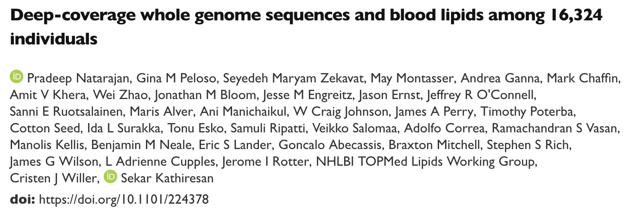
https://www.biorxiv.org/content/early/2017/11/24/224378

Slide 3
Hundreds of lipid loci have been discovered in GWAS in hundreds of thousands of individuals
Peloso GM, Natarajan P. Curr Opin Genet Dev. 2018

Slide 4
NHLBI TOPMed (N=137,562)
Project | N
AA CAC (Rotter, Taylor) | 1,409
AFGen (Ellinor) | 2,799
Africa7K (Tishkoff) | 7,500
Amish (Mitchell) | 1,100
ATGC (Burchard, Williams) | 15,580
BAGS (Barnes) | 1,100
BioMe (Do, Kenny, Loos) | 11,413
Boston-Brazil SCD (Sankaran) | 958
CARDIA (Fornage) | 3,622
CFS (Redline) | 1,000
Project | N
CHS (Psaty, Tracy) | 3,600
COPD (Silverman) | 12,785
CRA/CAMP (Weiss) | 6,619
FHS (Cupples, Ramachandran) | 4,089
HCHS/SOL (Kaplan, North) | 2,270
HyperGEN/GENOA (Arnett) | 3,161
GeneSTAR (Mathias) | 1,400
GenSalt (He) | 1,860
GOLDN (Arnett) | 967
IPF (Fingerlin, Schwartz) | 1,500
Project | N
JHS (Correa, Wilson) | 3,500
MESA (Rich, Rotter) | 4,595
MLOF (Johnsen, Konkle) | 5,147
OMG SCD (Ashley-Koch, Telen) | 675
PCGC CHD (Gelb, Seidman) | 3,230
PGX Asthma (Burchard, Hernandez) | 1,500
PharmHU (Boerwinkle, Sheehan) | 1,454
PROMIS (Saleheen) | 4,200
PUSH SCD (Nekhai) | 450
REDS-III Brazil (Custer, Kelly) | 2,809
Project | N
SAFS (Curran, Blangero) | 1,142
Sarcoidosis (Montgomery) | 650
SARP (Meyers) | 1,900
SAS (McGarvey) | 1,296
SIT SCD
THRV (Chen, Rao) | 2,585
TOPCHeF
VTE (Boerwinkle) | 6,000
walk PHaSST (Gladwin, Zhang) | 597
WHI (Kooperberg) | 11,100

Slide 5
Deep-coverage whole genome sequencing
 | Coding |  |  | Non-coding |  |  | Structural
Platform | common | low-frequency | rare | common | low-frequency | rare
GWAS | X |  |  | X
GWAS + imputation | X | X |  | X | X
Whole exome | X | X | X
Whole genome | X | X | X | X | X | X | X
Newly directly genotyped

Slide 6
Objectives
At current sample sizes (vs larger GWAS), what is the incremental value of WGS for:
  Locus discovery
  Clinical/translational insight

Slide 7
WGS samples

Slide 8
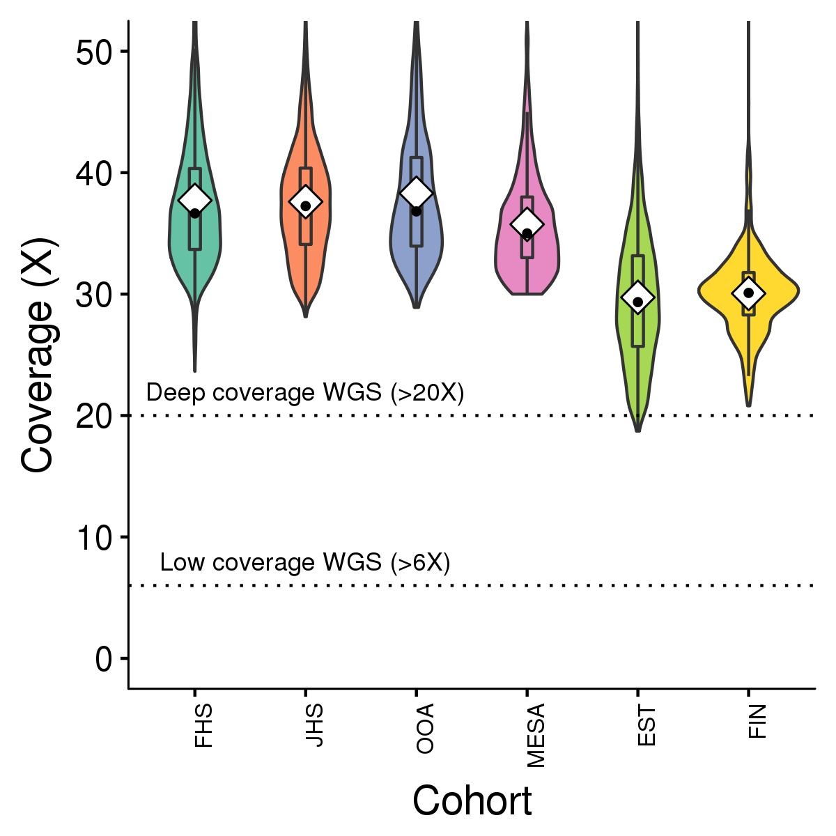
Whole genome sequence analysis in 16,324 individuals

Slide 9
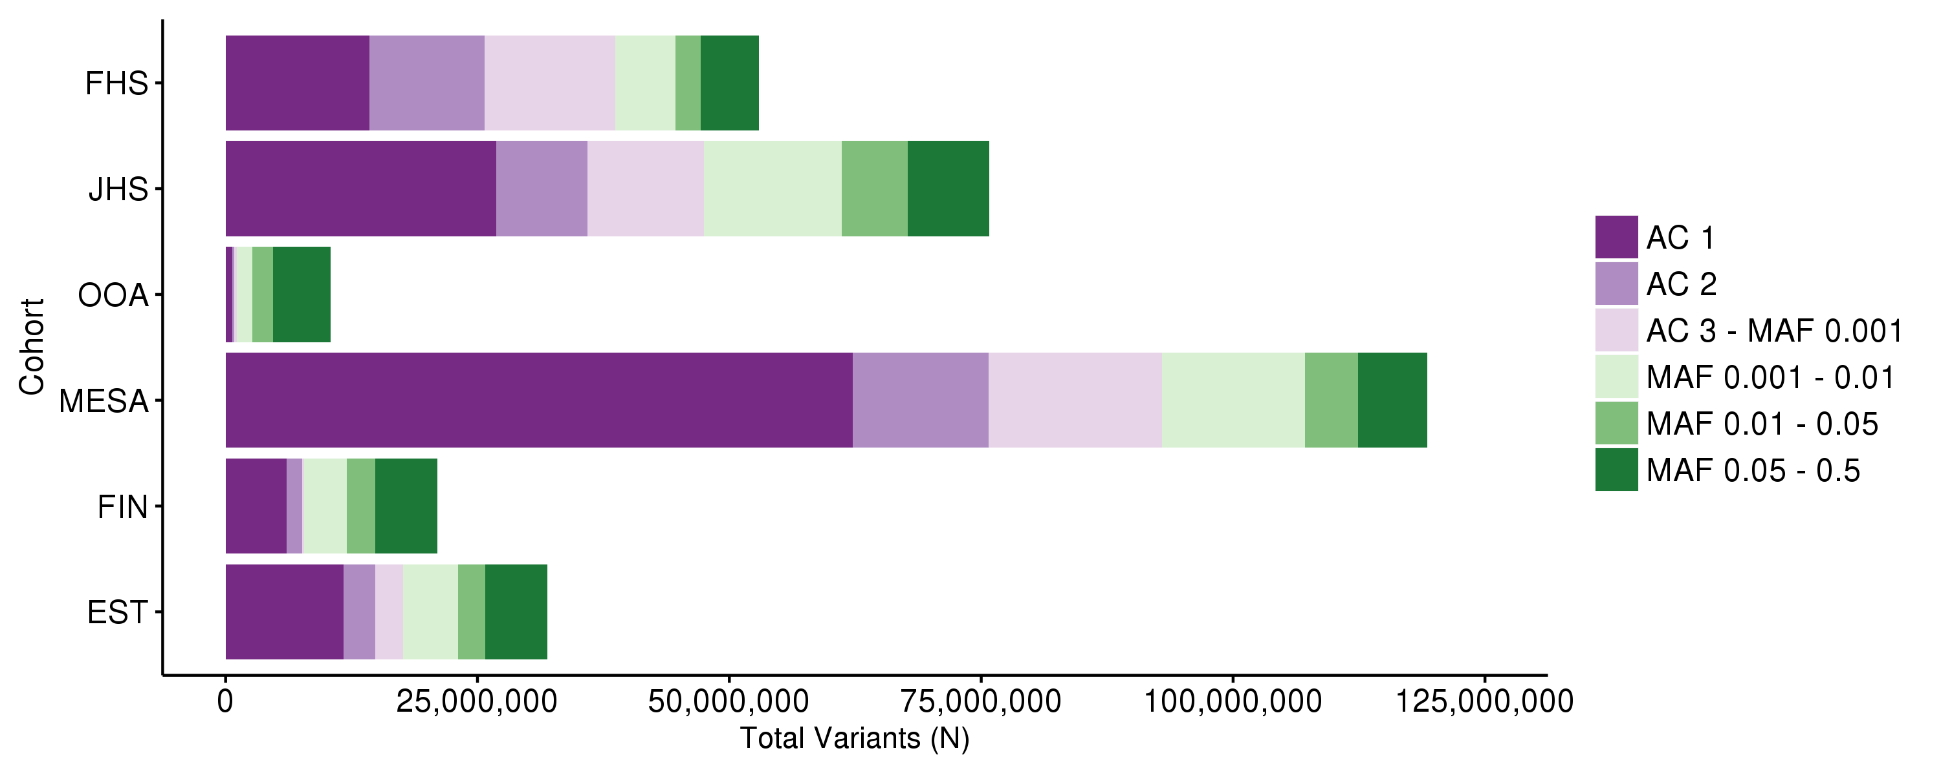
189M unique variants discovered among 16,324 samples

Slide 10
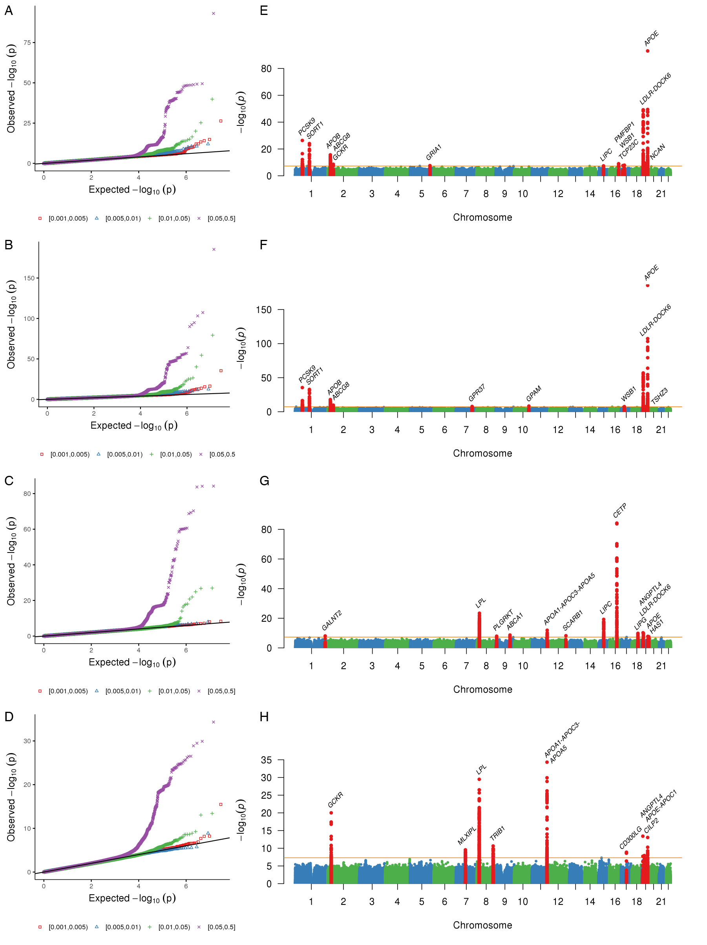
HDL cholesterol
Total cholesterol
Triglycerides
LDL cholesterol
 | MAF 0.1-0.5% | MAF 0.5-1% | MAF 1-5% | MAF 5-50% | ALL
Total cholesterol | 16 | 13 | 109 | 454 | 592
HDL cholesterol | 2 | 1 | 17 | 427 | 447
LDL cholesterol | 28 | 25 | 106 | 538 | 697
Triglycerides | 4 | 1 | 13 | 504 | 522
Allele frequency distribution of variants associated with lipids

Slide 11
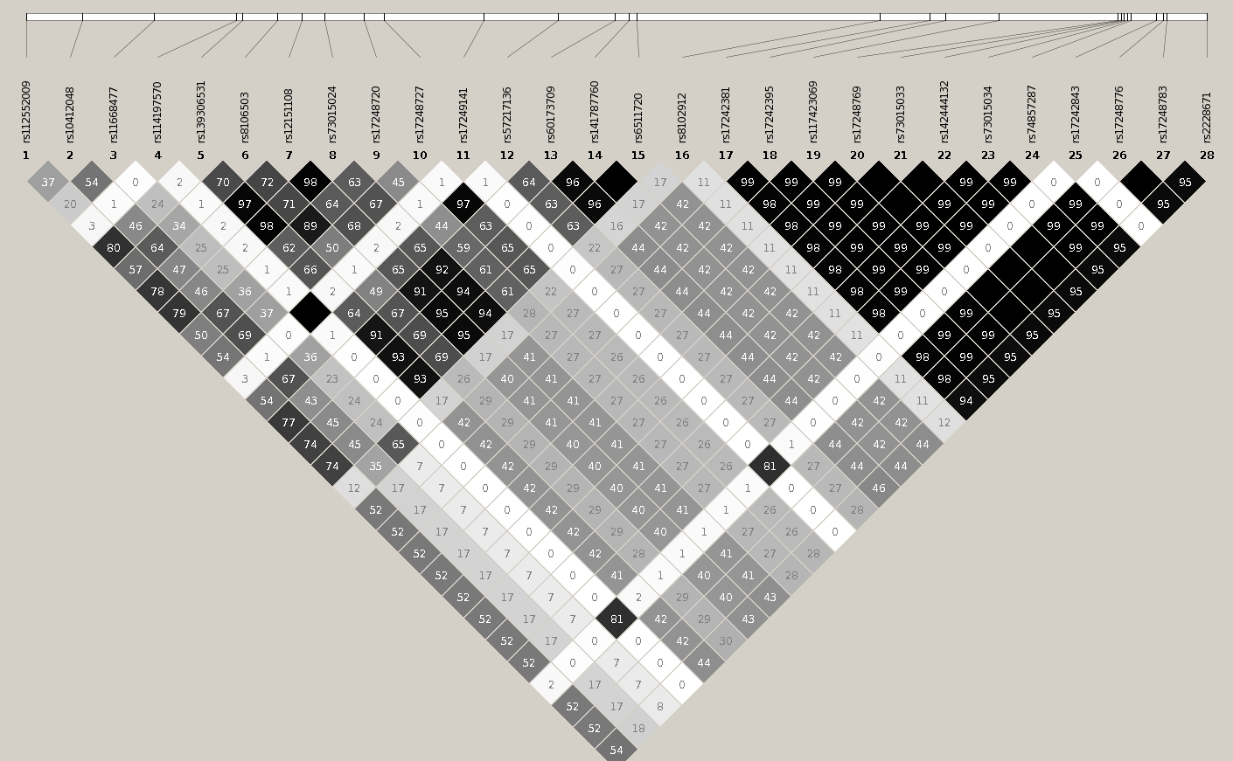
Low-frequency (AF 1%) African American-specific haplotype associated with LDL cholesterol at LDLR

Slide 12
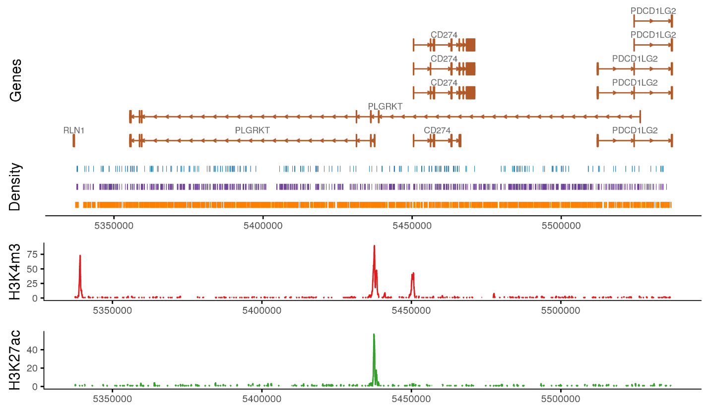
1-bp deletion (MAF 2%), previously poorly tagged, associated with HDL cholesterol

Slide 13
Four non-coding RVAS approaches using in silico annotations

Slide 14
Four non-coding RVAS approaches using in silico annotations

Slide 15
Expectation
Disruptive coding mutations within Mendelian lipid genes
Gene | cMAF | P
LDL cholesterol
LDLR | 0.021 | 3.4x10⁻⁹
APOB | 0.026 | 2.1x10⁻⁷
PCSK9 | 0.025 | 3.2x10⁻⁴²
LDLRAP1 | 0.0015 | 0.38
ABCG5 | 0.012 | 0.12
ABCG8 | 0.033 | 0.071
APOE | 0.019 | 7.2x10⁻¹⁰
Gene | cMAF | P
HDL cholesterol
APOA1 | 0 | NA
ABCA1 | 0.023 | 1.3x10⁻³
LCAT | 0.0026 | 1.6x10⁻⁷
CETP | 0.0013 | 7.6x10⁻⁵
LIPC | 0.014 | 0.16
LIPG | 0.0024 | 0.29
SCARB1 | 0.0056 | 3.6x10⁻⁴
Gene | cMAF | P
Triglycerides
LPL | 0.0042 | 7.9x10⁻⁵
APOC2 | 0 | NA
APOA5 | 0 | NA
APOC3 | 0.0089 | 1.1x10⁻¹⁴
GPIHBP1 | 0 | NA
LMF1 | 0.0033 | 0.29
ANGPTL3 | 0.0024 | 0.032
ANGPTL4 | 0.0029 | 0.026

Slide 16
Top associations for gene-linked rare non-coding variant tests at Mendelian lipid genes
Gene | Coding P | Group | Non-Coding P
LDL cholesterol
APOE | 7 x 10⁻¹⁰ | Gene expression, HepG2 | 8 x 10⁻²⁶
LDLR | 3 x 10⁻⁹ | TSS proximity, HepG2 | 1 x 10⁻¹⁰
APOB | 2 x 10⁻⁷ | Gene expression, Adipose nuclei | 5 x 10⁻⁵
HDL cholesterol
CETP | 8 x 10⁻⁵ | Gene expression, Adipose nuclei | 5 x 10⁻⁵
SCARB1 | 4 x 10⁻⁴ | TSS proximity, HepG2 | 1 x 10⁻³
LIPC | 0.16 | TSS proximity, Adipose nuclei | 3 x 10⁻³
Triglycerides
LPL | 8 x 10⁻⁵ | TSS proximity, HepG2 | 4 x 10⁻⁴
ANGPTL4 | 0.03 | TSS proximity, HepG2 | 3 x 10⁻³
APOA5 | NA | Gene expression, Adipose nuclei | 0.02

Slide 17
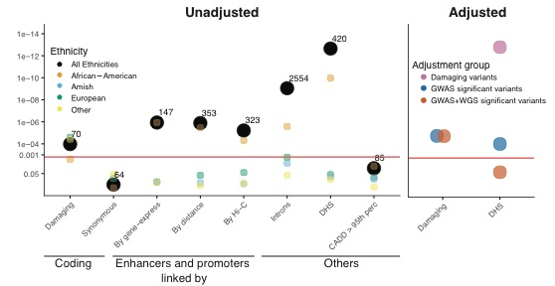
Exploring LDLR RVAS association

Slide 18
Current WGS association analyses limitations
Functional interpretation of rare non-coding mutations.
Effects of rare non-coding mutations likely weaker than rare coding mutations.
Above two issues will require much larger sample sizes (vs whole exome sequencing) and new methods to detect associations.

Slide 19
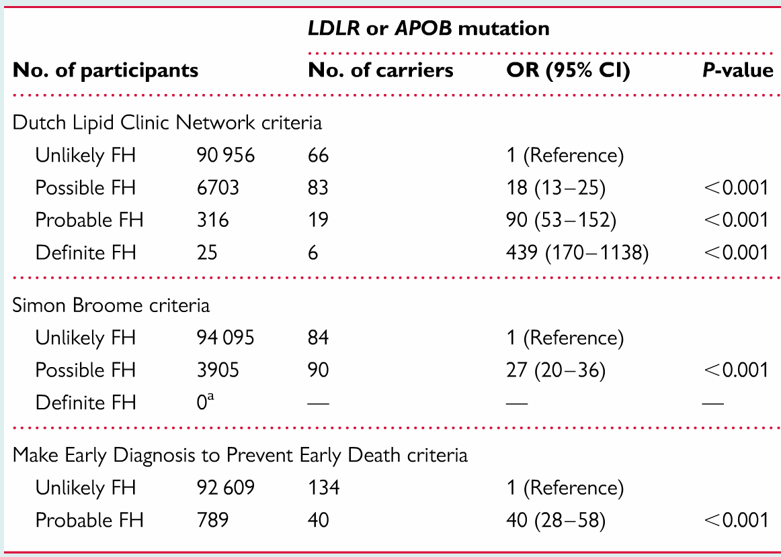
Can WGS improve the diagnostic yield of severe hypercholesterolemia?
Benn M et al. Eur Heart J. 2016

Slide 20
Whole genome sequencing
Simultaneous assessment of:
  Monogenic
  Polygenic

Slide 21
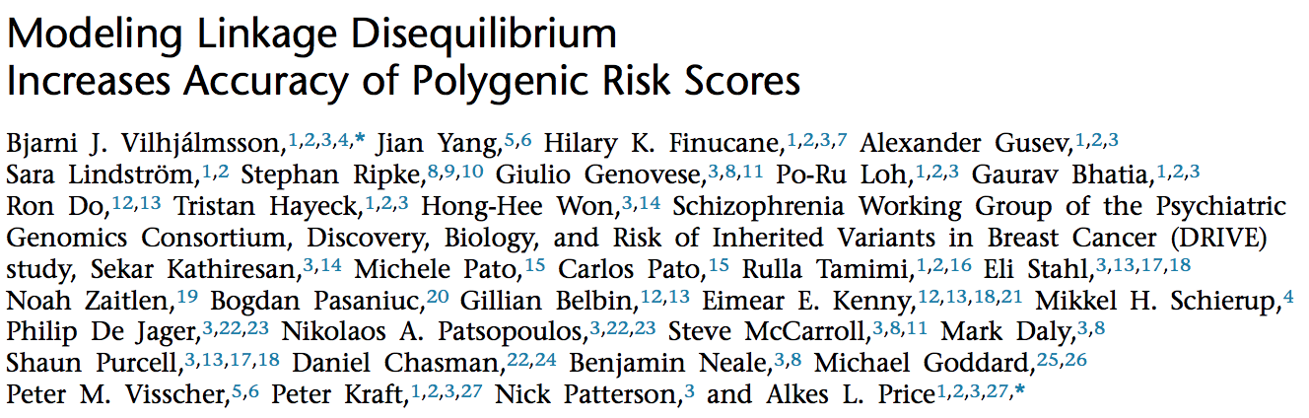
2M SNP polygenic score
Vilhjalmsson BJ et al. Am J Hum Genet. 2015

Slide 22
Knowledge of both monogenic and polygenic factors influences diagnostic yield
High LDL cholesterol: OR (prevalence)
 | Monogenic carrier | Top 5th percentile of Polygenic score
European Ancestry | 10.9 (1.6%) | 7.7 (19.6%)
African Ancestry | 7.4 (2.8%) | 3.2 (9.2%)

Slide 23
Can polygenic scoring be informative for monogenic mutation carriers?
APOB p.R3527Q - prevalence 12% in the Amish

Slide 24
Summary
Whole genome sequence analysis captures previously poorly catalogued variation, including variants poorly imputed in European and non-European ethnicities
Methods to improve rare non-coding variant functional prediction and larger samples are required to determine whether rare non-coding variation associates with lipids
Whole genome sequencing may clinically complement plasma lipoprotein measures for cardiovascular disease risk refinement.

Slide 25
Acknowledgements
MGH/Broad
Sekar Kathiresan
S. Maryam Zekavat
Mark Chaffin
Amit Khera
Andrea Ganna
Jesse Engreitz
Jon Bloom
Ben Neale
Mark Daly
BostonU
Gina Peloso
L. Adrienne Cupples
Vasan Ramachandran
UMich
Cristen Willer
Wei Zhao
Goncalo Abecasis
UMaryland
May Montasser
Jeff O’Connell
Jim Perry
Braxton Mitchell
Estonia
Maris Alver
Tonu Esko
Finland
Sanni Ruotsalainen
Ida Surakka
Veiko Salomaa
Samuli Ripatti
UVirginia
Stephen Rich
Ani Manichaikul
LA BioMed
Jerome Rotter
UWashington
W. Craig Johnson
UMississippi
Jim Wilson
Adolfo Correa
UCLA
Jason Ernst
MIT
Manolis Kellis
Funding
NIH/NHLBI TOPMed
NIH/NHLBI K08

