Slide 1
Individual response to vitamin D (INVITE) TRIAL MULTI-ETHNIC STUDY OF ATHEROSCLEROSIS
Ian de Boer MD MS
Bryan Kestenbaum MD MS
University of Washington
Division of Nephrology
Kidney Research Institute
Seattle, Washington

Slide 2
Low vitamin D levels CONSISTENTLY associated with CARDIOVASCULAR disease, FRACTURE, CANCER, & MORTALITY
Associations of serum 25(OH)D <20 ng/mL in Cardiovascular Health Study
 | Events | Follow-up | Adjusted hazard ratio
Incident MI | 299 | 14 years | 1.4 (0.9, 2.1)
Incident hip fracture | 244 | 11 years | 1.6 (1.1, 2.3)
Incident cancer | 304 | 8 years | 1.3 (1.0, 1.7)
All-cause mortality | 1,226 | 14 years | 1.3 (1.1, 1.6)

Slide 3
ASSOCIATIONS OF 25(OH)D LEVELS WITH CORONARY HEART DISEASE VARIES BY RACE/ETHNICITY
MESA
N=6,436

Slide 4
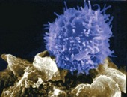
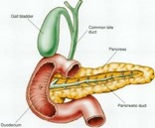
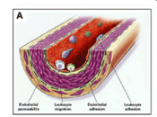
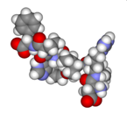
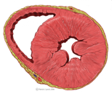
ACTIVATED VITAMIN D REGULATES GENETIC PATHWAYS related to CARDIOVASCULAR disease
25(OH)D
1,25(OH)₂D
VDR
VDRE
Immune
Glucose
Vascular
Parathyroid
RAAS
Myocytes

Slide 5
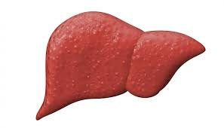
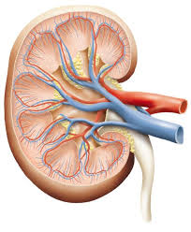
VITAMIN D METABOLISM OCCURS THROUGH A SERIES OF well-defined METABOLIC STEPS
Vitamin D3
Cholecalciferol
7-dehydrocholesterol
CYP2R1
25(OH)D
CYP27B1
CYP24A1
24,25(OH)₂D
1,25(OH)₂D
Biological effects

Slide 6
LARGE INTER-INDIVIDUAL VARIATION IN RESPONSE TO FIXED DOSE OF CHOLECALCIFEROL
Vitamin D3
Cholecalciferol
7-dehydrocholesterol
CYP2R1
25(OH)D
CYP27B1
CYP24A1
24,25(OH)₂D
1,25(OH)₂D
Biological effects

Slide 7
Individual response to vitamin D treatment (INVITE) AIMS
Identify genetic polymorphisms and clinical characteristics that modify the biological response to cholecalciferol treatment, assessed by changes in serum parathyroid hormone and 1,25-dihydroxyvitamin D concentrations
Identify improved biomarkers of baseline vitamin D status based on the biologic response to cholecalciferol treatment

Slide 8
Individual response to vitamin D treatment (INVITE) APPROACH
16-week interventional trial of cholecalciferol treatment within MESA
Five MESA field centers
Johns Hopkins, Columbia, Northwestern, Wake Forest, UCLA
Exclusion criteria
Current use of >1,000 IU vitamin D daily
History of kidney stones
History of hyperparathyroidism

Slide 9
Individual response to vitamin D treatment (INVITE) APPROACH
Treatment: 2000 IU cholecalciferol or placebo daily for 16 weeks (3:1 ratio)
Central block randomization at MESA coordinating center
Screening, recruitment, and drug dispensation at MESA field centers
Participants return 16-weeks later for repeat sample collection and pill counts

Slide 10
Individual response to vitamin D treatment (INVITE) OUTCOMES
Primary outcomes
$∆$ serum parathyroid hormone (PTH) concentration
$∆$serum 1,25(OH)₂D concentration
$∆ u$rine calcium concentration (safety)

Slide 11
Individual response to vitamin D treatment (INVITE) SUSPECTED MODIFYING FACTORS
Attributes that may influence impact of vitamin D treatment on study outcomes
Common and rare polymorphisms in vitamin D metabolism genes
Biomarkers of baseline vitamin D status (24,25-OH₂D)
Clinical characteristics (race, obesity, diabetes)

Slide 12
Individual response to vitamin D treatment (INVITE) MESA SITE COORDINATION
Johns Hopkins Wendy Post, Erin Michos
Northwestern Norrina Allen, Kiang Liu
Columbia Steve Shea
Wake Forest Greg Burke
UCLA Karol Watson
Seattle Kayleen Williams, Craig Johnson

Slide 13
Individual response to vitamin D treatment (INVITE) PITFALLS AND SOLUTIONS
Problem | Solution
Funding started after exam 6 | Re-contact participants who already completed exam 6
Fewer total MESA participants | Screen MESA Air participants for trial eligibility
High prevalence of vitamin D use | Add option for vitamin D washout period prior to entry
Slow enrollment | Add fifth MESA field center (UCLA)

Slide 14
Individual response to vitamin D treatment (INVITE) ENROLLMENT OVER 26 MONTHS

Slide 15
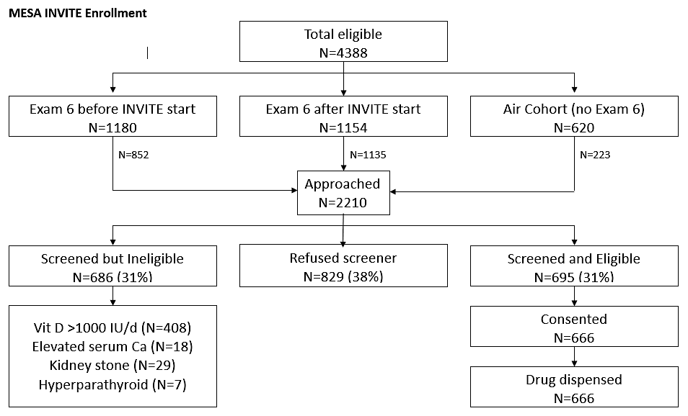
Individual response to vitamin D treatment (INVITE) ENROLLMENT OVER 26 MONTHS
Enrolled 666 / 1524 = 44% eligible participants

Slide 16
Individual response to vitamin D treatment (INVITE) RETENTION
666 MESA participants enrolled
26 lost to follow-up
590 Completed exam 6A
50 Exam 6A pending

Slide 17
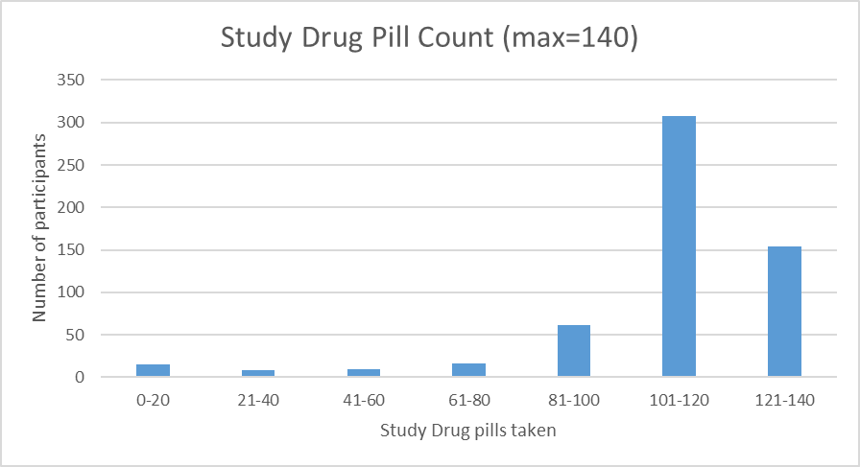
Individual response to vitamin D treatment (INVITE) ADHERENCE
Data from 573 participants who completed exam 6A
Target adherence = 112 pills
Follow-up visit window is 12-20 weeks.
521 of 573 participants (91%) reported 84-140 pills.

Slide 18
Individual response to vitamin D treatment (INVITE) completed work
481 laboratory assays completed (25-OHD, 1,25-OH2D, 24,25-OH2D, PTH)
474 letters sent
Last 6A visit scheduled for May 21, 2019

Slide 19
Individual response to vitamin D treatment (INVITE) planned analysis
1. Describe lessons learned conducting a clinical trial within an established observational cohort study
2. Determine clinical characteristics associated with individual-level response to cholecalciferol treatment (obesity, race, kidney function)
3. Identify common and rate genomic determinants of the individual-level response to cholecalciferol treatment
4. Assess novel biomarkers of vitamin D deficiency based on biologic response to cholecalciferol treatment

Slide 20
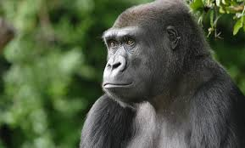
Vital trial results
January, 2019

Slide 21
Vital trial results
January, 2019

Slide 22
Vitamin D3
Cholecalciferol
7-dehydrocholesterol
CYP2R1
25(OH)D
CYP27B1
CYP24A1
24,25(OH)₂D
1,25(OH)₂D
Low serum 25(OH)D levels consistently associated with cardiovascular disease, cancer, fractures across multiple observational studies.
Cholecalciferol supplementation markedly increases serum 25(OH)D levels but does not impact these outcomes.

