Slide 1
MESA Project Office Report
Cashell E. Jaquish, Ph.D.
MESA Project Officer
Epidemiology Branch
Division of Cardiovascular Sciences
National Heart, Lung, and Blood Institute
MESA Steering Committee Webinar
June 29, 2020

Slide 2
NHLBI MESA Team – Staffing Changes
Project Office
Cashell E. Jaquish, Ph.D. – Project Officer
Lorraine Silsbee, Pd.D. – Former MESA PO / Consultant
George Papanicolaou, Ph.D. – Research Geneticist
Colin Wu, Ph.D. – Biostatistician
Contracting Office
Cornelius Moore – Contracting Officer
Tahir Seeba – Contracting Specialist

Slide 3
MESA Timeline & Exam 7
Baseline
Exam
2000-2002
Exam 2
2002-2004
Exam 3
2004-2005
Exam 4
2005-2007
VIII
Exam 7
2021-2023
Exam 5
2010-2011
Exam 6
2016-2018
N= 6,814
N= 6,232
N= 5,939
N= 5,704
N= 4,651
N= 3,294
N= 3,000
participant follow-up
January 2021 – Begin Exam Preparation
9 month Exam Prep Period
Exam Begins October 2021
Notes:
Participation of surviving cohort: 92, 89, 87, 76 and 63 percent.
Cohort for Exam 7 will be age 63 plus.

Slide 4
FY2020 NHLBI Funding Paylines
Grant Program | Percentile | Priority Score | Description
R01 | 16 | N/A | Research Project Grant
ESI | 26 | N/A | Early Stage Investigators
K awards | N/A | 32 | Career Dev’t Awards
*Depending on the availability of funds, the Institute may make funding decisions on competing applications outside of the pay range, through selective pay actions.
**Next NHLBI Advisory Council meeting is August 25, 2020.

Slide 5
FY2020 NHLBI Funding Paylines – Zones of Consideration*
Grant Program | Description | Zone of Consideration (priority score)
P01 | Program Project Grant | 10-30
T32, T35 | Institutional NRSA Training | 10-35
*A zone of consideration is a range of priority scores within which competing applications will be considered for funding.
http://www.nhlbi.nih.gov/research/funding/general/current-operating-guidelines

Slide 6
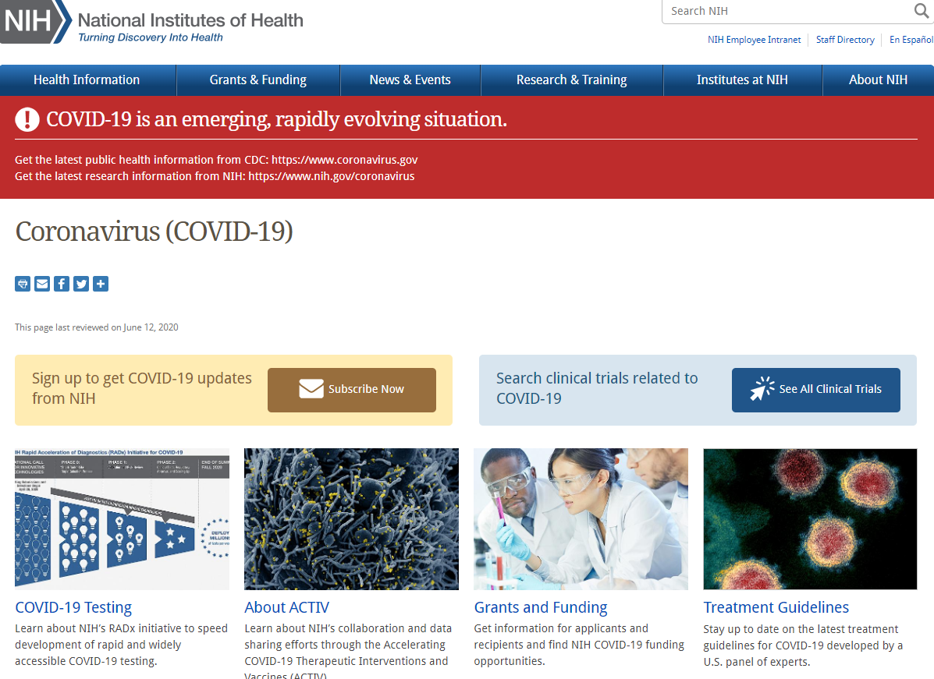
NIH COVID-19 Resources https://www.nih.gov/coronavirus
NIH Implementation of OMB Memorandum M-20-26 “Extension of Administrative Relief for Recipients and Applicants of Federal Financial Assistance Directly Impacted by the Novel Coronavirus (COVID-19) Due to Loss of Operations”

Slide 7
NHLBI Information and Resources on COVID-19 https://www.nhlbi.nih.gov/coronavirus
What is NHLBI’s strategy for research in response to the COVID-19 crisis?
What kinds of NHLBI funding opportunities are available for COVID-19 research?
Are there other NIH resources for researchers on COVID-19?

Slide 8
Unanticipated COVID related expenditures
Contact your program officer
In general, we are not accepting administrative supplement requests for COVID “hardships”
Budget for necessary COVID expenditures in the future

Slide 9
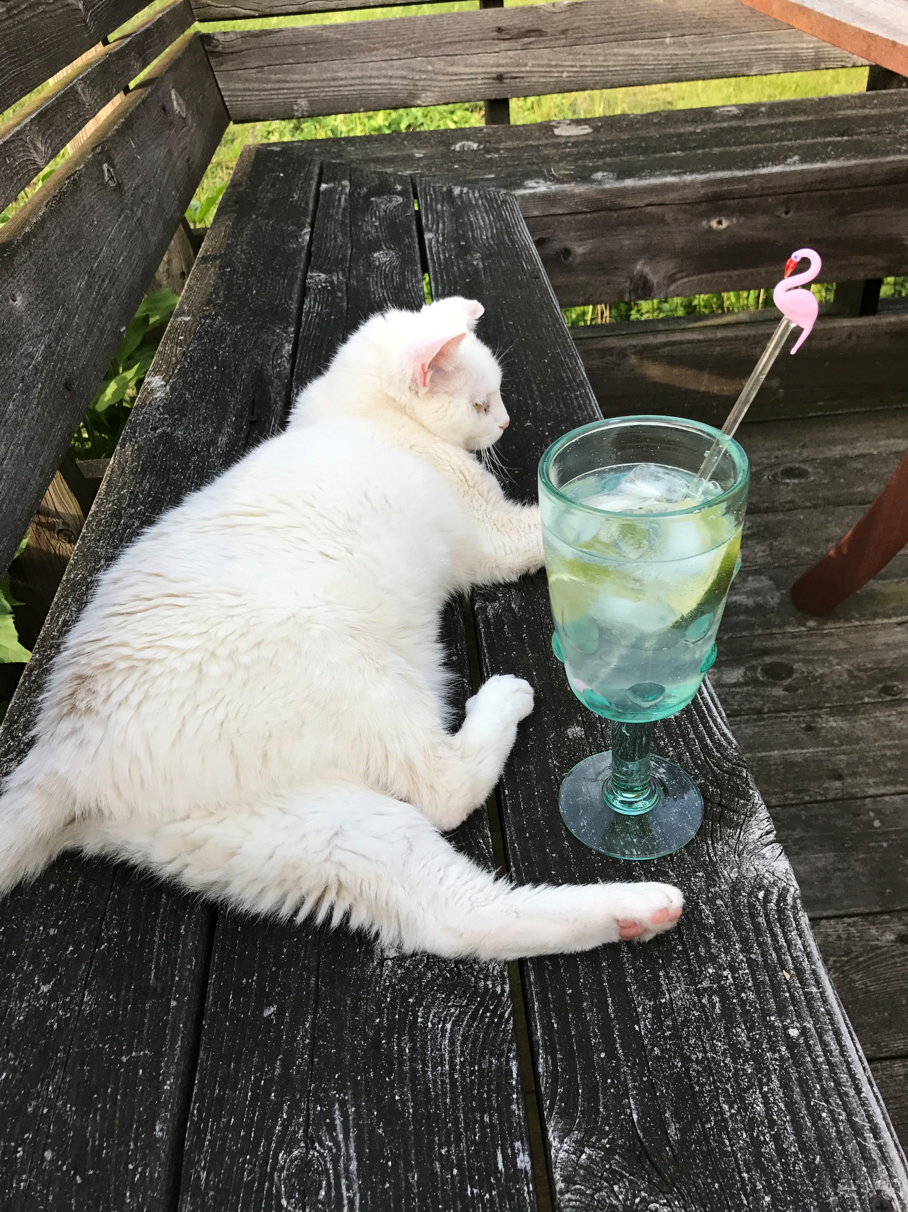
Thank you
and please take some time to be like Simone…
RELAX

