Slide 1
Subclinical Atherosclerosis and Sleep Apnea in the Multi-Ethnic Study of Atherosclerosis
Ying Zhao, MD FRCPC
Feb 25, 2015
Postdoctoral Research Fellow
Division of Sleep and Circadian Disorders
Brigham and Women’s Hospital
Harvard Medical School

Slide 2
Disclosures
None

Slide 3
Outline
Pathophysiologic mechanisms associating sleep apnea with carotid disease
Association between sleep apnea and carotid disease in MESA
Future directions

Slide 4
Stroke Risk Factors
Age, gender, race
HTN, A Fib, LVH, valve disease
Diabetes, dyslipidemia, carotid atherosclerosis
Smoking, alcohol
Sleep disordered breathing
35 to 45% of patients with CVD

Slide 5
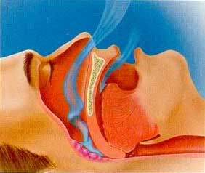
PHYSIOLOGIC PERTURBATIONS
INTERMEDIATE MECHANISMS
CLINICAL OUTCOMES
Chronic Intermittent Hypoxia
Ventilatory Overshoot Hyperoxia
Increased Sympathetic Nervous System Activity
Intrathoracic Pressure Swings
Hypercapnia
Increased Arousals
Reduced Sleep Duration
Abnormal HRV and increased HR
Increased Inflammation
Increased Oxidative Stress
Metabolic Dysfunction
Insulin Resistance
Hyper-coaguability
Endothelial Dysfunction
Autonomic Dysfunction
Systemic Hypertension
Atherosclerosis
Diastolic Dysfunction
Congestive Heart Failure
Cardiac arrhythmias
Stroke
Sleep-Apnea
Mehra et al. Curr Resp Med Rev 2007

Slide 6
Lorenz et al. Circulation 2007

Slide 7
cIMT in cardiovascular risk prediction
Polak et al. Stroke 2011

Slide 8
Sleep Apnea and Cardiovascular Disease
Marin et al. Lancet 2005;365:1046.
Notes:
Marin and colleagues studied 264 healthy men, 377 simple snorers, 403 subjects with untreated mild-to-moderate OSA, 235 subjects with untreated severe OSA< and 372 subjects who were treated with CPAP. Participants were followed up at yearly intervals over a mean of 10 years. End points were fatal cardiovascular events (death from MI or stroke) and nonfatal CV events (nonfatal MI, stroke, CABG, and coronary angiography). The risk of fatal (OR 2.9, 95% CI 1.2 to 7.5) and nonfatal CV events (OR 3.2, 95% CI 1.1 to 7.5) was significantly increased in patients with untreated severe OSA compared to healthy subjects. Risk for events in patients with treated OSA was similar to that noted in snorers and those with mild OSA.

Slide 9
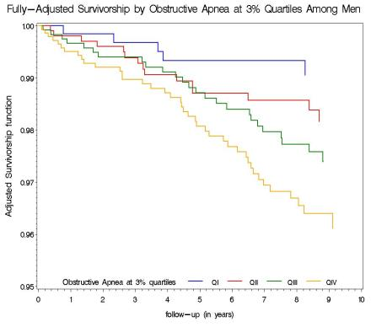
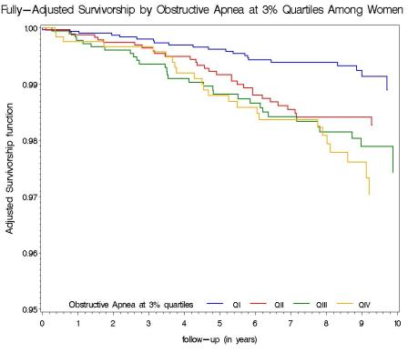
Sleep Heart Health Study Hazard Curves for Stroke By Gender N= 5,422; 8 year follow up Ischemic Strokes: Males-85; Females-108
MEN
WOMEN
Redline et al. AJRCCM 2010
Notes:
In covariate-adjusted Cox proportional hazard models, a significant positive association between ischemic stroke and OAHI was observed in men (p value for linear trend: 0.016) but not in women

Slide 10
Sleep Apnea and Incident Stroke in Men
Covariate | Unadjusted | Age-Adjusted | Fully-Adjusted*
Quartile of AHI
IV: 19.13 – 164.5 | 3.91 (1.55 – 9.86) | 3.05 (1.21 – 7.72) | 2.86 (1.10 – 7.39)
III: 9.50 – 19.12 | 2.35 (0.89 – 6.20) | 1.97 (0.74 – 5.21) | 1.86 (0.70 – 4.95)
II: 4.05 – 9.49 | 1.96 (0.71 – 5.40) | 1.86 (0.68 – 5.13) | 1.86 (0.67 – 5.12)
I: 0.00 – 4.04 | 1.00 | 1.00 | 1.00
*Adjusted for age, BMI, smoking status, SBP, blood pressure medications, diabetes, and race
Redline et al. Am J Respir Crit Care Med Vol 182. pp 269–277, 2010

Slide 11
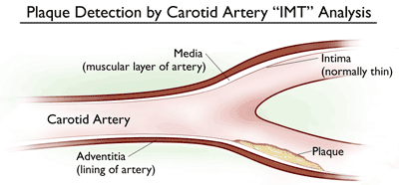
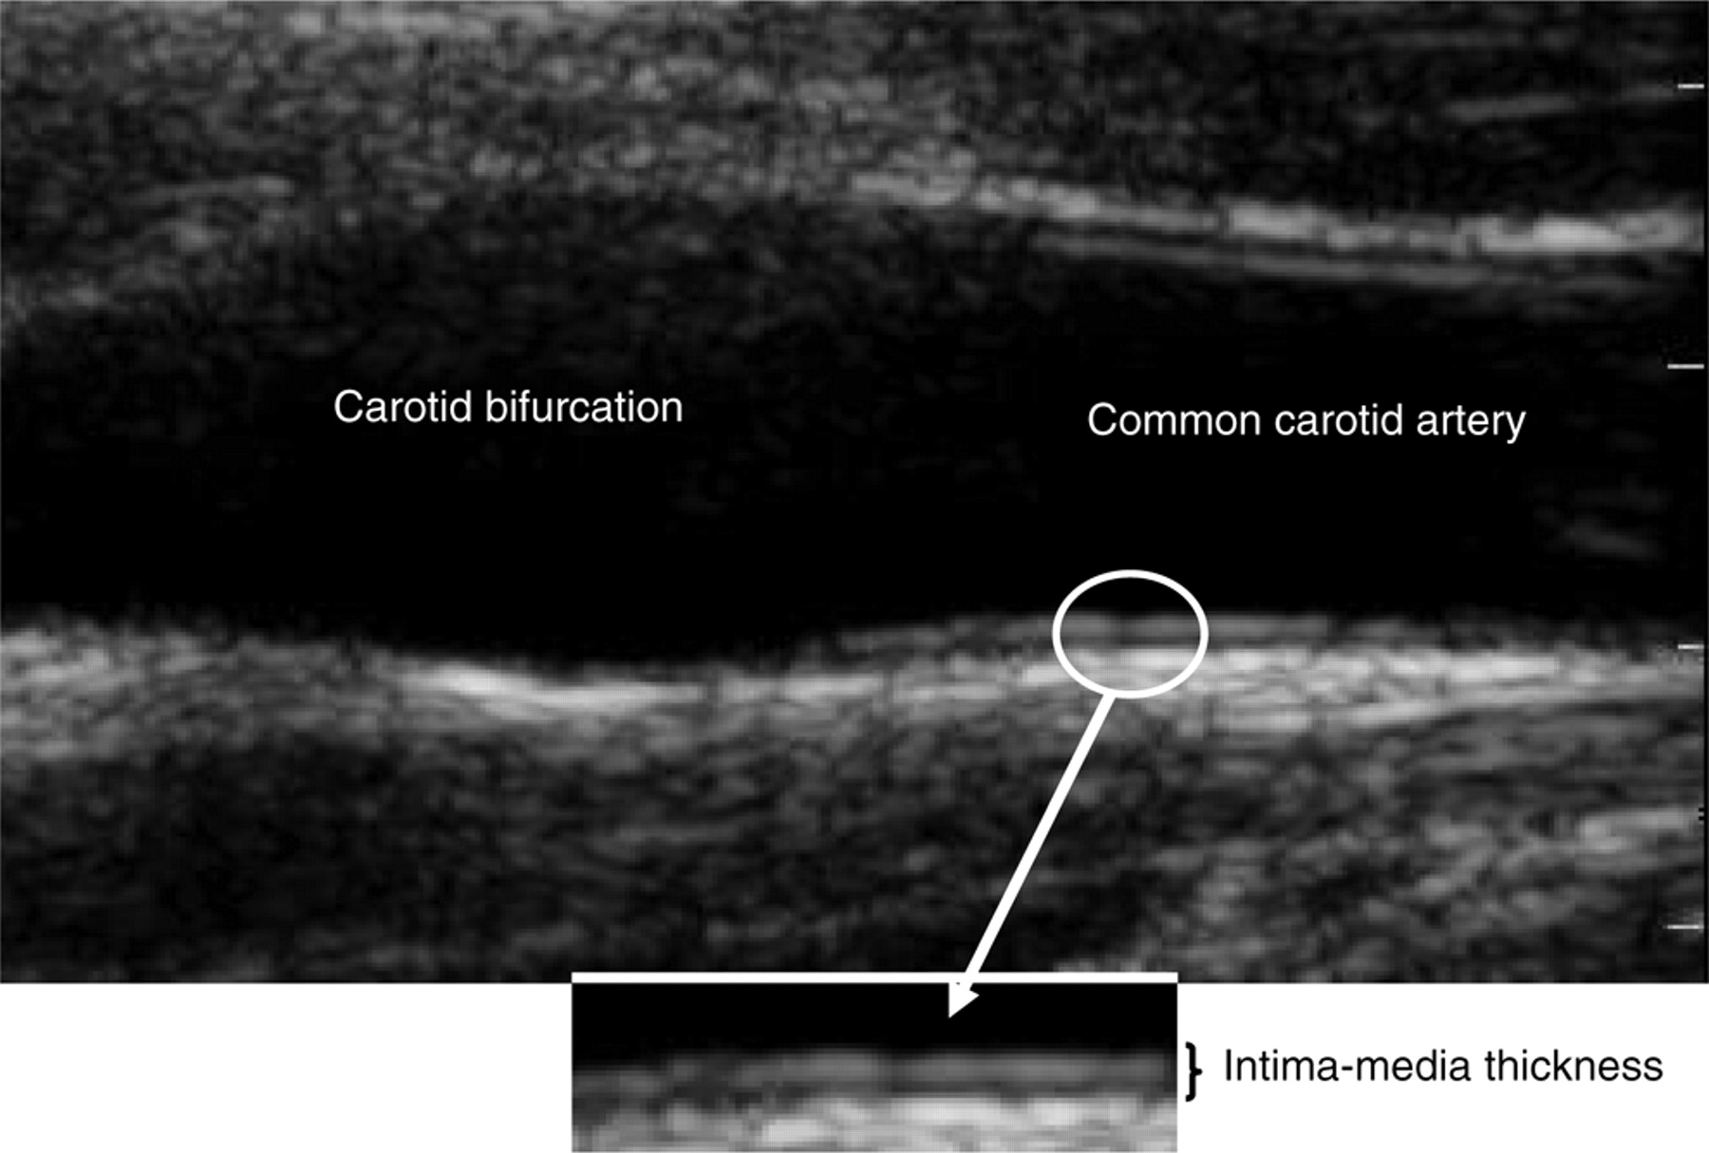

Slide 12
Carotid IMT and plaque
Different definitions of carotid IMT
Subjectively as present
Subjectively as ≥25% diameter narrowing
Combining a subjective judgment of being present or far wall IMT >1.5 mm in the common carotid artery and ICA
Continuous IMT value in the internal carotid artery (maximum IMT or the mean of the maximum IMT of 6 images)
Measured as a maximum ICA IMT >1.5 mm
Polak et al. JAHA 2013

Slide 13
Associations between obstructive sleep apnea, snoring, sleep quality and carotid disease
Ying Zhao, Sogol Javaheri, James Stein, Claudia Korcarz, Jing Wen, Rui Wang, Susan Redline

Slide 14
Definitions in current study
CCA IMT – calculated mean of the mean left and right mean far wall distal CCA wall thicknesses
Carotid plaque – discrete, focal wall thickening ≥1.5 cm or focal thickening ≤50% greater than the surrounding IMT
Carotid plaque presence
Carotid plaque score (0-12)
Stein et al. ASE Consensus Statement 2008
Tattersall et al. Stroke 2014

Slide 15
Table 1. Baseline Characteristics by OSA Severity Category
 | AHI <15 (n=1084) | AHI ≥15 (n=531) | P value
Demographics
Age, years | 69.4 ± 9.2 | 69.1 ± 8.9 | 0.108
Male gender, n (%) | 416 (38.4) | 325 (61.2) | <0.0001
Race/ethnicity, n (%)
White | 403 (37.2) | 170 (32.0) | 0.003
Chinese | 126 (11.6) | 81 (15.3)
Black | 316 (29.2) | 131 (24.7)
Hispanic | 239 (22.1) | 149 (28.1)
BMI, kg/m² | 27.7 ± 5.1 | 30.5 ± 5.7 | <0.0001
Waist circumference, cm | 96.9 ± 14.0 | 104.1 ± 13.9 | <0.0001
Smoking status, n (%)
Never | 514 (47.6) | 245 (46.2) | 0.215
Former | 485 (44.7) | 255 (48.2)
Current | 81 (7.5) | 29 (5.5)
Pack-years | 9.6 ± 18.6 | 9.9 ± 18.2 | 0.620
Current alcohol use, n (%) | 458 (42.4) | 232 (43.9) | 0.592
Habitual snoring, n (%) | 374 (34.8) | 270 (50.9) | <0.0001
Cardiovascular Risk Factors
Diabetes, n (%) | 153 (14.3) | 111 (20.9) | 0.001
Hypertension, n (%) | 597 (55.1) | 325 (66.2) | 0.021
Systolic blood pressure, mmHg | 122.5 ± 20.7 | 124.2 ± 19.4 | 0.063
Diastolic blood pressure, mmHg | 67.6 ± 9.8 | 69.3 ± 9.6 | 0.002
Serum HDL, mg/dl | 57.9 ± 17.2 | 51.5 ± 14.0 | <0.0001
Serum total cholesterol, mg/dl | 186.0 ± 35.7 | 179.7 ± 36.9 | 0.003
Statin use, n (%) | 370 (34.1) | 211 (39.7) | 0.031
Hypertensive medication use, n (%) | 559 (51.6) | 314 (59.1) | 0.005
Lipid-lowering medication use, n (%) | 391 (36.1) | 221 (41.6) | 0.033

Slide 16
 | Sleep Apnea |  |  |  |  | P value
 | AHI <15 (n=1084) | AHI ≥15 (n=531)
Carotid Ultrasound Measures
Common carotid artery IMT, mm Mean ± SD Median (IQR) | 0.85 ± 0.20 0.82 (0.72, 0.95) | 0.88 ± 0.19 0.84 (0.74, 0.99) |  |  |  | 0.001
Presence of carotid plaque, n (%) | 700 (64.6) | 373 (70.2) |  |  |  | 0.025
Plaque score Mean ± SD Median (IQR) | 2.07 ± 2.35 1 (0, 3) | 2.33 ± 2.38 2 (0, 4) |  |  |  | 0.015
Polysomnography Sleep Measures
Total sleep time, min | 366.3 ± 80.5 | 349.7 ± 83.4 |  |  |  | 0.0001
Sleep efficiency, % | 81.3 ± 11.9 | 76.6 ± 13.3 |  |  |  | <0.0001
Arousal index | 18.3 ± 8.7 | 29.6 ± 13.9 |  |  |  | <0.0001
% Sleep time spent in stage 3 and 4 sleep | 11.1 ± 9.2 | 8.3 ± 8.0 |  |  |  | <0.0001
% Sleep time spent in REM | 18.9 ± 6.3 | 16.3 ± 7.1 |  |  |  | <0.0001
% Sleep time spent with SaO₂ <90% | 1.6 ± 5.6 | 8.1 ± 12.0 |  |  |  | <0.0001

Slide 17
Table 1B: Baseline characteristics by presence of carotid plaque
 | Plaque Absent(n=579) | Plaque Present (n=1166) |  | P value
Demographics
Age, years | 65.5 ± 8.2 | 70.5 ± 9.1 | <0.0001
Male gender, n (%) | 254 (43.9) | 552 (47.3) | 0.185
Race/ethnicity, n (%)
White | 173 (29.9) | 460 (39.5) | 0.0006
Chinese | 87 (15.0) | 133 (11.4)
Black | 178 (30.7) | 300 (25.7)
Hispanic | 141 (24.4) | 273 (23.4)
BMI, kg/m² | 28.7 ± 5.6 | 28.6 ± 5.5 | 0.835
Waist circumference, cm | 98.5 ± 14.7 | 99.8 ± 14.3 | 0.071
Smoking status, n (%)
Never | 304 (52.6) | 504 (43.4) | 0.001
Former | 240 (41.5) | 566 (48.8)
Current | 34 (5.9) | 91 (7.8)
Pack-years | 7.3 ± 15.3 | 11.0 ± 19.7 | <0.0001
Current alcohol use, n (%) | 251 (43.4) | 496 (42.7) | 0.797
Habitual snoring, n (%) | 241 (41.6) | 452 (39.2) | 0.350
Cardiovascular Risk Factors
Diabetes, n (%) | 63 (10.9) | 223 (19.3) | <0.0001
Hypertension, n (%) | 269 (46.5) | 737 (63.2) | <0.0001
Systolic blood pressure, mmHg | 119.6 ± 19.5 | 125.1 ± 20.8 | <0.0001
Diastolic blood pressure, mmHg | 68.9 ± 9.8 | 67.7 ± 9.9 | 0.006
Serum HDL, mg/dl | 56.1 ± 16.1 | 55.4 ± 16.7 | 0.249
Serum total cholesterol, mg/dl | 185.3 ± 36.5 | 182.7 ± 36.3 | 0.153
Statin use, n (%) | 147 (25.4) | 480 (41.2) | <0.0001
Hypertensive medication use, n (%) | 256 (44.2) | 692 (59.4) | <0.0001
Lipid-lowering medication use, n (%) | 158 (27.3) | 502 (43.1) | <0.0001

Slide 18
Table 1B: Baseline characteristics by presence of carotid plaque
 | Plaque Absent (n=579) | Plaque Present (n=1166) |  | P value
Carotid Ultrasound Measures
Common carotid artery IMT, mm | 0.80 ± 0.15 | 0.89 ± 0.21 |  | <0.0001
Plaque score (range 0 to 12) | 0 ± 0 | 3.24 ± 2.21 |  | <0.0001
Polysomnography Sleep Measures
Total sleep time, min | 365.1 ± 76.4 | 358.7 ± 84.3 |  | 0.134
Sleep efficiency, % | 81.3 ± 11.9 | 78.9 ± 12.9 |  | <0.0001
Arousal index | 20.8 ± 11.7 | 22.6 ± 12.0 |  | 0.0008
% Sleep time spent in stage 3 and 4 sleep | 10.4 ± 9.0 | 10.1 ± 8.0 |  | 0.402
% Sleep time spent in REM | 19.0 ± 6.7 | 17.6 ± 6.7 |  | 0.0003
% Sleep time spent with SaO₂ <90% | 2.9 ± 6.0 | 4.1 ± 9.9 |  | 0.007

Slide 19
Table 2: Association between measures of sleep disordered breathing, snoring, sleep quality and the presence of carotid plaque
 | Model 1† |  | Model 2
 | OR (95% CI) | p-value | OR (95% CI) | p-value
Snoring, Hypoxemia & Sleep Disordered Breathing
AHI (≥15 ) | 1.28 [1.01, 1.63] | 0.038 | 1.22 [0.95, 1.57] | 0.127
AHI (continuously measured) | 1.01 [1.00, 1.01] | 0.092 | 1.00 [100, 1.01] | 0.404
Habitual Snoring | 1.05 [0.85, 1.31] | 0.638 | 0.988 [0.79, 1.24] | 0.918
% Sleep time with SaO₂ <90% (>0.64%) | 1.16 [0.93, 1.44] | 0.182 | 1.04 [0.83, 1.32] | 0.726
Sleep Quality
% Sleep time in stage 3 and 4 sleep (>8.3%) | 1.10 [0.88, 1.38] | 0.416 | 1.20 [0.95, 1.52] | 0.127
Arousal index (>19.5) | 1.19 [0.96, 1.48] | 0.120 | 1.24 [0.98, 1.55] | 0.068
Sleep maintenance efficiency (>82.4%) | 0.79 [0.63, 0.99] | 0.043 | 0.83 [0.66, 1.05] | 0.120
Sleep duration (>369 min) | 0.90 [0.73, 1.12] | 0.361 | 0.95 [0.76, 1.20] | 0.680
†Model 1: adjusted for demographic factors (age, race/ethnicity, gender)
Model 2: additionally adjusted for smoking status, pack years, BMI, alcohol use, presence of diabetes, use of antihypertensive medication, and statin use

Slide 20
Table 3: Association between measures of sleep disordered breathing, snoring, sleep quality and carotid intima-media thickness (cIMT)
 | Model 1† |  | Model 2
 | β (95% CI) | p-value | β (95% CI) | p-value
Snoring, Hypoxemia & Sleep Disordered Breathing
AHI (≥15) | 0.013 [-0.007, 0.032] | 0.193 | 0.002 [-0.018, 0.022] | 0.869
AHI (continuously measured) | 0.0003 [-0.00005, 0.001] | 0.075 | 0.0002 [-0.0004, 0.0008] | 0.487
Habitual Snoring | 0.001 [-0.017, 0.019] | 0.900 | -0.004 [-0.022, 0.014] | 0.663
% Sleep time with SaO₂ <90% (>0.64%) | 0.023 [0.005, 0.041] | 0.011 | 0.014 [-0.005, 0.032] | 0.155
Sleep Quality
% Sleep time in stage 3 and 4 sleep (8.3 %) | -0.016 [-0.034, 0.003] | 0.108 | -0.011 [-0.030, 0.007] | 0.233
Arousal index (>19.5) | 0.003 [-0.015, 0.021] | 0.734 | 0.006 [-0.012, 0.024] | 0.508
Sleep maintenance efficiency (>82.4%) | -0.013 [-0.032, 0.005] | 0.166 | -0.005 [-0.024, 0.013] | 0.589
Sleep Duration (>369 min) | -0.018 [-0.037, -0.0001] | 0.049 | -0.013 [-0.031, 0.005] | 0.168
†Model 1: adjusted for demographic factors (age, race/ethnicity, gender)
Model 2: additionally adjusted for smoking status, pack years, BMI, alcohol use, presence of diabetes, use of antihypertensive medication, and statin use

Slide 21
Table 4: Association between AHI (≥15) and presence of carotid plaque
 | OR (95% CI) | P-value | P-interaction 0.057
Age <68 N=787 | 1.51 (1.08, 2.11) | 0.017
Age ≥68 N=828 | 0.95 (-0.41, 1.36) | 0.774
*Similar age interaction was found when using AHI as a continuous variable (p-interaction 0.045)
Adjusted for age, gender, race/ethnicity, BMI, alcohol use, smoking status, pack years, presence of hypertension, diabetes, and statin use, and an interaction term between age and AHI

Slide 22
Table 4: Association between AHI (≥15) and mean CCA-IMT
 | β (95% CI) | P-value | P-interaction 0.043
Age <68 N=787 | 0.022 (-0.006, 0.051) | 0.121
Age ≥68 N=828 | -0.017 (-0.043, 0.010) | 0.224
Adjusted for age, gender, race/ethnicity, BMI, alcohol use, smoking status, pack years, presence of hypertension, diabetes, and statin use, and an interaction term between age and AHI

Slide 23
Compare and Contrast
Lutsey et al.
The association between severe OSA and CAC>0 was slightly stronger among younger participants than older participants
PR (95% CI) ≤67 years 1.22 (1.03, 1.45) and >67 years 1.16 (1.04, 1.28), p-interaction <0.01
Associations did not vary by sex or race/ethnicity
Javaheri et al.
LV mass and mass/volume were significantly increased with increasing AHI category for subjects ≤65 years
(β=1.84 ± 0.47 gm/m, p=0.0001 and β=0.02 ± 0.007 gm/mL, p=0.025, respectively)
Associations slightly (not significantly) stronger in Whites and Chinese

Slide 24
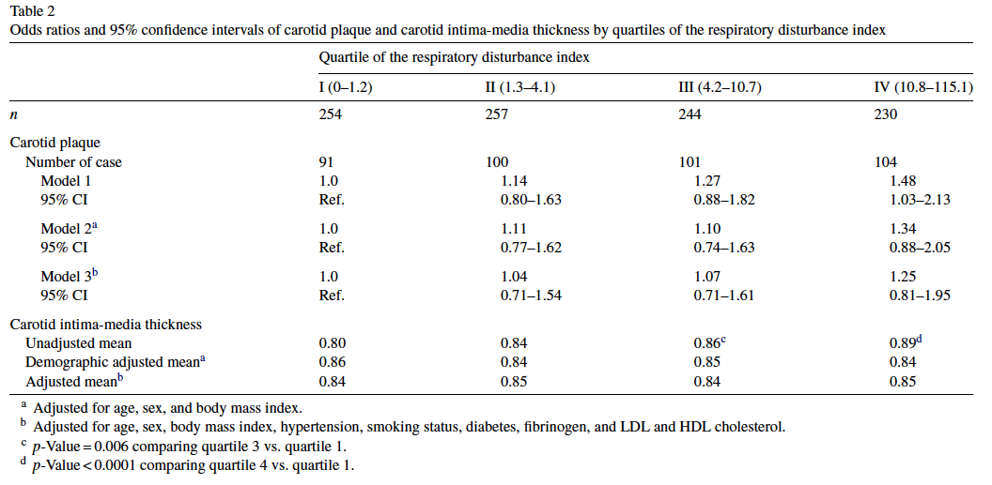
Compared to SHHS
Wattanakit et al. Atherosclerosis 2008

Slide 25
Summary
Sleep apnea (≥15) is significantly associated with the presence of carotid plaque in younger participants
There is also significant age interaction in the association between sleep apnea and cIMT
There appears to be a signal between arousal index and the presence of carotid plaque
No significant predictors of cIMT was found in the final model

Slide 26
Future Directions
Modeling of AHI and other sleep measures as continuous variables
Analyses comparing the highest AHI quartile with the lower quartiles

Slide 27
Acknowledgements
Susan Redline, Rui Wang, James Stein, Claudia Korcarz, Sogol Javaheri, Jing Wen

Slide 28
N= 552 532 297 234

