Slide 1
Subclinical Interstitial Lung Disease: MESA Lung Fibrosis (and Sleep…)
David J. Lederer, MD, MS
Associate Professor of Medicine and Epidemiology
Columbia University Medical Center

Slide 2
Disclosures
Steering Committee/Consultant
Gilead, RAINIER trial of simtuzumab for IPF
Intermune, ASCEND trial of pirfenidone for IPF
Consultant
Boehringer-Ingelheim
ImmuneWorks
XVIVO Therapeutics

Slide 4
What is Interstitial Lung Disease?

Slide 5
Interstitial lung disease (ILD) is not…
COPD
Emphysema
Chronic bronchitis
Asthma
Lung cancer
Pneumonia

Slide 6
Definition of Interstitial Lung Disease
NHLBI Working Group Definition of ILD:
“The presence of acquired cellular proliferation, cellular infiltration, and/or fibrosis of the lung parenchyma not due to infection or neoplasia.”
Rosas, Lederer, & Martinez. Ann Am Thorac Soc 2014;11:S169-77.

Slide 7
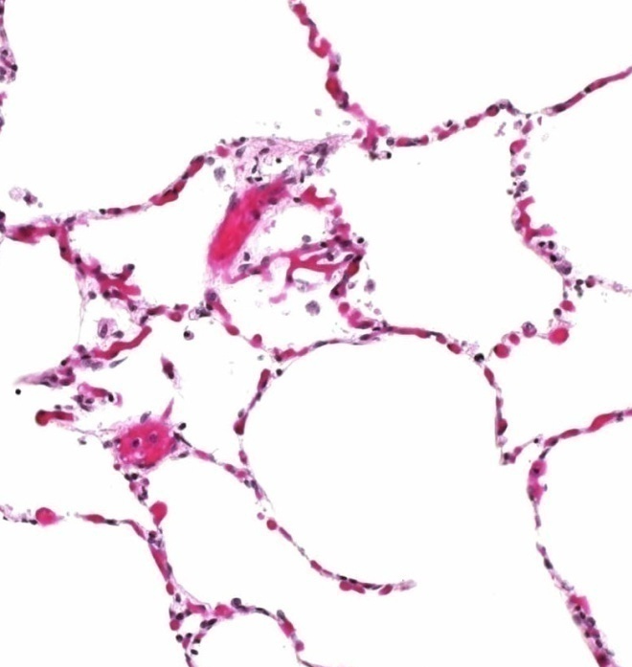
Interstitial lung disease
Fibrosis
Inflammation

Slide 8
Interstitial Lung Diseases
ILD of Known Cause or Association
Idiopathic Interstitial Pneumonias
Sarcoidosis
Medications
Radiation
Connective Tissue Disease
Hypersensitivity Pneumonitis
Pneumoconioses
“Other” ILD
LAM
Pulmonary LCH
Eosinophilic Pneumonias
Alveolar Proteinosis
Vasculitis
Genetic Syndromes
Idiopathic Pulmonary Fibrosis
Idiopathic nonspecific interstitial pneumonia
Respiratory bronchiolitis-ILD
Desquamative interstitial pneumonia
Cryptogenic organizing pneumonia
Acute interstitial pneumonia
Rare IIPs (LIP, IPPFE)
Unclassifiable IIP
Adapted from: ATS/ERS Guidelines for IIP. AJRCCM 2002:165:277-304, and ATS/ERS Update on IIPs. AJRCCM 2013;188:733-48.

Slide 9
Idiopathic Pulmonary Fibrosis
Peripheral lobular fibrosis of unknown cause
Disease of older adults
0.5% of US adults > 65 years old have IPF
1 new case diagnosed per 1,000 adults > 65 years old each year
“High impact” disease
Disabling exertional dyspnea and cough
Severe functional limitation
Impaired quality-of-life
Median survival time 3.8 years
Until recently, no FDA approved therapies in the US
Raghu et al. Lancet Resp Med 2014;2(7): 566 -72.

Slide 10
Clinically, ILD is typically identified and diagnosed using CT imaging of the chest
Ground-glass &
Reticulation
Patchy ground-glass
Reticulation &
honeycombing

Slide 11
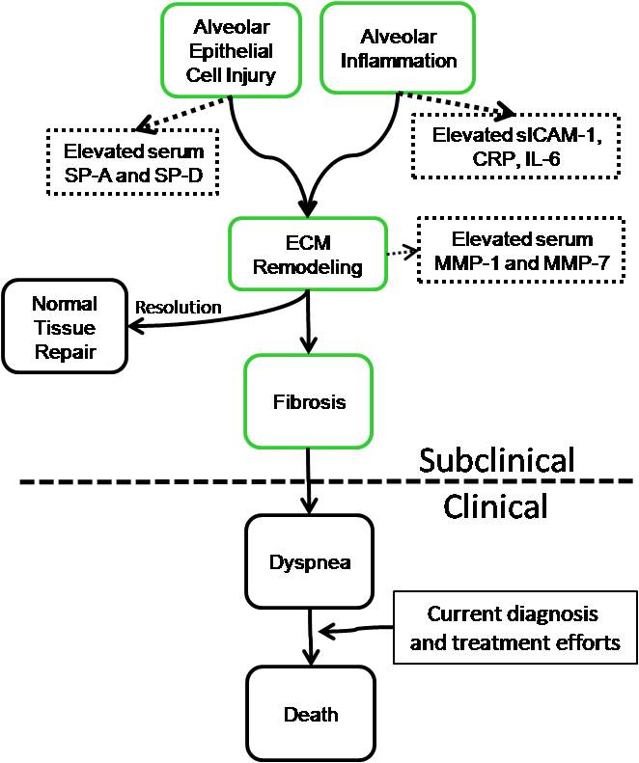

Slide 12
The Multi-Ethnic Study of Atherosclerosis (MESA)
NHLBI-funded prospective cohort study
6,814 adults were sampled from six communities in the U.S. in 2000-2002
Men and women age 45 to 84 years old free of clinical cardiovascular disease

Slide 13
Selected MESA exclusion criteria
Clinical cardiovascular disease: MI, angina, TIA, stroke, CHF
Active treatment for cancer
Residence in a skilled nursing facility
“Any serious medical condition which would prevent long-term participation”
Chest CT scan in the past year

Slide 14
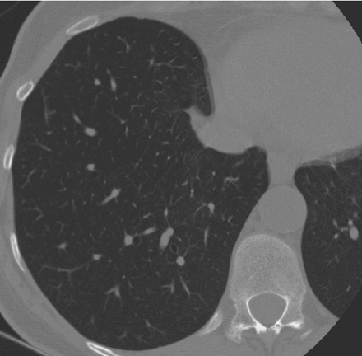
CT Attenuation of Normal Lung
Best et al., Radiology 2003

Slide 15
CT Attenuation of Normal Lung
-910 HU
Best et al., Radiology 2003

Slide 16
CT Attenuation of Normal Lung
-910 HU
Best et al., Radiology 2003

Slide 17
Quantification of Emphysema
Mishima et al. PNAS 1999;96:8829-34

Slide 18
Idiopathic Pulmonary Fibrosis
Normal Lungs
Usual Interstitial Pneumonia

Slide 19
CT Attenuation of Normal Lung
Best et al., Radiology 2003

Slide 20
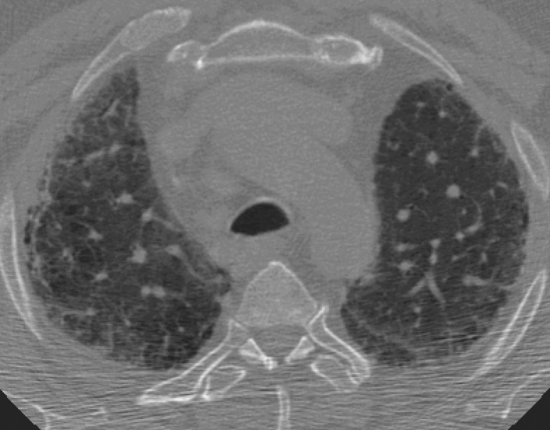
Increased CT attenuation in IPF
Best et al., Radiology 2003

Slide 21
Increased CT attenuation in IPF
-250 HU
Best et al., Radiology 2003

Slide 22
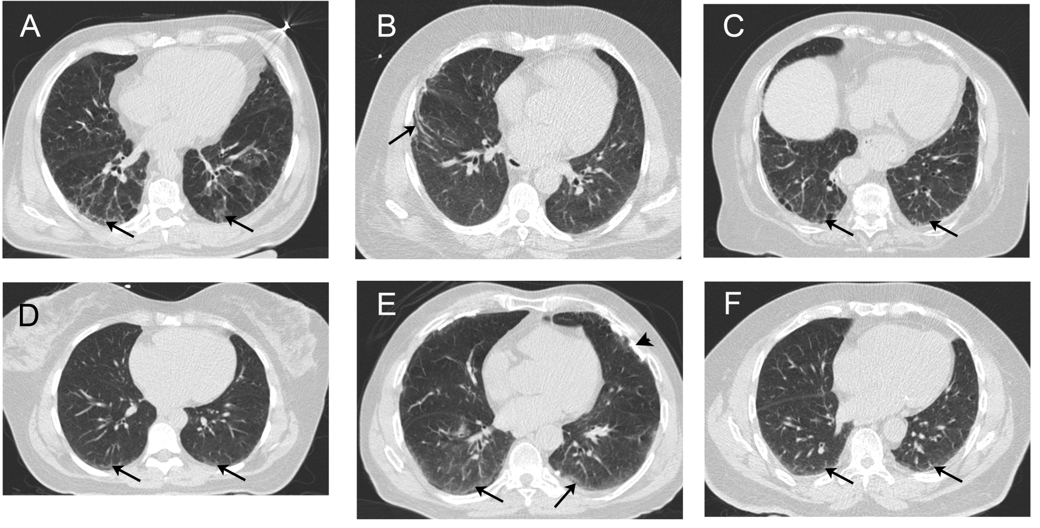
Elevated HAA resembles early ILD
Lederer (unpublished data)

Slide 23
MESA Exam Components
Exam component Year | Exam 1 2000-02 | Exam 2 2002-04 | Exam 3 2004-05 | Exam 4 2005-07 | Exam 5 2010-12
Medical, demographics, socioeconomics, diet, anthropometry | X | X | X | X | X
Phlebotomy | X | X | X | X | x
Cardiac CT scans | X | 50% | 50% | 25% | 50%
Full-lung CT scans |  |  |  |  | 50%

Slide 24
MESA Exam Components
Exam component Year | Exam 1 2000-02 | Exam 2 2002-04 | Exam 3 2004-05 | Exam 4 2005-07 | Exam 5 2010-12
Medical, demographics, socioeconomics, diet, anthropometry | X | X | X | X | X
Phlebotomy | X | X | X | X | x
Cardiac CT scans | X | 50% | 50% | 25% | 50%
Full-lung CT scans |  |  |  |  | 50%
HAA measured

Slide 25
“Interstitial Lung Abnormalities” (ILAs)
Washko & Rosas, NEJM 2011;364(10):897-906.

Slide 26
MESA Exam Components
Exam component Year | Exam 1 2000-02 | Exam 2 2002-04 | Exam 3 2004-05 | Exam 4 2005-07 | Exam 5 2010-12
Medical, demographics, socioeconomics, diet, anthropometry | X | X | X | X | X
Phlebotomy | X | X | X | X | x
Cardiac CT scans | X | 50% | 50% | 25% | 50%
Full-lung CT scans |  |  |  |  | 50%
HAA measured
ILA measured

Slide 27
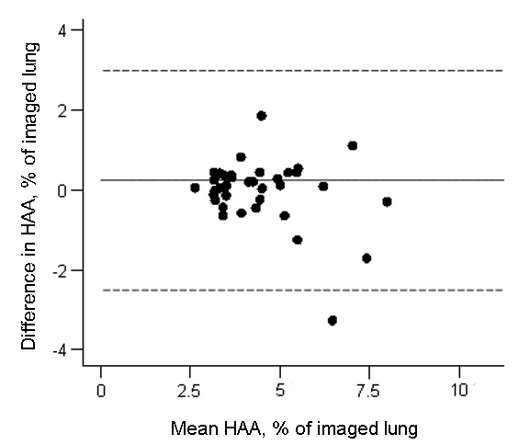
HAA reliability
ICC 0.93
42 full lung scans
Bland-Altman plot showing agreement between HAA on full and cardiac
CT scans. The mean difference was 0.2% (solid line).
The 95% limits of agreement were -2.5% to 3.0% (dashed lines).
Lederer (unpublished data)

Slide 28
HAA in “normals”
Median 4.1%
95th percentile 9.1%
“Elevated HAA”
HAA > 9.1%
Lederer (unpublished data)

Slide 29
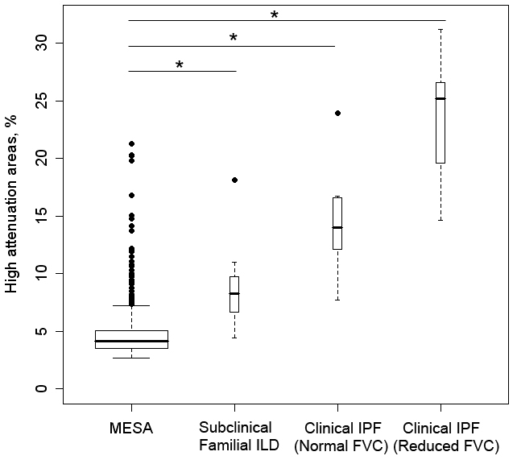
HAA: Construct Validity
Lederer (unpublished data)

Slide 30
Greater HAA is associated with lower FVC
Lederer (unpublished data)

Slide 31
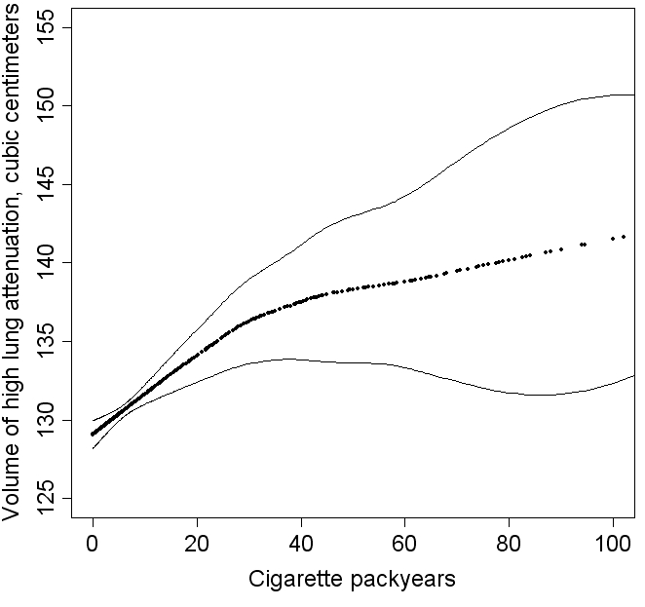
Cigarette smoking is associated with greater HAA
p < 0.001
Adjusted for age, sex, race/ethnicity, smoking status, height, body mass index,
waist and hip circumference, center, total volume of imaged lung, and mA dose
Lederer et al. AJRCCM 2009;180(5):407-14.

Slide 32
MESA Lung Fibrosis Aims
Aim 1
Determine whether cases with elevated HAA have higher serum levels of markers of alveolar epithelial cell injury and extracellular matrix remodeling compared to a comparison group
Aim 2
Determine whether MESA participants with elevated HAA have impaired lung function and exercise capacity compared to those with normal HAA
Aim 3
To perform statistical genetic analyses subclinical ILD phenotypes in the MESA and MESA Family Studies

Slide 33
HAA & ILA
Genetics
Sleep apnea
Biomarkers
Mortality
Dyspnea
Physiology
Autoimmunity

Slide 34
Exam 1 HAA is associated with Exam 5 ILA
 | Odds Ratio* | 95% CI | P value
Suspicious or confirmed ILA
Unadjusted OR | 1.74 | 1.32 – 2.31 | <0.001
Adjusted OR | 1.86 | 1.35 – 2.55 | <0.001
Suspicious for ILA
Unadjusted OR | 1.54 | 1.15 – 2.05 | 0.003
Adjusted OR | 1.61 | 1.18 – 2.20 | 0.003
Confirmed ILA (UIP pattern)
Unadjusted OR | 3.22 | 1.56 – 6.65 | 0.002
Adjusted OR | 3.87 | 1.74 – 8.58 | <0.001
Adjusted odds ratio are adjusted for age, gender, race, smoking status, packyears, body mass index, and study site
*per natural log unit increase in HAA
Podolanczuk & Lederer, unpublished data

Slide 35
HAA is associated with higher IgA rheumatoid factor levels
p< 0.001
Adjusted for age, gender, race/ethnicity, education, height, BMI, hip circumference, waist circumference,
smoking status, cigarette pack-years,site, MA dose, and percent emphysema on CT
Bernstein, Majka, & Lederer, unpublished data

Slide 36
HAA is associated with lower serum HDL
p < 0.001
Adjusted for age, gender, race/ethnicity, education, height, BMI, hip circumference, waist circumference,
smoking status, cigarette pack-years, HTN, DM, SBP, DBP, LDL, CAC, CRP, fasting glucose, statin use,
site, MA dose, total volume imaged lung and percent emphysema on CT
Podolanczuk & Lederer, unpublished data

Slide 37
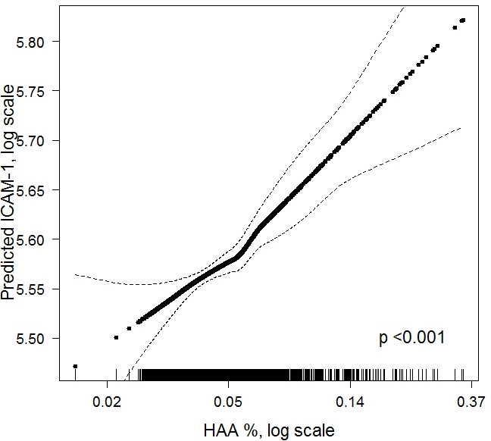
HAA is associated with higher sICAM-1 levels
p < 0.001
Adjusted for age, gender, race/ethnicity, education, height, BMI, hip circumference, waist circumference,
smoking status, cigarette pack-years, CAC, HTN, DM, SBP, DBP, LDL, VLDL, CRP, fasting glucose, statin use,
site, MA dose, total volume imaged lung and percent emphysema on CT
Podolanczuk & Lederer, unpublished data

Slide 39
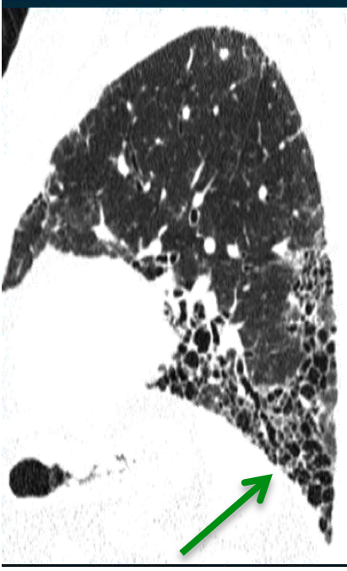

Slide 40
Inspiratory resistive breathing causes acute lung injury
Toumpanakis et al. Am J Respir Crit Care Med. 2010;182(9):1129-36.

Slide 41
ILAs are common in OSA
Podolanczuk, Basner, Redline, & Lederer (unpublished data)

Slide 42
Circulating AEC markers are elevated in OSA
*
*Adjusted for age, gender, race, BMI, and smoking status
Lederer DJ, Jelic S, Basner RC, Ishizaka A, Bhattacharya J. Eur Respir J. 2009;33(4):793-6.
Podolanczuk, Basner, Redline, & Lederer (unpublished data)

Slide 43
Proposed R01

Slide 44
Collaborators
University of Iowa
Eric Hoffman, PhD
John Newell, MD
Jered Siered
University of Virginia
Ani Manichaikul, PhD
Stephen Rich, PhD
University of Arizona
Paul Enright, MD
University of Pennsylvania
Steve Kawut, MD, MS
University of Vermont
Russ Tracy, PhD
Elaine Cornell
PICTOR
Matthew Baldwin, MD, MS
Elana Bernstein, MD, MS
Anna Podolanczuk, MD
Jessica Sell, MPH
Luke Benvenuto, MD
Michaela Restivo, MD
Mark Snyder, MD
Tatiana Blue
Jamiela McDonnough
Amika McBurnie
Wendy Gonzalez
Columbia University
Steve Shea, MD
Graham Barr, MD, DrPH
Dan Rabinowitz, PhD
Robert Basner, MD
John Austin, MD
University of Washington
Robyn McClelland, PhD
Ganesh Raghu, MD
Joel Kaufman, MD, PhD
Karen Hinckley-Stukovsky, MS
Kayleen Williams, MPH
NHGRI
Bernadette Gochuico, MD
Brigham & Women’s Hospital
Susan Redline, MD

Slide 47
Putative Causes of IPF
Injurious triggers
Cigarette smoking
Occupational exposures
Viral infection
Aberrant wound repair
Telomere length & hTERT, hTR mutations
SPTPA2, SFTPB, ELMOD2
MUC5B, FAM13A, DSP, ATP11A, DPP9

Slide 48
High attenuation areas (HAA)
Voxels with CT attenuation values between -600 and -250 HU
Lederer (unpublished data)

Slide 49
Park et al. Frontiers in Bioscience 2011;16:486-97.

Slide 50
Baseline inflammatory markers and HAA progression over a median of 3 years
Biomarker | No. | Progressors >0.08%/yr | Non-Progressors <0.08%/yr | P
sICAM-1, ng/ml | 1074 | 288 (253 – 335) | 260 (223 – 303) | 0.004
CRP, mg/L | 2547 | 3.0 (1.1 – 5.9) | 1.7 (0.8 – 4.1) | 0.001
vWF, % | 562 | 145 (100- 163) | 125 (94 – 164) | 0.36
sIL-2 receptor | 564 | 0.88 (0.75 – 1.20) | 0.81 (0.66 – 1.05) | 0.06
IL-6, pg/ml | 2498 | 1.30 (0.90 – 1.74) | 1.07 (0.70 – 1.70) | 0.007
Tissue Factor, pg/ml | 561 | 138 (90 – 173) | 102 (66- 150) | 0.06
Median (IQR) baseline serum biomarker levels adjusted for age, gender, race/ethnicity, smoking status,
cigarette packyears, urine cotinine, height, BMI, waist and hip circumference, and study site.
Lederer (unpublished data)

Slide 51
HAA is associated with higher IgM rheumatoid factor levels
p= 0.006
Adjusted for age, gender, race/ethnicity, education, height, BMI, hip circumference, waist circumference,
smoking status, cigarette pack-years,site, MA dose, and percent emphysema on CT
Bernstein & Lederer, unpublished data

Slide 52
HAA and ILA in in MESA
Lederer, unpublished data

Slide 53
Baseline RF IgA predicts ILA 10 years later
 | RF IgA < 7 | 7 < IgA <10 | 10 < IgA 17 | IgA > 17 | P for trend
No. | 890 | 727 | 638 | 656
ILA prevalence | 8.0% | 10.5% | 10.8% | 12.7%
RR for ILA | Ref | 1.26 (0.92 – 1.72) | 1.22 (0.88 – 1.67) | 1.37 (1.01 – 1.86) | 0.06
 | Beta (95% CI) | P value
No. | 2911
RR* for ILA | 1.17 (1.04 – 1.31) | 0.01
Adjusted for age, gender, race/ethnicity, study site, BMI, packyears, current smoking
*per natural log unit change in RF
Bernstein & Lederer, unpublished data

Slide 54
Reduced plasma sRAGE levels in COPD
Smith et al. Eur Resp J 2011;37:516-22

