Slide 1
Streamlining of MESA M&M Abstraction Forms
Aaron Folsom MD, MPH

Slide 2
Cardiac/PVD Abstraction
Current form contains 35 items
Reviewers recommend:
  Dropping 15 items
    #s 3-10, 12-13, 22-26, and at least dates from #20
  Maybe dropping additional 3 items
    #s 19-21

Slide 3
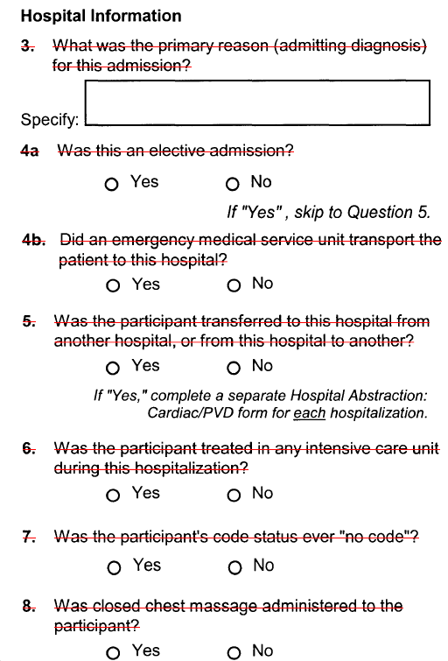
Cardiac/PVD- drop

Slide 4
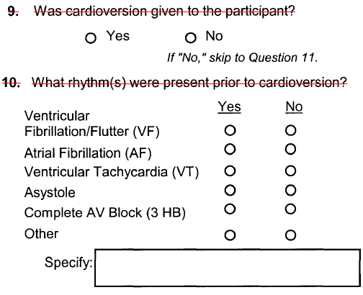
Cardiac/PVD- drop

Slide 5
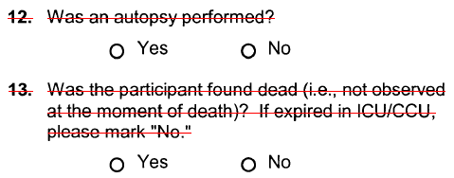
Cardiac/PVD- drop

Slide 6
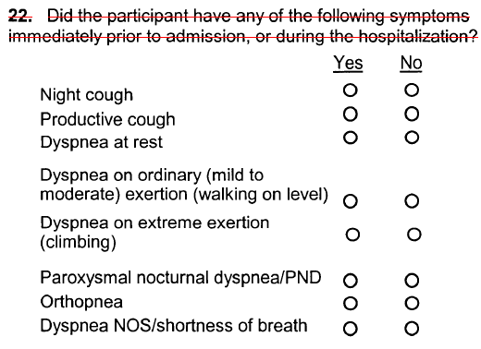
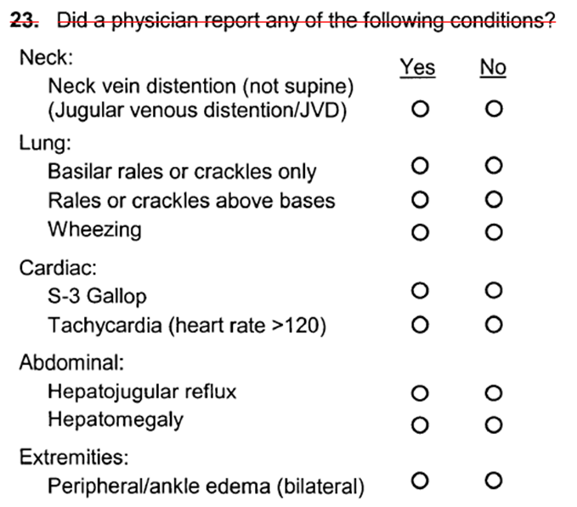
Cardiac/PVD- drop

Slide 7

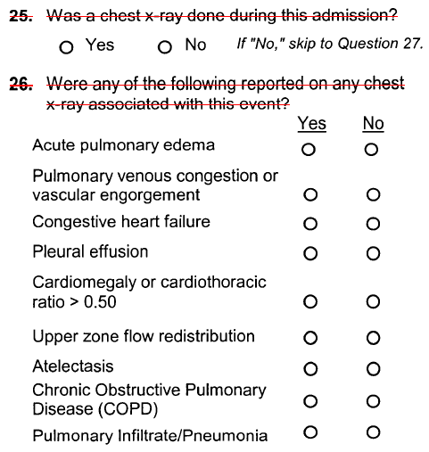
Cardiac/PVD- drop

Slide 8
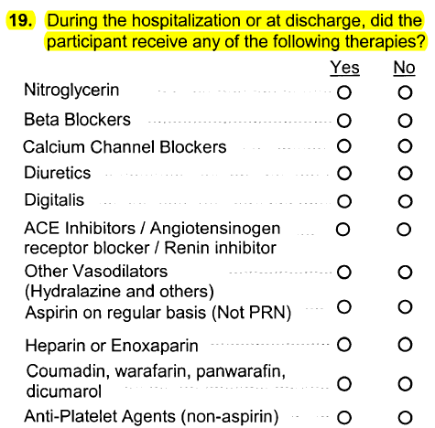
Cardiac/PVD- maybe drop

Slide 9
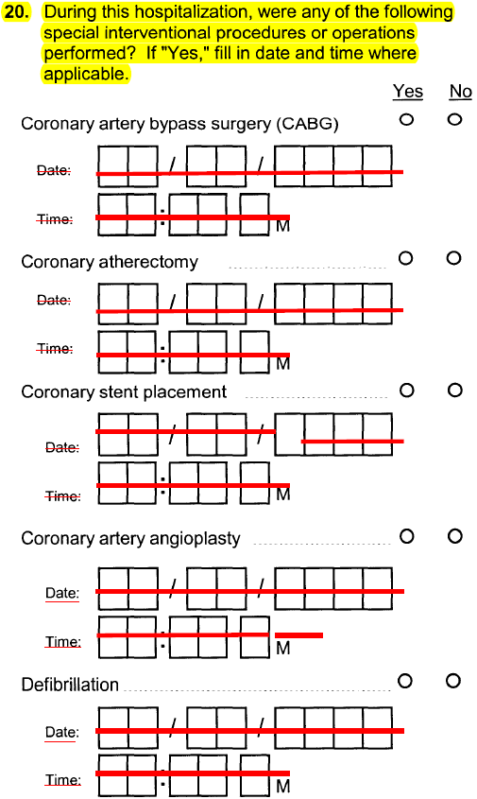
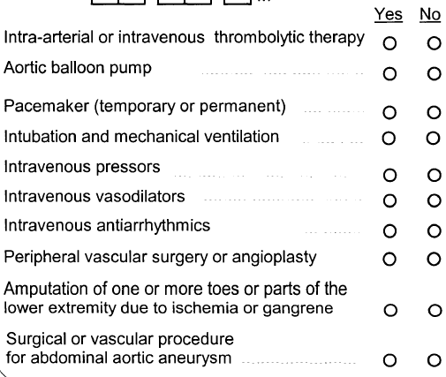
Cardiac/PVD- maybe drop

Slide 10
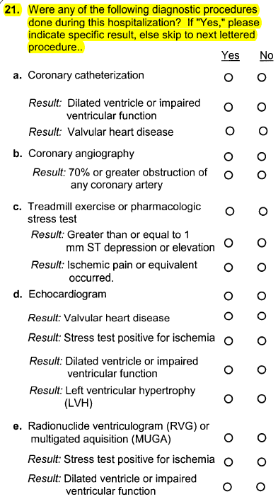
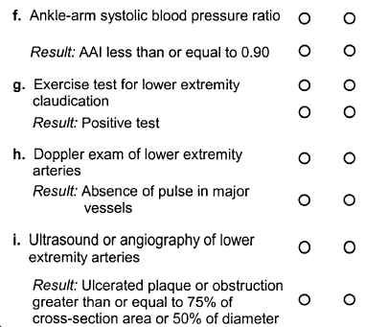
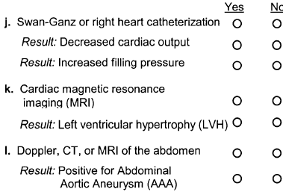
Cardiac/PVD- maybe drop

Slide 11
Stroke/TIA Abstraction
Current form contains 39 items
Reviewers recommend:
  Dropping 23 items
    #s 5-7, 9, 12, 14, 16-19, 21-33

Slide 12

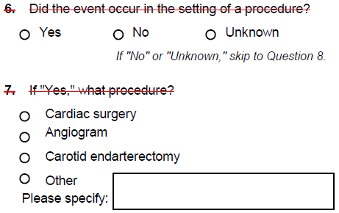
Stroke/TIA- drop

Slide 13
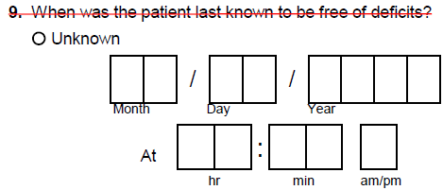
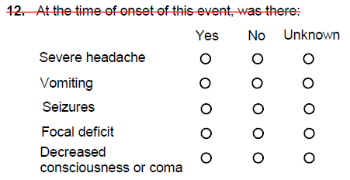
Stroke/TIA- drop

Slide 14
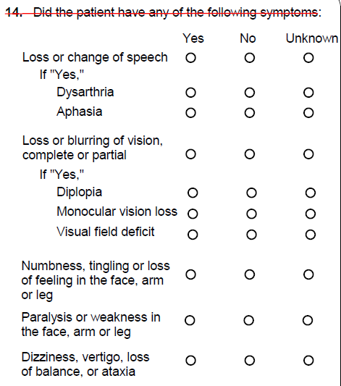
Stroke/TIA- drop

Slide 15
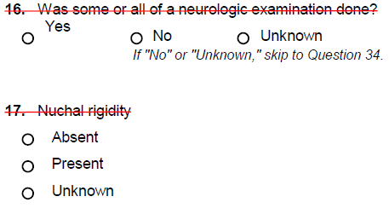
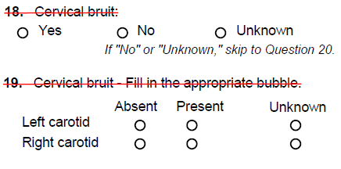
Stroke/TIA- drop

Slide 16
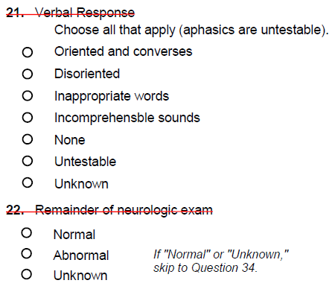
Stroke/TIA- drop

Slide 17
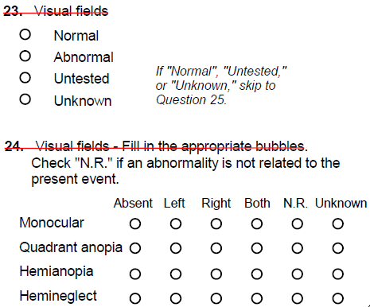
Stroke/TIA- drop

Slide 18
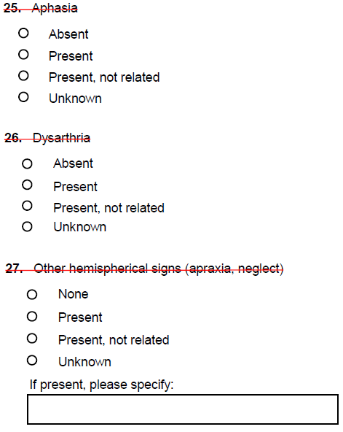
Stroke/TIA- drop

Slide 19
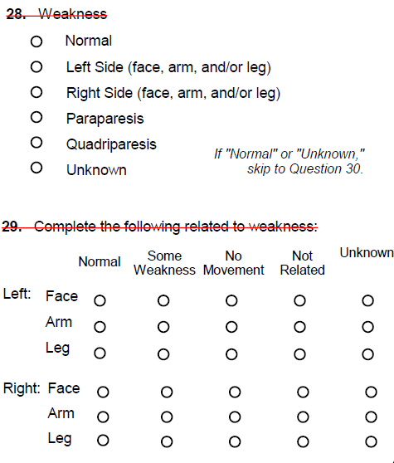
Stroke/TIA- drop

Slide 20
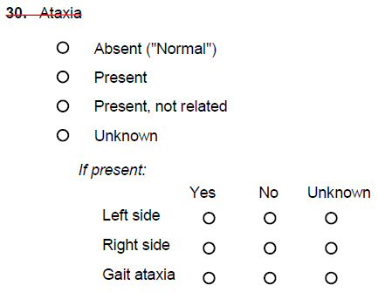
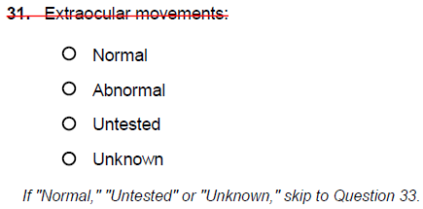
Stroke/TIA- drop

Slide 21
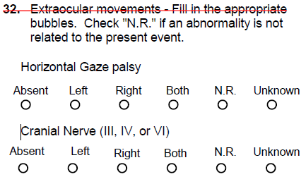
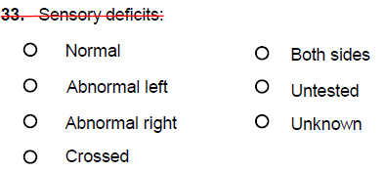
Stroke/TIA- drop

Slide 22
End Presentation

Slide 23
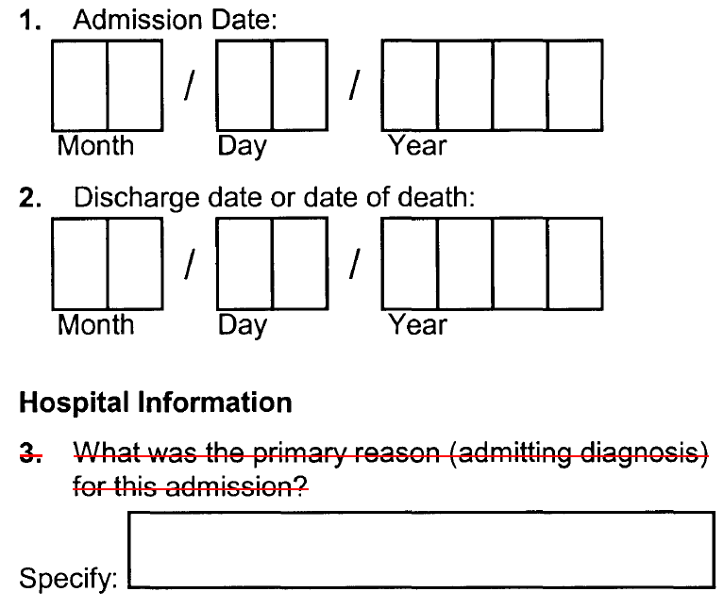
Cardiac/PVD

Slide 24
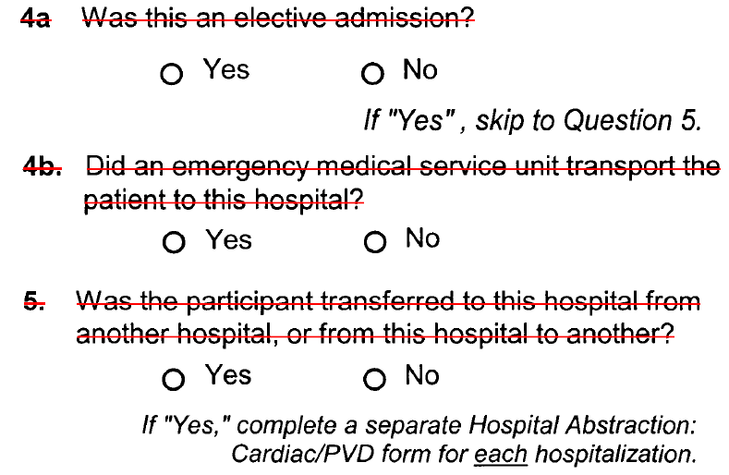
Cardiac/PVD

Slide 25
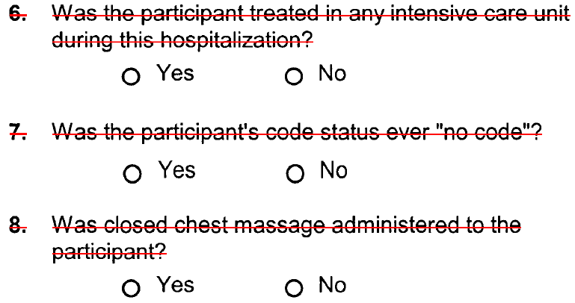
Cardiac/PVD

Slide 26
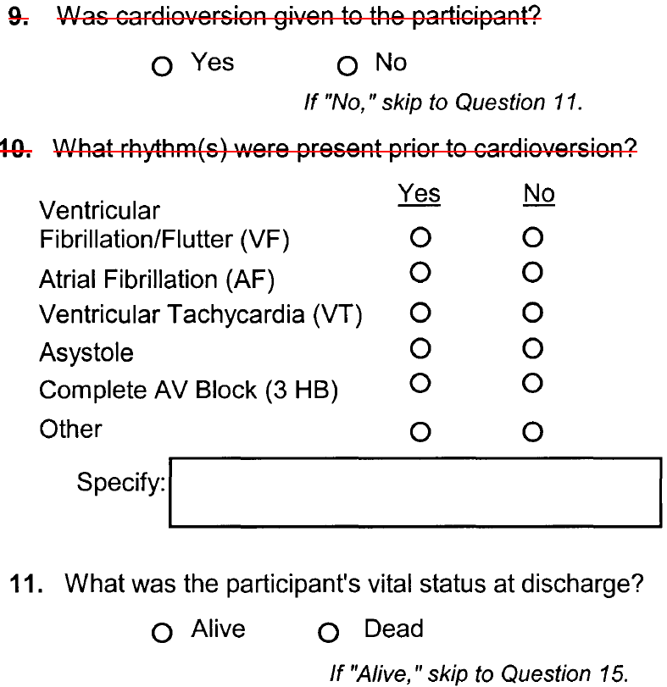
Cardiac/PVD

Slide 27
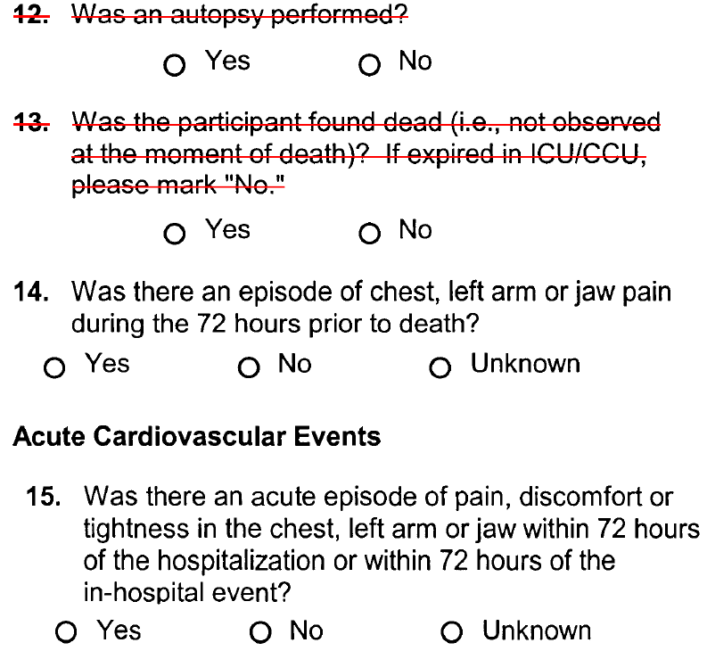
Cardiac/PVD

Slide 28
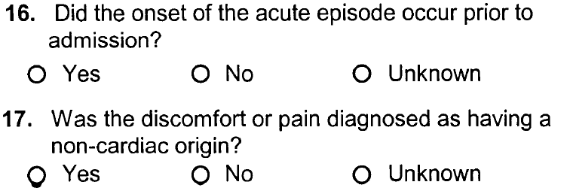
Cardiac/PVD

Slide 29
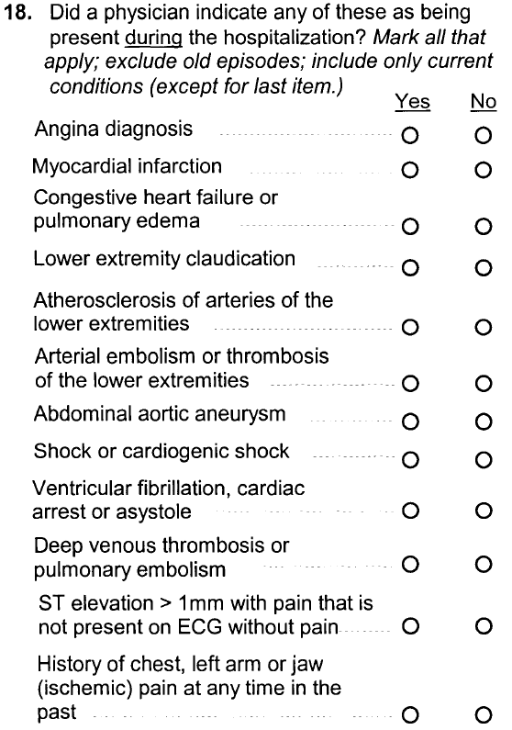
Cardiac/PVD

Slide 30
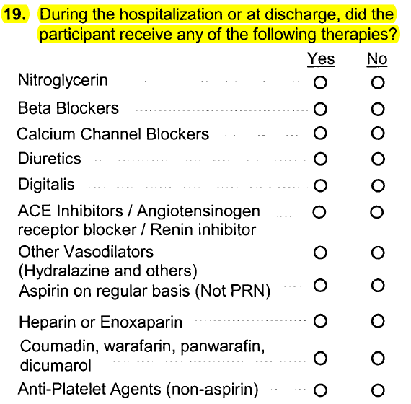
Cardiac/PVD

Slide 31
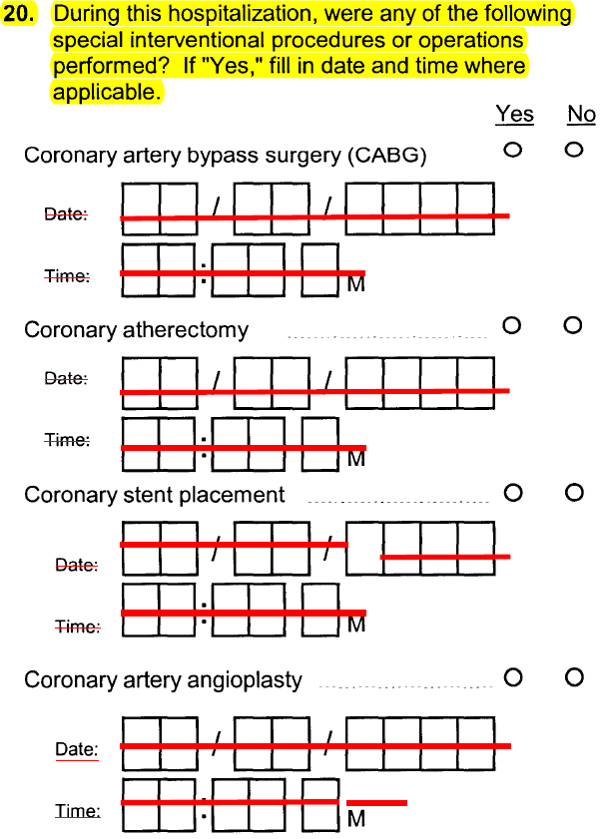
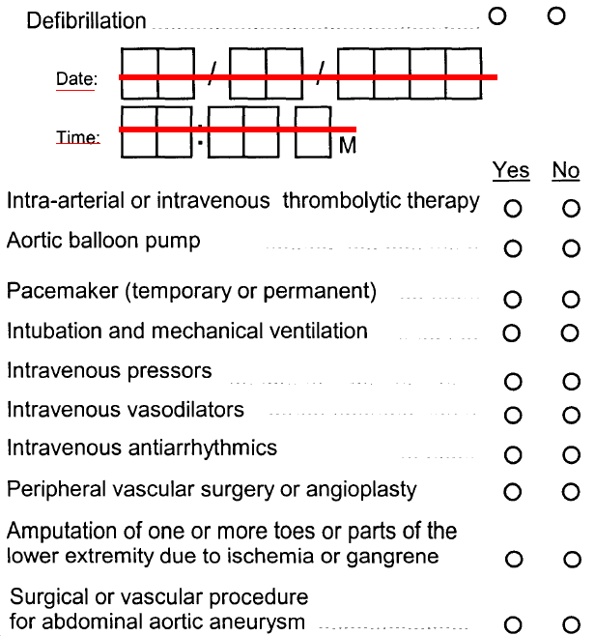
Cardiac/PVD

Slide 32
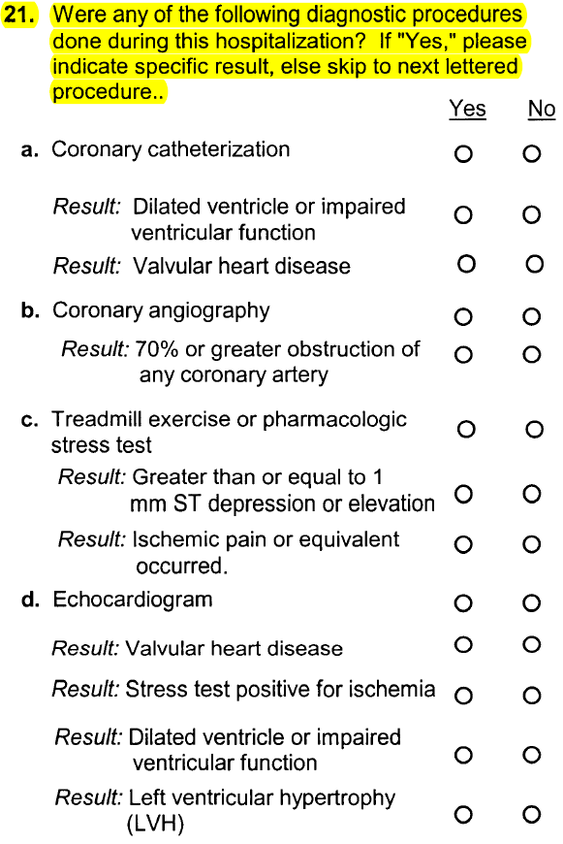
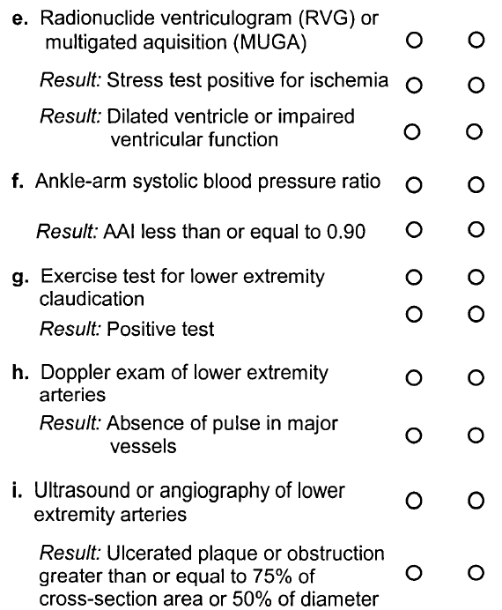
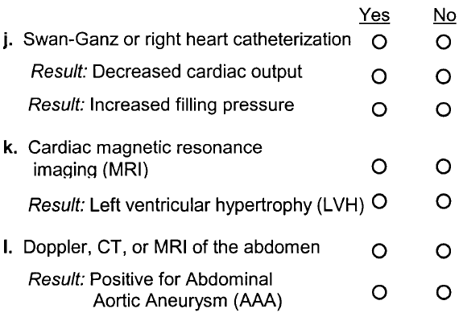

Slide 33
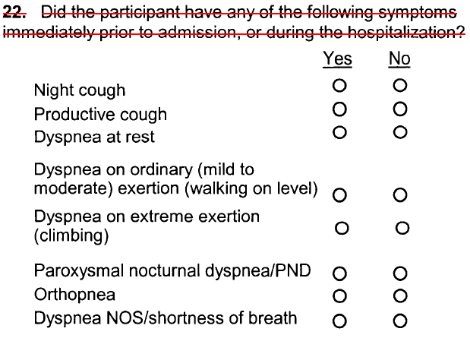
Cardiac/PVD

Slide 34
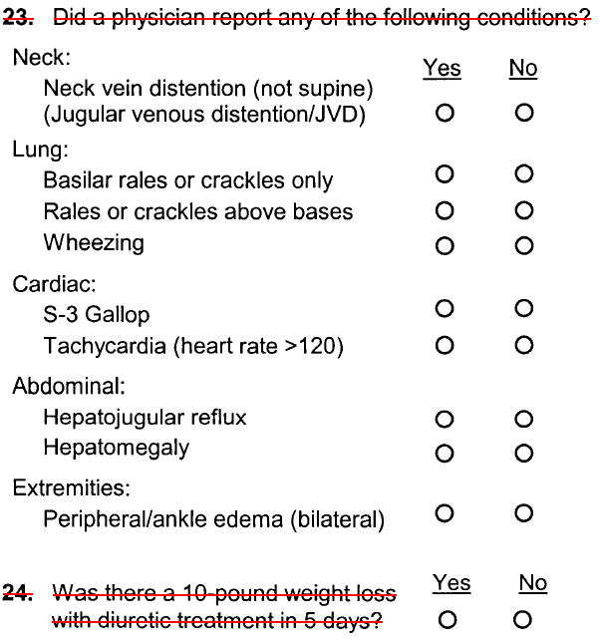
Cardiac/PVD

Slide 35
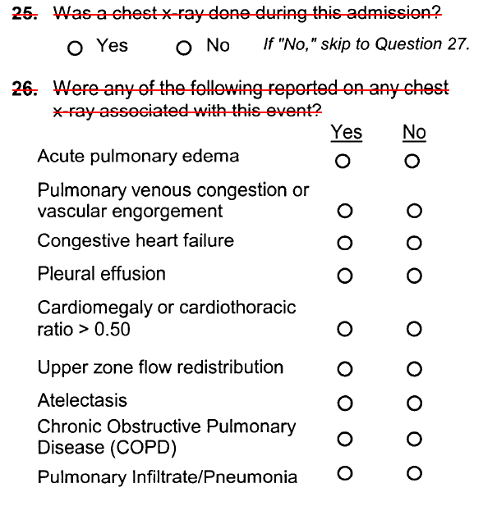
Cardiac/PVD

Slide 36
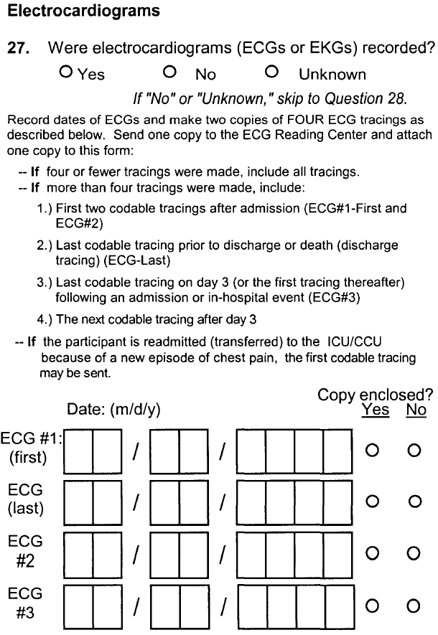
Cardiac/PVD

Slide 37
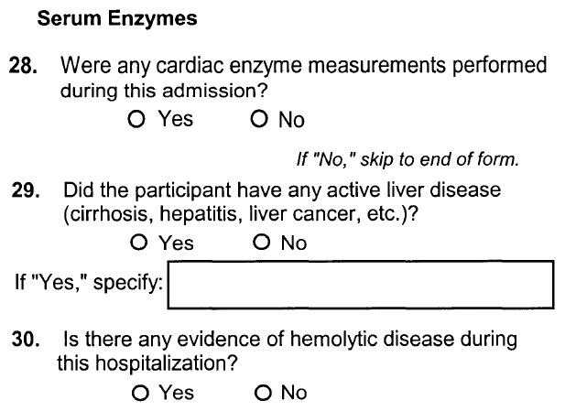
Cardiac/PVD

Slide 38
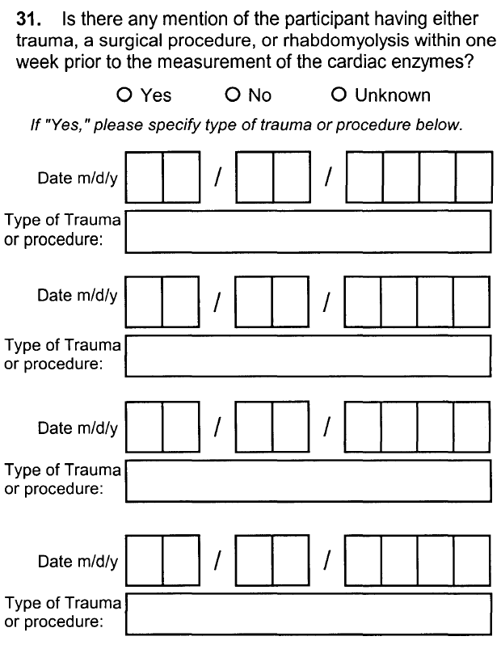
Cardiac/PVD

Slide 39
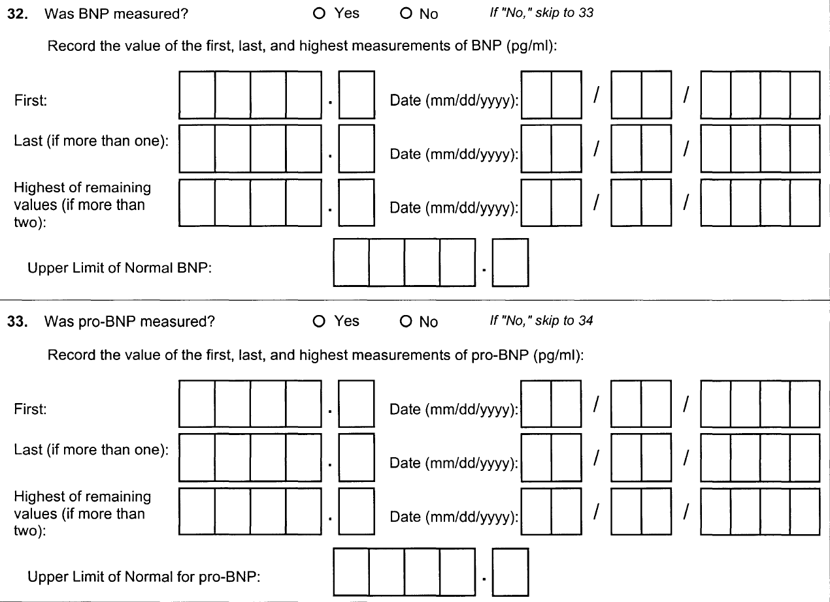
Cardiac/PVD

Slide 40
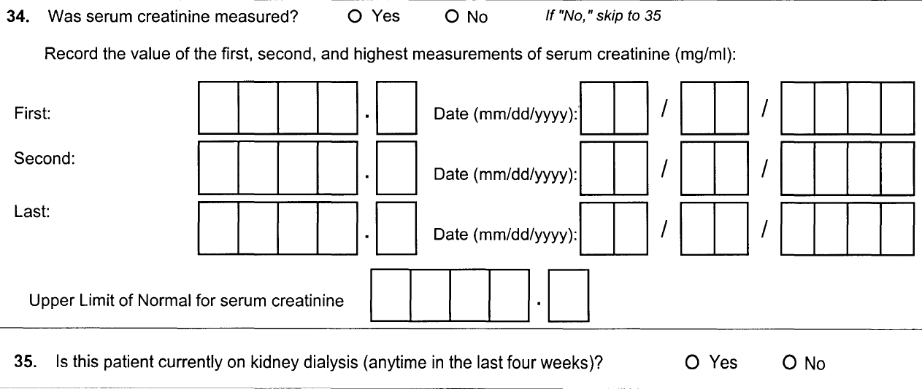
Cardiac/PVD

Slide 41
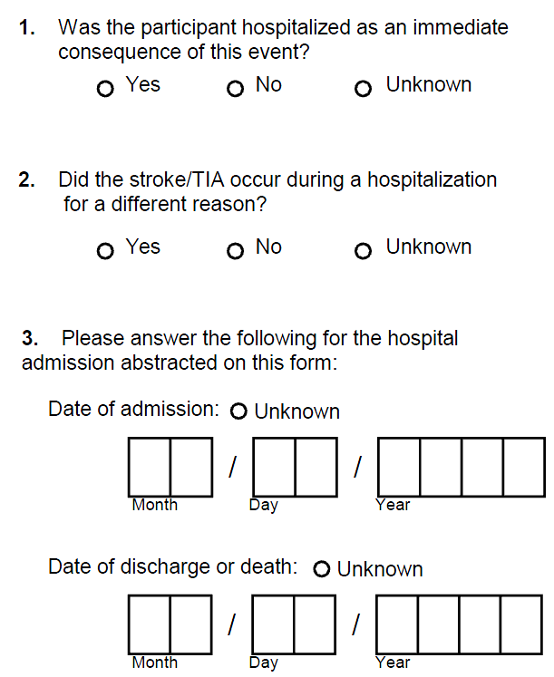
Stroke/TIA

Slide 42
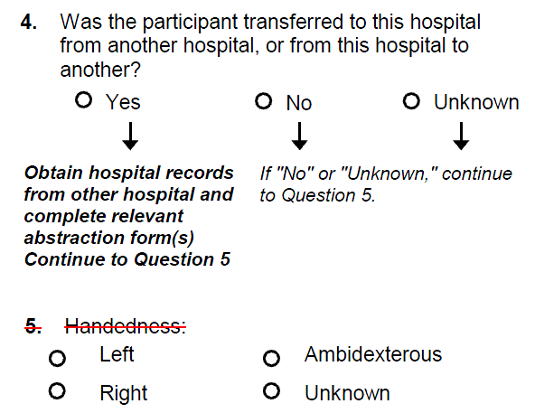
Stroke/TIA

Slide 43
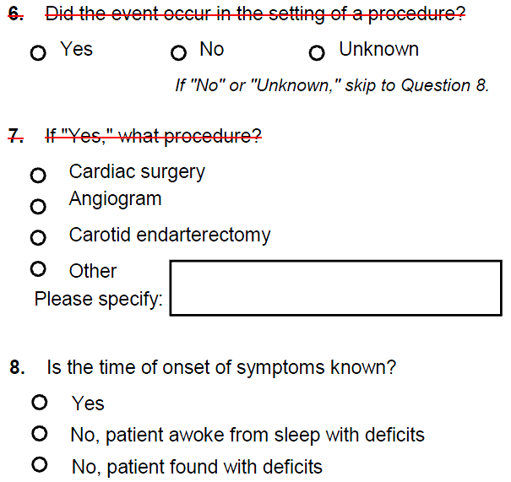
Stroke/TIA

Slide 44

Stroke/TIA

Slide 45

Stroke/TIA

Slide 46

Stroke/TIA

Slide 47

Stroke/TIA

Slide 48


Stroke/TIA

Slide 49

Stroke/TIA

Slide 50

Stroke/TIA

Slide 51

Stroke/TIA

Slide 52

Stroke/TIA

Slide 53

Stroke/TIA

Slide 54

Stroke/TIA

Slide 55

Stroke/TIA

Slide 56

Stroke/TIA

Slide 57

Stroke/TIA

Slide 58

Stroke/TIA

Slide 59

Stroke/TIA

Slide 60

Stroke/TIA

Slide 61


Stroke/TIA

Slide 62

Stroke/TIA

Slide 63

Stroke/TIA

