Slide 1
MESA P&P REPORT
SC Meeting 2/25/15
Steve Shea
Moyses Szklo
Robyn McClelland

Slide 5
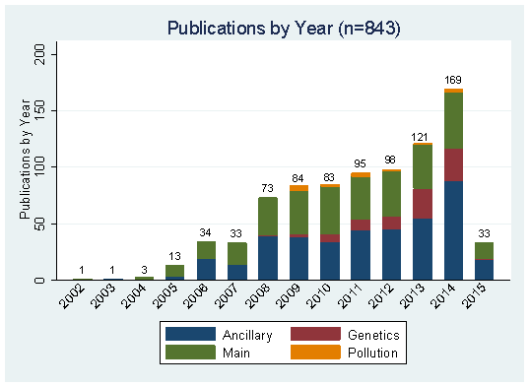
Slide courtesy of Robyn McClelland

Slide 6
Approved Paper Proposals (n=1348)
Cumulative by Year
Data Cumulative Through 1/26/2015 Slide courtesy of Robyn McClelland

Slide 7
Publications (n=735)
Cumulative by Year
Data Cumulative Through 1/26/2015 Slide courtesy of Robyn McClelland
Notes:
This does not include Genetics or Air Publications (as they are not reviewed by our committee).

Slide 8
Abstracts (n=1047)
Cumulative by Year
Data Cumulative Through 1/26/2015 Slide courtesy of Robyn McClelland

Slide 9
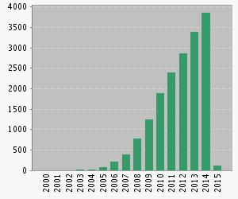
Citations by Year (with Multi-Ethnic Study of Atherosclerosis in “topic”—Web of Science search)
Citations in Each Year
Sum of times cited: 17424 (up from 15307 last Fall)
Without self citation: 14810 (up from 12967 last Fall)
Average citations per article: 16.25 (up from 15.25 last Fall)
h-index: 64 (up from 58 last Fall)
Slide courtesy of Robyn McClelland

Slide 10
BS ratio = Abstracts (N=1047)/Publications (N= 735) = 1.42
BS/H ratio = 1.42/64 = 0.022

