Slide 1
Changes in Metabolic Risk Factors and Their Associations with Cognitive Performance
Center for Healthy Aging and Alzheimer’s Prevention
Timothy Hughes, PhD April 20, 2017
Assistant Professor Internal Medicine and Epidemiology

Slide 2
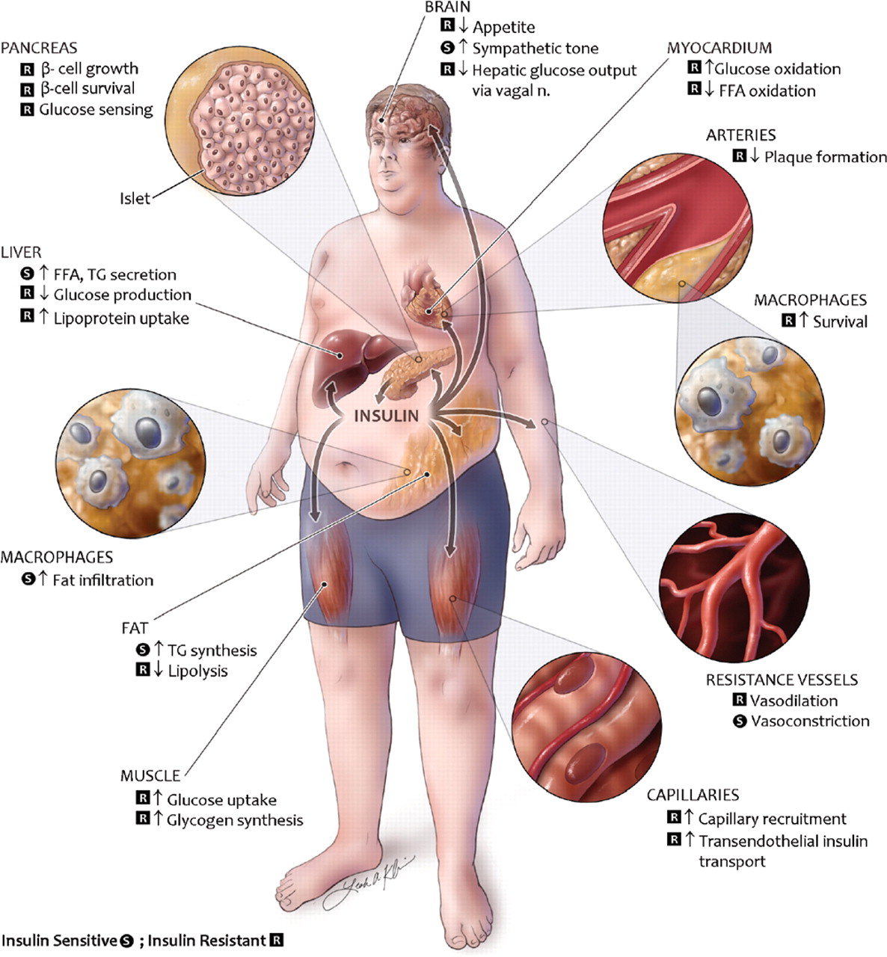
Rask-Madsen and Kahn. ATVB 2012

Slide 3
Metabolic Contributions to Dementia
Metabolic and vascular risk factors are important modifiable risk factors for dementia
Often comorbid conditions
Overlap in metabolic syndrome
Accelerate trajectory of cognitive decline
Increase risk diagnosis of dementia
Hypothesis – Longer burden of metabolic dysregulation is associated with poorer cognitive performance.

Slide 4
Methods
Cardiometabolic phenotyping was conducted in MESA between Exams 1 and 5.
Metabolic syndrome, BP, waist circumference and lipids at Exams 1 – 5
Glucose and Insulin at Exam 1 and 5
Hemoglobin A1c at Exam 2
Cognitive function evaluated during Exam 5 (n=4592)
Cog
2000 2002 2004 2006 2008 2010 2012
Exam 1 Exam 2 Exam 3 Exam4 Exam 5

Slide 5
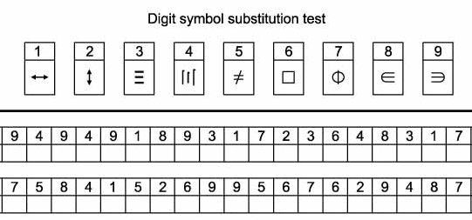
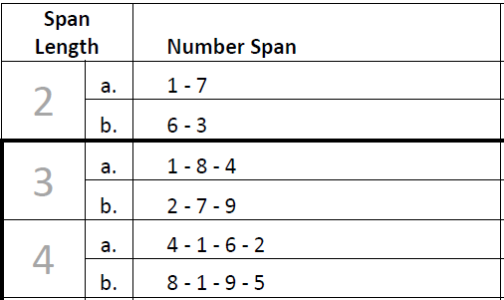
Methods: Exam 5 Cognitive Data
Cognitive Abilities Screening Instrument (CASI) -
‘global’ quantitative assessment on attention, concentration, orientation, memory, etc.⁴
Digit Symbol Coding –
a measure of processing speed and
psychomotor function^{5*}
Digit Span – Two parts:
Attention/concentration (DS-Forwards)
Working memory (DS-B)^{5*}
4. Teng et al. Int Psycho. 2014
5. Wechsler. 1996*
*Normative data available Wechsler Adult Intelligence Scale-III (WAIS-III)

Slide 6
Methods: Exam 5 Cognitive Data
The CASI, DSC, and DS tests completed 4592 participants across the six centers, (96.8% completion rate at Exam 5)
Excluded 199 (4%) CASI :
99 with CASI scores deemed invalid by the test administrator
26 participants with technically invalid (CASI <5)
74 individuals with an ICD-9 or dementia meds
Hughes et al. Alz & Demen: DADM, 2017

Slide 7
Methods: Exam 5 Cognitive Data
Cognitive impairment based on tests?
‘Low cognitive function’ defined for each racial/ethnic group (bottom 10%)
4. Teng et al. Int Psycho. 2014
5. Wechsler. 1996*
Hughes et al. Alz & Demen: DADM, 2017

Slide 8
Methods: Exam 5 Cognitive Data
Changes in risk factors assessed:
Absolute differences (Exam 5 – Exam 1)
Mean across exams (Exam 1…Exam 5)
Models for GLM and logistics outcomes
Model 1 – age, gender, race, education and APOE-4
Interaction models – Model 1 plus interactions: race, baseline diabetes and baseline hypertension
Employed canonical correlations and machine learning
Hughes et al. Alz & Demen: DADM, 2017

Slide 9
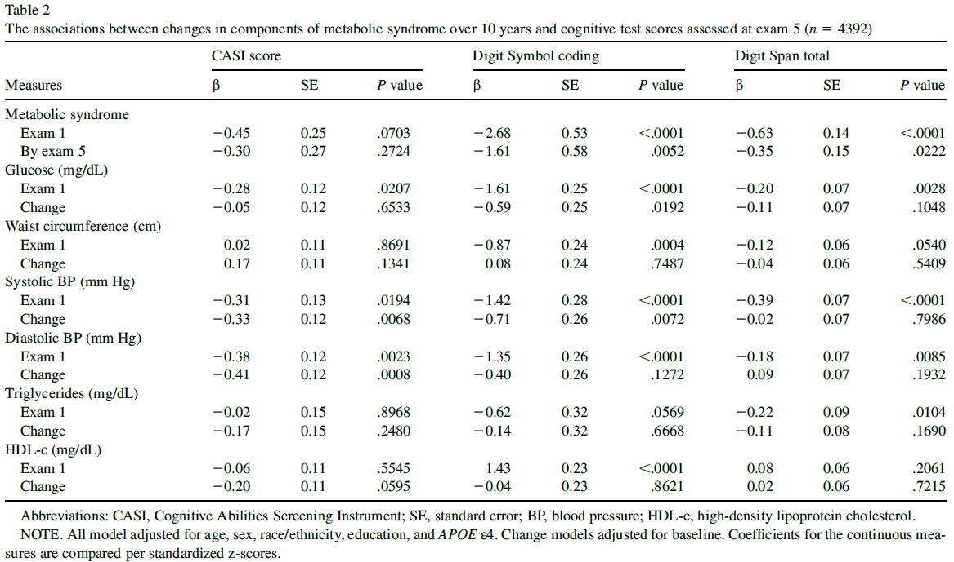
Results – Across All Cog Tests
Hughes et al. Alz & Demen: DADM, 2017

Slide 10
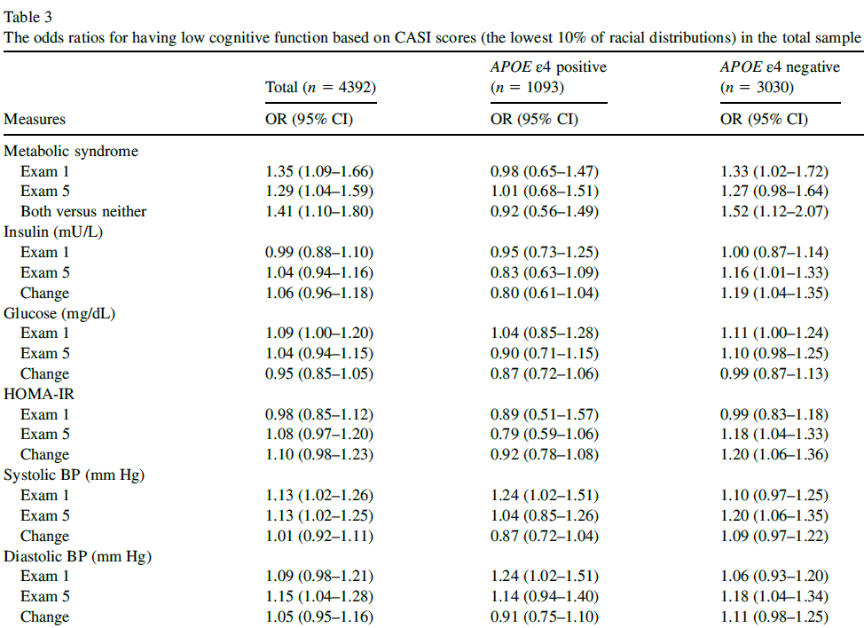
Results – Across All Cog Tests

Slide 11
Summary / Conclusion
Our findings suggest that metabolic syndrome and specifically the elements of higher fasting glucose along with increasing blood pressure over time were significant predictors of poorer cognitive performance 10 years later.
These associations appeared to be stronger among those without APOE ε4.

Slide 12
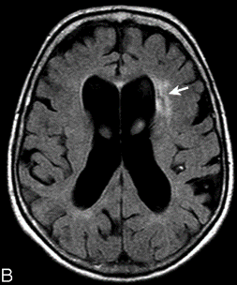
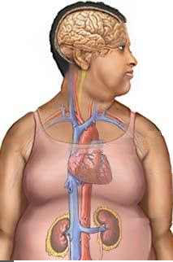
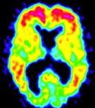
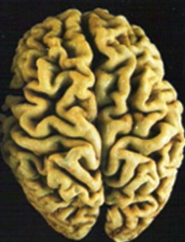
Next Steps Mechanistic Links Between Metabolism and Dementia
Vascular
Dementia
Small Vessel Disease
Amyloid Pathology
Mixed
Dementia
Neuro-
degeneration
Alzheimer’s
Disease
APOE ε4
Notes:
Next, we wanted to look at the individual and combined contribution of AB and WMH. In this age group most participants have AB deposition and some WMH.
So we used a median split to define high WMH and combined it with AB-status

Slide 13
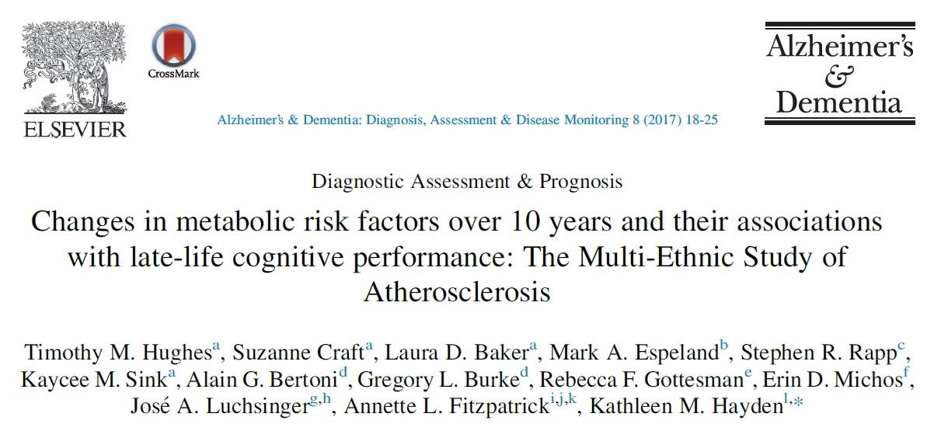
Hughes et al. Alz & Demen: DADM, 2017

