Slide 1
Memory and Dementia Initiatives
MESA Cognitive Working Group
Annette Fitzpatrick, PhD
David Jacobs, PhD
Timothy Hughes, PhD

Slide 2
Why CVD and Alzheimer’s Disease?
Alzheimer’s disease (AD) is more than plaques and tangles
Vascular disease is recognized as a modifiable risk factor for AD and related dementias (Expert Panels: ADRD 2013¹ and AHA/ASA 2011²)
Intervene on:
What? Mechanisms remain unclear
Hypertension
Diabetes
Who? African Americans and Hispanics are 2X as likely to get AD, possibly the amyloid plaque burden³
Key modifiable risk factors
Montine et al. Neurology 2014
Gorelick et al. Stroke 2011
Gottesman et al. Neurology 2015

Slide 3
Thoughts from the MESA Cognitive Working Group
MESA can play a key role in identifying CVD and metabolic targets for AD and related dementias
Deep phenotyping (subclinical CV biomarkers, etc)
Over 15 years of follow-up
Diverse geographic representation racial/ethnic groups (AA, Hispanic and Chinese under-represented)
OMICs: GWAS data, TOPMed pilot and COMBI-BIO

Slide 4
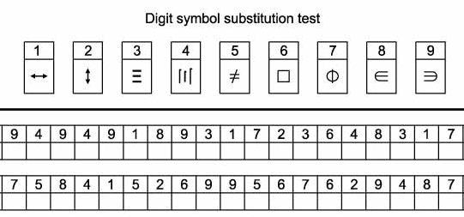
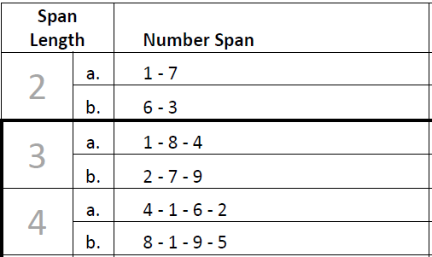
Existing Cognitive Data (up to Exam 5)
The Cognitive Abilities Screening Instrument (CASI) – ‘global’ quantitative assessment on attention, concentration, orientation, memory, etc.⁴
Digit Symbol Coding – a measure of processing speed and psychomotor function. ^{5*}
Digit Span – Two parts:
Attention/concentration (DS-Forwards)
Working memory (DS-B). normative data)^{5*}
4. Teng et al. Int Psycho. 2014
5. Wechsler. 1996*
*Normative data available Wechsler Adult Intelligence Scale-III (WAIS-III)

Slide 5
Progress: Published Manuscripts
Fitzpatrick AL, Rapp SR, Luchsinger J, Hill-Briggs F, Alonso A, Gottesman R, Lee H, Carnethon M, Liu K, Williams K, Sharrett AR, Frazier-Wood A, Lyketsos C, Seeman T. Sociodemographic Correlates of Cognition in the Multi-Ethnic Study of Atherosclerosis (MESA). Am J Geriatr Psychiatry 2015; 23:684-697.
Fujiyoshi A, Jacobs DR Jr, Alonso A, Luchsinger JA, Rapp SR, Duprez DA. Validity of death certificate and hospital discharge ICD codes for dementia diagnosis: the Multi Ethnic Study of Atherosclerosis. Alzheimer Dis Assoc Disord.
Fujiyoshi A, Jacobs DR, Jr., Fitzpatrick AL, Alonso A, Duprez D, Sharrett AR, Seeman T, Blaha M, Luchsinger JA, Rapp SR. Coronary artery calcium and risk of dementia in the Multi-Ethnic Study of Atherosclerosis. Circulation: Cardiovascular Imaging (in press).
Hughes TM, Craft C, Baker L, Espeland MA, Rapp SR, Sink KM, Bertoni AG, Burke GL, Gottesman RF, Michos ED, Luchsinger JA, Fitzpatrick AL, Hayden KM. Changes in Metabolic Risk Factors over 10 years and Their Associations with Late-Life Cognitive Performance: The Multi-Ethnic Study of Atherosclerosis (MESA). Alzheimer's & Dementia: Diagnosis, Assessment & Disease Monitoring (DADM) 2017; Vol 8: pg18-25.

Slide 6
Progress: Submitted Manuscripts
Charles LE, Fekedulegn D, Burchfiel CM, Fujishiro K, Zeki Al Hazzouri A, Fitzpatrick AL, Rapp AL. Work Hours and Cognitive Function: The Multi-Ethnic Study of Atherosclerosis (MESA). Submitted to Annals of Epidemiology.
Johnson DA, Lane J, Wang R, Reid M, Djonlagic I, Fitzpatrick AL, Rapp SR, Charles LE, Saxena R, Redline S. Greater Cognitive Deficits with Sleep-Disordered Breathing among Individuals with Genetic Susceptibility to Alzheimer’s Disease: the Multi-Ethnic Study of Atherosclerosis (MESA). Submitted to Annals of ATS.
Zeki Al Hazzouri A, Yaffe K, Vittinghoff E, Elfassy T, Odden MC , Caunca M, Auer R, Mayeda ER, Fitzpatrick AL, Luchsinger JA, Rapp SR, Gottesman RF, Wright CB. Racial/ethnic differences in the association of systolic blood pressure across midlife and late life on cognitive function: The Multi-Ethnic Study of Atherosclerosis. Submitted to JAMA.
Ong KL, Allison M, Fitzpatrick AL, Hayden KM, Hughes TM, Luchsinger JA, Maniam J, McClelland R, Morris MJ, Rapp SR, Rye K, Sandfort V. Relationship of lipids and lipid-lowering medications with cognitive function: The Multi-Ethnic Study of Atherosclerosis. Submitted to Am J Epidemiology.
Jingzhong Ding et al. Aging-related mitochondrial dysfunction and cognitive function: a transcriptomic analysis of monocytes in a community-based population. Submitted to JAMA Neurology.

Slide 7
Progress: Presentations
Hughes TM, Espeland M, Sink KM, Baker L, Craft S, Rapp SR, Fitzpatrick AL, Sharrett AR, Luchsinger JA, Klein R, Klein B, Cotch MF, Wong TY. Changes in Retinal Signs and Their Associations with Cognitive Performance: The Multi-Ethnic Study of Atherosclerosis (MESA). Oral presentation AAIC July 2016.
Fujiyoshi A, Jacobs DR Jr, Fitzpatrick AL, Alonso A, Duprez DA, Sharrett AR, Seeman T, Blaha MJ, Luchsinger JA, Rapp SR. Coronary Artery Calcium and Dementia Risk: the MESA Study. AHA March 2016.
Johnson DA, Wang R, Reid M, Djonlagic I, Fitzpatrick AL, Rapp SR, Charles LE, Redline S. Association between Sleep-Disordered Breathing and Cognitive Function; Effect Modification by Apolipoprotein E-4 In the Multi-Ethnic Study of Atherosclerosis. Poster presentation to ATS April 2016.
Djonlagic I, Redline S, Mariani S, Johnson D, Purcell S, Weng J. Associations between Sleep Efficiency and Cognitive Function in the Multi-Ethnic Study of Atherosclerosis (MESA). Oral and poster presentation at SLEEP June 2017.
Zeki Al Hazzouri A, Yaffe K, Vittinghoff E, Elfassy T, Odden MC, Caunca M, Auer R, Mayeda ER, Fitzpatrick AL, Luchsinger JA, SR Rapp, Gottesman RF, Wright CB. Racial/ethnic differences in the association of systolic blood pressure across midlife and late life on cognitive function: The Multi-Ethnic Study of Atherosclerosis. Oral presentation to AAIC July 2017.
Jingzhong Ding et al. Aging-related mitochondrial dysfunction and cognitive function: a transcriptomic analysis of monocytes in a community-based population. Poster presentation to AAIC July 2017.

Slide 8
Additional Proposals: Topics
First Author | Topic
E August | Subclinical Vascular
LM Besser | Neighborhood Characteristics
J Cao | Plasma Phospholipid Fatty Acids
I Djonlagic | Sleep EEG Spectral Power
K Hayden | DASH Diet
Y Hou | Air Pollution
TM Hughes | Insulin Resistance and Arterial Stiffness
X Li | Genome-Wide Association Study (GWAS)
L Munoz | Stress
R Remigio-Baker | Optimal Weight
A Zeki Al Hazzouri | Cardiovascular exposures and Depression

Slide 9
Memory and Dementia Ancillary Studies
Using Existing Data

Slide 10
Ancillary Studies: Using Exam 5 data
“Whole Genome Sequence Analysis of Dementia” (PI: Richard Mayeux)
To utilize Exam 5 cognitive data to create a cognitive phenotype (n=4,651)
Combine whole genome sequencing data currently being generated by NHLBI, existing GWAS data from MESA SHARe, and selected phenotype data
“MESA WAGE” (PI: Richard Mayeux)
Select cognitively normal individuals as controls for the AD cases in the Watson and Curoverse projects.
Identify novel candidate genes/regions from genomics

Slide 11
Exam 6 and Beyond
Memory and Dementia Ancillary Studies

Slide 12
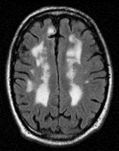
Atrial Fibrillation (PI: Susan Heckbert) (n=1500, All sites)
Goal: To study subclinical atrial fibrillation (AF) and AF burden in relation to brain and cardiac structure and function and cardiovascular events
Repeat CASI, Digit Span and Digit Symbol at Exam 6
ZioPatch for AF monitoring (up to 28 days)
Brain MRI ~18 months after Exam 6
Funded: R01 HL127659 (Heckbert)
ZioPatch
MRI
2016 2017 2018 2019 2020 2021

Slide 13
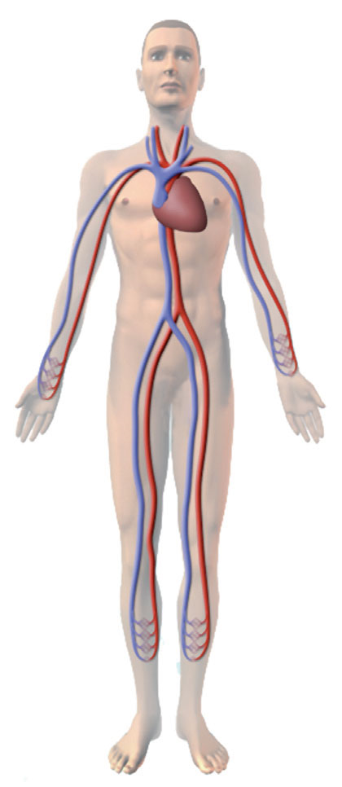
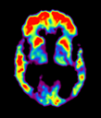
MESA Memory (PI: Timothy Hughes) (n=540, WFU only)
Goal - Determine how differential vascular risk factor profile (micro- vs. macro-) for each racial group might explain excess pathology and AD risk.
Repeat CASI, DSC and DS
Detailed cognitive battery (UDS v3, used by all NIH-funded AD Centers)
Physical exam by clinician
Cognitive adjudication (normal, MCI, dementia subtypes)
Brain MRI (non-contrast, structural and functional, detailed vascular reads)
β-amyloid PET imaging
LP substudy (n=200, 40%)
Funded: R01 AG054069 (Hughes) P30 AG049638 (Craft)
Exams 1-6
Cog
MRI
PET
Cog
MRI
2016 2017 2018 2019 2020 2021

Slide 14
MESA Memory Visit Schedule
Starting Today
1.5 years from now
2-3 years from now
Over the next 2 months
MESA Exam 6
Brain MRI (60 min)
Telephone Call (30 min)
Cognitive Testing (90 min)
Cognitive Testing (90 min)
Clinical Visit (45 min)
Brain MRI (60 min)
Amyloid PET (90 min)
Clinical Visit (45 min)
…over two months

Slide 15
MESA Memory Visit Schedule
after AFIB Visits wearing the Zio Patch®
Starting Today
2 years from now
3 years from now
1 year from now
MESA Exam 6
Cognitive Testing (90 min)
Telephone Call (30 min)
Cognitive Testing (90 min)
Cognitive Testing (20 min)
Brain MRI (60 min)
Brain MRI (60 min)
Clinical Visit (45 min)
Clinical Visit (45 min)
Amyloid PET (90 min)
…over two months
…over two months

Slide 16
MESA Epigenetics of AD (PI: Jingzhong Ding) (n=1050, WFU and JHU)
Goal - Leverage epigenetic and transcriptomic data from monocytes showing oxidative phosphorylation (OXPHOS) pathway is associated with cognition
Preliminary data show strong associations between OXPHOS pathway and cognitive performance at Exam 5
Add cognitive battery (to JHU) combine WFU
Cognitive Adjudication (by WF AD Center)
Funding: R01 AGXXXXXX (Ding) pending – 05/2021
Cog
2016 2017 2018 2019 2020 2021

Slide 17
Antecedent
Cardiometabolic Dysfunction
Neuroimaging Abnormalities
Age-Related Dementia
Cerebrovascular dysfunction
Vascular Cognitive Impairment
Subclinical
Vascular Disease
Amyloid Pathology
Metabolic Dysregulation
Neuro-degeneration
Alzheimer’s
Disease
OXPHOS
MESA Study
MESA Memory Study

Slide 18
Why So Much Detail?
Neuro-
degeneration
cSVD
Amyloid
SNAP
Dementia
AD
VCI
Resilience
SNAP = non-Alzheimer’s pathophysiology, AD = pure Alzheimer’s disease, VCI = vascular cognitive impairment, cSVD = cerebral small vessel disease
Hughes, unpublished

Slide 19
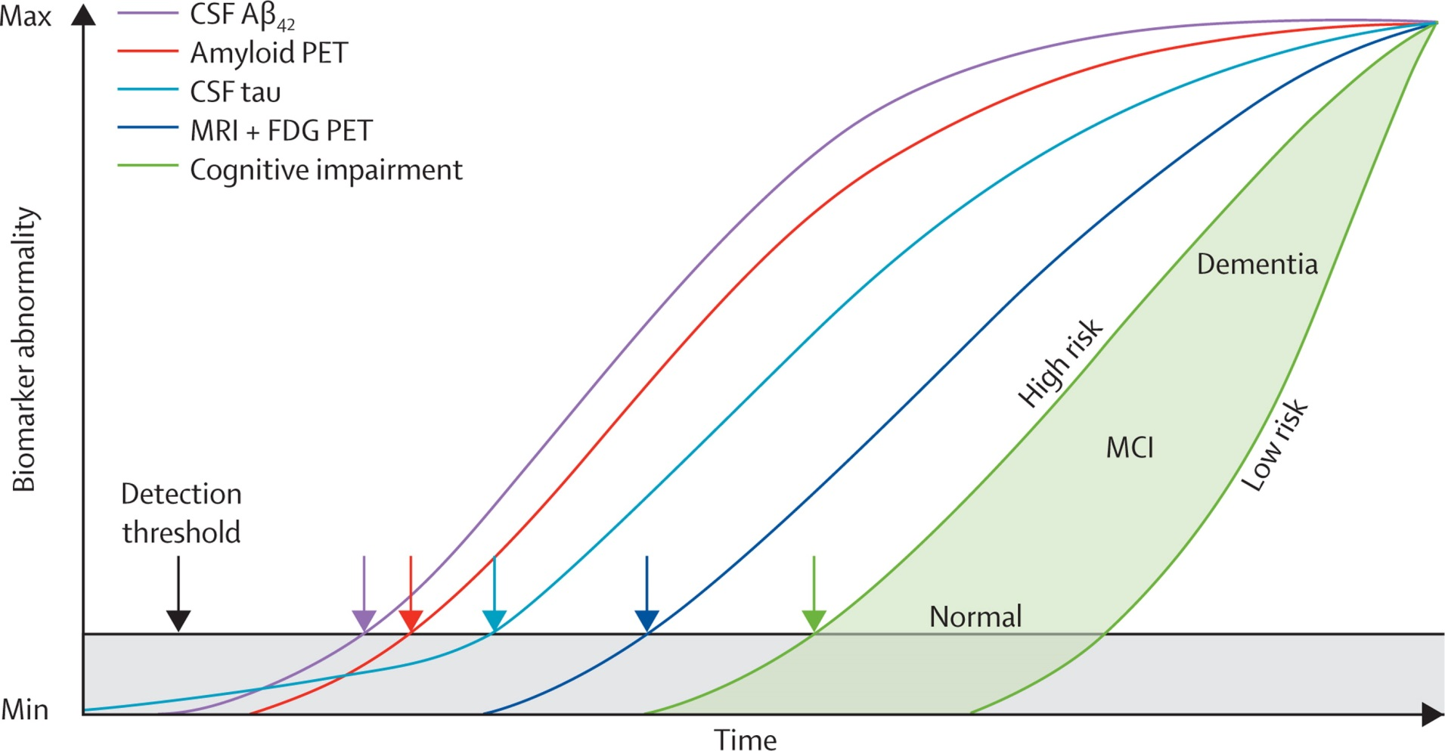
Current Model of AD
Jack et al. Lancet 2013

Slide 20
Antecedent
Cardiometabolic Dysfunction
Neuroimaging Abnormalities
Age-Related Dementia
Cerebrovascular dysfunction
Vascular Cognitive Impairment
Subclinical
Vascular Disease
Amyloid Pathology
Metabolic Dysregulation
Neuro-degeneration
Alzheimer’s
Disease
OXPHOS
MESA Study
MESA Memory Study
Additional leverage points:
GWAS, TOPMed, metabolomics
Sleep
CVD, diet, environment, etc…
…over 100 ancillary studies

Slide 21
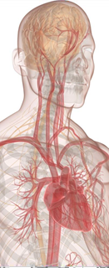
Next Steps
Memory and Dementia Ancillary Studies

Slide 22
Guidance From the Cognitive Working Group (Jacobs, Fujiyoshi, Hughes, Fitzpatrick, Rapp, et al.)
Improve ascertainment of dementia diagnoses
Guidance on existing cognitive outcomes
Capitalize on NIH funding earmarked for AD
Formally contribute to AD research
Contribute to defining vascular contributions to AD
Identify modifiable targets for AD prevention
Leverage (unparalleled) deep genotyping and phenotyping in MESA
MESA missing AD outcomes

Slide 23
Guidance From the Cognitive Working Group (Jacobs, Fujiyoshi, Hughes, Fitzpatrick, Rapp, et al.)
Better ascertainment of dementia diagnoses
Using ICD codes, plus
Death certificates, plus
Medication (acetylcholinesterase and NMDA receptor inhibitors)
Approach improved detection of dementia cases up to exam
306 people were found to have any of these codes
Includes detailed medical record review
Evidence for any dementia in 224
Non-dementia condition in 18
Information was insufficient in 64
31 did not have a medical record at the CoC
33 did not contain note of dementia
Fujiyoshi et al. Alzheimer’s disease and associated disorders. 2016.

Slide 24
We propose to define “Possible ICD-based All Cause Dementia” as: a) meeting any 2 or more of criteria A-G or b) meeting only a single criterion A-E.
The date of occurrence is the date of the hospitalization or death certificate of first occurrence of meeting any of the A-G ICD-based criteria.
ICD9 (used in hospital records) | Rubric
290.4 | Vascular Dementias
290 except 290.4 | Several other dementias
294 | Persistent mental disorders due to conditions classified elsewhere
331.0 | Alzheimer's disease
331.1 | Frontotemporal dementia
331.2 | Senile degeneration of brain
331.82 | Dementia with Lewy body
331.83 | Mild cognitive impairment
331.9 | Cerebral degeneration unspecified
438.0 | Cognitive deficits, late effects of cerebrovascular disease
780.93 | Memory loss
F00 | Dementia in Alzheimer
F01 | Vascular Dementia
F03 | Unspecified dementia
F04 | Organic amnesic syndrome not induced alcohol and other psychoactive substances
G30 | Alzheimer's disease
G31. except for G31.2 | Other degenerative disease of nervous system, not elsewhere classified
I69.91 | Cognitive deficits following unspecified cerebrovascular disease
R41 | Other symptoms and signs involving cognitive functions and awareness
Criterion definition
 | ICD9 code | ICD10 code
A. Vascular dementia | 290.4 | F01
B. Alzheimer's dementia | 331.0 | F00, G30
C. Other dementias and chronic organic psychotic conditions | 290, 294 (not 290.4, 294.8, 294.9) | F03
D. Other persistent mental disorders | 294.8 or 294.9 | F04
E. Other specified dementias and non-specific conditions | 331.1, 331.2, 331.8, 331.9 | G31 not G31.2
F. Cognitive deficits: late effects of cerebrovascular disease | 438.0 | I69.91
G. General signs and symptoms: memory loss | 780.93 | R41
Fujiyoshi et al. Alzheimer’s disease and associated disorders. 2016.

Slide 25
Guidance From the Cognitive Working Group (Jacobs, Fujiyoshi, Hughes, Fitzpatrick, Rapp, et al.)
Strengths
Yields dementia variable with high positive predictive value
Limitations
Clinical data (ICD, claims, etc) underestimate the:
Incidence and Prevalence
Date of diagnosis
Subtypes not adjudicated
Death certificates
Include diagnoses directly responsible
Medications often not prescribed by dementia specialist

Slide 26
Guidance From the Cognitive Working Group (Jacobs, Fujiyoshi, Hughes, Fitzpatrick, Rapp, et al.)
Additional Guidance on using Exam 5 cognitive data (CAS, DSC, DS)
Reference normative data and its limitations for racial/ethnic subgroups
Option to cross-reference with MESA Memory and Epigenetics of AD full cognitive batteries
Next Steps: consider using CMS outpatient codes

Slide 27
10 NIH AD PARs
Health Disparities
PAR-15-349 – Health Disparities and Alzheimer’s Disease (R01)
PAR-15-350 – Emerging Directions for Addressing Health Disparities in Alzheimer’s Disease (R03)
Caregiving
PAR-15-348 – Research on Informal and Formal Caregiving for Alzheimer's Disease (R01)
PAR-15-351 – Research on Informal and Formal Caregiving for Alzheimer's Disease (R21).
Epidemiology
PAR-15-356 - Major Opportunities for Research in Epidemiology of Alzheimer's Disease and Cognitive Resilience (R01).
Diagnosis and Prediction
PAR-15-359 – Novel Approaches to Diagnosing Alzheimer's Disease & Predicting Progression (R01)
Molecular and Cellular Mechanisms
PAR-15-358 - Capturing Complexity in the Molecular and Cellular Mechanisms Involved in the Etiology of AD (R01)
Brain Aging
PAR-15-357 – Understanding Alzheimer’s Disease in the Context of the Aging Brain (R01)
Clinical Trials
PAR-16-365 – Pilot Clinical Trials for the Spectrum of Alzheimer’s Disease and Age-related Cognitive Decline (R01)
PAR-16-364 – Phase III Clinical Trials for the Spectrum of Alzheimer’s Disease and Age-related Cognitive Decline (R01).
https://www.nia.nih.gov/research/blog/2015/10/take-advantage-new-opportunities-alzheimers-research

Slide 28
MultisiteAD proposal (Hughes, Hayden, Luchsinger)
Built as extension of MESA Memory and AFIB
Pilot feasibility - Memory and Epigenetics studies
350+ cognitive tests (98% at WFU and JHU)
90% MRI consent rate (WFU)
94% PET consent rate (WFU)
Rationale – Why now?
AD funding a priority for NIH and US congress
Mean age 74±6 [range 65 to 94]
Initial estimates is that 18% of WFU participants are cognitively impaired (MCI to AD).
Exam 7
Exam 8
Cog
MRI
PET
Cog
MRI
2016 2017 2018 2019 2020 2021 2022 2023

Slide 29
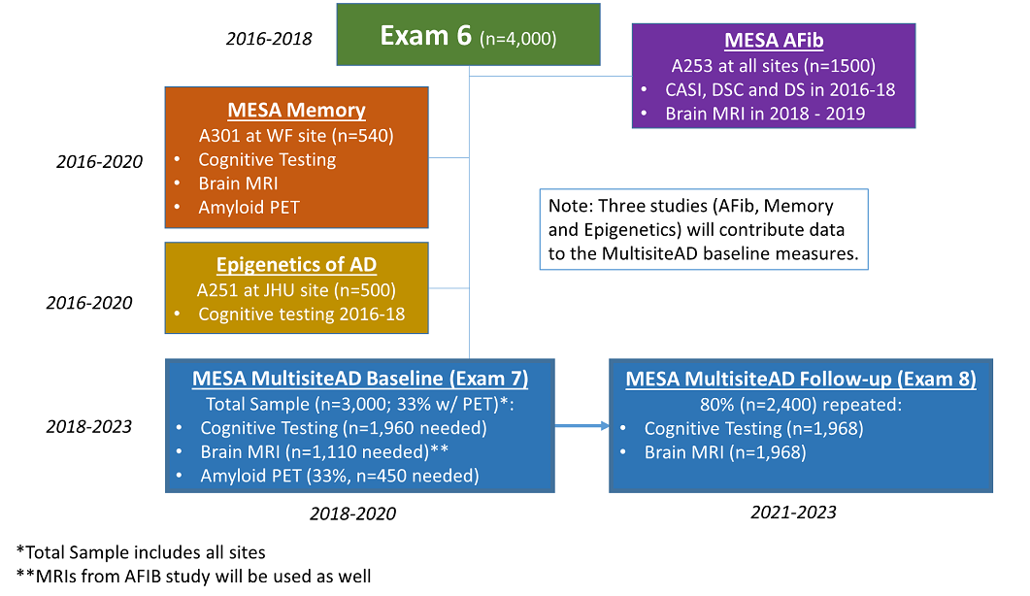
Leveraging Data

Slide 30
AD Study
MESA CC
Johns
Hopkins
Wake Forest
Minnesota
Columbia
North-western
UCLA
AD Study
AD Study
(n=532)
(n=677)
(n=646)
AD Study
AD Study
(n=753)
(n=663)
(n=696)
AD Study
MESA Multisite AD Proposal
MESA Sites
Multisite AD Study

Slide 31
MultisiteAD proposal (Hughes, Hayden, Luchsinger)
Facilitate building robust collaborations between MESA field centers and local AD Centers/Programs.
Such collaborations are new recommendations for NIH-funded AD Centers.
Large budget grant to NIA fund Exam 7 and Exam 8
Exam 7
Exam 8
Cog
MRI
PET
Cog
MRI
2016 2017 2018 2019 2020 2021 2022 2023

Slide 32
Summary & discussion
Memory and Dementia Ancillary Studies

Slide 33
Summary - I
OSMB recommends increasing aging focus of MESA
Physical (function / frailty)
Cognitive (function / frailty)
MESA is a unique resource for the epidemiology of AD. A field that is missing:
Targets for prevention
Subclinical CVD
Ethnic diversity
‘omics’ approaches of TOPMed

Slide 34
Summary - II
The overarching goals of our work:
Drill down on how vascular risk factors are associated with AD and related dementias
Determine if differences in vascular/metabolic risk factors profiles predict cognitive impairment and explain the excess risk among non-white racial/ethnic groups.
Find novel targets for the prevention of AD and related dementias
Consider the benefit of careful cognitive follow-up of MESA participants
AD is too late to intervene
Family planning is essential for new diagnoses
Collaborations with AD Centers can provide this support

Slide 35
Acknowledgments
MESA Program Officers for their Support of Cognitive Data:
Diane Bild
Jeannie Olsen
Lorraine Silsbee
MESA Cognitive Working Group Members
MESA PIs who have developed Ancillary Studies
MESA Field Center PIs, Study Coordinators and Staff for rigorously collecting cognitive data
MESA Investigators who are using the data to write manuscripts
MESA Participants

