Slide 1
MESA Publications Update
Moyses Szklo (Chair) Kiang Liu
Norrina B Allen Robyn McClelland
Matthew Allison Joseph F. Polak
Alain G. Bertoni Steven J. Shea
Michael Blaha Benjamin M Smith
Lyndia Brumback Susan Heckbert
Ian de Boer João A. Lima

Slide 2
Publications (n=1263) Cumulative by Year
Data Cumulative Through 9/6/2017

Slide 3
Abstracts (n=1360) Cumulative by Year
Data Cumulative Through 9/6/2017
Notes:
Includes Air and Genetics.

Slide 4
Upcoming Presentations
24 MESA abstracts were submitted to the AHA Scientific Sessions meeting scheduled for November 11-15, 2017. (Also, 23 out of 24 abstracts were accepted by AHA.)
16 MESA abstracts were submitted to 15 different conferences other than the AHA meeting listed above. These 15 conferences will be held between March 2017 and January 2018.

Slide 5
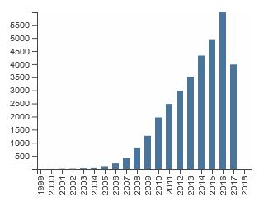
Citations by Year (with Multi-Ethnic Study of Atherosclerosis in “topic”—Web of Science search)
Citations in Each Year
Citations in Each Year
Citations Per Year
Average citations per article: 20 (up from 19 in April, 17.5 last year)
h-index: 82 (up from 78 in April, 73 last year, 64 the year before)

