Slide 1
MESA Air Updates
Joel D. Kaufman

Slide 2
Updates on Grants
EPA: MESA Air Next Stage (83830001)
Recommended 3/13/2017 for funding by EPA STAR Grants Program
no award yet
Some involvement by all field centers, and re-contact of Family participants in MESA Air and new recruits in NY, LA
NIEHS: Air Pollutants and Cardiovascular Risk: Investigating Thresholds with Pooled Cohorts and Electronic Health Records (R01 ES027696)
Pending award
No field center participation (but MESA/MESA Air data)
NIEHS: Impact of Air Pollution Exposure on Heart and Brain Aging in MESA (R01ES028614)
Resubmitted to NIH in July 2017
Involves all 6 field centers: air monitoring, ECG ZioPatches, etc
NIEHS Bridge Funding (R56ES026528)
Started in February 2017
Fixed site monitoring in all six communities
Baltimore field center home monitoring

Slide 3
R56 Progress
Fixed site monitoring in all MESA cities: started in March/April 2017
Data analysis is in progress
Home Monitoring in Baltimore
Completed first home monitoring campaign at 20 participant homes: July 21st – September 1st
Winter campaign coming up: January/February 2018

Slide 4
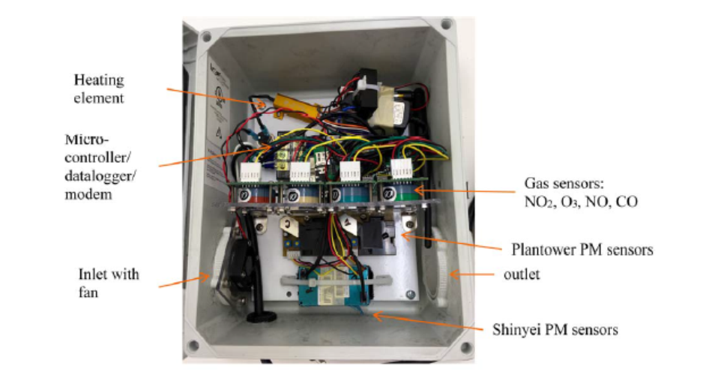
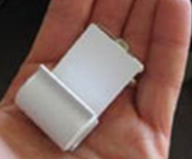
New Air Monitoring Equipment
Home and fixed monitoring sites +
Ogawa samplers for confirmation/QA at home monitoring sites

Slide 5
Long-Term Monitor Locations
Notes:
Link to map: https://drive.google.com/open?id=1l5HM5L27tAH6tEb29U4iZ6AvvmY&usp=sharing

Slide 6
Extra slides

Slide 7
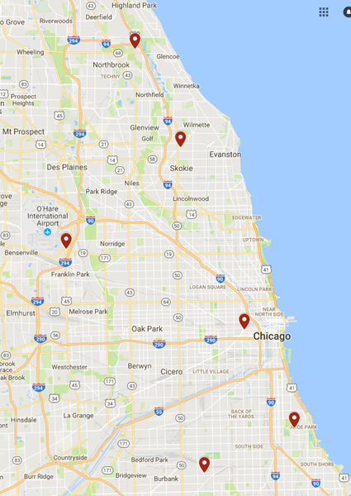
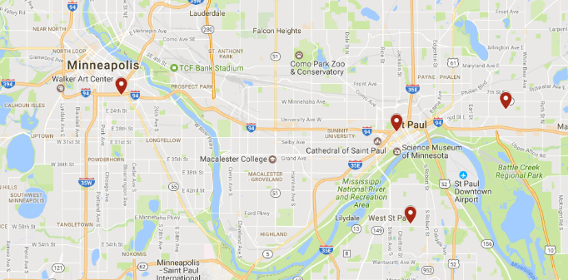
Long-Term Monitor Locations: LA, St. Paul, Chicago

Slide 8
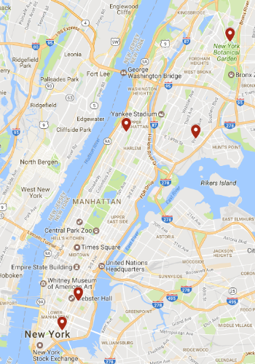
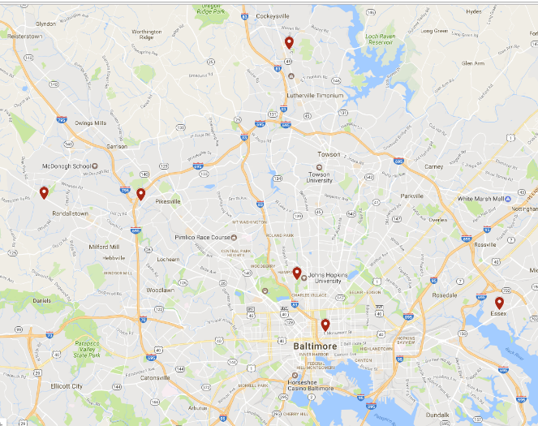
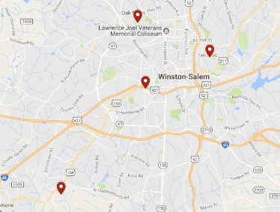
Long-Term Monitor Locations: NYC, Winston-Salem, Baltimore

Slide 9
EPA: MESA Air Next Stage
Full title
The Multi-Ethnic Study of Atherosclerosis and Air Pollution (MESA Air): Next Stage
Submission dates
Feb 2015, July 2016
Role of MESA Field Centers
Events follow-up for MESA Air participants (including MESA Family participants previously consented to MESA Air)
Current status
Received top score in review and likely to receive funding, waiting for EPA

Slide 10
NIH: Pooled Cohorts
Full title
Air Pollutants and Cardiovascular Risk: Investigating Thresholds with Pooled Cohorts and Electronic Health Records
Submission dates
July 2015 (HEI), March 2016 (NIH), Nov 2016 (NIH)
Role of MESA Field Centers
None (but using MESA/MESA Air data)
Current status
Anticipate funding anytime

Slide 11
NIH: Heart and Brain Aging (HF/AF)
Full title
Impact of Air Pollution Exposure on Heart and Brain Aging in MESA
(Original title: Air Pollution, Heart Failure and Atrial Fibrillation in MESA)
Submission dates
April 2015, Nov 2015, Nov 2016
Role of MESA Field Centers
Help with air monitoring at long-term sites (4-6/city) and participant homes (40/city)
Retrieval of pacemaker/ICD data
Administration of shortened MESA Air Questionnaire
Current status
Scored well but not in fundable range
Currently have one year of related R56 funding
Resubmitted in July 2017

Slide 12
NIH: R56
Role of MESA Field Centers
JHU only: help with air monitoring at participant homes in Baltimore
Current status
Funded for one year (partial funding of first year of R01)
Air monitors set up at long-term sites in all six MESA cities
Home monitoring for Baltimore in summer 2017 and winter 2018

Slide 13
Real-time data transfer (5-minute PM_{2.5} data over 48 hours at 2 monitors in LA)
Notes:
https://shiny.deohs.washington.edu/app/uw-radical

