Slide 1
Tissue sodium, inflammation, and blood pressure in MESA
R01 HL133860-01
Vanderbilt University Overall PIs: Thomas J Wang, MD & Jens M. Titze MD MESA ²³Na-MRI Reading Center Biostatistical analysis
Erlangen | Northwestern | Vermont | Washington
 | MESA Field Center | MESA Central Lab | MESA Coordinating Center
²³Na-MRI installation, quality control, and analytics | Blood pressure, ²³Na-MRI scans, phlebotomy | Flow cytometry (Th17), Cytokines (IL17) Serum Na+ | Administration, Data storage, Publication oversight
Peter Linz Michael Uder | Kiang Liu Norrina Allen James Carr | Russ Tracy Peggy Doyle | Richard Kronmal

Slide 2
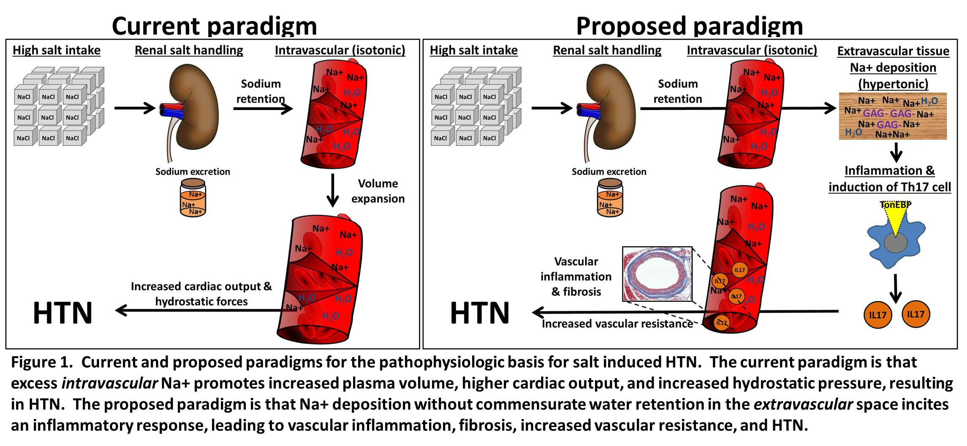
Concept: tissue Na+ → Th17 inflammation → ↑BP
Notes:
High blood pressure, or hypertension, is a major cause of heart disease, stroke, and kidney disease and is more common in middle-aged to elderly individuals. Salt (sodium) retention and inflammation are thought be important reasons why people develop hypertension, but the actual mechanisms are not completely understood. New data suggest that accumulation of sodium in tissues such as skin may be an important cause, by inducing inflammation; therefore, we propose to investigate this novel hypothesis by studying participants in the Multi-Ethnic Study of Atherosclerosis

Slide 3
Specific Aims
Aim 1. To define the distribution of tissue Na+ content in middle-aged to elderly individuals in the community. We will non-invasively quantify skin and muscle Na+ concentration using ²³Na-MRI in MESA participants at the Chicago, IL field center during exam 6 (2016-2018).
Aim 2. To investigate the association of tissue Na+ levels with blood pressure. Blood pressure will be measured in MESA participants and the association between skin Na+ concentration and systolic blood pressure will be examined in multivariable-adjusted linear regression analyses.
Aim 3. To examine the association of tissue Na+ with Th17 and other cellular markers of inflammation. Circulating immune cells, including Th17 cells, will be quantified via flow cytometry among MESA participants who undergo ²³Na-MRI. The association between skin Na+ concentration and Th17 cells will be examined in multivariable-adjusted linear regression analyses.

Slide 4
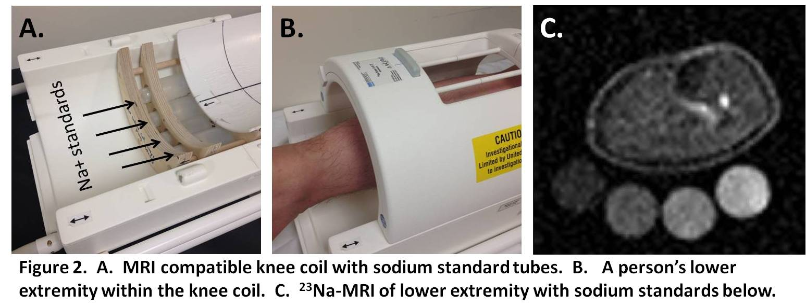
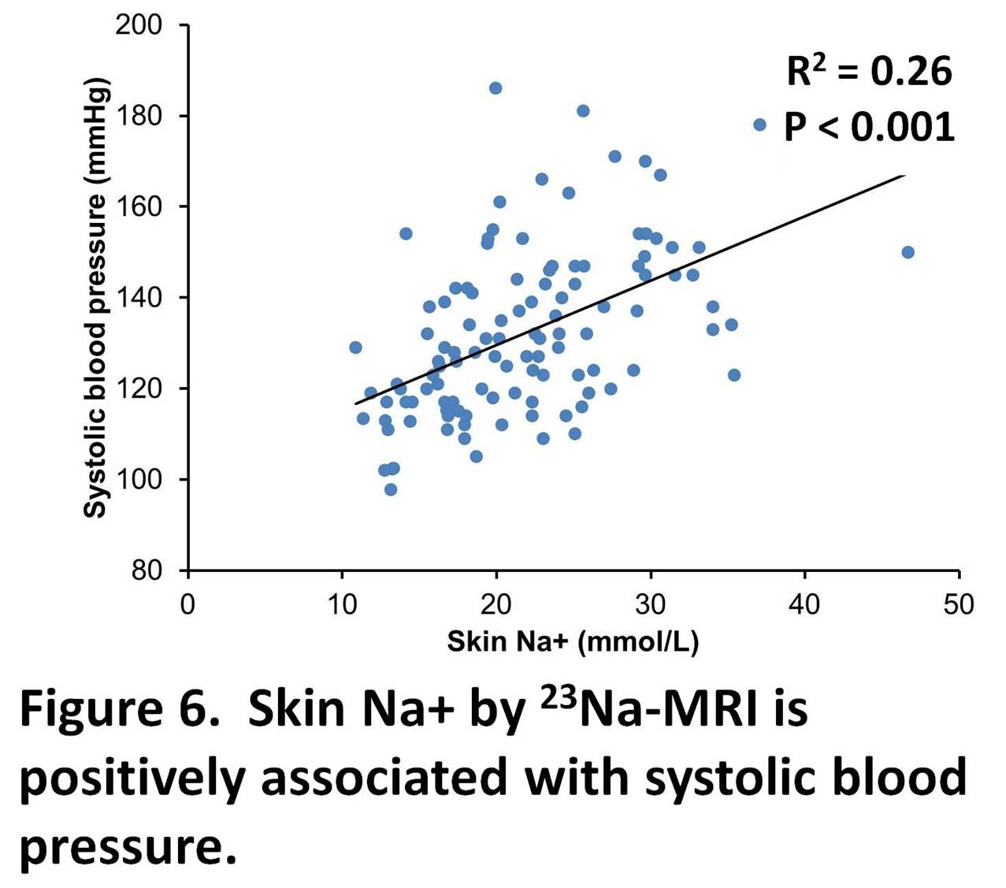
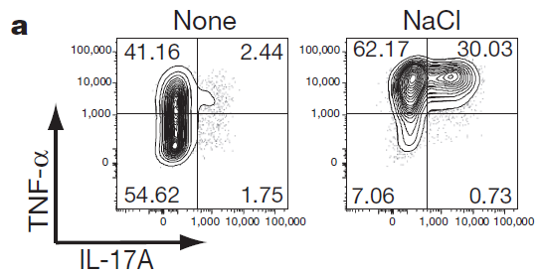
Methods
Aim 1
Aim 2
Aim 3

Slide 5
Progress: Sodium MRI
Month | Scans | Cumulative
September- November | 55 | 55
December-February | 31 | 86
March-May | 100 | 186
June-August | 65 | 251

Slide 6
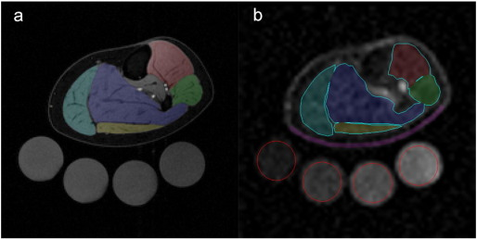
Sodium MRI - Analysis
Wang et al MRI 2017

Slide 7
Sodium MRI: Inter-reader repro
Skin
Muscle

Slide 8
Sodium MRI: Intra-reader repro
Skin
Muscle

Slide 9
Progress: Blood Collection
363 participants in whom blood samples were collected at NU and shipped overnight to Vermont

Slide 10
The year(s) ahead
Calendar Year | NIH Grant Year | Major Activity
2017-2018 | 2 | Complete sodium MRI scans and blood collections
2018-2019 | 3 | Complete sodium MRI scans analysis Complete blood immune profiling Preliminary data analysis
2019-2020 | 4 | Data analysis Abstracts, presentations, publications

Slide 11
Tissue sodium, inflammation, and blood pressure in MESA
R01 HL133860-01
Vanderbilt University Overall PIs: Thomas J Wang, MD & Jens M. Titze MD MESA ²³Na-MRI Reading Center Biostatistical analysis
Erlangen | Northwestern | Vermont | Washington
 | MESA Field Center | MESA Central Lab | MESA Coordinating Center
²³Na-MRI installation, quality control, and analytics | Blood pressure, ²³Na-MRI scans, phlebotomy | Flow cytometry (Th17), Cytokines (IL17) Serum Na+ | Administration, Data storage, Publication oversight
Peter Linz Michael Uder | Kiang Liu Norrina Allen James Carr | Russ Tracy Peggy Doyle | Richard Kronmal

