Slide 1
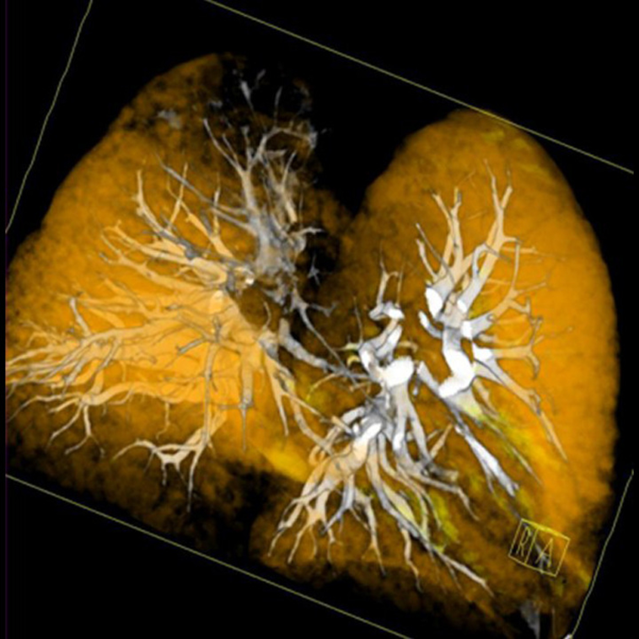
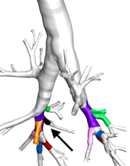
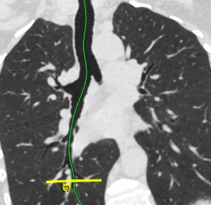
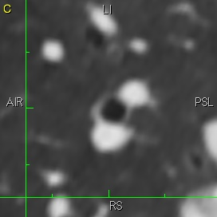
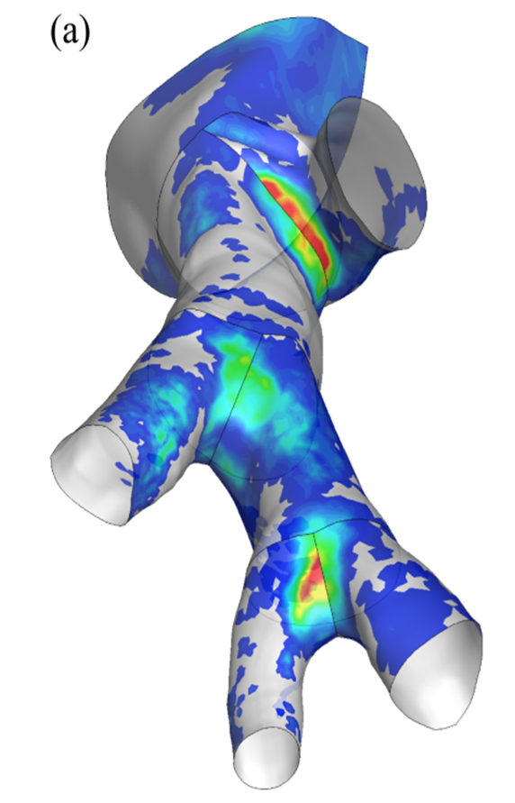
MESA Lung III & non-smokers
10th generation airway
1.6 mSv
Status Report
September 8, 2017

Slide 2
Mesa lung iii & non-smoker measures
  KEY MEASURES
    Lung questionnaire
    Post-bronchodilator spirometry
    Non-contrast and contrast chest CT
  EXAM 6 TARGET
    2,650

Slide 3
spirometry
COMPLETION
Site | Exam 6 visits to 9/6/2017 | Selected | Consented | Pre-BD spirometry | Post-BD spirometry | Post-BD Spirometry | Lung Questionnaire
 |  | Spirometry % | Spirometry % | Completed % | Selected % | Completed % | Completed %
3: WFU | 264 | 90.9 | 99.2 | 86.7 | 25.5 | 64.0 | 98.5
4: CU | 353 | 89.0 | 95.2 | 92.0 | 35.1 | 74.2 | 100.0
5: JHU | 360 | 93.3 | 98.2 | 97.5 | 32.6 | 72.0 | 100.0
6: UMN | 497 | 97.4 | 98.6 | 95.0 | 22.4 | 32.7 | 100.0
7: NWU | 527 | 92.4 | 96.7 | 85.7 | 25.4 | 40.4 | 100.0
8: UCLA | 442 | 92.1 | 98.3 | 91.5 | 25.3 | 48.9 | 99.2
Total | 2443 | 92.8 | 97.7 | 91.5 | 27.2 | 54.5 | 99.7
QUALITY
DATA TRANSFER
REPORTING
Exam 6
Site | Spirometry | Spirometry | Spirometry
 | completed | received at CC | not received at CC
3: WFU | 196 | 179 | 17
4: CU | 265 | 251 | 14
5: JHU | 307 | 294 | 13
6: UMN | 438 | 372 | 66
7: NWU | 389 | 368 | 21
8: UCLA | 356 | 246 | 110
Total | 1951 | 1710 | 241
Site | 25th %ile | Median days | 75th %ile
3: WFU | 41 | 54 | 67
4: CU | 47 | 57 | 71
5: JHU | 40 | 50 | 63
6: UMN | 48 | 56 | 68
7: NWU | 46 | 57 | 72
8: UCLA | 61 | 71 | 92
All Sites | 46 | 56 | 69
Last month by site
Week

Slide 4
CT
COMPLETION
Site | Exam 6 visits | Any CT | Any CT | Any CT | Contrast CT | Contrast CT | Contrast CT
 | to 9/6/2017 | Selected | Consented | Completed | Selected | Consented | Completed
3: WU | 264 | 90.9 | 98.3 | 41.1 | 53.8 | 88.7 | 34.8
4: CU | 353 | 89.0 | 92.0 | 82.4 | 63.2 | 63.7 | 72.0
5: JHU | 360 | 93.3 | 93.8 | 97.8 | 66.9 | 64.7 | 90.6
6: UMN | 497 | 97.4 | 95.9 | 93.3 | 35.2 | 82.3 | 95.2
7: NWU | 527 | 92.4 | 75.2 | 83.9 | 73.6 | 54.1 | 89.8
8: UCLA | 442 | 92.1 | 97.1 | 29.4 | 72.6 | 84.1 | 19.1
Total | 2443 | 92.8 | 91.0 | 72.6 | 61.0 | 70.3 | 59.8
QUALITY
DATA TRANSFER
Protocol / QC issue | Exam 6 | Last month | Preceding month
High (above consent) | 0.22% (3) | 0.65% (1) | 0% (0)
High (below consent) | 0.07% (1) | 0% (0) | 0% (0)
Low | 6.08% (82) | 1.94% (3) | 2.9% (2)
QC Error | 1.63% (22) | 1.29% (2) | 0% (0)
Site | Reviewed | In process | Pending | Need attention
3: WFU | 93 | 11 | 0 | 4
4: CU | 220 | 0 | 5 | 3
5: JHU | 293 | 6 | 0 | 0
6: UMN | 422 | 3 | 4 | 0
7: NWU | 307 | 0 | 0 | 1
8: UCLA | 95 | 6 | 2 | 4
Total | 1430 | 26 | 11 | 12
High (above consent) Examples: Participant was scanned twice; other issues with the scan that resulted in radiation above 6.5mSv
High (below consent) Examples: Participants who were not selected, but consented and completed scan; other issues with the scan, but radiation not above consented limit
Low Level: Protocol deviation that influence radiation but total dose is below consented limit Examples: Scan starts more than 2cm above the apices or ends more than 5cm below the base of the lung
QC Error: Violation is not protocol related Examples: scan clipping or motion resulting in unusable data; uncontrollable event resulting in unusable data.
REPORTING
Site | 25th %ile | Median days | 75th %ile
All Sites | 53 | 73 | 152

Slide 5


TAKE-HOME POINTS
    Lung questionnaire
    Spirometry quality
    CT consents
    Reporting
    Post-bronchodilator spirometry completion
    Contrast CT completion

