Slide 1
MESA Heart Failure Study (Shah/Bertoni PIs)
Specific Aims:
Aim 1 (Prevalence): Determine the prevalence of early HF
Aim 2 (Pathogenesis): Examine associations between risk factors, biomarkers, and changes in risk factors with early HF and its pathophysiologic markers:
Cardiac mechanics
Ventricular-arterial coupling
Myocardial pressure-stress relationships
Aim 3 (Phenomics): Perform machine learning analyses of previously ascertained MESA quantitative data and relate risk factor phenotypic signatures to pathophysiologic markers and HF subtypes
All participants, all 6 sites:
Questionnaires:
KCCQ
6MWT
Echocardiography
GE Vivid T8 2D, M-mode, color Doppler, tissue Doppler, speckle-tracking
Resting echo
Passive leg raise maneuver
Arterial tonometry
Fukuda VaSera
Pulse-wave velocity
Augmentation index
Arterial waveform
Wake Forest (n=300):
Cardiopulmonary exercise test

Slide 2
MESA Exam 6:
Heart Failure Study Components
Site | Selected | Echo | Arterial Stiffness | Physical Activity | KCCQ-12 | 6MWT
Wake Forest | 266 | 190 | 187 | 265 | 264 | 230
Columbia | 355 | 352 | 348 | 350 | 351 | 289
Johns Hopkins | 362 | 352 | 352 | 362 | 362 | 300
Minnesota | 497 | 465 | 458 | 495 | 496 | 404
Northwestern | 528 | 525 | 512 | 523 | 525 | 406
UCLA | 445 | 435 | 422 | 441 | 440 | 387
Total | 2453 100% | 2319 94.5%* | 2279 92.9%** | 2436 99.3% | 2438 99.4% | 2016 82.2%
CPET (Wake Forest only): n=92/300
*95.8% and **94.7% at Spring MESA SC meeting

Slide 3
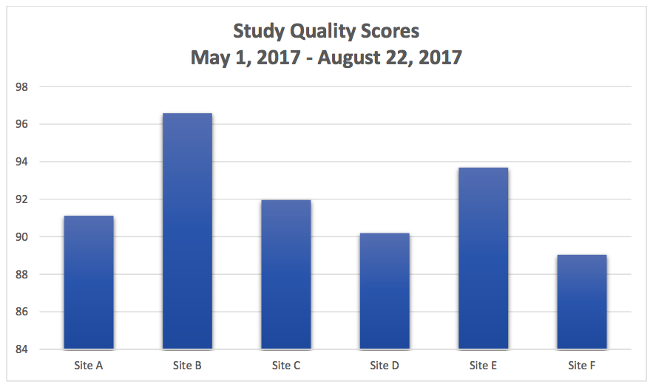
MESA Exam 6:
Echo Quality Scores by Site

Slide 4
MESA Exam 6: Echo alerts
Total number of echos received at Echo Reading Center as of 8/24/17: n=2276 (n=1431 at prior SC meeting)
Referrals/alerts:
Immediate referrals: 3/2276 (0.1%)
Urgent referrals: 32/2276 (1.4%)
Routine alerts: 204/1191 (9.0%)
No alert: 2037/2276 (89.5%)

Slide 5
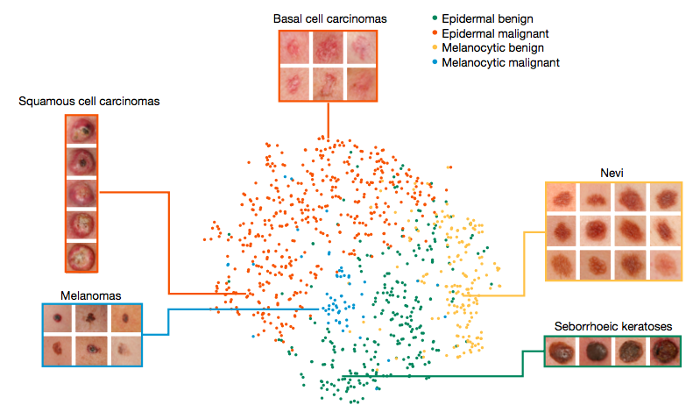
Deep learning for dermatologic Dx
Esteva A, et al. Nature 2017

Slide 6
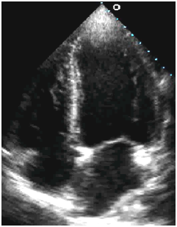
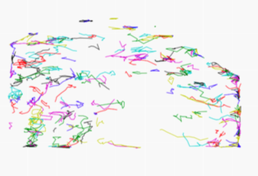
Machine learning of echo images
Deep learning to
Identify views
(e.g., A4c)
Automated identification of cardiac chambers
Active appearance models for segmentation
Particle tracking for tissue displacement, velocities, strain
Collaboration with Rahul Deo, MD, PhD (UCSF)

Slide 7
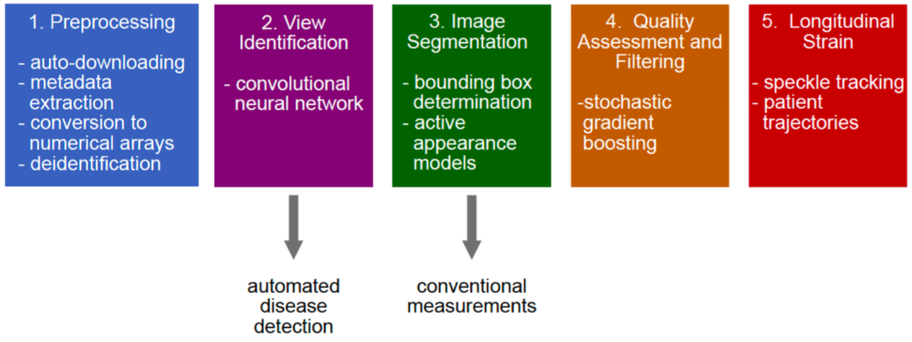
Machine learning of echo images
Deo R, et al. arXiv.org

Slide 8
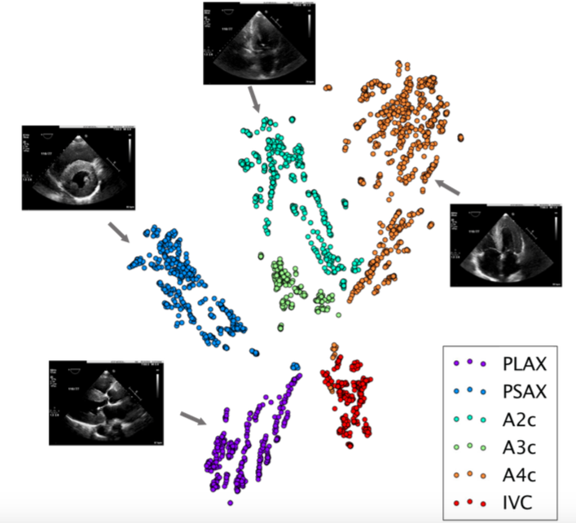
Machine learning of echo images
Convolutional neural network (CNN) to identify echo views
Deo R, et al.
arXiv.org

Slide 9
Machine learning of echo images
Automated image segmentation of the left ventricle
Deo R, et al. arXiv.org

Slide 10
Machine learning of echo images
Deep learning to
Identify views
(e.g., A4c)
Automated identification of cardiac chambers
Active appearance models for segmentation
Particle tracking for tissue displacement, velocities, strain
Echo image server:
High throughput analysis for automated diagnosis, feature identification
Collaboration with Rahul Deo, MD, PhD (UCSF)

