Slide 1
Environmental and occupational risk Factors of subclinical interstitial lung disease
Cora Sack, MD MPH
Fellow in Department of Occupational and Environmental Health Sciences &
Division of Pulmonary, Critical Care and Sleep Medicine
University of Washington
March 28, 2018

Slide 2
Conflicts of Interests & Disclaimers
No relevant commercial interests to disclose
This report has not been formally reviewed by Environmental Protection Agency (EPA). The findings and conclusions in this report are those of the authors and do not necessarily represent the views of the EPA or the National Institute for Occupational Safety and Health (NIOSH). EPA and NIOSH do not endorse any products or commercial services mentioned in this publication.

Slide 3
Background
Interstitial lung diseases are associated with high morbidity and mortality
  Idiopathic pulmonary fibrosis remains the primary cause of lung transplantation in the United States
Etiology is largely unknown
  Long latency period before disease manifestation
  Chronic mixed exposures
  Rare and heterogeneous outcome
Environmental and occupational exposures may be risk factors for disease
  Mineral dust and pneumoconiosis
  Air pollution and IPF exacerbations

Slide 4
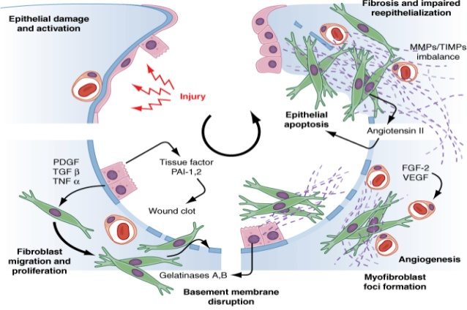
Adapted from: Fauci AS, Kasper DL, Braunwald E, Hauser SL, Longo DL, Jameson JL, Loscalzo J: Harrison’s Principles of Internal Medicine, 17th Edition: http://www.accessmedicine.com

Slide 5
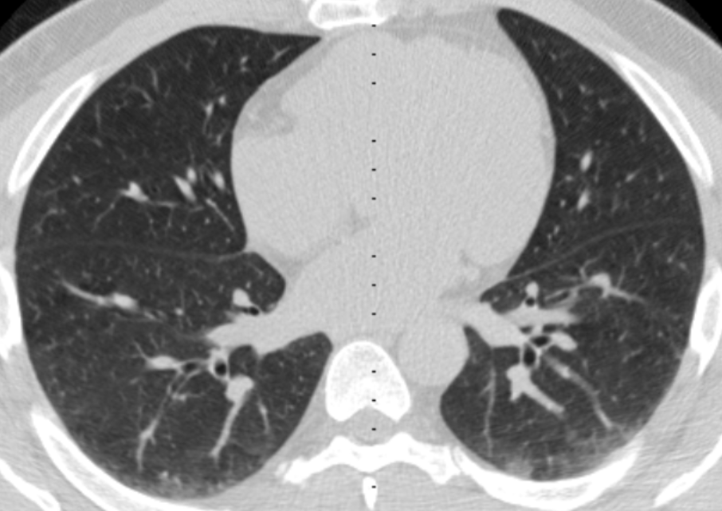
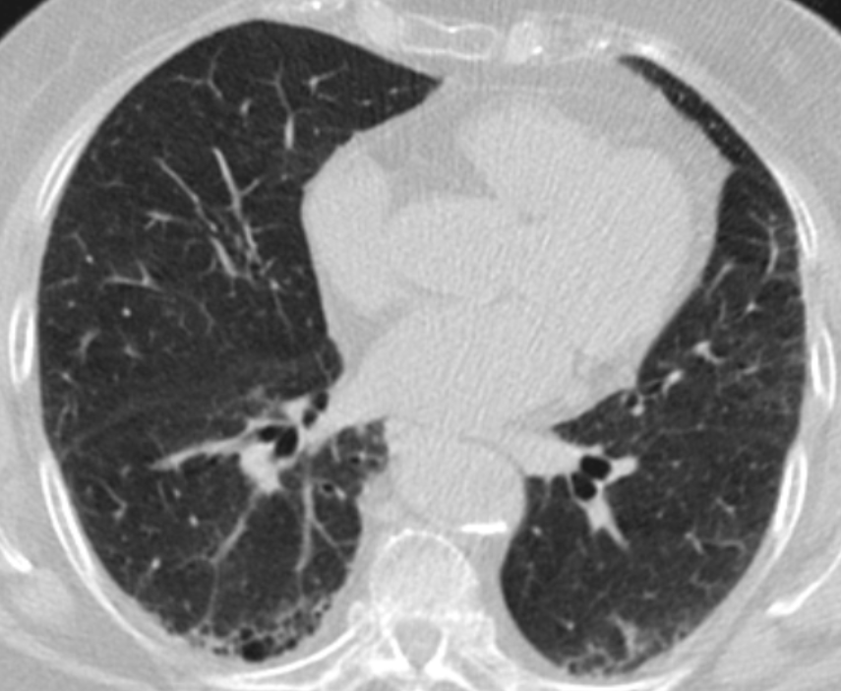
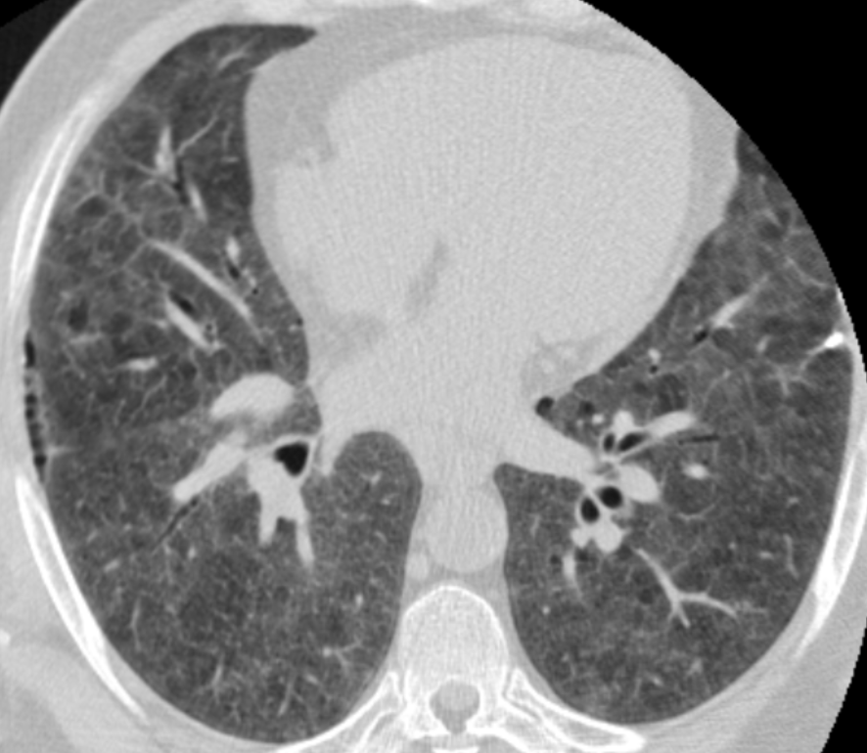
MESA Outcomes of Subclinical ILD
Interstitial lung abnormalities (ILA): visual assessment of early interstitial changes in non-dependent portion of lung
High attenuation areas (HAA): quantitative measurement of attenuation on CT-scan
CT chests with 10%, 15% and 32% HAA
Notes:
Studying subclinical forms of ILD on CT scan may help identify possible antecedent causes of disease. This shortens the long time gap between exposure and disease manifestation

Slide 6
Research Questions
Aim 1:
Is exposure to ambient air pollution associated with interstitial lung abnormalities (ILA) and high attenuation areas (HAA) on CT chest?
Aim 2:
Is occupational exposure to vapors, gas, dust and fumes (VGDF) associated with ILA and HAA on CT chest?

Slide 7
methods

Slide 8
Study Participants
2000 |  | 2001 | 2002 |  | 2003 | 2004 |  | 2005 |  | 2006 | 2007 |  | 2008 | 2009 | 2010 |  | 2011 | 2012
 | Exam 1 |  |  | Exam 2 |  |  | Exam 3 |  | Exam 4 |  |  |  |  |  |  | Exam 5
 | Cardiac CT |  |  |  |  |  |  |  |  |  |  |  |  |  |  | Cardiac/ Full Lung CT
HAA Measurements
ILA Measurement

Slide 9
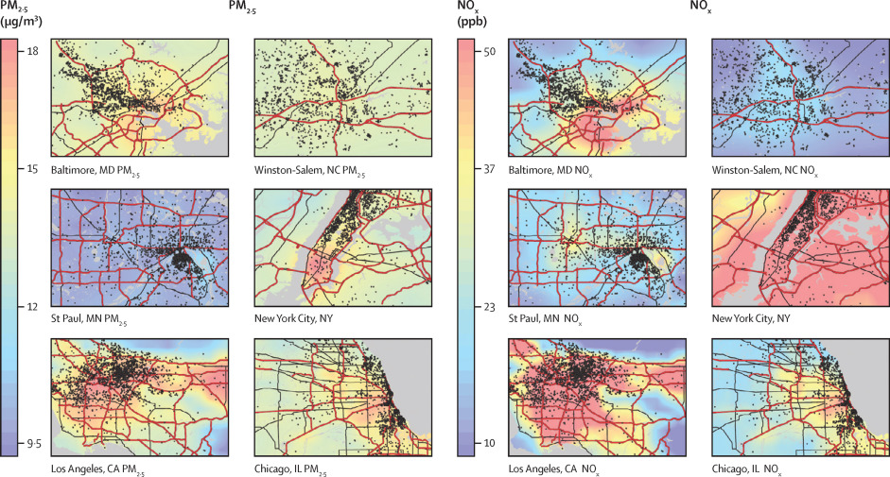
Ambient Air Pollution Assessment
Notes:
MESA Air measured ambient pollutant concentrations at participating field centers. These measurements supplemented measurements from EPA monitoring locations to estimate individual pollutant concentrations at participant homes. Models extend back to 1999.
Maps showing the predicted concentrations of PM2.5 and NOx in MESA cities. Predicted levels are based on residential address, using spatio-temporal models which incorporate geographic and cohort –specific covariates

Slide 10
Occupational Exposure Assessment
Demographic questionnaires with current/ last employment at each MESA exam
Self Reported Exposures to Vapors Gas Dust Fumes (VGDF):
  Obtained during Exam 4
  Presence/ absence, duration, severity of exposure to VGDF
Job Exposure Matrix (JEM) Assigned Exposures to VGDF:
  Developed and validated by industrial hygienists at NIOSH
  Based on Bureau of Census occupational codes
  Likelihood and severity of exposure to VGDF, subcategories of dust
Notes:
We used 2 traditional methods for characterizing occupational exposures: self-report and expert opinion using JEM

Slide 12
Statistical Analysis
Prevalence of ILA
Multivariable logistic regression
Exposure
  Estimate of 10 year pollution concentration
  Self-reported and JEM-assigned occupational exposures
Adjusted for age, gender, ethnicity, tobacco use (current smoking status, pack years), site
Progression of HAA
Linear mixed model
Exposure:
  baseline exposure at year 2000 & long- term exposure from recruitment to follow up exam
  Self- reported and JEM-assigned occupational exposures
Adjusted for age, gender, ethnicity, tobacco use (current smoking status, pack years), site, educational attainment, occupational exposures, height, BMI, waist circumference, eGFR, total volume imaged lung, percent emphysema, CT scanner type
Potential effect modification based on stratification on smoking status, gender, ethnicity

Slide 13
Results
Aim 1: Association with Air Pollution Exposure

Slide 14
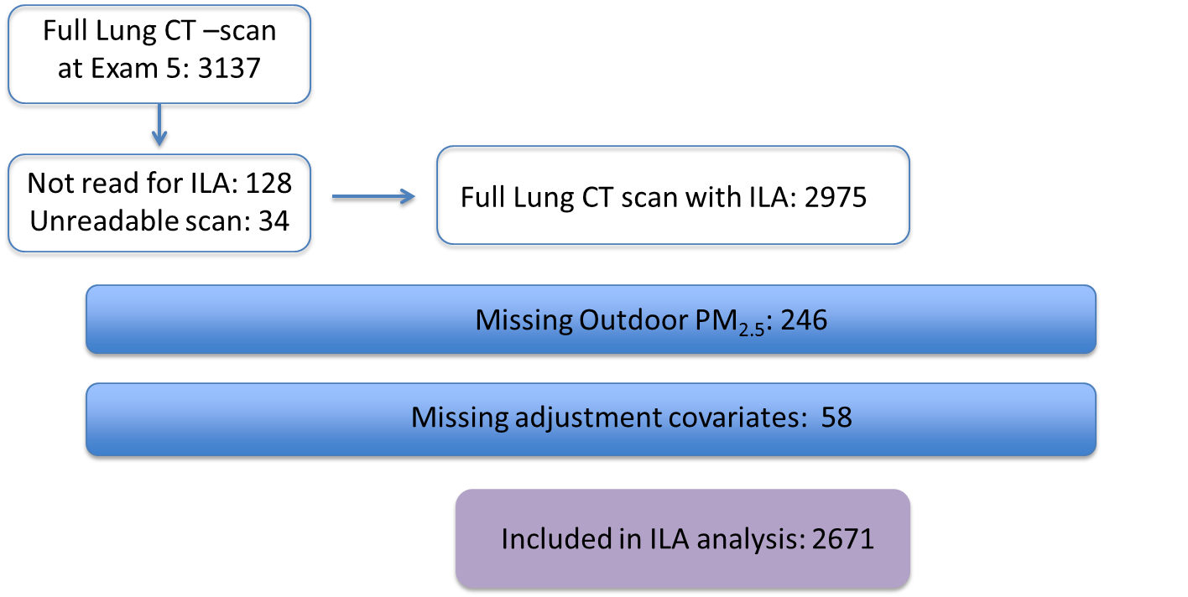
Participants in the ILA Analysis

Slide 15
Participants in HAA Analysis
Enrolled: 6814 MESA
HAA at baseline: 6813
Follow- Up HAA: 5965
Baseline HAA Only: 848
2 Time Points:
2935
3 Time Points:
2385
4 Time Points: 646
Missing Outdoor PM_{2.5}
Baseline HAA Only: 817
2 Time Points:
2838
3 Time Points:
2287
4 Time Points:
623
Missing Adjustment Covariates
Baseline HAA Only: 722
2 Time Points:
2678
3 Time Points:
2231
4 Time Points:
586
Included in HAA analysis: 5495

Slide 16
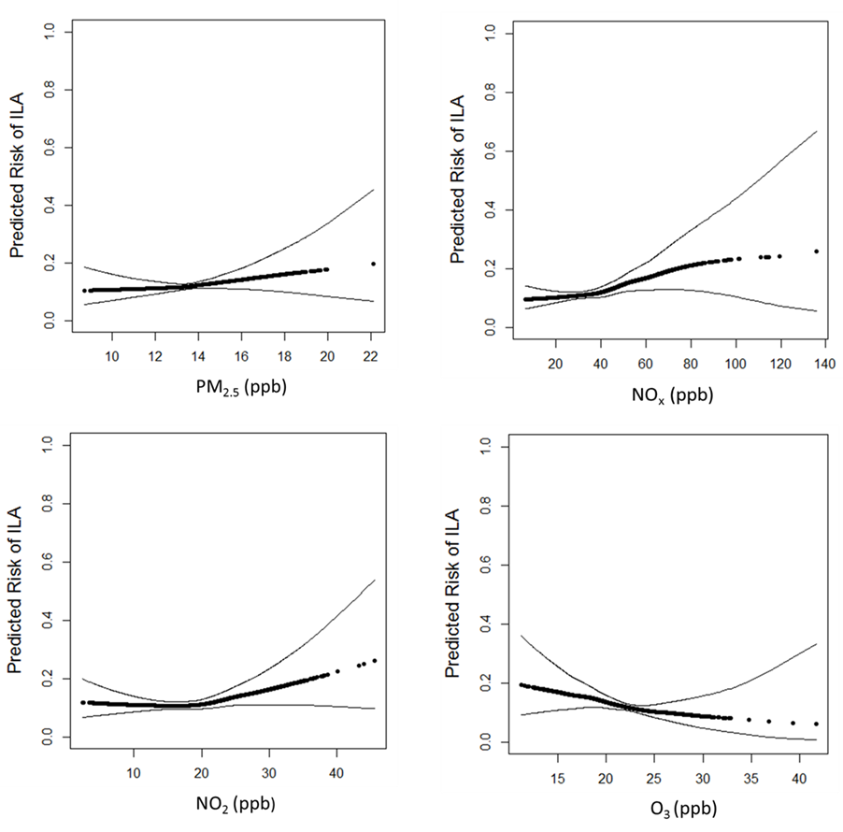
10 Year Estimates of Pollution Exposure and Risk of ILA
 | Per 5 mcg/m³ increment in PM_{2.5} (95% CI) | P | Per 40 ppb increment in NO_{x} (95%CI) | p | Per 10 ppb increment in NO₂ (95% CI) | p | Per 10 ppb increment in O₃ (95% CI) | p
Odds Ratio | 1.43 (0.81 to 2.54) | 0.22 | 1.77 (1.06 to 2.95) | 0.03 | 1.28 (0.90 to 1.82) | 0.16 | 0.63 (0.31 to 1.28) | 0.20

Slide 17
Long-term Estimates of Pollution Exposure and HAA Progression
 | Annual change in % HAA per 5 mcg/m³ increment in PM_{2.5} (95% CI) | p | Annual change in % HAA per 40 ppb increment in NO_{x} (95%CI) | p | Annual change in % HAA per 10 ppb increment in NO₂ (95% CI) | p | Annual change in % HAA per 10 ppb increment in O₃ (95% CI) | p
Overall | 0.43 (-0.08 to 0.94) | 0.10 | 0.45 (-0.02 to 0.92) | 0.06 | 0.17 (-0.16 to 0.51) | 0.32 | 0.10 (-0.49 to 0.71) | 0.73
Race |  | 0.002 |  | 0.007 |  | 0.04 |  | 0.55
White | 0.93 (0.26 to 1.61) |  | 0.82 (0.07 to 1.57) |  | 0.47 (0 to 0.96) |  | 0.41 (-0.35 to 1.18)
Asian | 0.33 (-1.07 to 1.74) |  | 0.31 (-0.89 to 1.53) |  | -0.13 (-0.88to 0.62) |  | 1.49 (-0.15 to 3.17)
Black | 0.45 (-0.70 to 1.63) |  | 0.80 (-0.11 to 1.71) |  | 0.11 (-0.60 to 0.82) |  | 0.04 (-1.22 to 1.31)
Hispanic | 0.80 (-0.42 to 2.04) |  | 0.34 (-0.64 to 1.38) |  | 0.65 (-2.10 to 1.52) |  | -0.97 (-2.39 to 0.46)

Slide 18
Results
Oxides of nitrogen, and perhaps PM_{2.5}, are associated with phenotypes of subclinical ILD
Race may modify the association between pollution and progression of HAA

Slide 19
results
Aim 2: Association with Occupational Exposures

Slide 20
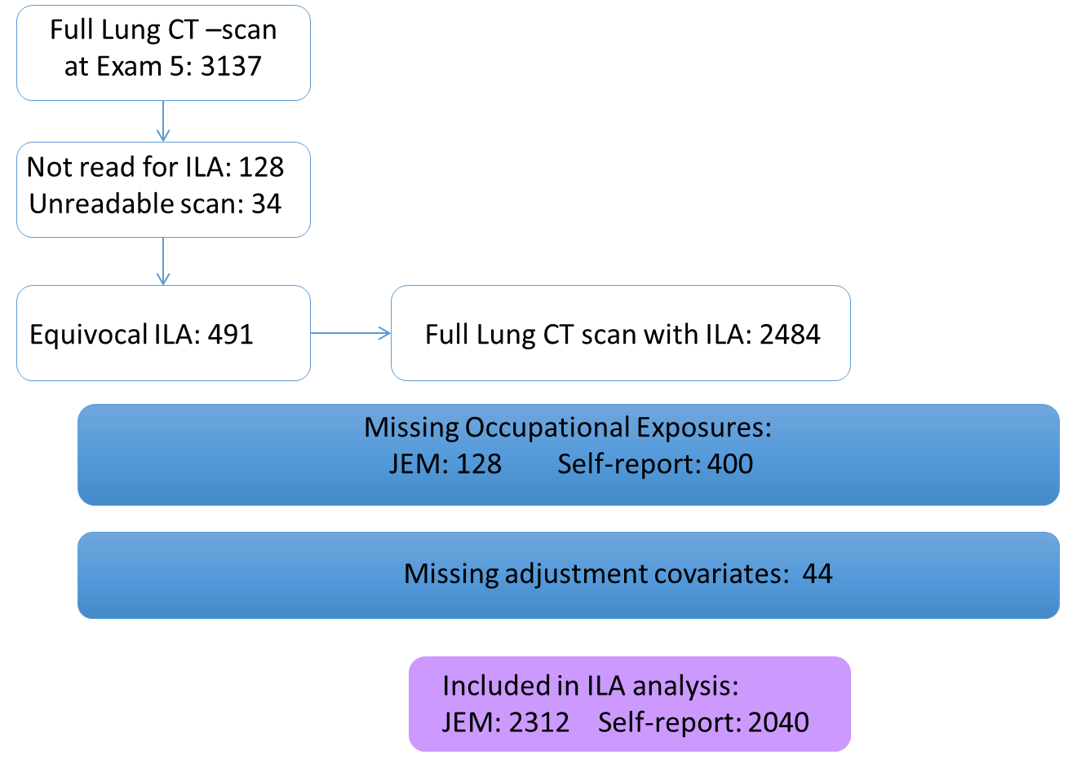
Participants in ILA Analysis

Slide 21
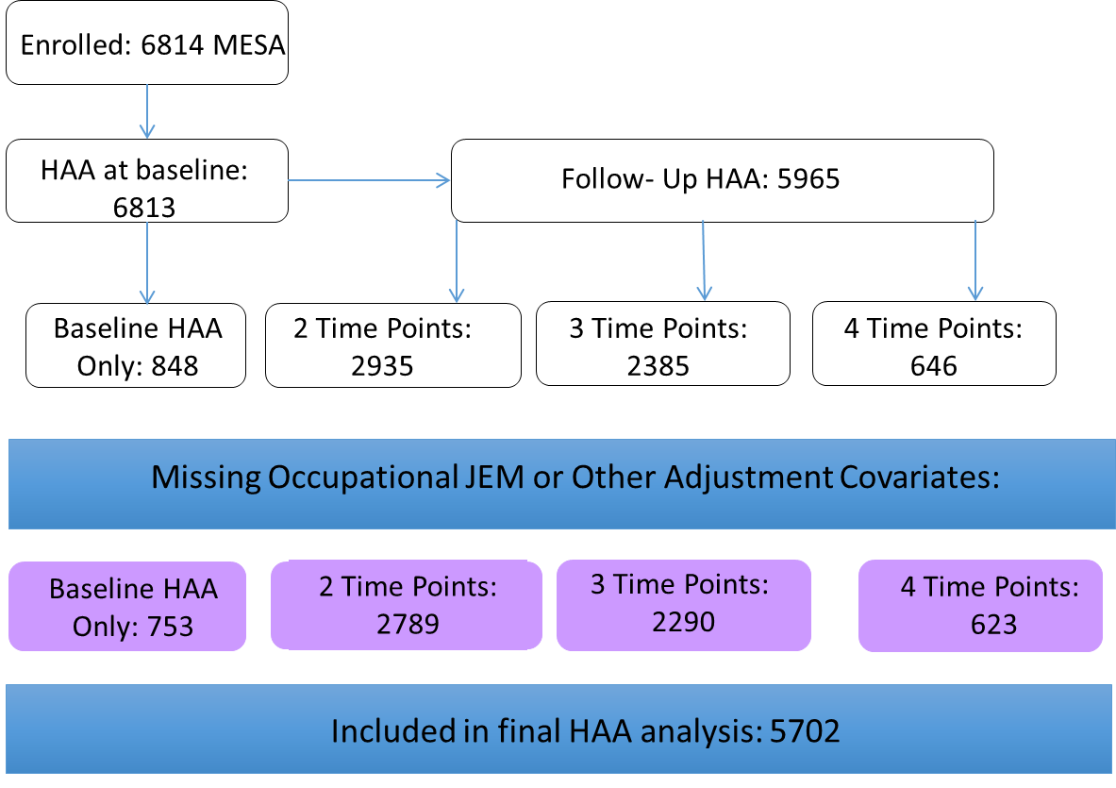
Participants in HAA Analysis

Slide 22
Notes:
A high percentage of workers were retired at baseline (38%), which increased to 43% by exam 5
According to the JEM, 16% had intermediate exposure and 7.5% had high exposure to VGDF
According to self report 37% report exposure to dust, 19% to gases/ vapors and 24% to fumes
Similar to other studies, there was low correlation between JEM assigned and self report exposures

Slide 23
Association between Occupational Exposures and ILA
 | Overall OR (95%CI) | Baseline Age < 65 years OR (95% CI) | Employed at Exam 5 OR (95% CI)
JEM- assigned VGDF Exposure | 1.04 (0.83 to 1.30) | 1.22 (0.85 to 1.73) | 1.39 (0.94 to 2.08)
Inorganic Dusts | 1.21 (0.82 to 1.81) | 0.45 (0.12 to 1.75) | 0.48 (0.12 to 1.86)
Organic Dusts | 0.92 (0.59 to 1.42) | 1.76 (0.94 to 3.69) | 2.33 (1.13 to 4.80)
Self- reported Exposure
Gas/ Vapor | 1.30 (0.93 to 1.83) | 1.76 (1.09 to 2.84) | 1.97 (1.16 to 3.35)
Dust | 0.94 (0.69 to 1.29) | 0.96 (0.62 to 1.48) | 1.14 (0.69 to 1.87)
Fumes | 1.13 (0.81 to 1.58) | 1.39 (0.89 to 2.25) | 1.57 (0.90 to 2.72)
Notes:
P-value interaction for employment status 0.22
P-value interaction for age 0.7

Slide 24
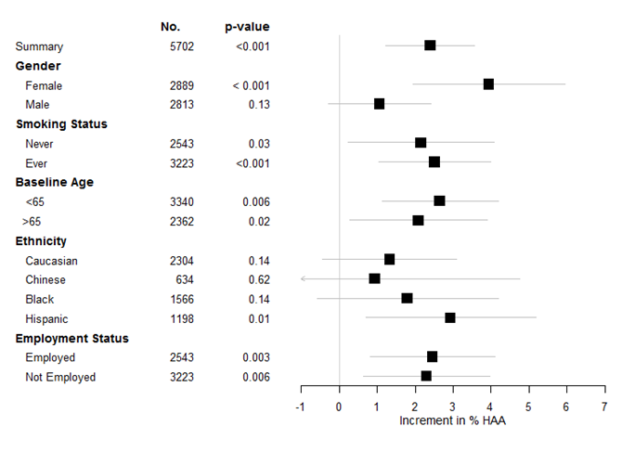
Association between JEM assigned exposures and HAA prevalence

Slide 25
Results
JEM- assigned and self- reported exposures to VGDF were associated with measurement of subclinical ILD
Most consistent between JEM-assigned exposures and HAA
Dose- response and possible temporal relationship

Slide 26
Limitations
Misclassification of subclinical ILD
  Radiographic definition not pathologic diagnosis
  Cardiac CT scan versus full lung CT scan
  Changes in scanner technology through study
Pollutant estimates based on outdoor concentration at participant homes and might not reflect participant microenvironment
Both JEM-assigned and self-reported occupational exposures with important sources of bias and misclassification

Slide 27
Conclusions
Sophisticated exposure modeling allow us to investigate possible associations between pollutant levels and novel diseases
Self- reported and expert- assigned VGDF exposure represents a broad range of occupational exposures
Multiple environmental and occupational exposures may contribute to subclinical manifestations of ILD
More studies are needed that examine environmental and occupational risk factors of chronic lung disease

Slide 28
Acknowledgements
Joel Kaufman and David Lederer
Additional Coauthors and contributors:
  Sverre Vedal
  Lianne Sheppard
  Ganesh Raghu
  R Graham Barr
  Anna Podolanczuk
  Brent Doney
  Laura Hooper
  Eric Hoffman
  Noah Seixas
  Amanda Gassett
  Karen Hinckley-Stukovsky
  Kayleen Williams
  Steve Kawut
Investigators, the staff, and the participants of the MESA study. A full list of participating MESA investigators and institutions can be found at http://www.mesa.nhlbi.org
Grant Funding:
NIH/ NHLBI T32

Slide 29
Questions?

Slide 30
ILA analysis
10 Year Estimates of Pollution Exposure and Risk of Interstitial Lung Abnormalities
 | OR per 5 mcg/m³ increment in PM_{2.5} (95% CI) | p | OR per 40 ppb increment in NO_{x} (95%CI) | p | OR per 10 ppb increment in NO₂ (95% CI) | p | OR per 10 ppb increment in O₃ (95% CI) | P
Overall | 1.43 (0.81 to 2.54) | 0.22 | 1.77 (1.06 to 2.95) | 0.03 | 1.28 (0.90 to 1.82) | 0.16 | 0.63 (0.31 to 1.28) | 0.20
Sex |  | 0.33 |  | 0.33 |  | 0.29 |  | 0.46
Female | 1.15 (0.54 to 2.44) |  | 1.55 (0.79 to 3.05) |  | 1.27 (0.80 to 2.01) |  | 0.62 (0.24 to 1.57)
Male | 1.96 (0.82 to 4.66) |  | 2.08 (0.94 to 4.58) |  | 1.31 (0.75 to 2.28) |  | 0.60 (0.20 to 1.83)
Race |  | 0.70 |  | 0.79 |  | 0.78 |  | 0.95
White | 1.37 (0.61 to 3.08) |  | 1.84 (0.77 to 4.41) |  | 1.29 (0.75 to 2.20) |  | 0.51 (0.19 to 1.41)
Asian | 6.79 (0.85 to 54.0) |  | 2.93 (0.69 to 12.5) |  | 1.82 (0.71 to 4.64) |  | 1.72 (0.18 to 16.2)
Black | 0.84 (0.22 to 3.16) |  | 1.03 (0.38 to 2.78) |  | 0.69 (0.35 to 1.38) |  | 0.97 (0.25 to 3.82)
Hispanic | 1.24 (0.32 to 4.84) |  | 2.33 (0.70 to 7.73) |  | 1.89 (0.75 to 4.80) |  | 0.23 (0.03 to 1.93)
Tobacco Use |  | 0.08 |  | 0.19 |  | 0.28 |  | 0.03
Never-smoker | 1.74 (0.73 to 4.16) |  | 2.89 (1.35 to 6.16) |  | 2.08 (1.17 to 3.69) |  | 0.30 (0.10 to 0.93)
Ever-smoker | 1.04 (0.40 to 2.76) |  | 1.05 (0.45 to 2.43) |  | 0.81 (0.46 to 1.43) |  | 1.44 (0.52 to 4.01)
Exposure to NO_{x} associated with higher prevalence of ILA
Associations may be stronger in never-smokers
Similar qualitative results seen with 20 and 30 year exposure estimates

Slide 31
ILA Analysis

Slide 32
HAA Analysis
Long-term Estimates of Pollution Exposure and Progression of HAA
 | Annual change in % HAA per 5 mcg/m³ increment in PM_{2.5} (95% CI) | p | Annual change in % HAA per 40 ppb increment in NO_{x} (95%CI) | p | Annual change in % HAA per 10 ppb increment in NO₂ (95% CI) | p | Annual change in % HAA per 10 ppb increment in O₃ (95% CI) | p
Overall | 0.43 (-0.08 to 0.94) | 0.10 | 0.45 (-0.02 to 0.92) | 0.06 | 0.17 (-0.16 to 0.51) | 0.32 | 0.10 (-0.49 to 0.71) | 0.73
Sex |  | 0.83 |  | 0.43 |  | 0.42 |  | 0.27
Female | 0.45 (-0.25 to 1.16) |  | 0.87 (0.20 to 1.54) |  | 0.43 (-0.0 5to 0.91) |  | -0.23 (-1.07 to 0.61)
Male | 0.32 (-0.40 to 1.05) |  | -0.05 (-0.66 to 0.27) |  | -0.19 (-0.66 to 0.27) |  | 0.57 (-0.27 to 1.41)
Race |  | 0.002 |  | 0.007 |  | 0.04 |  | 0.55
White | 0.93 (0.26 to 1.61) |  | 0.82 (0.07 to 1.57) |  | 0.47 (0 to 0.96) |  | 0.41 (-0.35 to 1.18)
Asian | 0.33 (-1.07 to 1.74) |  | 0.31 (-0.89 to 1.53) |  | -0.13 (-0.88to 0.62) |  | 1.49 (-0.15 to 3.17)
Black | 0.45 (-0.70 to 1.63) |  | 0.80 (-0.11 to 1.71) |  | 0.11 (-0.60 to 0.82) |  | 0.04 (-1.22 to 1.31)
Hispanic | 0.80 (-0.42 to 2.04) |  | 0.34 (-0.64 to 1.38) |  | 0.65 (-2.10 to 1.52) |  | -0.97 (-2.39 to 0.46)
Tobacco Use |  | 0.65 |  | 0.46 |  | 0.51 |  | 0.87
Never-smoker | 0.52 (-0.18 to 1.22) |  | 0.66 (0.02 to 1.31) |  | 0.33 (-0.14 to 0.80) |  | 0.02 (-0.83 to 0.88)
Ever-smoker | 0.46 (-0.24 to 1.18) |  | 0.48 (-0.17 to 1.13) |  | 0.16 (-0.31 to 0.62) |  | 0.07 (-0.74 to 0.89)
Notes:
NO_{x} associated with a trend towards increased progression of HAA
PM_{2.5}, No_{x}, NO₂ associated with increased progression of HAA in Caucasians
No significant cross sectional associations between baseline pollutant levels and HAA
Interaction p-values:
Gender: PM_{2.5} 0.27; NO_{x} 0.29; NO₂ 0.19; O₃

Slide 33
Association between Occupational Exposures and ILA

Slide 34
HAA Analysis

Slide 35
Timeline
1999 | 2000 |  | 2001 | 2002 |  | 2003 | 2004 |  | 2005 |  | 2006 | 2007 |  | 2008 | 2009 | 2010 |  | 2011 | 2012
 |  | Exam 1 |  |  | Exam 2 |  |  | Exam 3 |  | Exam 4 |  |  |  |  |  |  | Exam 5
 |  | Aortic Calcium/ Cardiac CT |  |  |  |  |  |  |  |  |  |  |  |  |  |  | Cardiac/ Lung CT
 |  |  |  |  |  |  |  |  | Exposure Monitoring for MESA Air
 | Fixed Site Pollutant Monitors
 | Exposure Modelling
 | Surveillance for Clinical Events
Notes:
MESA Air measured ambient pollutant concentrations at participating field centers. These measurements supplemented measurements from EPA monitoring locations to estimate individual pollutant concentrations at participant homes. Models extend back to 1999.

Slide 36
Timeline
Demographic and Employment Questionnaire
1999 | 2000 |  |  | 2001 | 2002 |  | 2003 | 2004 |  | 2005 |  | 2006 | 2007 |  | 2008 | 2009 | 2010 |  | 2011 | 2012
 |  | Exam 1 |  |  |  | Exam 2 |  |  | Exam 3 |  | Exam 4 |  |  |  |  |  |  | Exam 5
 |  |  | Aortic Calcium/ Cardiac CT |  |  |  |  |  |  |  |  |  |  |  |  |  |  | Cardiac/ Lung CT
Self-exposure VGDF questionnaire
Notes:
MESA Air measured ambient pollutant concentrations at participating field centers. These measurements supplemented measurements from EPA monitoring locations to estimate individual pollutant concentrations at participant homes. Models extend back to 1999.

