Slide 1
MESA Operations

Slide 2
Operations Subcommittee Report
Timeline
Follow-up calls
Participant Relations Committee
Exam 6
Core and Ancillary Study Progress
Alerts
Results Reporting
Retention Strategies

Slide 3
MESA 3 Timeline
Exam 6 Sept 6, 2016 – March 30, 2018
Annual Follow-up phone calls run congruent with fiscal years

Slide 4
Follow-up Call Retention
85%
Retention = Completed / (Enrolled – Dead)

Slide 5
Follow-up Retention by Ethnicity
85%
Retention = Completed / (Enrolled – Dead) except FU 15 (windowed)
Notes:
done

Slide 6
Follow-up 18 Completion by Site
Site Name | Follow-up Due | Contacts Made |  | Interviews Completed |  | Unable | Refused
Wake Forest | 831 | 536 | 65% | 495 | 60% | 31 | 9
Columbia | 900 | 551 | 61% | 508 | 56% | 38 | 2
Hopkins | 854 | 708 | 83% | 634 | 74% | 64 | 6
Minnesota | 877 | 719 | 82% | 664 | 76% | 53 | 1
NWU | 969 | 719 | 74% | 642 | 66% | 64 | 11
UCLA | 1080 | 800 | 74% | 635 | 59% | 147 | 15
Total | 5511 | 4033 | 73% | 3578 | 65% | 397 | 44
Includes active and study drop out participants with closed contact windows for “true retention.”
Notes:
% of FU complete does not include drop outs.

Slide 7
Follow-up Retention by Site
85%
85%
Retention = Completed / (Enrolled – Dead) except FU 18 (windowed)
Notes:
Cut and paste

Slide 8
Follow-up
FU18 Ended August 14, 2017 (65% complete)
Scheduled Exam 6 and asks participants stroke symptom and medical literacy questions.
FU19 started August 15, 2017
Adds questions to assess cognitive impairment, continues with Exam 6 scheduling for those who have not completed Exam 6.

Slide 9
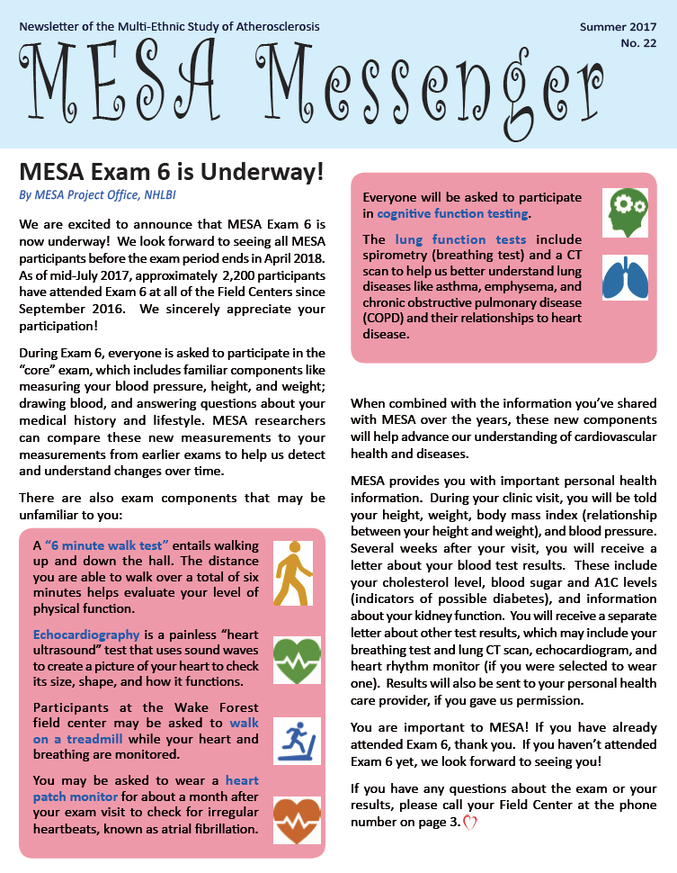
Participant Relations Committee
Newsletter
Mailed in August 2017
Articles include
Exam 6 Update and invitation (Lorraine Silsbee)
Combatting Alzheimer’s Disease (Tim Hughes)
Seeking Clues to Early Heart Failure (Alain Bertoni)
One newsletter per year planned for remainder of MESA 3 contract

Slide 10
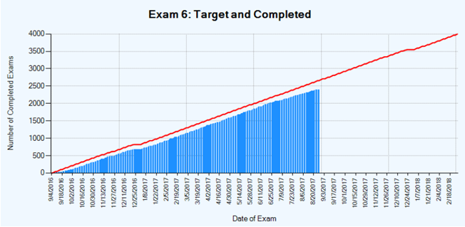
Exam 6 Completion
As of 8/28/2017, 2400 participants completed Exam 6 core exam during the 245 clinic days (9.0 ppts/day). If on target, 2700 participants would have completed the exam (~11 ppts/day), so retention is currently at 89% of the target.

Slide 11
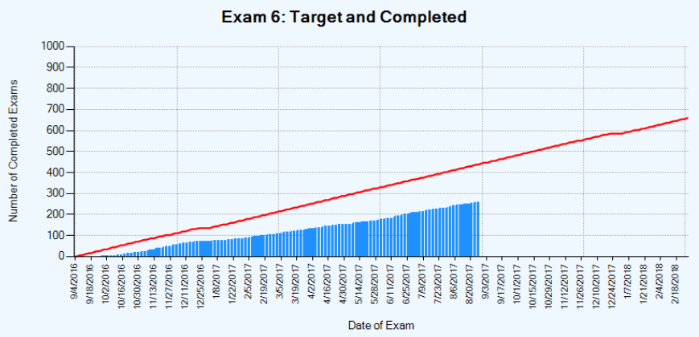
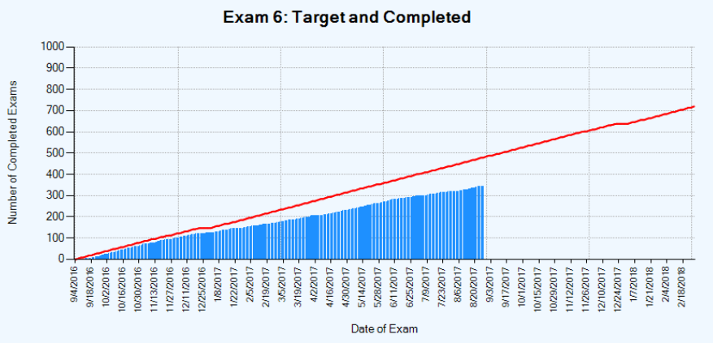
Exam 6 Completion
Wake Forest
Completed 258 Exam 6 visits (1.1 per clinic day, 59% of goal).
Target is 438 (1.8 per clinic day).
Columbia
Completed 345 Exam 6 visits (1.4 per clinic day, 72% of goal).
Target is 478 (2.0 per clinic day).

Slide 12
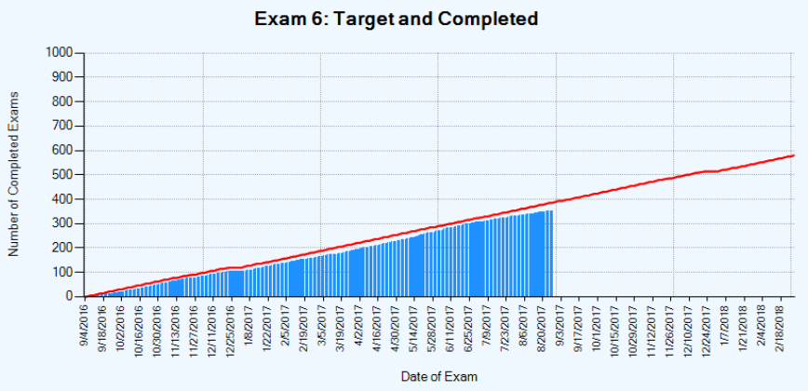
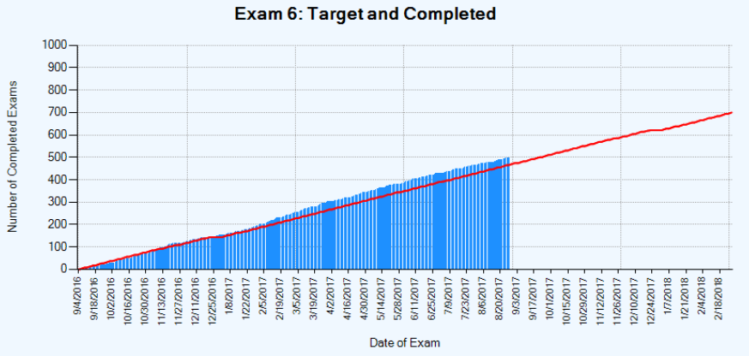
Exam 6 Completion
Johns Hopkins
Completed 352 Exam 6 visits (1.4 per clinic day, 94% of goal).
Target is 385 (1.6 per clinic day).
Minnesota
Completed 495 Exam 6 visits (2.0 per clinic day, 106% of goal).
Target is 465 (1.9 per clinic day).

Slide 13
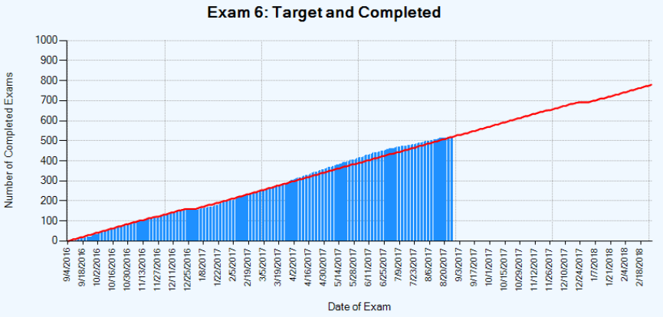
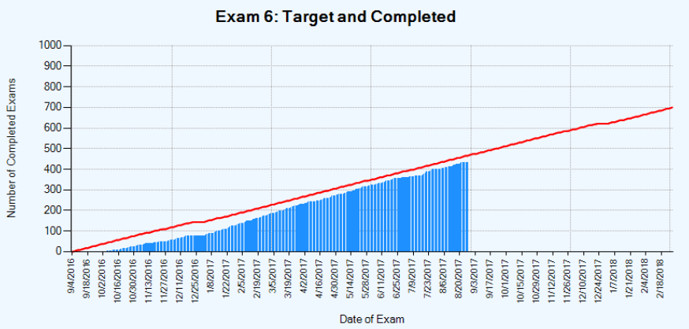
Exam 6 Completion
Northwestern
Completed 516 Exam 6 visits (2.1 per clinic day, 100% of goal).
Target is 518 (2.1 per clinic day).
UCLA
Completed 434 Exam 6 visits (1.8 per clinic day, 93% of goal).
Target is 465 (1.9 per clinic day).

Slide 14
Exam 6 Core Completion
Site | Visits | Blood Pressure | Oximetry | Anthro pometry | Phlebotomy | Urine | Medications | Medical History | Personal History | Physical Function
WFU | 260 | 257 | 257 | 259 | 246 | 247 | 257 | 260 | 259 | 259
COL | 345 | 344 | 342 | 344 | 316 | 308 | 343 | 343 | 340 | 339
JHU | 353 | 353 | 352 | 353 | 346 | 334 | 353 | 353 | 353 | 353
MN | 495 | 495 | 495 | 495 | 485 | 487 | 494 | 494 | 494 | 493
NWU | 519 | 519 | 519 | 519 | 503 | 510 | 517 | 516 | 513 | 512
UCLA | 435 | 432 | 432 | 433 | 418 | 426 | 432 | 431 | 430 | 430
Total | 2407 | 2400 | 2397 | 2403 | 2314 | 2312 | 2396 | 2397 | 2389 | 2386

Slide 15
Exam 6 AS Completion – AFib
Site | Selected HR Monitor | Consented HR Monitor | Consented to Cog Function Tests | Consented to Brain MRI
WFU | 260 | 161 | 259 | 162
COL | 345 | 194 | 193 | 189
JHU | 353 | 194 | 337 | 192
MN | 495 | 277 | 298 | 291
NWU | 519 | 253 | 252 | 252
UCLA | 435 | 269 | 273 | 271
Total | 2407 | 1348 | 1612 | 1357
Site | Eligible for Patch | Patch #1 Applied | Patch #2 Mailed to Ppt* | Cog Function Testing Complete | # with prior Afib (including E6 self-report) | # Alerts
WFU | 147 | 122 | 83 | 121 | 18 | 5
COL | 164 | 130 | 90 | 126 | 23 | 3
JHU | 144 | 138 | 107 | 136 | 23 | 4
MN | 249 | 222 | 191 | 221 | 27 | 5
NWU | 232 | 205 | 131 | 201 | 31 | 10
UCLA | 237 | 233 | 45 | 231 | 34 | 10
Total | 1173 | 1050 | 647 | 1036 | 156 | 37
*As of 8/24/2017, participants are asked to wear 1 heart monitor patch instead of 2.

Slide 16
Exam 6 AS Completion – Heart Failure
Site | Selected | Echo | Arterial Stiffness | Physical Activity | KCCQ-12 | 6MW | 6MW Exclusion
WFU | 122 | 83 | 121 | 18 | 5 | 122 | 83
COL | 124 | 87 | 121 | 21 | 3 | 124 | 87
JHU | 131 | 107 | 130 | 23 | 4 | 131 | 107
MN | 221 | 191 | 220 | 27 | 5 | 221 | 191
NWU | 201 | 130 | 197 | 29 | 10 | 201 | 130
UCLA | 224 | 45 | 222 | 33 | 10 | 224 | 45
Total | 1023 | 643 | 1011 | 151 | 37 | 1023 | 643

Slide 17
Exam 6 AS Completion – UKNOW
Site | Selected | ICIQ- FLUTS/MLUTS
WFU | 260 | 259
COL | 345 | 338
JHU | 353 | 352
MN | 495 | 494
NWU | 519 | 512
UCLA | 435 | 430
Total | 2407 | 2385

Slide 18
Exam 6 AS Completion – MESA Memory
Target sample (n=550, 80% of 675) for cognitive testing, MRI and AB-PET.
LP sub-study has a target sample size of 200 (37% of 540)

Slide 19
Exam 6 AS Completion – MESA Lung/Lung NS
Lung/Lung NS Components
Spirometry Completion
Site | Selected ANY Lung CT | Consented ANY Lung CT | Completed ANY Lung CT | Selected Contrast CT | Consented Contrast CT | Completed Contrast CT | Not eligible for Contrast | Consented to Spirometry | Completed Spirometry | Completed Lung Q
WFU | 236 | 232 | 97 | 140 | 124 | 39 | 14 | 96 | 84 | 95
COL | 306 | 283 | 230 | 215 | 136 | 75 | 34 | 228 | 209 | 228
JHU | 330 | 309 | 302 | 235 | 152 | 113 | 27 | 299 | 279 | 302
MN | 482 | 462 | 430 | 175 | 144 | 100 | 39 | 427 | 395 | 430
NWU | 479 | 360 | 307 | 381 | 206 | 115 | 79 | 305 | 267 | 307
UCLA | 400 | 388 | 110 | 315 | 265 | 46 | 24 | 110 | 106 | 110
Total | 2233 | 2034 | 1476 | 1461 | 1027 | 488 | 217 | 1465 | 1340 | 1472
Site | Exam 6 Visits | Selected for Spirometry | Consented to Spirometry | Completed Pre-BD Spirometry | Not eligible for Pre-BD Spirometry | Selected Post-BD Spirometry | Pre-BD Spiro not complete | Completed Post-BD Spirometry | Post-BD Spirometry Not Complete | Completed Lung Questionnaire
WFU | 260 | 236 | 234 | 192 | 12 | 30 | 50 | 32 | 18 | 189
COL | 345 | 306 | 291 | 255 | 11 | 25 | 92 | 68 | 24 | 254
JHU | 353 | 330 | 324 | 301 | 15 | 8 | 99 | 71 | 28 | 301
MN | 495 | 482 | 475 | 437 | 15 | 23 | 98 | 32 | 66 | 437
NWU | 519 | 479 | 463 | 380 | 17 | 66 | 97 | 39 | 58 | 380
UCLA | 435 | 400 | 393 | 349 | 11 | 33 | 88 | 43 | 45 | 346
Total | 2407 | 2233 | 2180 | 1914 | 81 | 185 | 524 | 285 | 239 | 1907
Notes:
Karen to provide slides

Slide 20
Exam 6 AS Completion – MESA INVITE
 |  | Total Screeners Complete |  |  |  |  |  | Screening Result |  |  |  | Consent status for those eligible |  |  | Study Drug Status for those consented |  | 2-week phone call | 6A Visit Complete
 |  | E6 Complete before INVITE start |  | E6 Complete after INVITE start |  | E6 Pending
Site | Selected | E6 Visits | Screener Complete | E6 Visits | Screener Complete | E6 not complete | Screener Complete | Refused | Not Eligible | Eligible | Missing/ Incomplete | Consented | Declined Consent | Pending Consent | Dispensed | Not Dispensed
WFU | 707 | 145 | 2 | 86 | 60 | 476 | 0 | 22 | 15 | 25 | 26 | 23 | 2 | 0 | 16 | 7 | 5 | 0
COL | 736 | 147 | 17 | 148 | 132 | 441 | 0 | 36 | 53 | 62 | 14 | 55 | 2 | 5 | 52 | 3 | 52 | 19
JHU | 631 | 91 | 43 | 213 | 213 | 327 | 9 | 79 | 109 | 80 | 0 | 63 | 0 | 17 | 63 | 0 | 56 | 29
NWU | 816 | 223 | 11 | 249 | 247 | 344 | 0 | 57 | 143 | 58 | 2 | 54 | 4 | 0 | 54 | 0 | 48 | 20
Total | 2890 | 606 | 73 | 696 | 652 | 1588 | 9 | 194 | 320 | 225 | 42 | 195 | 8 | 22 | 185 | 10 | 161 | 68
Of 739 screened participants, 31% are eligible, 44% ineligible, and 26% refused to participate.
85% of ineligible participants were excluded for exceeding 1000IU of vitamin D daily.
Notes:
Karen to provide slides

Slide 21
Exam 6 AS Completion – Epigenetics of Atherosclerosis CUS
Site | Selected and had E6 Visit | Consented | Completed CUS | CUS not completed
WFU | 207 | 161 | 41 | 3
COL | 298 | 189 | 137 | 1
JHU | 250 | 184 | 175 | 1
MINN | 345 | 273 | 194 | 1
Total | 1100 | 807 | 547 | 6
Notes:
Karen to provide slides

Slide 22
Exam 6 RC Data Transmission – Echo
 | WFU | Col. | JHU | UMN | NWU | UCLA | Total
Echo Completed | 177 | 339 | 340 | 462 | 513 | 421 | 2252
Data Received at CC | 172 | 316 | 324 | 443 | 497 | 401 | 2153
Data Not Received at CC | 5 | 23 | 16 | 19 | 16 | 20 | 99
No data for HT letter after 8 weeks | 0 | 0 | 0 | 1 | 0 | 1 | 2
No data for HT letter after 12 weeks | 0 | 0 | 0 | 1 | 0 | 0 | 1

Slide 23
Exam 6 RC Data Transmission – Heart Monitor Patch
 | WFU | Col. | JHU | UMN | NWU | UCLA | Total
Heart Monitor Patch Registered (1 or 2 per ppt) | 209 | 211 | 220 | 407 | 332 | 289 | 1668
Patches Received at RC | 202 | 192 | 216 | 396 | 318 | 269 | 1593
Data Received at CC (# patches) | 196 | 179 | 197 | 386 | 299 | 258 | 1515
Data Not Received at CC (# patches) | 6 | 13 | 19 | 10 | 19 | 11 | 78
No data for HT letter after 8 weeks (requires data from 2 patches) | 3 | 3 | 1 | 1 | 9 | 16 | 33
No data for HT letter after 12 weeks (requires data from 2 patches) | 13 | 19 | 29 | 41 | 24 | 133 | 269

Slide 24
Exam 6 RC Data Transmission – Spirometry
 | WFU | Col. | JHU | UMN | NWU | UCLA | Total
Spirometry Completed | 192 | 255 | 301 | 437 | 380 | 349 | 1914
Data Received at CC | 179 | 235 | 283 | 372 | 368 | 239 | 1676
Data Not Received at CC | 13 | 20 | 18 | 65 | 12 | 110 | 238
No data for HT Letter after 8 weeks | 5 | 3 | 0 | 32 | 1 | 0 | 41
No data for HT Letter after 12 weeks | 1 | 6 | 0 | 26 | 8 | 96 | 137

Slide 25
Exam 6 RC Data Transmission – Blood Assays
 | WFU | Col. | JHU | UMN | NWU | UCLA | Total
Phlebotomy Completed | 246 | 316 | 346 | 485 | 503 | 418 | 2314
Lipid Data Received at CC | 225 | 294 | 324 | 461 | 478 | 370 | 2152
Data Not Received at CC | 21 | 22 | 22 | 24 | 25 | 48 | 162
No data for Lab Letter after 8 weeks | 0 | 1 | 0 | 0 | 0 | 0 | 1
No data for Lab Letter after 12 weeks | 0 | 0 | 0 | 0 | 0 | 0 | 0
Notes:
Phlebotomy Completed includes partial blood draw.

Slide 26
Exam 6 RC Data Transmission – Lung CT Emphysema
 | WFU | Col. | JHU | UMN | NWU | UCLA | Total
Lung CT Completed | 82 | 204 | 276 | 389 | 307 | 78 | 1333
Data for High-Tech Letter Received at CC | 72 | 165 | 251 | 346 | 276 | 59 | 1169
Data for High-Tech Letter Not Received at CC | 88% | 81% | 91% | 89% | 90% | 76% | 88%
No data for HT letter - scan performed 4<8 weeks prior | 10 | 39 | 25 | 43 | 31 | 19 | 167
No data for HT letter - scan performed 8<12 weeks prior | 2 | 24 | 1 | 10 | 5 | 1 | 43
No data for HT letter – scan performed > 12 weeks prior | 0 | 3 | 12 | 2 | 4 | 1 | 22
Notes:
As of 3/27/2017

Slide 27
Exam 6 Alerts
Site | Wake | Col | JHU | Minn | NWU | UCLA | Total
Oximetry Complete | 257 | 342 | 352 | 495 | 519 | 433 | 2398
Oximetry Alert | 0 | 4 | 2 | 1 | 1 | 1 | 9
BP Complete | 257 | 344 | 353 | 495 | 519 | 433 | 2401
BP Alert | 2 | 4 | 16 | 9 | 9 | 5 | 45
Echo Complete | 174 | 336 | 321 | 461 | 507 | 375 | 2174
Echo Read Complete | 187 | 298 | 314 | 433 | 483 | 405 | 2120
Echo Alerts | 0 | 9 | 4 | 5 | 5 | 8 | 31
Participants with 1st Heart Monitor Patch Applied | 122 | 84 | 129 | 211 | 201 | 216 | 963
Heart Monitor Patch Safety Read Complete (2 per ppt) | 194 | 176 | 195 | 383 | 296 | 255 | 1499
Heart Monitor Patch Alert | 6 | 6 | 6 | 7 | 11 | 10 | 46
CT Complete | 97 | 230 | 302 | 430 | 307 | 113 | 1479
Lung Safety Read Done | 81 | 187 | 282 | 384 | 290 | 82 | 1306
Lung CT Alerts* | 4 | 13 | 38* | 32 | 78* | 10 | 175
Lipids Data Received | 225 | 294 | 324 | 461 | 478 | 370 | 2152
Lipids Alert | 1 | 3 | 1 | 2 | 3 | 3 | 13
Carotid US Complete | 41 | 138 | 175 | 195 | 0 | 0 | 549
Carotid US Alerts | 5 | 11 | 9 | 15 | 0 | 0 | 40

Slide 28
Exam 6 Results Reporting Lab Assays
Procedure | Count | Minimum | 25th Percentile | Median | 75th Percentile | Maximum
3: Wake Forest | 203 | 18 | 28 | 33 | 41 | 155
4: Columbia | 277 | 13 | 27 | 34 | 49 | 173
5: Johns Hopkins | 305 | 17 | 27 | 34 | 45 | 94
6: Minnesota | 435 | 16 | 26 | 32 | 42 | 94
7: Northwestern | 450 | 3 | 25 | 31 | 42 | 148
8: UCLA | 358 | 4 | 23 | 29 | 36 | 67
Total | 2028 | 3 | 28 | 32 | 42 | 173

Slide 29
Exam 6 Results Reporting Spirometry
Procedure | Count | Minimum | 25th Percentile | Median | 75th Percentile | Maximum
All Sites | 1357 | 2 | 46 | 56 | 69 | 301
3: Wake Forest | 167 | 12 | 41 | 54 | 67 | 235
4: Columbia | 205 | 12 | 47 | 57 | 71 | 246
5: Johns Hopkins | 270 | 3 | 40 | 50 | 63 | 143
6: Minnesota | 320 | 2 | 48 | 56 | 68 | 301
7: Northwestern | 332 | 26 | 46 | 57 | 72 | 183
8: UCLA | 63 | 20 | 61 | 71 | 92 | 244

Slide 30
Exam 6 Results Reporting Echo
Procedure | Count | Minimum | 25th Percentile | Median | 75th Percentile | Maximum
All Sites | 2018 | 12 | 49 | 62 | 76 | 320
3: Wake Forest | 171 | 14 | 51 | 64 | 77 | 112
4: Columbia | 296 | 12 | 49 | 61 | 76 | 320
5: Johns Hopkins | 312 | 12 | 43 | 54 | 70 | 196
6: Minnesota | 409 | 18 | 50 | 62 | 75 | 218
7: Northwestern | 473 | 14 | 45 | 58 | 72 | 175
8: UCLA | 357 | 19 | 56 | 66 | 80 | 162

Slide 31
Exam 6 Results Reporting Heart Patch Monitor
Procedure | Count | Minimum | 25th Percentile | Median | 75th Percentile | Maximum
All Sites | 539 | 14 | 64 | 85 | 129 | 317
3: Wake Forest | 84 | 14 | 70 | 128 | 184 | 247
4: Columbia | 47 | 34 | 68 | 103 | 149 | 317
5: Johns Hopkins | 74 | 34 | 58 | 73 | 104 | 306
6: Minnesota | 155 | 35 | 61 | 73 | 97 | 287
7: Northwestern | 149 | 39 | 68 | 91 | 147 | 287
8: UCLA | 30 | 62 | 79 | 90 | 167 | 227

Slide 32
Retention Strategies
Home Visits (starting September 2017)
Limited one hour exam with core components
Invitation to Exam 6 for study dropouts
Exam 6 announcements and site-specific Ancillary Study descriptions in MESA Messenger Newsletter

