Slide 1

Lung disease risk in former and “light” smokers
Pooled Cohorts Study
Elizabeth Oelsner, MD, MPH
Columbia University / Division of General Medicine
MESA Steering Committee
March 28, 2018
NIH/NHLBI K23-HL130627; R21-HL129924; R21-HL121457

Slide 2
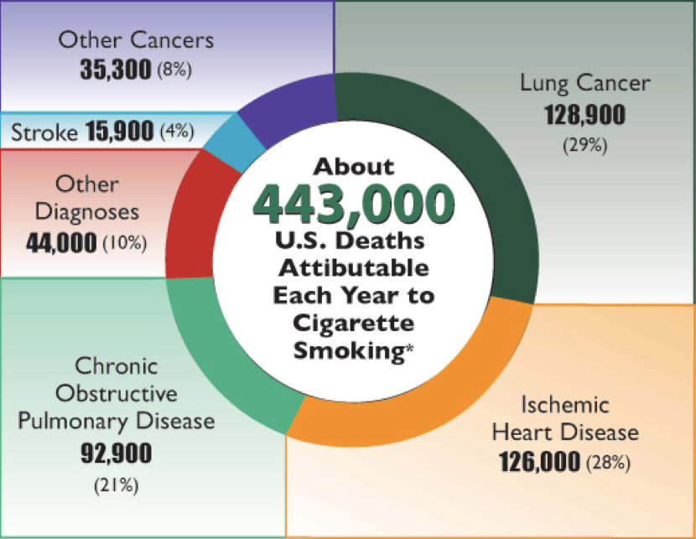
Smoking-related diseases and behaviors in the US
Smoking-related deaths, 2005-2009
CDC Factsheets. National Health Interview Survey, US, 2005–2014

Slide 3
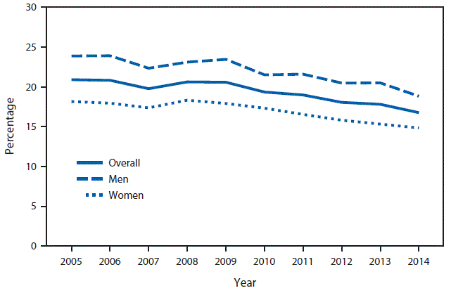
Smoking-related diseases and behaviors in the US
Smoking-related deaths, 2005-2009
Percent of adults currently smoking, 2005-2014
CDC Factsheets. National Health Interview Survey, US, 2005–2014

Slide 4
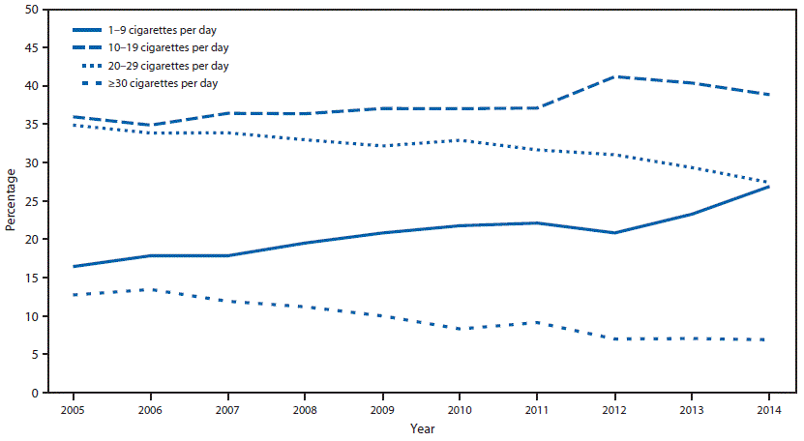
Smoking-related diseases and behaviors in the US
Smoking-related deaths, 2005-2009
Percent of adults currently smoking, 2005-2014
Cigarettes smoked per day in current smokers, 2005-2014
1-9 CPD
30+ CPD
CDC Factsheets. National Health Interview Survey, US, 2005–2014

Slide 5
Smoking-related diseases and behaviors in the US
Smoking-related deaths, 2005-2009
Percent of adults currently smoking, 2005-2014
Cigarettes smoked per day in current smokers, 2005-2014
1-9 CPD
30+ CPD
Knowledge gaps regarding respiratory risks in former & “light” smokers
CDC Factsheets. National Health Interview Survey, US, 2005–2014

Slide 6
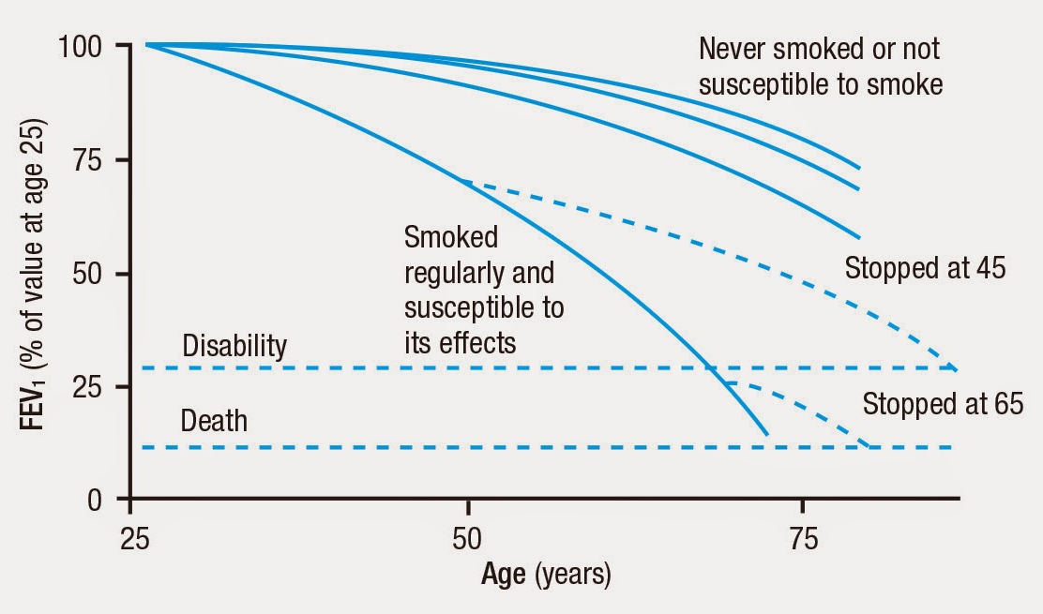
Smoking and lung function decline
FEV1 peaks in early adulthood and then declines
Smoking accelerates FEV1 decline
Accelerated FEV1 decline is recognized as a cause of COPD (FEV1/FVC <0.70)
“A susceptible smoker who stops smoking will not recover lost FEV1, but the subsequent rate of loss of FEV1 will revert to normal” – Fletcher & Peto 1977
Neas & Schwartz, Am J Epidemiol 1998. McGeachie, NEJM 2016. Lange P, NEJM 2015. Fletcher & Peto, Br Med J 1977. Anthoniesen, AJRCCM 2002. Lee & Fry, BMC Med 2010.

Slide 7
Smoking and lung function decline
FEV1 peaks in early adulthood and then declines
Smoking accelerates FEV1 decline
Accelerated FEV1 decline is recognized as a cause of COPD (FEV1/FVC <0.70)
“A susceptible smoker who stops smoking will not recover lost FEV1, but the subsequent rate of loss of FEV1 will revert to normal” – Fletcher & Peto 1977
Never
Neas & Schwartz, Am J Epidemiol 1998. McGeachie, NEJM 2016. Lange P, NEJM 2015. Fletcher & Peto, Br Med J 1977. Anthoniesen, AJRCCM 2002. Lee & Fry, BMC Med 2010.

Slide 8
Smoking and lung function decline
FEV1 peaks in early adulthood and then declines
Smoking accelerates FEV1 decline
Accelerated FEV1 decline is recognized as a cause of COPD (FEV1/FVC <0.70)
“A susceptible smoker who stops smoking will not recover lost FEV1, but the subsequent rate of loss of FEV1 will revert to normal” – Fletcher & Peto 1977
Never
Current
Neas & Schwartz, Am J Epidemiol 1998. McGeachie, NEJM 2016. Lange P, NEJM 2015. Fletcher & Peto, Br Med J 1977. Anthoniesen, AJRCCM 2002. Lee & Fry, BMC Med 2010.

Slide 9
Smoking and lung function decline
FEV1 peaks in early adulthood and then declines
Smoking accelerates FEV1 decline
Accelerated FEV1 decline is recognized as a cause of COPD (FEV1/FVC <0.70)
“A susceptible smoker who stops smoking will not recover lost FEV1, but the subsequent rate of loss of FEV1 will revert to normal” – Fletcher & Peto 1977
Never
Former
Current
Neas & Schwartz, Am J Epidemiol 1998. McGeachie, NEJM 2016. Lange P, NEJM 2015. Fletcher & Peto, Br Med J 1977. Anthoniesen, AJRCCM 2002. Lee & Fry, BMC Med 2010.

Slide 10
Smoking and lung function decline
FEV1 peaks in early adulthood and then declines
Smoking accelerates FEV1 decline
Accelerated FEV1 decline is recognized as a cause of COPD (FEV1/FVC <0.70)
“A susceptible smoker who stops smoking will not recover lost FEV1, but the subsequent rate of loss of FEV1 will revert to normal” – Fletcher & Peto 1977
Never
Former
Current
Compared to never smokers, former smokers hypothesized to have lower FEV1 (low intercept) but same FEV1 decline (normal slope)
Neas & Schwartz, Am J Epidemiol 1998. McGeachie, NEJM 2016. Lange P, NEJM 2015. Fletcher & Peto, Br Med J 1977. Anthoniesen, AJRCCM 2002. Lee & Fry, BMC Med 2010.

Slide 11
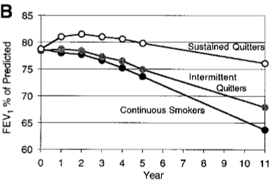
Smoking cessation and lung function decline
Marked improvement in FEV1 decline was demonstrated in a randomized controlled trial of a smoking cessation intervention
The Lung Health Study included smokers without clinical lung disease
Anthoniesen, AJRCCM 2002. Lee & Fry, BMC Med 2010.

Slide 12
Smoking cessation and lung function decline
Marked improvement in FEV1 decline was demonstrated in a randomized controlled trial of a smoking cessation intervention
The Lung Health Study included smokers without clinical lung disease
Former
Anthoniesen, AJRCCM 2002. Lee & Fry, BMC Med 2010.

Slide 13
Smoking cessation and lung function decline
Marked improvement in FEV1 decline was demonstrated in a randomized controlled trial of a smoking cessation intervention
The Lung Health Study included smokers without clinical lung disease
Former
Current
Anthoniesen, AJRCCM 2002. Lee & Fry, BMC Med 2010.

Slide 14
Smoking cessation and lung function decline
Marked improvement in FEV1 decline was demonstrated in a randomized controlled trial of a smoking cessation intervention
The Lung Health Study included smokers without clinical lung disease
Former
Current
Comparisons of lung function decline in former smokers versus never smokers are limited and inconsistent
Anthoniesen, AJRCCM 2002. Lee & Fry, BMC Med 2010.

Slide 15
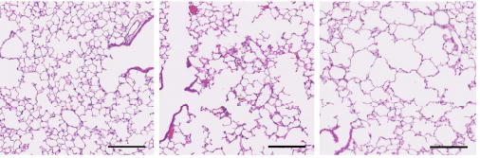
Mechanisms of lung function decline
Mechanisms of lung function decline that show sustained dysregulation after smoking cessation
Inflammation | Yes
Immune modulation | Yes
Epigenetics | Yes
Airway hyper-responsiveness | Yes
Mucous hypersecretion | Yes
Emphysema | Yes
↑Emphysema with intermittent smoking
Continuous cigarette smoke
Intermittent cigarette smoke
Control
Biological and physiological evidence suggest that accelerated lung function decline should be anticipated in former smokers, and that there is no safe level of cigarette exposure
Verbanck S, AJRCCM 2006. Bhatt S, AJRCCM 2017. Oelsner, Thorax 2017. Wang G, PLoS One 2015. Kamehama N, ARJCMB 2018.

Slide 16
Aims
In a general population-based sample of adults with preserved lung function and without clinical lung disease, we aimed to test for differences in lung function decline according to smoking status and intensity

Slide 17
NHLBI Pooled Cohorts Study
9 cohorts
65,251 participants
653,380 person-years of follow-up for respiratory mortality
Non-spiro exam
Spiro exam
Oelsner et al, Am J Epidemiol (technical review).

Slide 18
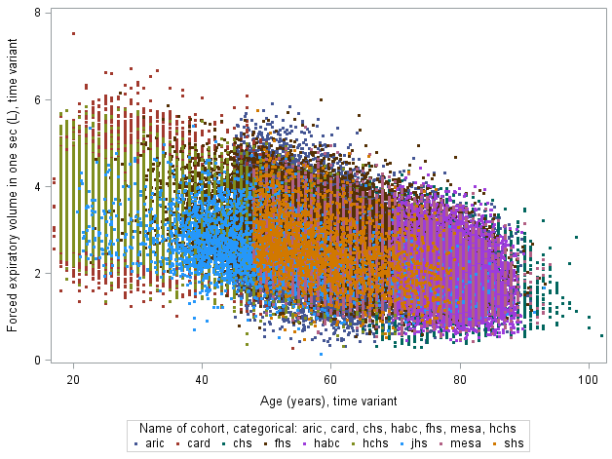
Longitudinal lung function data
FEV1 (mL) versus age
105,700 valid FEV1 observations
59,508 participants
Pre-bronchodilator spirometry
Quality controlled according to 2005 ATS/ERS standards
Percent predicted FEV1 and FVC calculated via NHANES III equations
Airflow limitation defined by FEV1/FVC < lower limit of normal (LLN)
Restrictive spirometry defined by FEV1/FVC>LLN and FVC<LLN
Oelsner et al, Am J Epidemiol (technical review). Hankinson, AJRCCM 1999.

Slide 19
Selection of study sub-sample
Inclusion criteria:
  2+ valid spirometry exams
Exclusion criteria:
  Prevalent clinical asthma, COPD, emphysema, or chronic bronchitis (prior MD diagnosis and/or inhaler use)
  Initial spirometry with airflow limitation or restrictive pattern
  Baseline exam within 2 years of reported quit date
  Inconsistent smoking status not conforming to one of four patterns:
    Never-smokers
    Former-smokers
    Quitting smokers (current → former smoker)
    Sustained current smokers

Slide 20
Variables
Smoking status and intensity
Mainly self-reported, with biochemical verification in a subset
Smoking status, time-variant
  Never = <100 lifetime cigarettes
  Current = within past 30 days
Self-reported pack-years at baseline
Self-reported time-variant cigarettes per day

Slide 21
Variables
Smoking status and intensity
Mainly self-reported, with biochemical verification in a subset
Smoking status, time-variant
  Never = <100 lifetime cigarettes
  Current = within past 30 days
Self-reported pack-years at baseline
Self-reported time-variant cigarettes per day
Decline in lung function
Pre-bronchodilator spirometry
Annualized rate of decline in:
  FEV1
  FVC
  FEV1/FVC
Incident airflow limitation
Incident restrictive spirometry

Slide 22
Statistical analyses
Never smokers used as reference group
Mixed models for lung function decline
  Cohort-specific unstructured covariance matrix
  Adjustment for time-varying age, age², smoking, height²; and time-invariant source cohort, gender, race, baseline age (centered), birth-year (centered), site, and educational attainment
  Multiplicative interactions with age for all time-invariant covariates
  Effect estimate for smoking*age interpreted as the association with annualized lung function decline
Cox proportional hazards models for incident airflow limitation; similarly adjusted, additionally including baseline FEV1 and FVC
Sensitivity analyses (stratification; multiple imputation)

Slide 23
CONSORT diagram
Only one spirometry exam attempted
HCHS/SOL (n=16,415)
JHS (n=3,680)
SHS (n=3,516)
Not selected for spirometry in MESA (n=2,331)
Declined spirometry (n=3,408)
NHLBI Pooled Cohorts Study
(n=65,251)
Eligible/selected for 2+ spirometry exams
(n=35,901)
<2 valid spirometry exams (n=9,800)
2+ valid spirometry exams
(n=26,101)
Airflow limitation (n=3,705)
Restrictive pattern (n=1,453)
Preserved lung function
(n=20,943)
Clinical asthma (n=902)
Clinical COPD (n=805)
Without prevalent clinical lung disease
(n=19,236)
Inconsistent smoking status (n=2,532)
Quit within 2 years of baseline (n=120)
Missing covariate data (n=372)
Final sub-sample
(n=16,212)

Slide 24
Baseline characteristics
 | Never smokers | Former smokers | Quitting smokers | Current smokers | Total
No. (%) | 8,179 (50%) | 4,973 (31%) | 1,636 (10%) | 1,424 (9%) | 16,212
Cohort (%)
ARIC | 41% | 54% | 42% | 49% | 45%
CARDIA | 22% | 4% | 19% | 36% | 17%
CHS | 10% | 15% | 4% | 3% | 11%
FHS | 11% | 6% | 29% | 7% | 11%
Health ABC | 7% | 11% | 2% | 2% | 7%
MESA | 9% | 10% | 3% | 3% | 8%
Age, years | 52 | 60 | 45 | 49 | 53
Male (%) | 33% | 58% | 46% | 48% | 43%
Race/ethnicity (%)
White | 69% | 80% | 75% | 55% | 71%
Black | 27% | 17% | 24% | 44% | 25%
Other | 5% | 3% | 2% | 1% | 4%

Slide 25
Baseline smoking and lung function
 | Never smokers | Former smokers | Quitting smokers | Current smokers | Total
Smoking, median
Pack-years |  | 14 | 18 | 20 | 15
Cigarettes/day |  | 0 | 15 | 20 | 20
Age at smoking initiation |  | 18 | 18 | 17 | 18
Age at quitting |  | 39 |  |  | 39
Lung function, mean
FEV1 percent-predicted | 100.8 | 100.0 | 97.0 | 96.5 | 99.8
FVC percent-predicted | 100.9 | 100.9 | 99.3 | 99.1 | 100.6
Baseline FEV1/FVC | 78.9 | 76.1 | 77.4 | 78.4 | 77.9
No. exams, median (IQR) | 3 (2, 4) | 2 (2, 3) | 3 (2, 4) | 2 (2, 3) | 2 (2, 3)
Years of spirometry follow-up, median (IQR) | 9 (3, 20) | 6 (3, 16) | 14 (4, 21) | 4 (3, 14) | 7 (3, 20)

Slide 26
Unadjusted comparisons
 | Never smokers | Former smokers | Quitting smokers | Current smokers
Delta FEV1 (mL/year) | -35.0 | -43.1 | -38.4 | -41.6
Delta ppFEV1 (%/10-years) | -.83 | -1.81 | -2.93 | -5.62
Incident airflow limitation, No. (IDR) | 247 (26) | 237 (48) | 151 (66) | 155 (120)
Changes in lung function defined as (first value – last value) / (first age – last age). Incidence density rates (IDRs) defined per 10,000 person-years of observation. Mean differences versus never-smokers all statistically significant (P<.01).
In unadjusted data, ever smokers demonstrate significantly greater FEV1 decline versus never smokers, and greater incidence of airflow limitation.

Slide 27
Decline in lung function
 | Former smoking vs never smoking |  |  | Current smoking vs never smoking
Change in lung function | Effect estimate | 95% CI | P-value | Effect estimate | 95% CI | P-value
FEV1, mL/year | -1.71 | -2.26, -1.16 | <.0001 | -2.92 | -3.62, -2.22 | <.0001
FVC, ml/year | -1.78 | -2.46, -1.10 | <.0001 | -2.13 | -2.99, -1.27 | <.0001
FEV1/FVC, %/year | -.022 | -.030, -.013 | <.0001 | -.052 | -.063, -.041 | <.0001
Mixed model with cohort-specific unstructured covariance matrix. Adjustment for time-varying age, age², smoking, height²; and time-invariant source cohort, gender, race, baseline age (centered), birth-year (centered), site, and educational attainment. Interactions with age included for all time-invariant covariates. Effect estimate for smoking*age interpreted as the association with annualized lung function decline.
Average FEV1 decline -33.7 mL/year. Average FVC decline -36.8 mL/year. Average FEV1/FVC decline -.185 %/year.

Slide 28
Decline in lung function
 | Former smoking vs never smoking |  |  | Current smoking vs never smoking
Change in lung function | Effect estimate | 95% CI | P-value | Effect estimate | 95% CI | P-value
FEV1, mL/year | -1.71 | -2.26, -1.16 | <.0001 | -2.92 | -3.62, -2.22 | <.0001
FVC, ml/year | -1.78 | -2.46, -1.10 | <.0001 | -2.13 | -2.99, -1.27 | <.0001
FEV1/FVC, %/year | -.022 | -.030, -.013 | <.0001 | -.052 | -.063, -.041 | <.0001
-5%
-9%
-5%
-6%
-12%
-28%
Mixed model with cohort-specific unstructured covariance matrix. Adjustment for time-varying age, age², smoking, height²; and time-invariant source cohort, gender, race, baseline age (centered), birth-year (centered), site, and educational attainment. Interactions with age included for all time-invariant covariates. Effect estimate for smoking*age interpreted as the association with annualized lung function decline.
Average FEV1 decline -33.7 mL/year. Average FVC decline -36.8 mL/year. Average FEV1/FVC decline -.185 %/year.
Former smoking status was independently associated with accelerated decline in FEV1, FVC, and FEV1/FVC, with effect estimates approximately 50% of those for current smoking.

Slide 29
Incident airflow limitation
 | Former smoker versus never smoker |  |  | Quitting smoker versus never smoker |  |  | Sustained smoker versus never smoker
Model | HR | 95% CI | P | HR | 95% CI | P | HR | 95% CI
Main model | 1.46 | 1.21, 1.76 | <.0001 | 2.80 | 2.25, 3.48 | <.0001 | 4.13 | 3.33, 5.12 | <.0001
+ Baseline spirometry | 1.25 | 1.04, 1.52 | .020 | 1.81 | 1.46, 2.26 | <.0001 | 2.46 | 1.98, 3.05 | <.0001
Cox proportional hazards model with cohort as a stratum term. Adjustment for baseline age, age², smoking, height², gender, race, baseline age (centered), birth-year (centered), site, and educational attainment.
Former smoking status was also associated with incident airflow limitation, independent of initial spirometry. No significant associations were found for restrictive spirometry.

Slide 30
Pack-year history
 | Never smokers | Former smokers | Current smokers
FEV1 (mL/year)
<10 pack-years | Ref | -0.91 | -2.26
10-20 pack-years |  | -1.26 | -4.87
20+ pack-years |  | -1.03 | -7.23
FVC (mL/year)
<10 pack-years | Ref | -1.18 | -1.64
10-20 pack-years |  | -1.21 | -4.17
20+ pack-years |  | -1.68 | -2.15
FEV1/FVC (percent)
<10 pack-years | Ref | -.006 | -.029
10-20 pack-years |  | -.021 | -.066
20+ pack-years |  | -.022 | -.165
Even <10 pack-years of smoking was associated with accelerated lung function decline in both former and current smokers
Mixed model with cohort-specific unstructured covariance matrix. Adjustment for time-varying age, age², smoking exposure category, height²; and time-invariant source cohort, gender, race, baseline age (centered), birth-year (centered), site, and educational attainment. Statistically significant (P<.05) unless noted in italics.

Slide 31
Current cigarettes per day (CPD)
 | Never smokers | Former Smokers | <3 CPD | 3-20 CPD | 20-30 CPD | 30+ CPD
FEV1 (mL/year) | Ref | -1.68 | -2.56 | -2.57 | -3.33 | -4.66
FVC (mL/year) | Ref | -1.76 | -2.57 | -1.73 | -2.60 | -2.40
FEV1/FVC (%/year) | Ref | -.022 | -.029 | -.050 | -.055 | -.087
Mixed model with cohort-specific unstructured covariance matrix. Adjustment for time-varying age, age², smoking exposure category, height²; and time-invariant source cohort, gender, race, baseline age (centered), birth-year (centered), site, and educational attainment. Interactions with age included for all time-invariant covariates. Effect estimate for (smoking exposure category)*age interpreted as the association with annualized lung function decline. All comparisons statistically significant (P<.001).
Current smoking, even <3 cigarettes/day, associated with substantially greater lung function decline compared to both never and former smoking

Slide 32
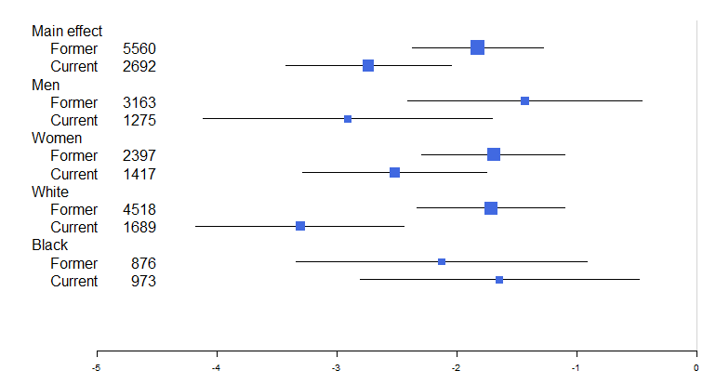
FEV1 decline and smoking status, stratified by sex and race/ethnicity
Former
N
Current
Main effect
Former smoking consistently associated with accelerated FEV1 decline regardless of sex or race/ethnic group.
Men
Women
White
Black
Change in FEV1/year, mL
Effect estimate is the coefficient for age*smoking status. Fully stratified analyses. Mixed models with cohort-specific covariance matrix. Adjusted for age, smoking-status, height², study, gender, race. Interactions with age modeled for smoking status and all time-invariant factors.

Slide 33
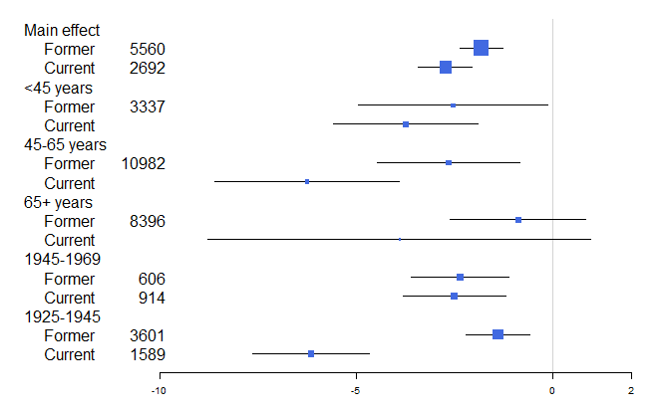
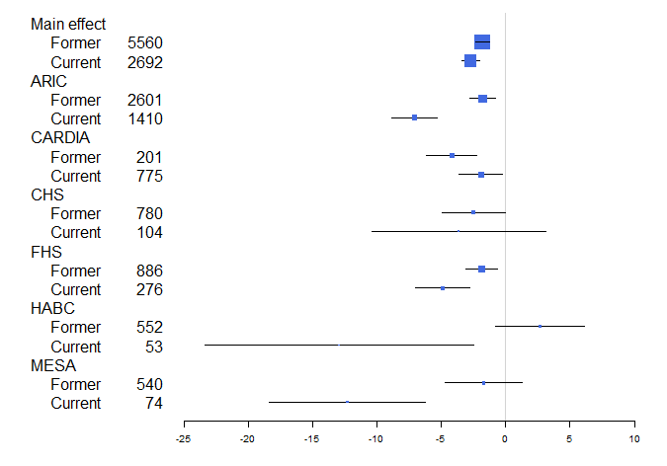
FEV1 decline and smoking status, stratified by by age, birth, and study cohort
Former
N
N
Current
Change in FEV1/year, mL
Change in FEV1/year, mL
Effect estimate is the coefficient for age*smoking. Fully stratified analyses. Mixed models with cohort-specific covariance matrix. Adjusted for age, smoking-status, height², study, gender, race. Interactions with age modeled for smoking status and all time-invariant factors.
More variability in estimates among older participants and cohorts.

Slide 34
Multiple imputation conditional on vital status
Imputation of missing lung function follow-up
Censoring of imputed lung function if deceased
No exclusions for spirometry QC, baseline CLD, or smoking pattern. Excludes ARIC exams 4 and 5 and CHS year 18.
Model-based estimates from a mixed model with cohort-specific covariance matrix adjusted for time-varying age, height², smoking status; birth year, study, sex, race/ethnicity, education, site; interactions with age included for all covariates. Original data, N=87,310 observations. Fully imputed data, N= 10,957,500 observations. Conditional imputation, N= 10,168,600 observations.
Similar results obtained using multiple imputation approach conditional on vital status.

Slide 35
Limitations
Selection biases
  Similar trends in all age groups and cohorts
  Robust to multiple imputation approach
No data on cigarette type or composition (e.g., menthol)
Heterogeneity of susceptibility (latent variables)
Measurement error
Limited number of observations per individual

Slide 36
Conclusions
Years after quitting, former smokers demonstrate accelerated lung function decline compared to never-smokers
Smoking-related lung function loss is apparent even with “light” smoking
These findings are consistent with biological and physiological models demonstrating incomplete reversibility and nonlinearity of smoking’s effects on the lungs

Slide 37







NHLBI Pooled Cohorts Study
George O’Connor
Josee Dupuis
Mike Cuttica
Ravi Kalhan
David Jacobs
Lewis Smith
Columbia
R Graham Barr
Pallavi Balte
Joe Schwartz
Andrew Moran
Yiyi Zhang
David Couper
Laura Loehr
Aaron Folsom
Alanna Morrison
Dick Kronmal
Russ Tracy
Bruce Psaty
Paolo Chaves
Stephanie London
Alex Reiner
Funding
NIH/NHLBI
K23-HL130627
R21-HL129924
R21-HL121457
Pat Cassano
Jiayi Xu
Ann Newman
Sachin Yende
Jason Sanders
Paul Enright
Ani Manichaikul
Joseph Schwartz
Andrew Moran
Michael Tsai
Yiyi Zhang

Slide 38
Thank you!

Slide 39
Unadjusted comparisons vs never-smokers
 | Never smokers | Former smokers | Quitting smokers | Current smokers
Change in lung function
FEV1 (mL/year) | -35.0 | -43.1 | -38.4 | -41.6
FVC (mL/year) | -39.4 | -51.7 | -40.1 | -39.3
FEV1/FVC (%/year) | -.12 | -.10 | -.19 | -.31
Change in percent-predicted lung function
ppFEV1 (%/year) | -.083 | -.181 | -.293 | -.562
ppFVC (%/year) | -.183 | -.316 | -.284 | -.443
Incident spirometric abnormalities, No. (IDR)
Airflow limitation | 247 (25.9) | 237 (47.6) | 151 (66.4) | 155 (119.5)
Restrictive pattern | 389 (40.8) | 237 (47.6) | 95 (34.7) | 81 (75.2)
Changes in lung function defined as (first value – last value) / (first age – last age). Incidence density rates (IDRs) defined per 10,000 person-years of observation. Mean differences versus never-smokers statistically significant (P<.01) for all smoking groups unless noted in italics.
In unadjusted data, former smokers demonstrate significantly greater lung function decline versus never smokers, and greater incidence of airflow limitation.

Slide 40
Multiple imputation of missing spirometry
 | Original data | Full imputations | Censored imputations
N, cohorts | 6 | 6 | 6
N, participants | 36,190 | 34,835 | 34,835
N, observations | 87,310 | 10,957,500 | 10,168,600
N, imputations | n/a | 100 | 100
% efficiency | n/a | >99% | >99%
CPU time | 12.9 seconds | 1 hour 37 minutes | 1 hour
ARIC exams 1-2
CHS exams 2, 6, 9
Health ABC
MESA

Slide 41
Multiple imputation (MI) to address potential selection biases
N=34,835 | Observations | Smoking status | FEV1 (ml/year) | SE | 95% CI |  | P-value
Original | 87,310 | Never | -30.70 | 0.21 | -31.11 | -30.29 | <.0001
 |  | Former | -33.96 | 0.26 | -34.46 | -33.46 | <.0001
 |  | Current | -34.78 | 0.35 | -35.46 | -34.09 | <.0001
Full imputation | 10,957,500 | Never | -36.57 | 0.41 | -37.38 | -35.76 | <.0001
 |  | Former | -39.78 | 0.48 | -40.73 | -38.84 | <.0001
 |  | Current | -40.59 | 0.91 | -42.39 | -38.80 | <.0001
Imputation censored on vital status | 10,168,600 | Never | -29.87 | 0.24 | -33.33 | -29.40 | <.0001
 |  | Former | -32.71 | 0.29 | -33.28 | -32.15 | <.0001
 |  | Current | -33.82 | 0.44 | -34.68 | -32.97 | <.0001
No exclusions for spirometry QC, baseline CLD, or smoking pattern. Excludes ARIC exams 4 and 5 and CHS year 18. Model-based estimates.
Unadjusted results in imputed data conditional on vital status similar to original data.

Slide 42
Multiple imputation conditional on vital status
No exclusions for spirometry QC, baseline CLD, or smoking pattern. Excludes ARIC exams 4 and 5 and CHS year 18.
Model-based estimates from a mixed model with cohort-specific covariance matrix adjusted for time-varying age, height², smoking status; birth year, study, sex, race/ethnicity, education, site; interactions with age included for all covariates. Original data, N=87,310 observations. Fully imputed data, N= 10,957,500 observations. Conditional imputation, N= 10,168,600 observations.
Similar results obtained using imputed data conditional on vital status in less highly selected sample.

